Slide 1
WGSIP interaction with the WMO RCOFs - A Southern African perspective
WA Landman

Slide 2
The RCOF concept
Towards the end of 1997 two important climate-related events occurred
The record-breaking El Niño episode
The holding of the first series of Regional Climate Outlook Forums (RCOFs) in southern Africa
Awareness of the likelihood of an El Niño grew throughout 1997
Forums in other regions of the world was accelerated to provide assistance during the period of the event
The Forum process promoted the recognition in many parts of the world that short-range climate predictions could be of substantial benefit in adapting to and mitigating climate variations
An important aspect of the Forums is the facility to bring together experts in various fields, local meteorologists and end-users of forecasts in an environment that encourages interaction and learning
Capacity building is one of the key tasks

Slide 3
Regional Climate Outlook Forums
Southern African Regional Climate Outlook Forum (SARCOF)
Greater Horn of Africa Climate Outlook Forum (GHACOF)
Climate Outlook Forum for West Africa (PRESAO : PRÉvisions Saisonnières en Afrique de l'Ouest)
FOCRAII : Forum on Regional Climate Monitoring, Assessment and Prediction for Regional Association II (Asia)
Western Coast of South America Climate Outlook Forum (WCSACOF)
Southeast of South America Climate Outlook Forum (SSACOF)
The Pacific Islands: The Island Climate Update
Pacific Islands online Climate Outlook Forum (PICOF)
Climate Outlook Forum for Central America
Southeastern Europe Climate Outlook Forum (SEECOF)
South Asian Climate Outlook Forum (SASCOF)
Climate Outlook for Cricket in the Caribbean: The Outfield

Slide 4
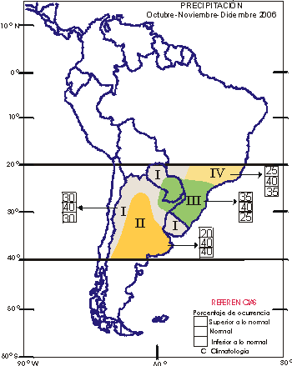
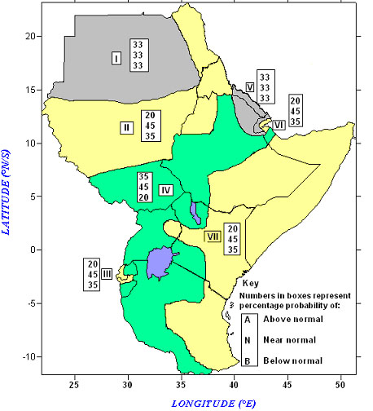
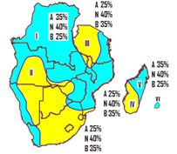
Typical RCOF forecasts

Slide 5
Typical relative score between categories

Slide 7
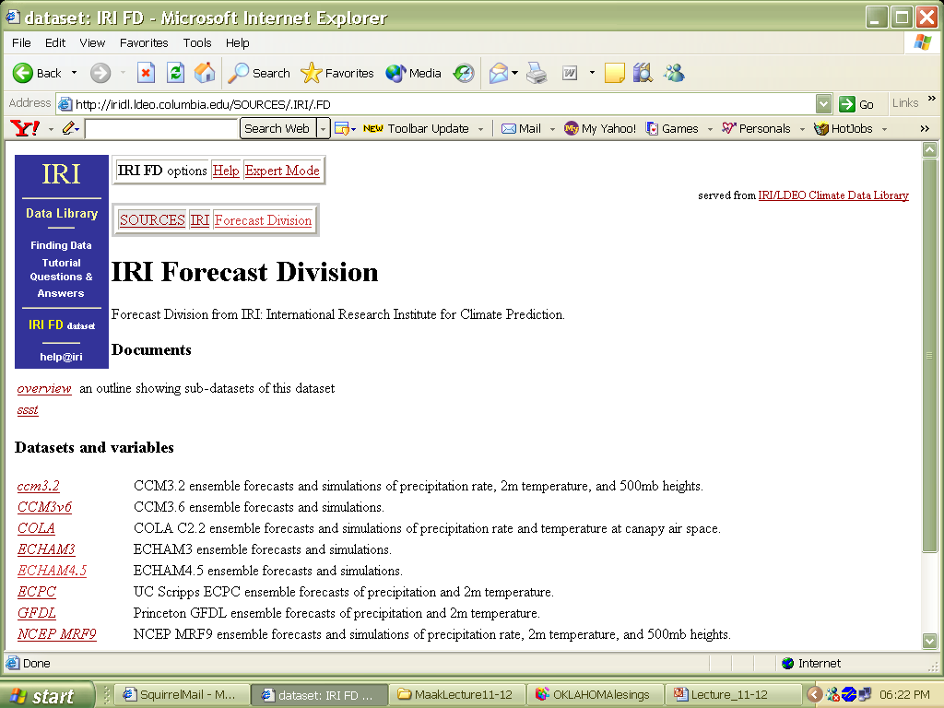

Slide 8
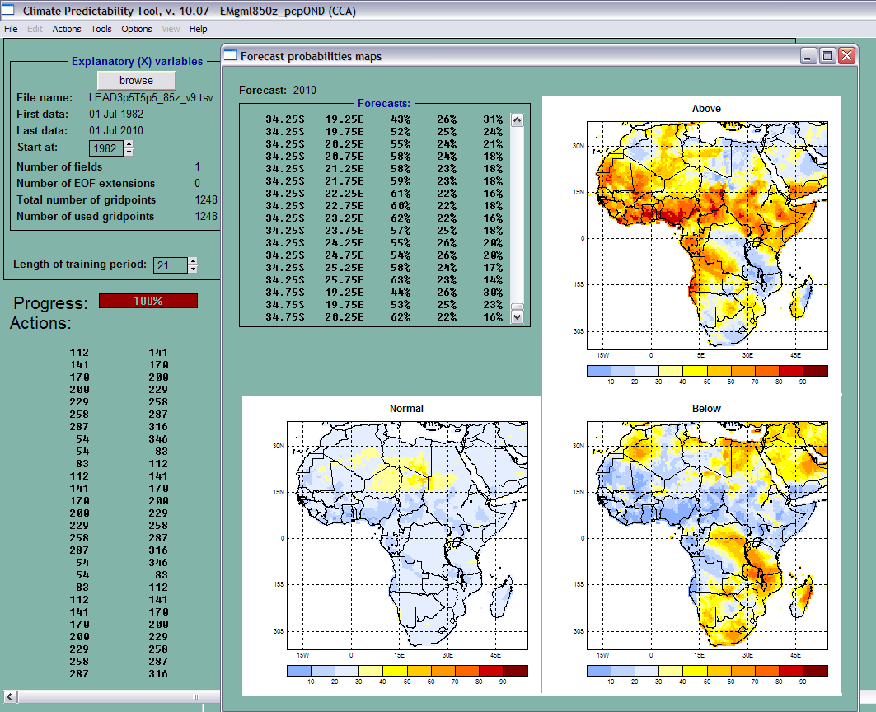

Slide 9
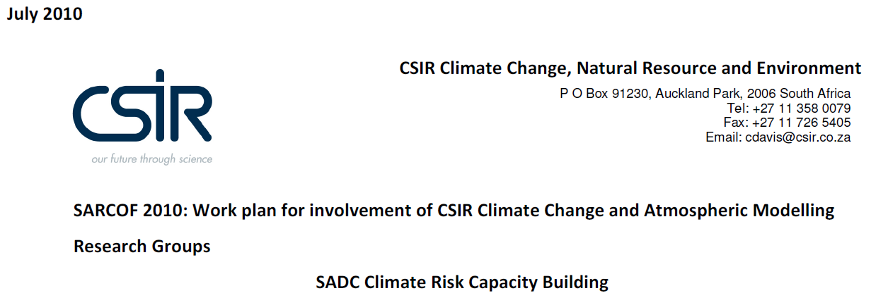
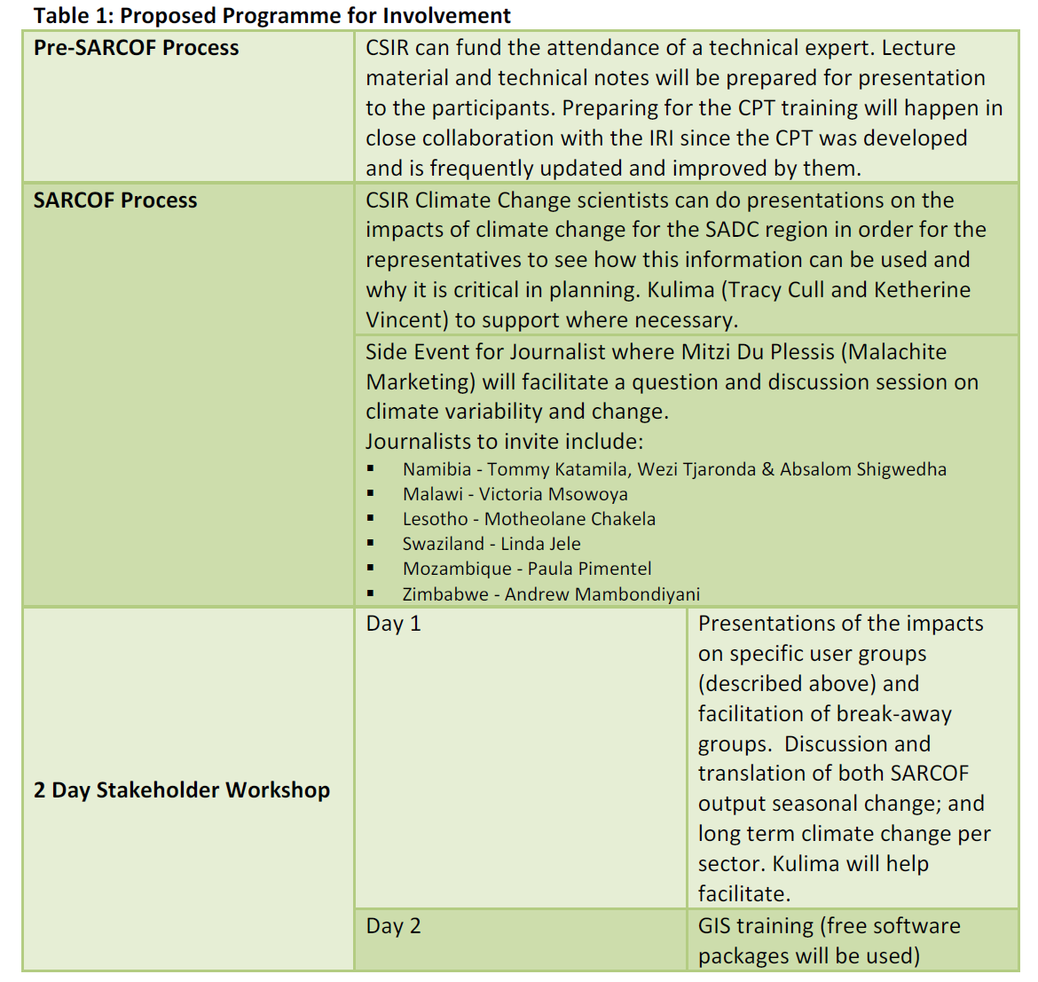

Slide 10
Forecast vs. Observation: Probability of exceeding the 85%-tile of the climatological record; Three-category observations

Slide 11
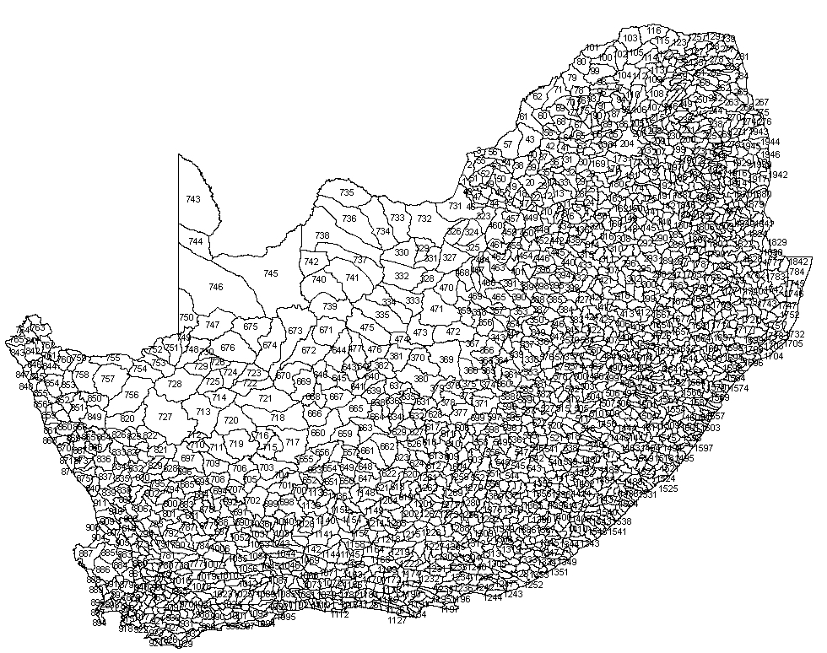
The STREAMFLOW forecast
1946 quaternary catchments

Slide 13
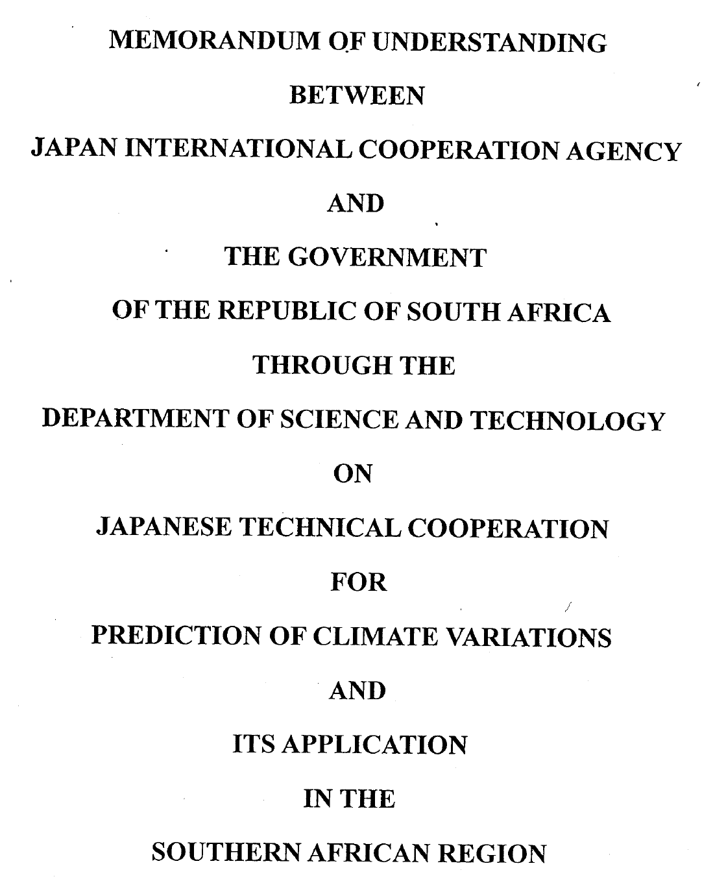
IBSA-OCEAN
ACCESS-JAMSTEC
To promote scientific co-operation among India, Brazil and SA to exchange expertise and knowledge in the fields of Ocean Science and Technology
Theme 1: Climate Variability and Change Research
MULTI-MODEL PREDICTION

Slide 15
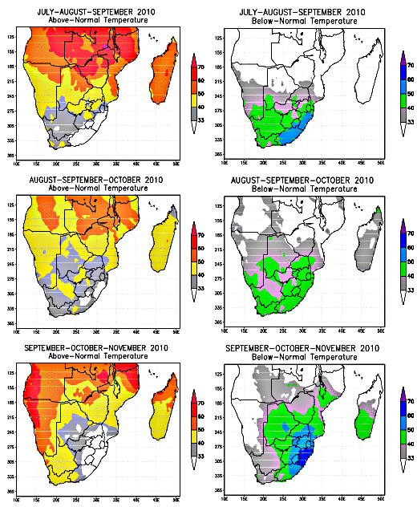
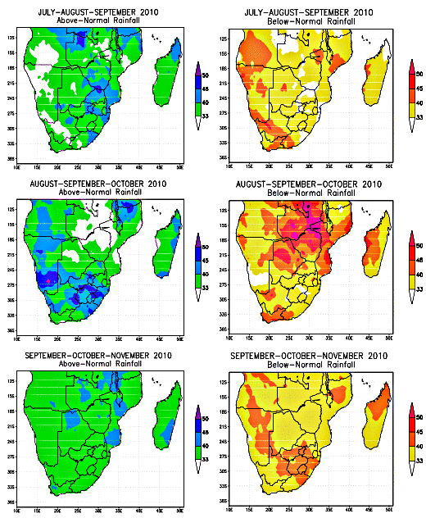
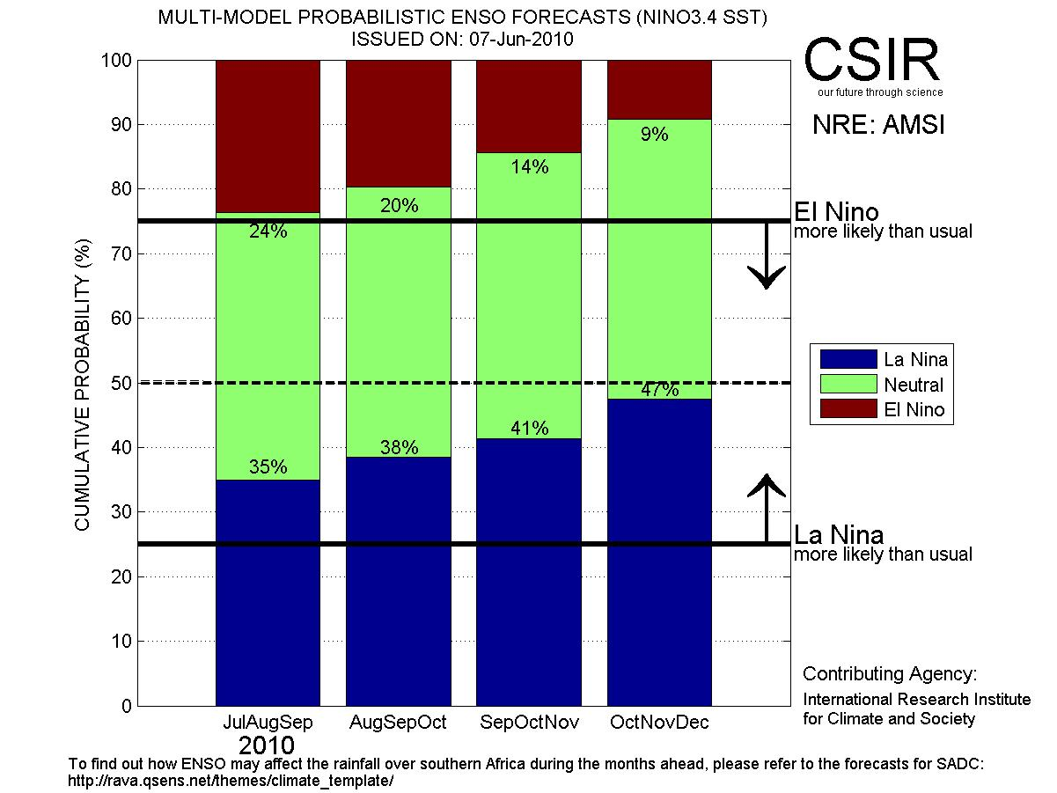
Recent seasonal forecasts

Slide 16
Recommendation
CHFP data available through IRI data library
In CPT format for CPT users
Process studies
Operational prediction by using forecasts from operational global models (again using the IRI data library)

