Slide 1
WGIP 13TH SESSION – Buenos Aires, Argentina, 29-31 July 2010
Discussion of WWRP development of operational 1-90 prediction capability
Pedro L. Silva Dias
National Laboratory for Scientific Computing/LNCC Petrópolis RJ, Brazil
and
University of São Paulo/USP
São Paulo SP, Brazil
TIGGE panel member

Slide 2
Resumé of THORPEX Science Plan
Research on weather forecasts from 1 to 14 days lead time
Four research Sub-programmes
  Predictability and dynamical processes
  Observing systems
  Data assimilation and observing strategies
  Societal and economic applications
Emphasis on ensemble prediction
Interactive forecast systems “tuned” for end users – e.g. targeted observations and DA
THORPEX Interactive Grand Global Ensemble/TIGGE
Emphasis on global-to-regional influences on weather forecast skill

Slide 3
The key objectives of TIGGE
* An enhanced collaboration on development of ensemble prediction, internationally and between operational centers and universities,
* New methods of combining ensembles from different sources and of correcting for systematic errors (biases, spread over-/under-estimation),
* A deeper understanding of the contribution of observation, initial and model uncertainties to forecast error,
* A deeper understanding of the feasibility of interactive ensemble system responding dynamically to changing uncertainty (including use for adaptive observing, variable ensemble size, on-demand regional ensembles) and exploiting new technology for grid computing and high-speed data transfer,
* Test concepts of a TIGGE Prediction Centre to produce ensemble-based predictions of high-impact weather, wherever it occurs, on all predictable time ranges,
The development of a prototype future Global Interactive Forecasting System.

Slide 4
Highlights
Improved stochastic treatments of model errors in ensemble predictions. Still, physical basis questionable in many instances.
Growing maturity of ensemble Kalman filter for improved data assimilation, ensemble initialization.
Successful demonstrations of convection-permitting ensembles.
Facilitation of research and model comparisons with new TIGGE data set
Reforecasts and ensemble post-processing

Slide 5
GIFS-TIGGE roadmap
The THORPEX implementation plan envisages the establishment of a Global Interactive Forecast System (GIFS) to realise the benefits of THORPEX in operational forecasting.
We envisage 3 main stages:
  TIGGE (2005 onwards) – scientific research based on archive of ensemble forecasts.
  GIFS Development (2008-2012) – development and evaluation of products & services based on ensemble forecast data
  GIFS Implementation (after 2012) – implementation of real-time products and services. “End to end” GIFS.
GIFS-FDP is focused on stage 2 – the next steps
Longer-term developments depend on benefits demonstrated in GIFS-FDP

Slide 6
Ten of the leading weather forecast centres in the world regularly contribute ensemble forecasts to the THORPEX Interactive Grand Global Ensemble (TIGGE) project, to support the development of probabilistic forecasting techniques. The map above shows how the ensemble forecasts are transferred from these ten data providers to three archive centres, where they are available to scientific researchers around the world. As well as being part of the THORPEX programme, TIGGE is part of the “Global Earth Observation System of Systems” (GEOSS).
GRIB2 +BUFFR based archiving – WMO compliant

Slide 7
Emergency managers need to have the best information possible within their reach, far in advance as well as when a threat looms over a populated area. Later ensemble forecasts, as illustrated above, showed increasing probability that Lupit would turn north-eastwards, sparing the Philippines this time – which is what actually happened. This picture shows a NOAA website display of hurricane forecasts tracks from three TIGGE data providers for Lupit (in colour, with actual track in black).

Slide 8
Extended Forecasts - > 15d
A few centers produce dynamical forecasts > 15 days: ECMWF, JMA, NCEP, CPTEC ……
Atmospheric and coupled models.

Slide 9

1. ECMWF forecasting systems
HRES
T_{L}1279L91 (d0-10)
EPS
T_{L}639L62 (d0-10)
T_{L}319L62 (d10-15/32)
SF
T_{L}159L62 (m0-7/12)
Atmospheric model
Atmospheric model
Wave model
Wave model
Ocean model
Real Time Ocean Analysis ~8 hours
Delayed Ocean Analysis ~12 days
Notes:
Ocean data assimilation with 10-day window every 10 days. Forcing from ocean to atmosphere through SST+ocean currents (wave model), vice versa through P-E, wind stress, heat flux.

Slide 10
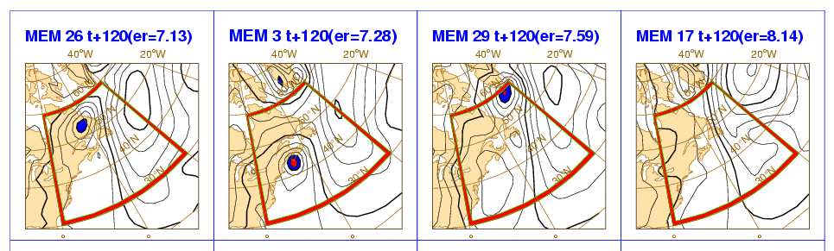
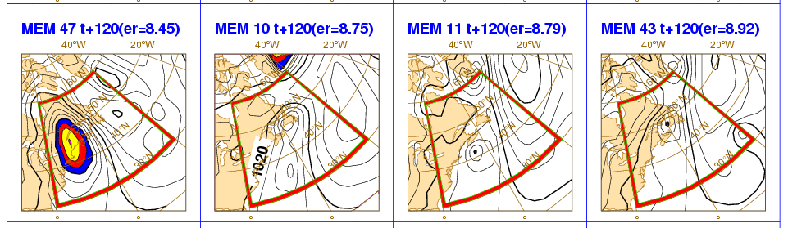
1. The operational ECMWF EPS
The EPS includes 51 forecasts with 639v319 resolution:
T_{L}639L62 (~32km, 62 levels) from day 0 to 10
T_{L}319L62 (~64km, 62 levels) from day 10 to 15 (32 at 00UTC on Thursdays).
Initial uncertainties are simulated by perturbing the unperturbed analyses with a combination of T42L62 singular vectors, computed to optimize total energy growth over a 48h time interval (OTI).
Model uncertainties are simulated by adding stochastic perturbations to the tendencies due to parameterized physical processes.
Currently, the EPS runs twice-daily to 15 days, coupled from day 10 at 00UTC. The EPS is extended to 32d weekly, at 00UTC on Thursdays. Discussing plans to (i) increase its frequency to twice-weekly and (ii) possibly to extend it to 46 days.
NH
SH
TR
Definition of the
perturbed ICs
1
2
…..
50
51
Products

Slide 11
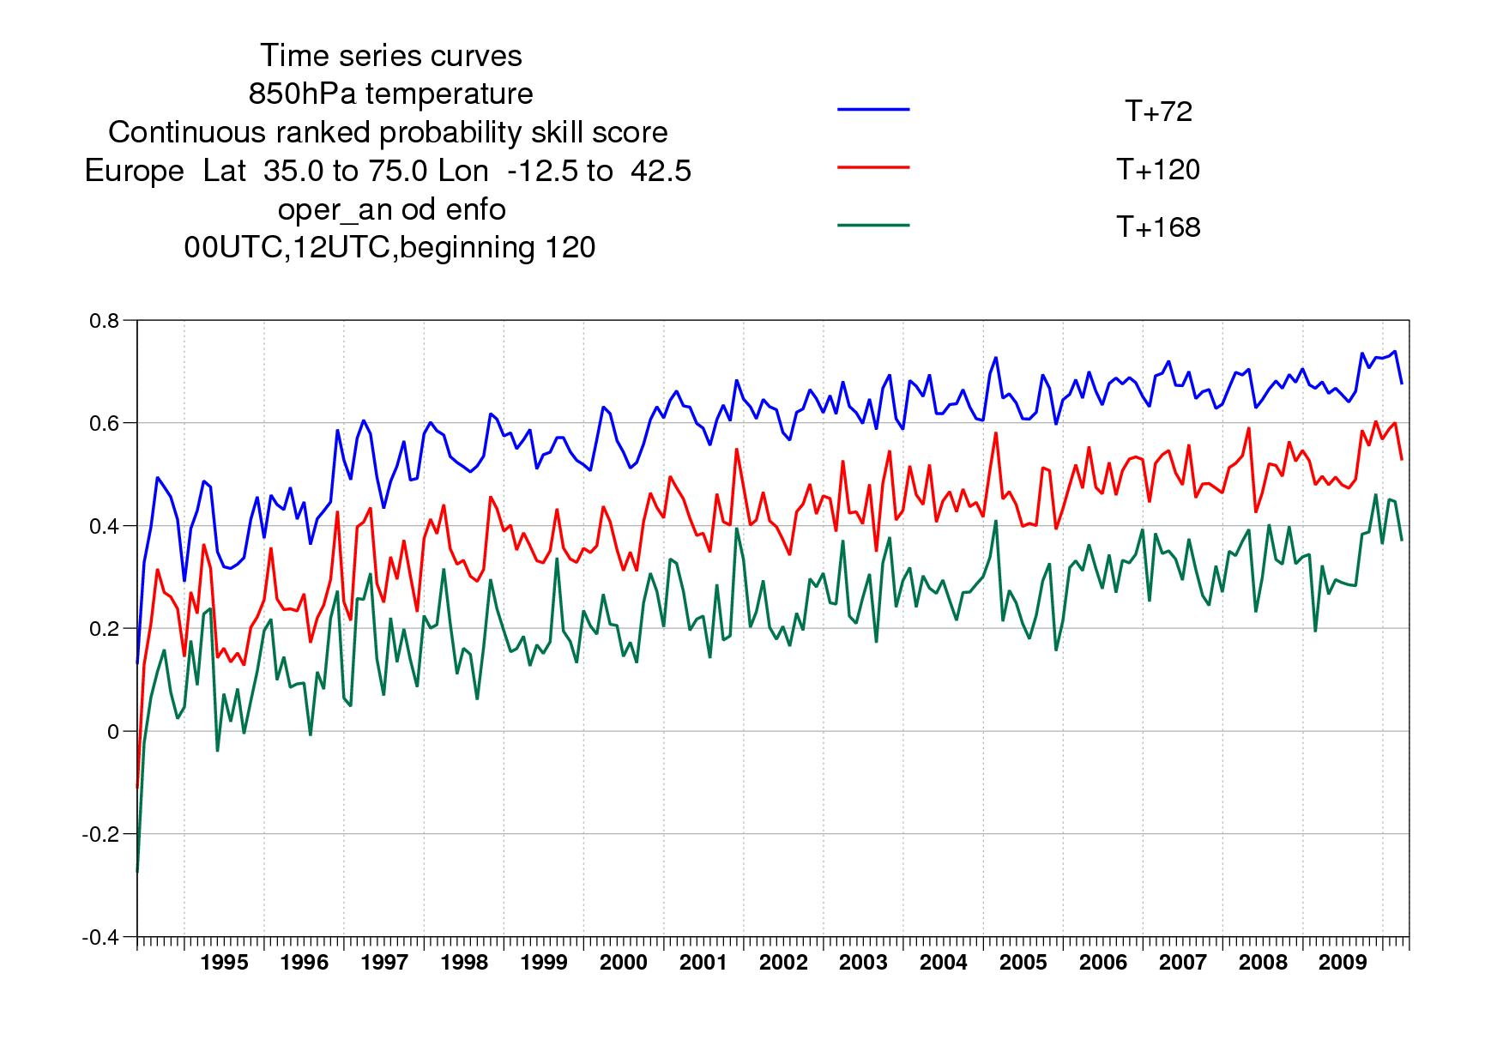
1. EPS performance: T850 v an, EU
The performance of the EPS has been improving continuously for upper level fields, as seen by looking at the CRPSS for the t+72h, t+120h and t+168h probabilistic prediction of T850 over Europe (verified against analyses).
Results indicate a predictability gain of about 2.6 days/decade.

Slide 12
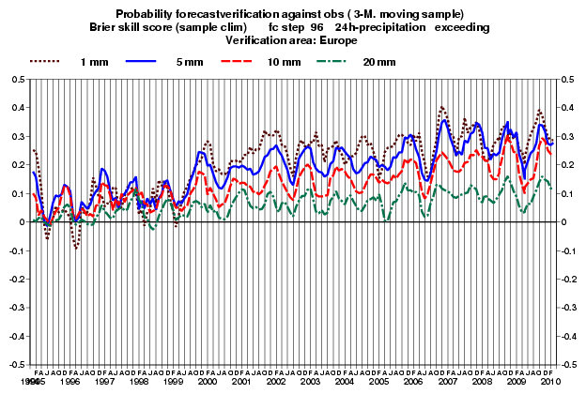
2. ECMWF EPS performance: TP24 v obs, EU
For surface weather parameters such as precipitation verified against observations, the improvement has been slower, as shown by the BSS of the probabilistic prediction of 24h accumulated precipitation over Europe (right).

Slide 13
3.ECMWF work with TIGGE ensembles, calibration and combination
Hagedorn et al (2010) have compared the performance of the TIGGE ensemble 2-meter Temperature (2mT) forecasts against a multi-model analysis and, over Europe, against observations (from synop stations). Furthermore, they have investigated the impact of bias-correction and of calibration on the ensemble performance.
Hereafter, some results based on the average scores for DJF 2008-09 computed for T850 and 2mT using ERA-Interim analysis or observations, for NH and Europe, are briefly discussed.
Results indicates that a multi-model ensemble containing nine TIGGE ensembles did not improve on the performance of the best single-model, the ECMWF EPS. However, a reduced multi-model system, consisting of only the four best ensemble system (MSC, NCEP, UKMO and ECMWF), showed an improved performance. However, reforecast-calibrated ECMWF EPS forecasts were of comparable or superior quality to the multi-model predictions, when verified against ERA-interim analysis or against observations.

Slide 14
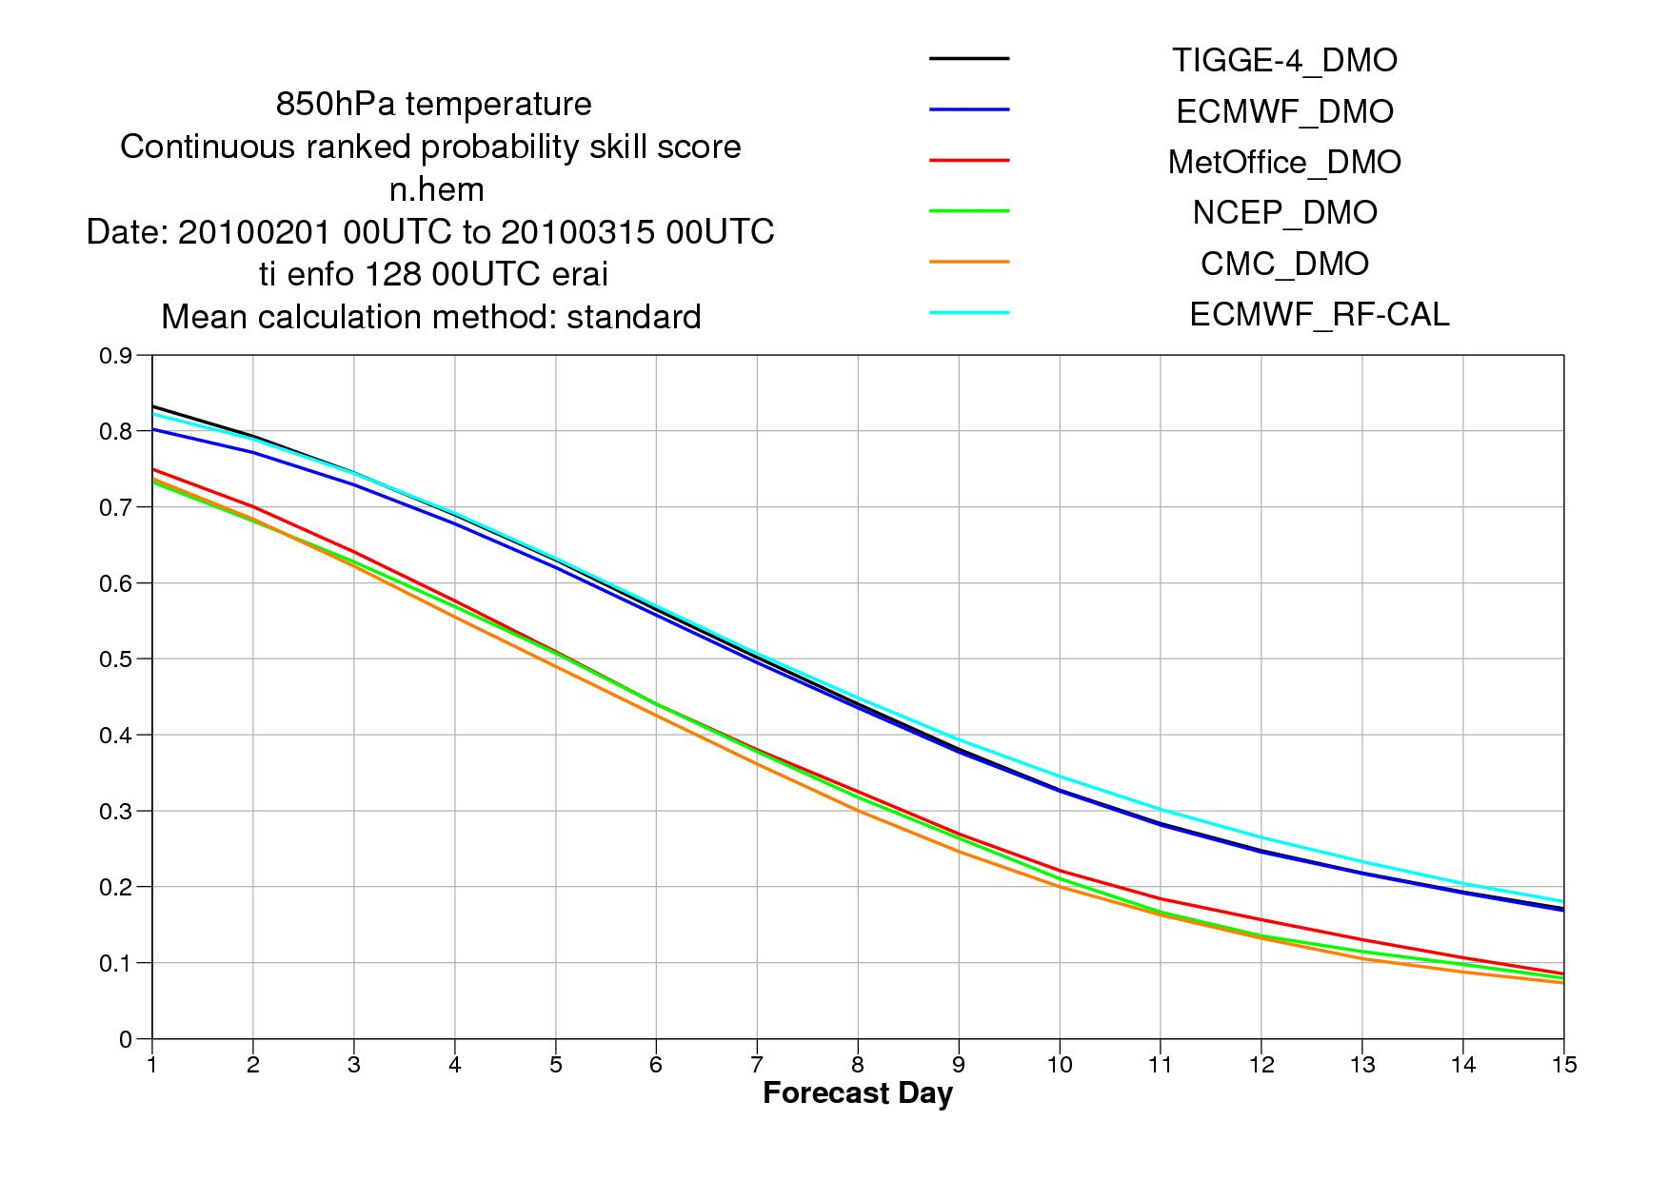
4. ECMWF work with TIGGE ensembles, calibration and combination
CRPSS for T850 over NH for FM2010 (43 cases) verified against ERA-Int. Results are shown for the TIGGE-4 (CMC, ECMWF, MetOffice, and NCEP) multi-model (solid line), each contributing system, and the re-forecast calibrated ECMWF ensemble.
For T850 the EC-EPS DMO is very reliable and re-calibration has only a small positive impact.
~1.5d
~1.8d

Slide 15
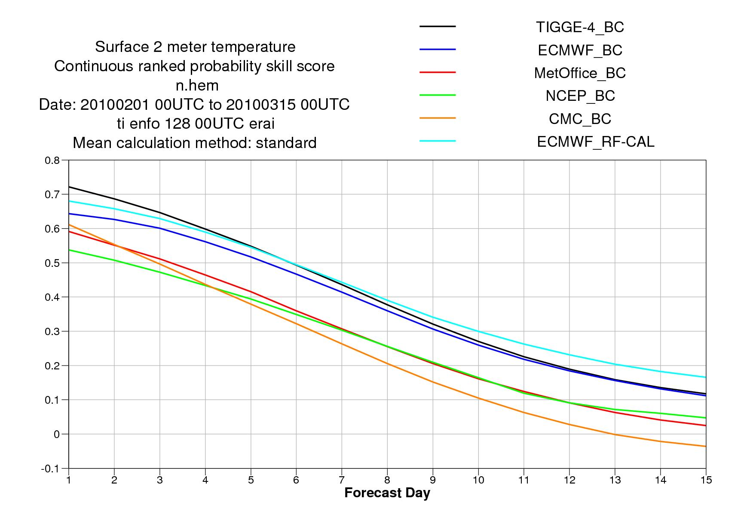
5. ECMWF TIGGE ensembles, calibration and combination
CRPSS for 2m-T over NH for FM2010 (43 cases) verified against ERA-Int. Results are shown for the bias-corrected (based on the past 30 days) TIGGE-4 multi-model, each contributing system, and the re-forecast calibrated ECMWF ensemble.
For 2m-T the EC-EPS DMO is less reliable and re-calibration has a larger positive impact.
~2.2d
~2d

Slide 16
Eighth meeting of the GIFS-TIGGE Working Group
World Meteorological Organization, Geneva, Switzerland
23 February 2010
New methods of combining ensembles from different sources and of correcting for systematic errors (biases, spread over-/under-estimation),
- Calibration of model ensembles on the basis of past performance (typically,
correcting ensemble mean for observed systematic bias, or ensemble spread on the basis of observed spread-skill relationship; see, e. g., Gneiting et al., MWR, 2005; ‘dressing’ ensembles)
- Use of reforecasts, performed on past situations, for increasing size of training
sample (Hamill et al.)
- Combining different ensembles, possibly by assigning them weights on the basis of observed past performance (Weigel and Bowler, QJRMS, 2009, Johnson and Swinbank, QJRMS, 2009)

Slide 17
Eighth meeting of the GIFS-TIGGE Working Group
World Meteorological Organization, Geneva, Switzerland
23 February 2010
Question
Is there any point in taking larger values of N ?
Scores saturate for ensemble sizes N of the order of a
few tens. The higher the sharpness of the predicted
probabilities, the more rapid the saturation.
Conclusion on ensemble size
Objective scores saturate in the range N ≈ 30-50 because it is possible in practice to evaluate only probabilistic predictions of events or one-dimensional variables. Evaluating probabilistic predictions of multidimensional variables would require validating samples of inaccessible size.
Is there any point in taking larger values of N ?

Slide 18
6.ECMWF Monthly fc system: ROCA over NH
The performance of EPS/monthly (the old monthly system was merged with the EPS in March 2008) weekly-average forecasts from has also been continuously improving up to fc-day 18 (left). The signal for longer fc days is weaker (right). This is shown here in terms of the area under the relative operating characteristic curve for the probabilistic prediction of 2m-T in the upper tercile.
Day 12-18
Day 19-32
Monthly Forecast d12-18
Persistence of day 5-11
Monthly Forecast d19-32
Persistence of day 5-18
Notes:
The scores of the monthly forecast for MAM for day 12-18 and day 19-32. At both ranges the forecast is better than the persistence.
The scores at 12-18 are sligthly lower the MAM2007 but this could just be due to variability of year to year.

Slide 19
7. ECMWF Further extension of the EPS to 46 days?
The possible benefits of extending the monthly forecasting system to 46 days have been evaluated. A 15-member ensemble starting on the 15th of each month from 1991 to 2007 (1979-2008 for the 15th July starting date) has been integrated for 46 days using the same configuration as the operational monthly forecasts. Results indicate that those forecasts are significantly more skilful than the seasonal forecasts of month 2 issued the same day (15th of the month)
Average ROC area for PR(2MT>upper 1/3) computed for all NH land point for DJF.
Blue is the SF d30-61 forecast (available on the 15th of the month).
Red is the EPS d15-46 forecast, which would also be available on the 15th of the month.

Slide 20
8.ECMWF 32d EPS extension twice a week?
Experimentation has been performed to assess the potential benefit of extending the EPS to 32 days twice a week, on Thursdays and Sundays.
32d EPS have been run on the 15th and the 18th of NDJF 2009/10 (4 cases). To calibrate the 32d EPS forecasts, hindcasts have been started on the 15th 18th and 22nd of NDJF 1989-2008. This plot compares the ROCA for the probabilistic prediction of 2m-T in the upper tercile over Europe.
Thursday fc d19-25
Sunday fc d16-22

Slide 21
JMA specifications of the NWP model for Extended-range forecast
Model | JMA AGCM
Horizontal resolution | TL159 (about 1.125º Gaussian grid ~110km)
Vertical Layers | 60 (Top Layer Pressure:0.1hPa)
Time integration range | One-month forecast: 34 days Early Warning Information: 17 days
Ensemble size | 50 members
Perturbation method | Breeding Growing Mode (BGM) & Lagged Average Forecast (LAF) method
SST | Persisted anomaly
Land surface Parameters | Initial conditions of land parameters are provided by a land surface analysis system. Observation of snow depth reported in SYNOP is assimilated.

Slide 22
Specification of Hindcast Experiment for Extended-range forecast
Model | JMA AGCM(TL159)
Target years | 1979 to 2004, 26 years
Target months | All months ( initial date is the 10th, 20th and end of every month)
Integration time | 34 days
Ensemble size | 5 members
Atmospheric initial condition | JRA-25 (the Japanese 25-year Reanalysis)
SST | Persisted anomaly
Land surface initial condition | Climatology

Slide 23
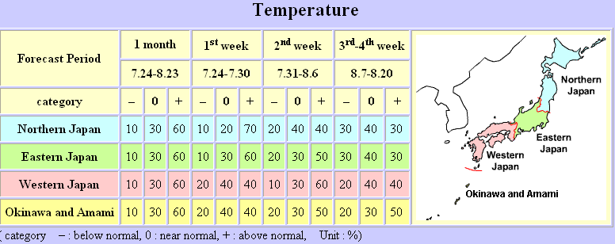
JMA Extended-range Forecast Services (1)
One-month Forecast (Temperature, Precipitation, Sunshine duration, Snowfall)
Date of Issue | Every Friday
Forecast Period | 1st-, 2nd-,3rd &4th –week, 1 month mean
Climate and Outlook in Japan
http://ds.data.jma.go.jp/tcc/tcc/products/japan/index.html

Slide 24
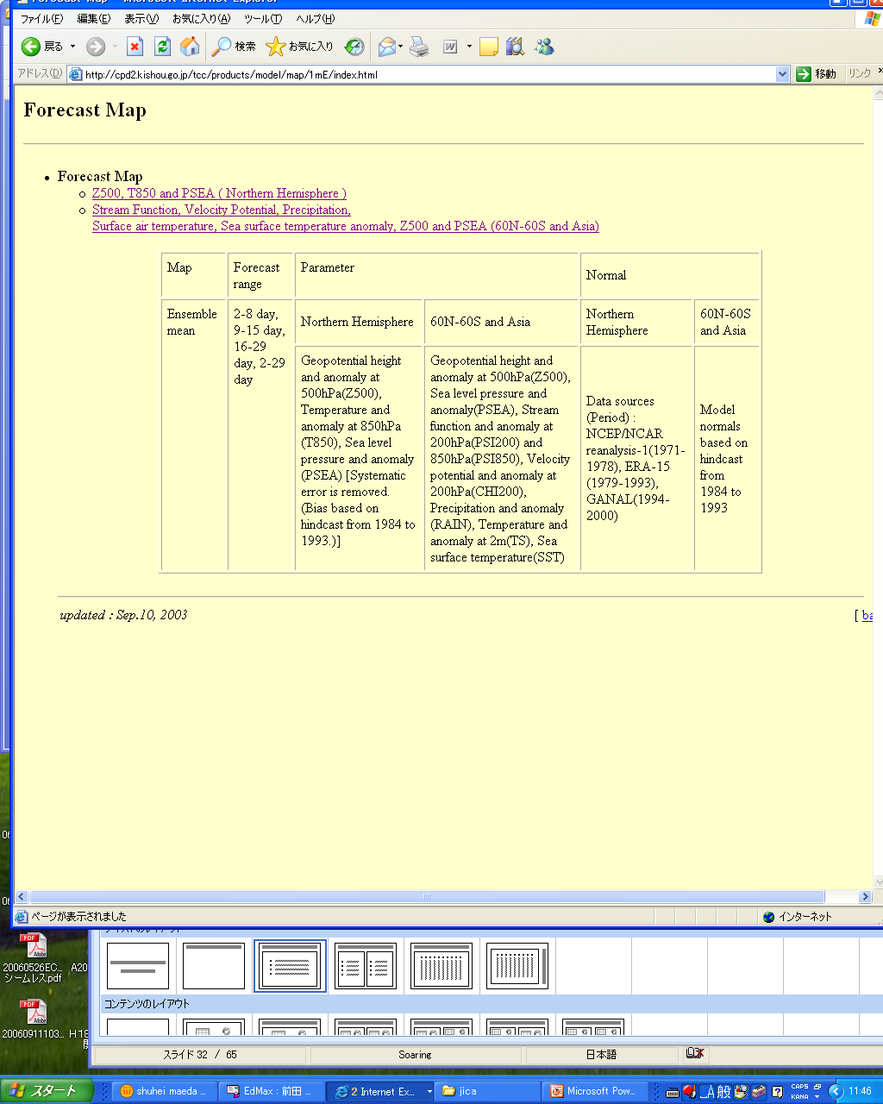
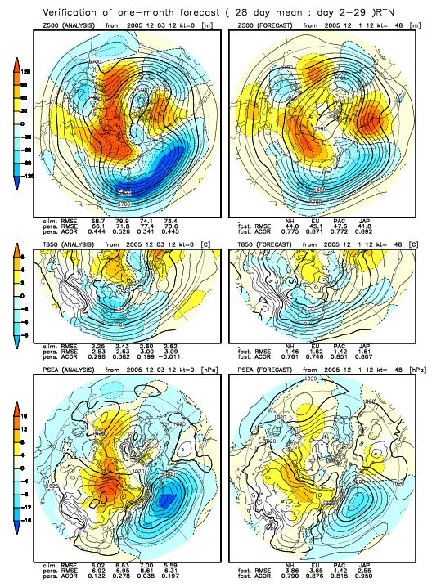
JMA Provision of numerical prediction products for ERF
The numerical products are available on the Tokyo Climate Center website.
http://ds.data.jma.go.jp/tcc/tcc/products/model/index.html

Slide 25
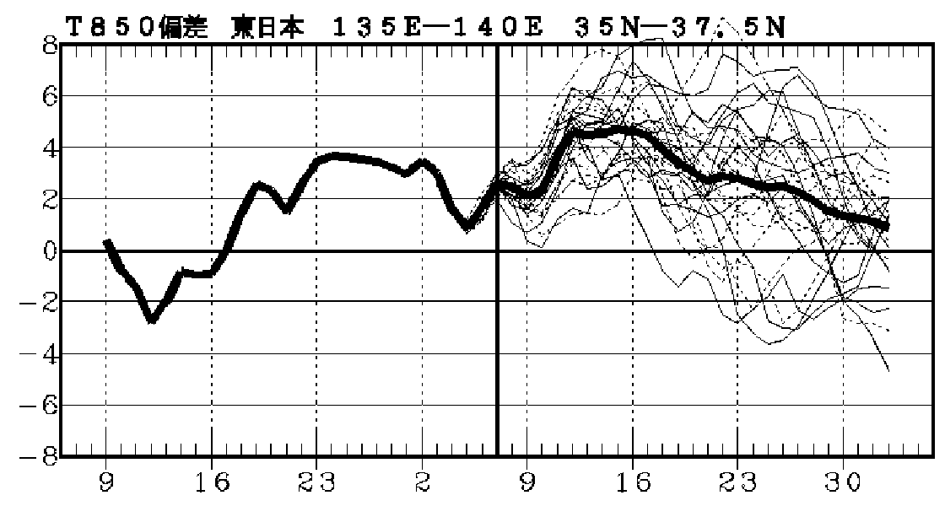
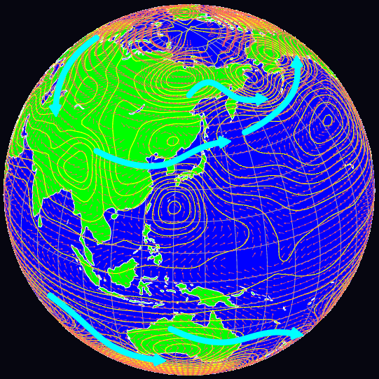
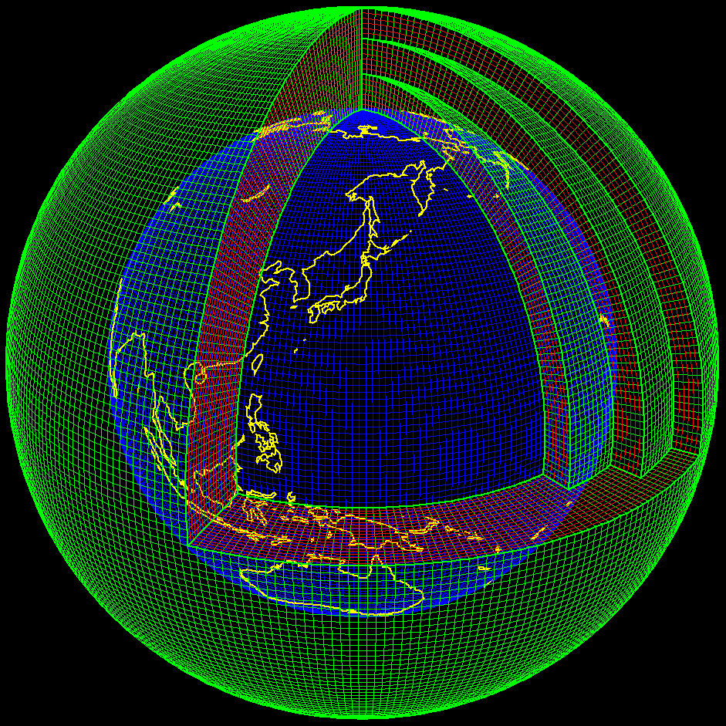
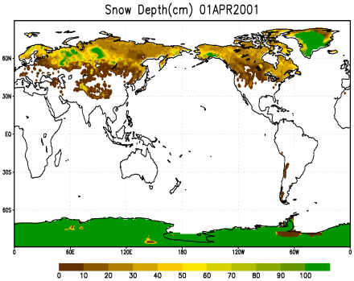
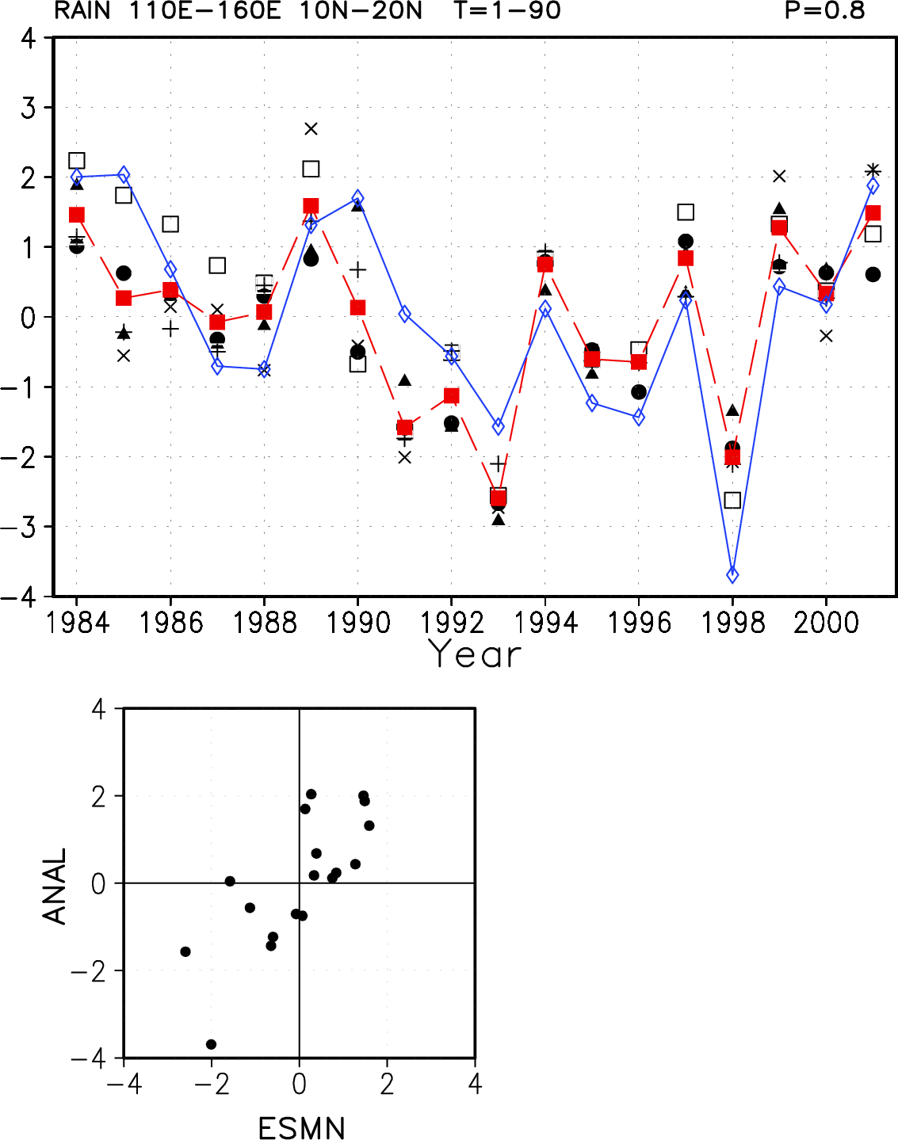
The JMA’s EPS for Extended-range Forecast Outlook
4D-VAR Assimilation
JMA Global
Atmospheric Model
Ensemble Products
Calibration
Land-Surface Assimilation
Verification
SST: Boundary condition
Hindcast

Slide 26

NCEP – status of > 15 day forecasts
NCEP climate forecast system in operation produces monthly means for periods longer than 15d and a development system that produces forecasts every 6h out to 45 d. The latter will be operational in early 2011; the test historical dataset is very inclusive and should be available next year from NCDC;
NCEP considering a fully coupled system to replace GFS (1-14d) but don't have the computing resources to test it at this time;
Evaluation Metrics: time evolution of teleconnecion patterns and MJO;

Slide 27
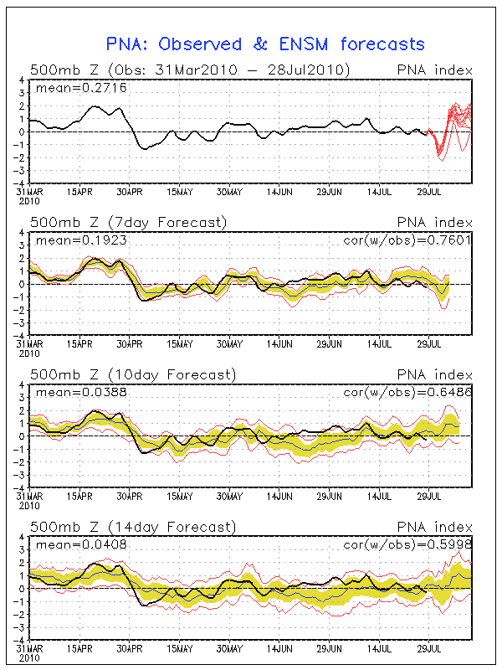
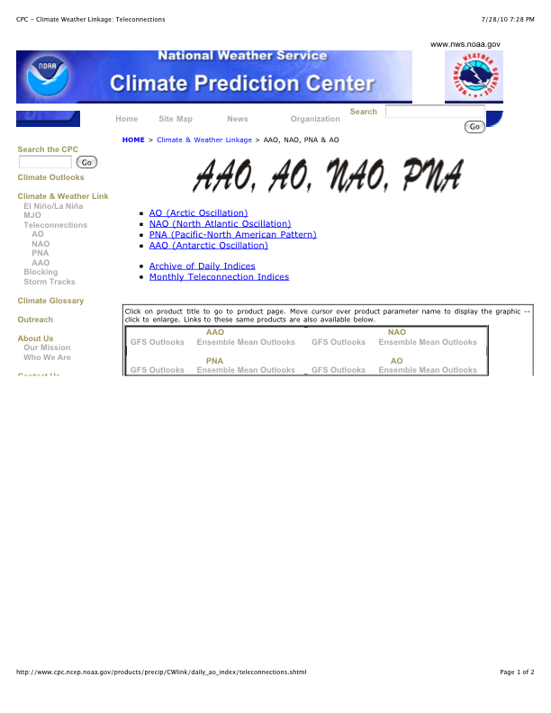

Slide 28
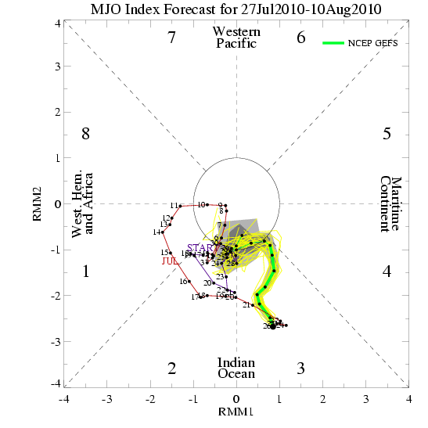

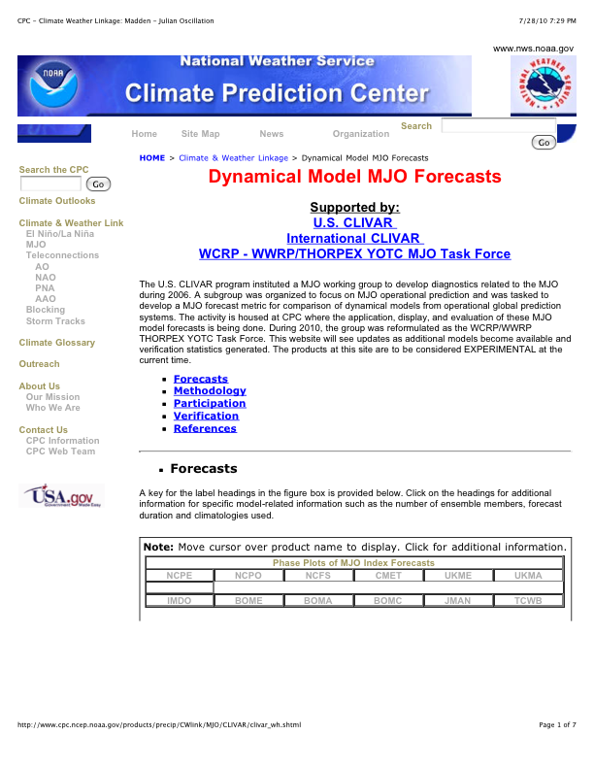

Slide 29
CPTEC status progress report: activities on extended and long-range forecasting
Caio Coelho and Paulo Nobre
caio.coelho@cptec.inpe.br
Paulo.nobre@cptec.inpe.br

Slide 30
CPTEC seasonal prediction operational runs
Global Atmospheric GCM
  KUO, RAS, GRELL, DERF
  SST: NCEP CFS & CPTEC CCA FCST, prescribed SSTA
  120 Members per month
  4 months forecast
Global Coupled Ocean-Atmosphere GCM
  T062L28, RAS atmos, ¼ degree, L20, 40S-40N ocean
  10 Members per month
  7 months forecast
Regional Atmospheric Eta Model
  40 Km grid L38 over South America
  AGCM T062L28, Kuo, LBC
  5 members per month
  4 months forecast
DERF – Global Coupled Ocean-Atmosphere GCM
  T126L28, RAS atmos, ¼ degree, L20, 65S-65N ocean
  2 members per day
  30 days forecast

Slide 31
CPTEC Coupled Ocean-Atmosphere predictability experiment
(based on Paulo Nobre’s info)
OGCM Modular Ocean Model (MOM3)‏
  Global Tropics (40S – 40N)‏
  1/4 x 1/4 degree deep tropics of the Atlantic Ocean
  Pacanowski and Philander vertical mixing
  Rigid lid approximation
CGCM: (daily, fully coupled) to CPTEC AGCM, T062L28, RAS, SSiB.
Atmos IC: NCEP
Ocean IC: MOM3 forced runs, no Ocean Data Assimilation
10 members, 20 years of 8 month forecast runs for the 12 calendar month for both AGCM and both AGCM and CGCM, totaling 3200 years of integration at INPE's NEC-SX6.
Paulo Nobre – CPTEC -

Slide 32
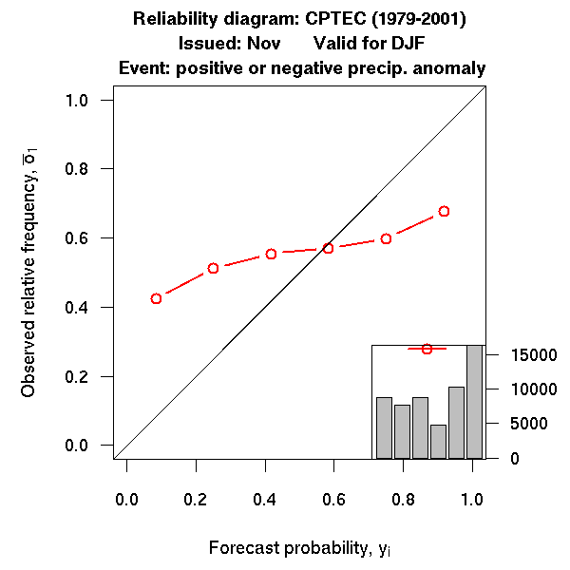
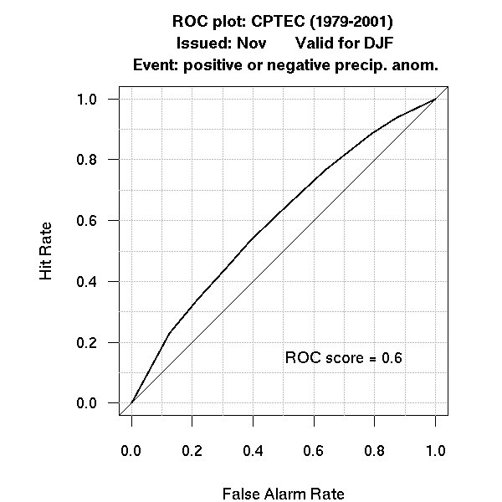
CPTEC examples of developed verification products

Slide 33
CPTEC Coupled Ocean-Atmosphere GCM operational runs at INPE-CPTEC
CGCM – seasonal climate
  7 months forecast
  10 members ensembles, Coupled model initialization:
    Atmos: NCEP análises for 10 consecutive days
    Ocean: forced OGCM run with prescribed atmos fluxes
  Resolution:
    Atmos: T062L28
    Ocean: ¼ x ¼ lat-lon, 10S-10N, over the Atlantic
    O-A Coupling latitute belt: 40S – 40N
  Prognostic fields: Precipitation, SST (global, Niño Index).
CGCM – extended weather
  30 days forecast
  2 members per day (00 and 12 UTC)
  Resolution
    Atmos: T126L28
    Ocean: ¼ x ¼ lat-lon, 10S-10N, Atlantic sector, 2 deg. extratropics
    O-A Coupling latitute belt: 65S – 65N
  Prognostic fields: SLP, Geopot. Height, Temperature, Precip., SST
Thanks to Paulo Nobre, Marta Malagutti, Emanuel Giarolla, Domingos Urbano, Roberto de Almeida

Slide 34
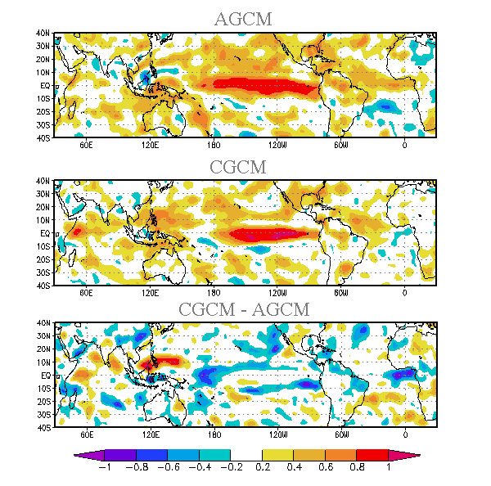
CPTEC Coupled Ocean-Atmosphere processes at play
DJF Precipitation Forecasts anomaly correlations
Increased
Coupled
Model
Forecast
Skill
Nobre et al. (2008, in prep)‏

Slide 35
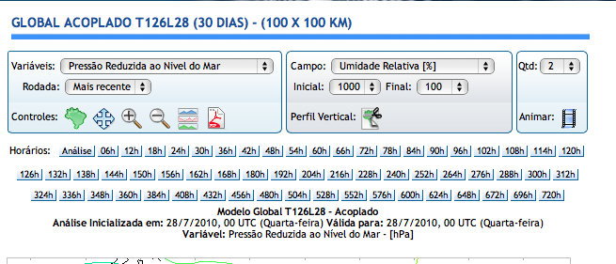

30 day forecasts with Coupled Atmos/Ocean Products –
www.cptec.inpe.br

Slide 36
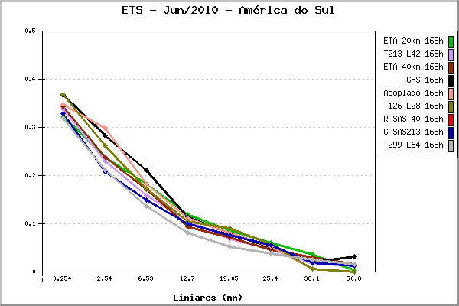
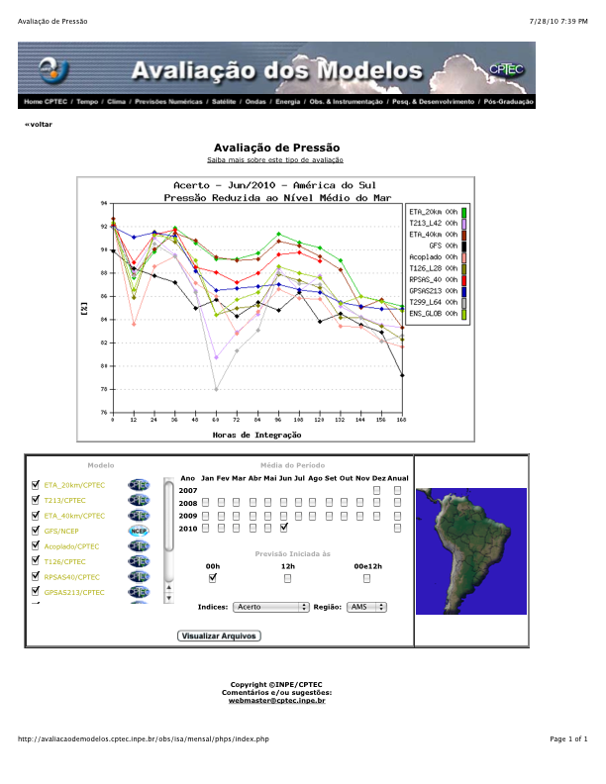
Evaluation of 30 day forecasts

Slide 37
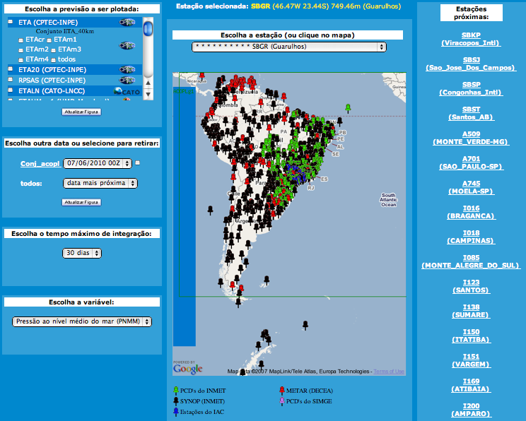
MASTER – Univ. of Sao Paulo – www.master.iag.usp.br

Slide 38
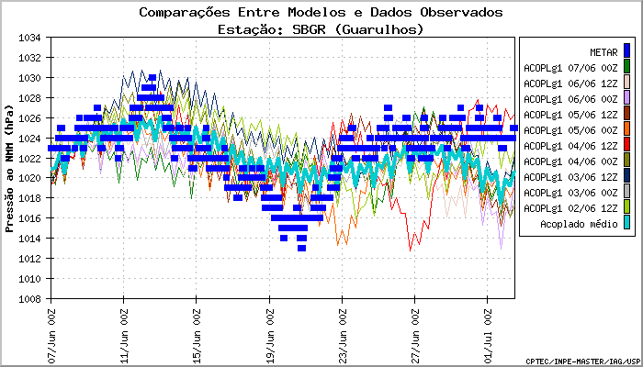
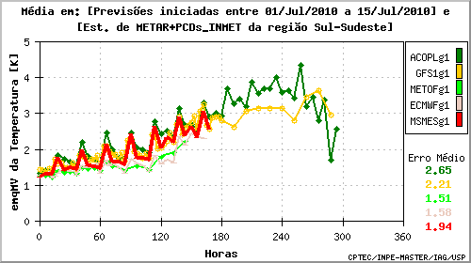
SLP – SBGR Airport – Sao Paulo Brazil
Blue line – average of last 10 forecasts – 5 days
Blue dots: obs
Mean Square Error after Bias removal
Temperatura 2m

Slide 39
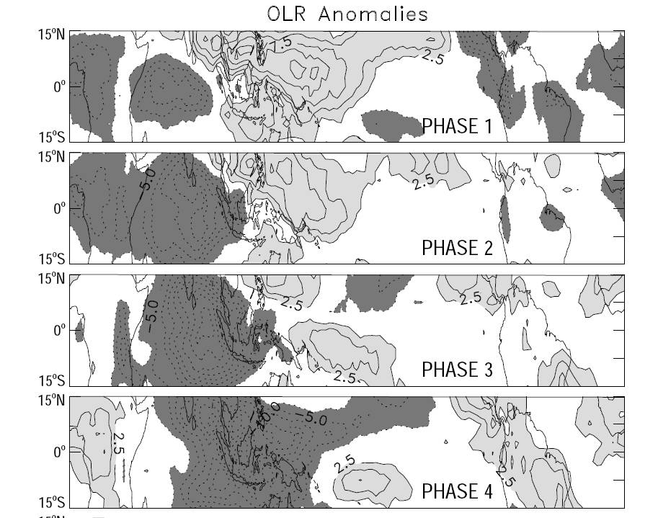
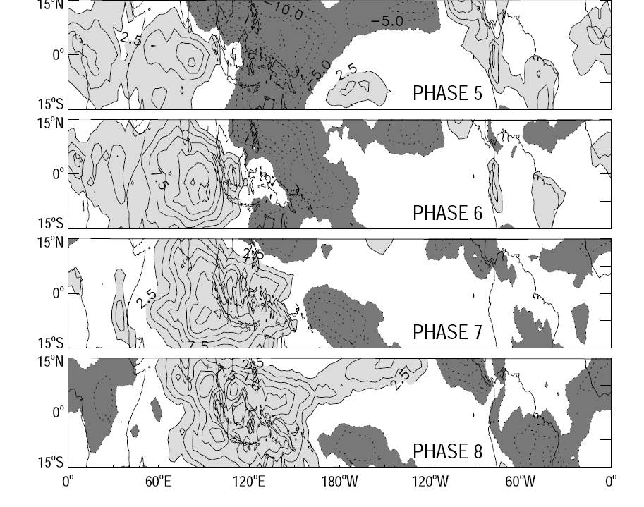
Fig 9 Phase composites of OLR anomalies. Light (dark) shading indicates positive
(negative) anomalies. Contour interval is 2.5 W m-2; zero contours omitted.
Influence of the Madden-Julian Oscillation on forecasts of
extreme precipitation in the contiguous United States
Charles Jones, Jon Gottschalck
Leila M. V. Carvalho and Wayne Higgins, 2010 - MWR

Slide 40
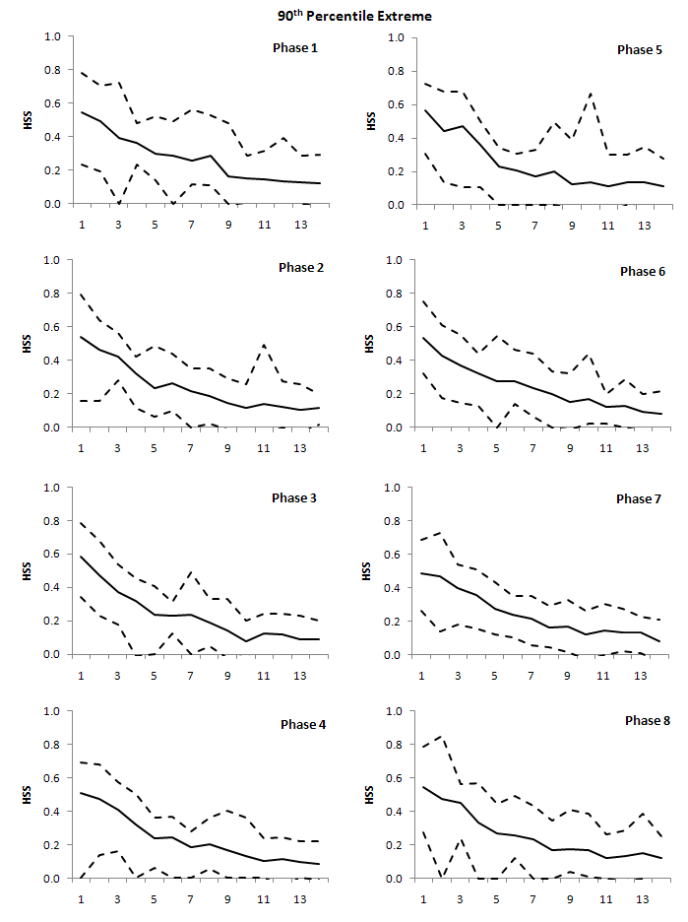
Figure 11 shows detailed views of the influence of the MJO on forecast skill for 90th percentile extreme precipitation. Each panel shows the mean and spread of HSS validated on each MJO phase; statistics are computed only over gridpoints that are
statistically significant relative to inactive MJO conditions. The first aspect to notice is that HSS 3 0.1 extends to 13-14 day lead times especially in phases 1-2 and 7-8, which contrasts to the overall skill of 7-8 day shown previously (Fig. 8). Another important
point is that the maximum HSS validated during MJO conditions is higher than the
overall skill (Fig. 8) and extend to longer leads in phases 1-2 and 8.

Slide 41
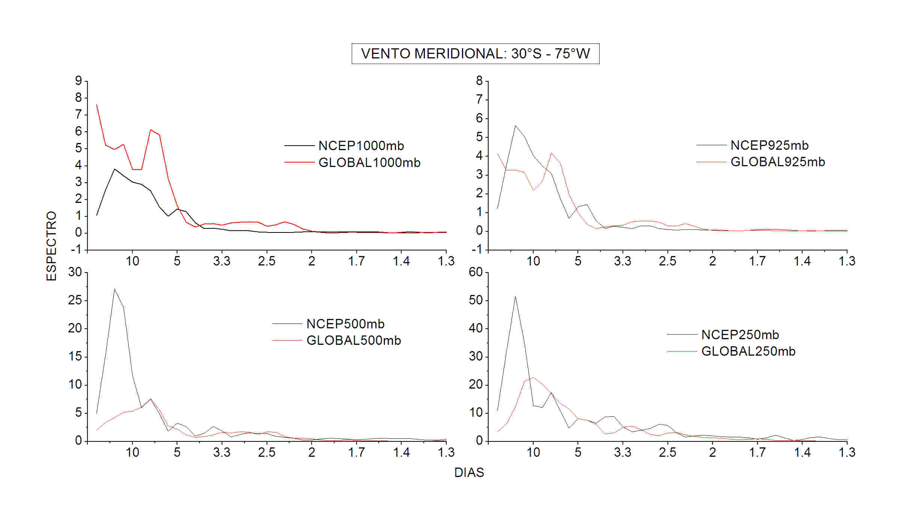
A general problem with >15d forecasts and seasonal forecasts:
lack of power in the intraseasonal time scale
Power spectra of meridional wind at 40S , 60W – CPTEC – From seasonal forecasting model
S. Ferraz and P. Silva Dias – 2010 – prep.

Slide 42
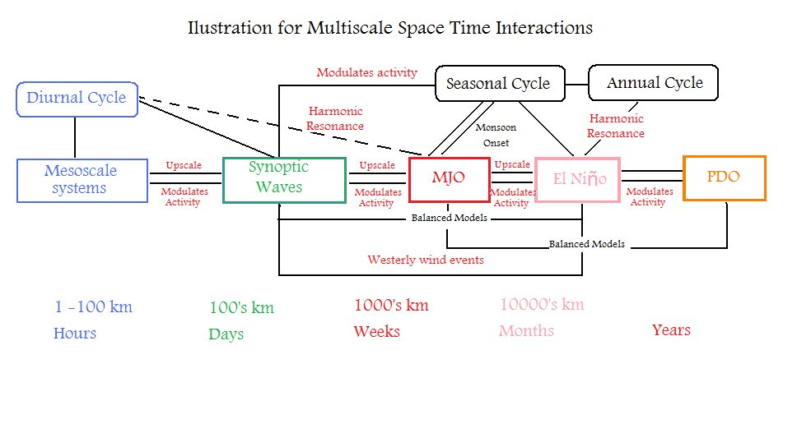
General View
Based on Raupp and Silva Dias – JAS 2010 – Ramirez, Silva Dias and Raupp in prep.

Slide 43
GIFS TIGGE WG ‐ 8th meeting (WMO Geneva 22‐24 February 2010)
Collaboration with WCRP including the CHFP
A way forward was to work together on a sub‐seasonal to seasonal project i.e. 0 to 90 days. The UKMO has agreed to host a workshop in Dec. to take this
forward – it should naturally lead to much closer links between TIGGE and the CHFP.
There is a basic mismatch since TIGGE is “real time” and has limited data sets. It may be possible to extend some TIGGE forecasts from 15 to 90 days to look at the “first” season (CPTEC may extend form 30 days to this longer range).
The CHFP organises runs only 4 times /y with 10 member ensembles – the TIGGE data could fit in the early part of the case studies. Thus the research project should focus on the first season and move to running once month. Initially it may be worth looking at the past 3 years from the start of the TIGGE archive out to 15 days and the CHFP archive for longer timescales.
Organisationally a sub‐group of WGSIP should work with a TIGGE sub‐group on this topic.
Technical liaison would be essential – a technical person from CHFP should liaise with a TIGGEGIFS expert (possibly from NCAR).
Extreme events were of interest – the common infrastructure should facilitate research in this area.

Slide 44
The GIFS‐TIGGE WG welcomed the opportunity to collaborate with WGSIP on a proposed seamless forecasting project focused on the 0‐90 day range. A workshop is planned at the Met Office in December to initiate this project, with involvement from members of the GIFSTIGGE WG and WGSIP.
Action items from GIFS TIGGE WG ‐ 8th meeting (WMO Geneva 22‐24 February 2010):
Action 8.11.1: David Burridge to nominate a representative from one of the TIGGE archive centres to liaise with the technical manager at CIMA, which hosts the CHFP data set, to compare CHFP and TIGGE archive methods and recommend how to proceed for the planned project.
Action 8.11.2: Pedro Silva‐Dias to represent the GIFS‐TIGGE WG at the next WGSIP meeting, planned for July in Argentina.
Action 8.11.3: Richard Swinbank to represent GIFS‐TIGGE WG at WCRP‐WWRP workshop on intraseasonal forecasting in Exeter ‐ Nov 2010

Slide 45
Conclusions:
Need closer collaboration with TIGGE, primarily with centers doing > 15 day forecasts;
  Use of coupled models
  Combination of models: estimation theory – Bayesian approach…
  Experience in handling data sets : TIGGE of the order of Pb/yr

