Slide 1
SOME LRF Activities in south africa
Willem A. Landman

Slide 2
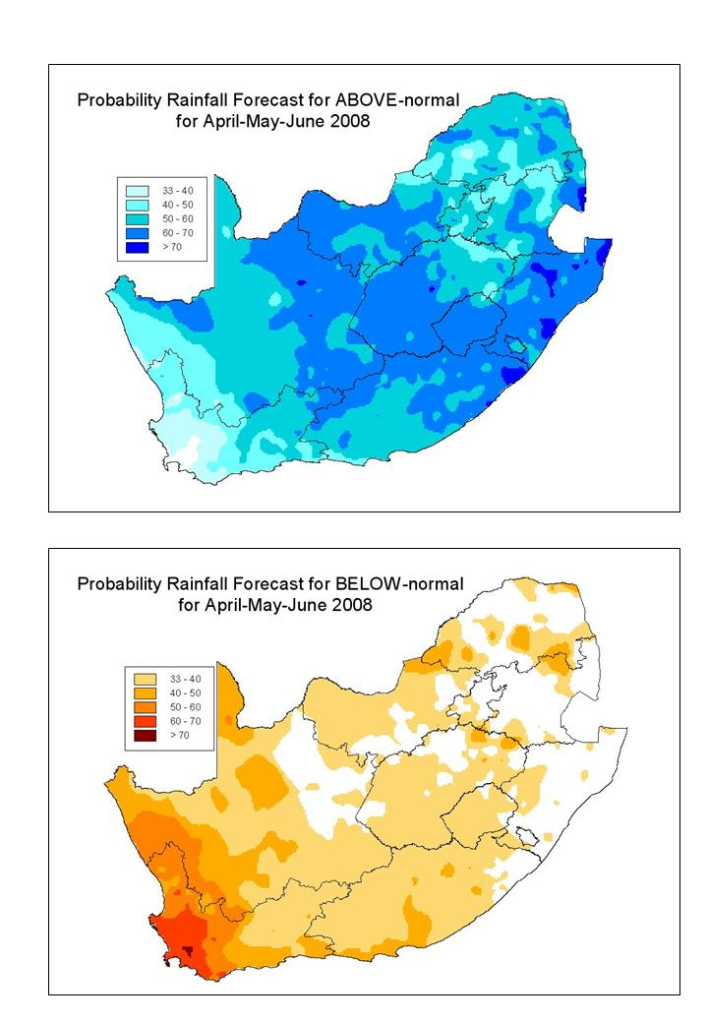
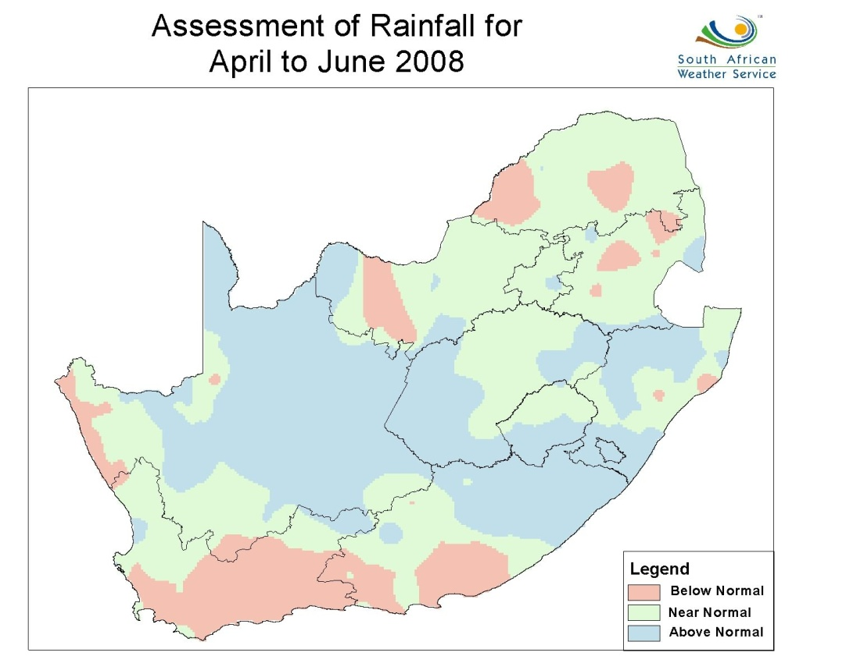
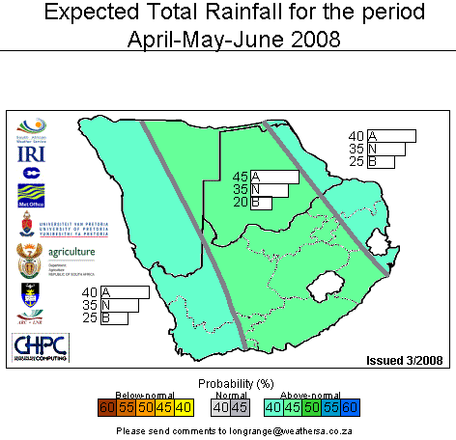
Objective multi-model forecast
Subjective consensus forecast

Slide 3
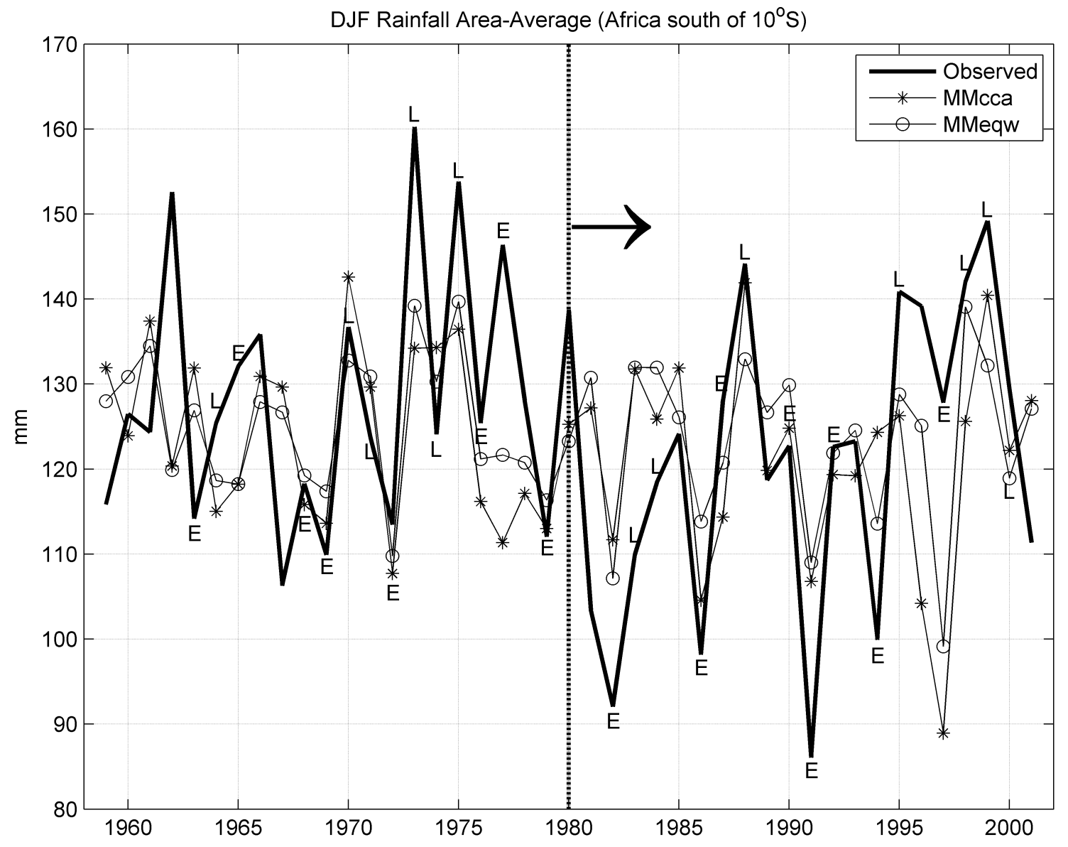

Slide 4
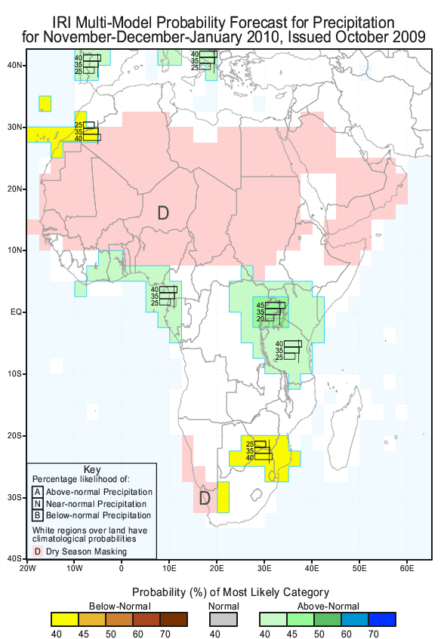
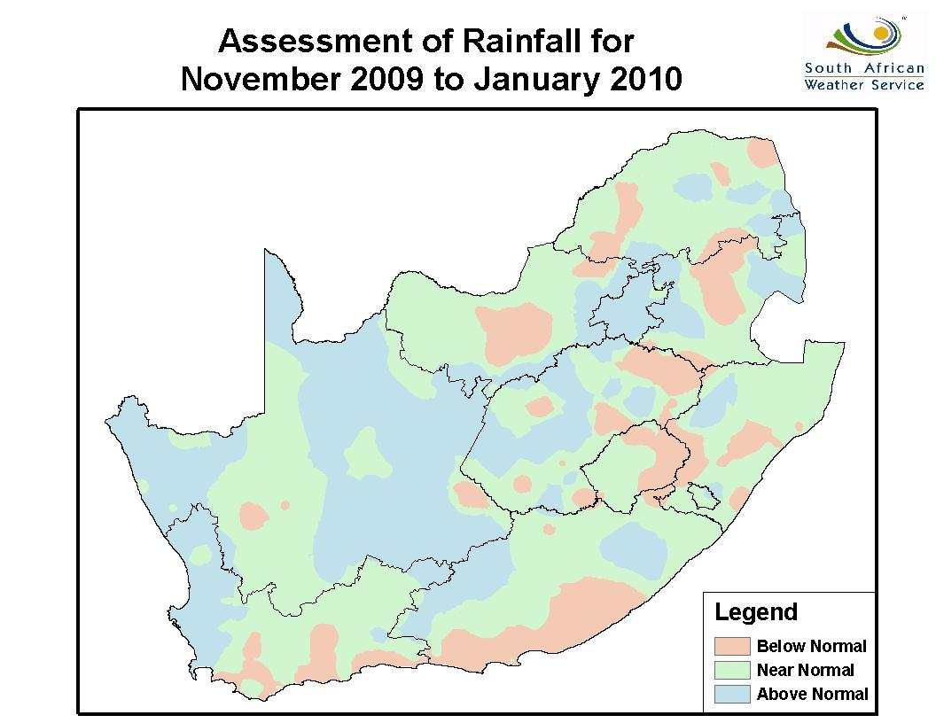
November-DECEMBER-January 2009/10

Slide 5
Weather and Climate Modelling at the NRE
Atmospheric Modelling Strategic Initiative
(AMSI)
Component 1
High-resolution Weather Forecasting
(1-10 days)
Component 2
Long-Range Forecasting
(Weeks to months)
Component 3
Climate Change Projections
(Decadal and multi-decadal)
Component 4
Model Development
Operational Forecasting
SEAMLESS FORECASTING: Using common forecast systems to predict for multiple time scales

Slide 6
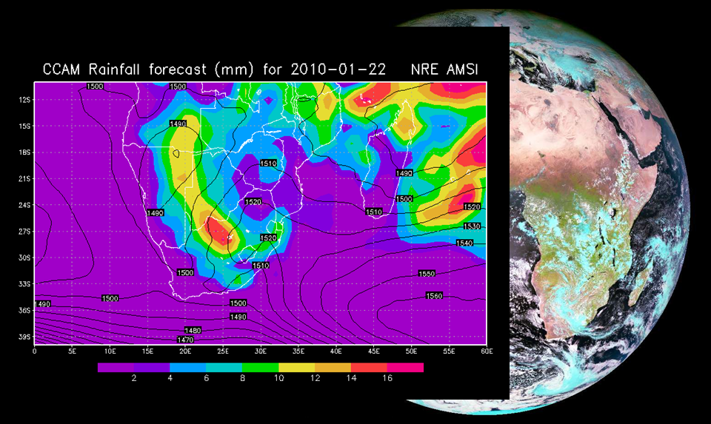
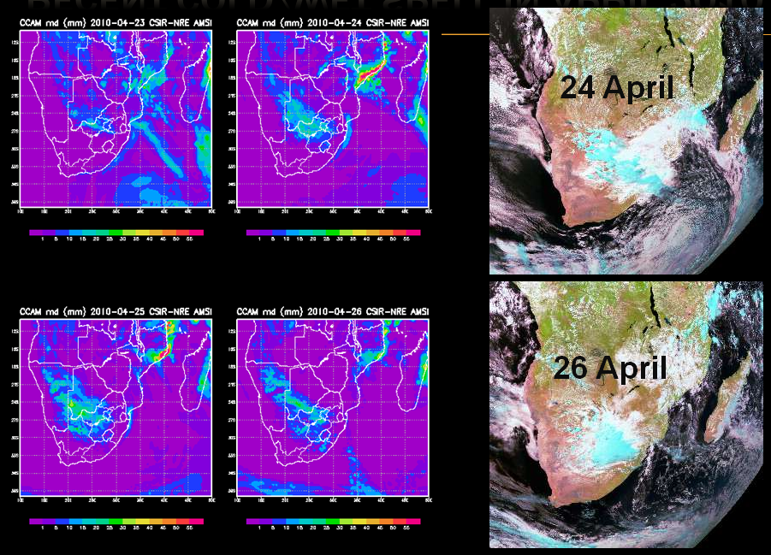
50 km
15 km

Slide 7
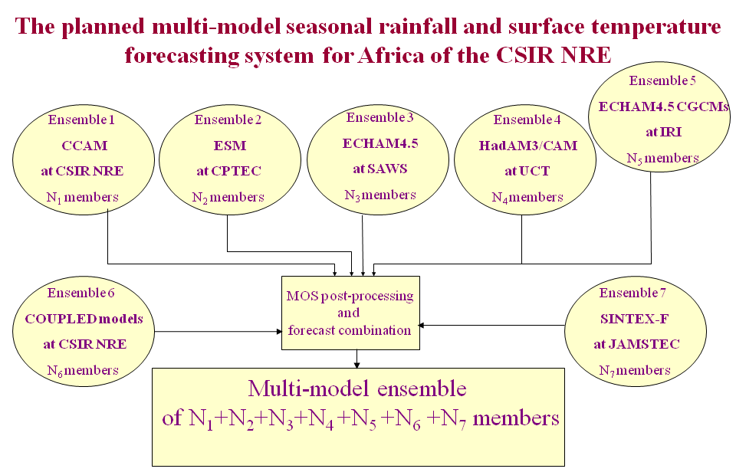
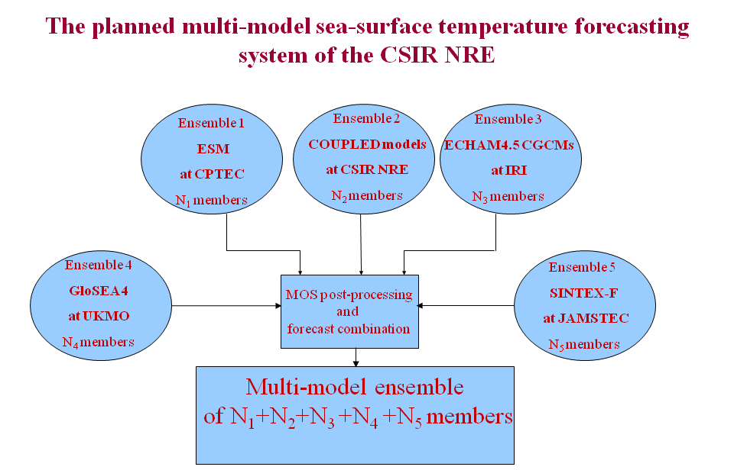

Slide 8
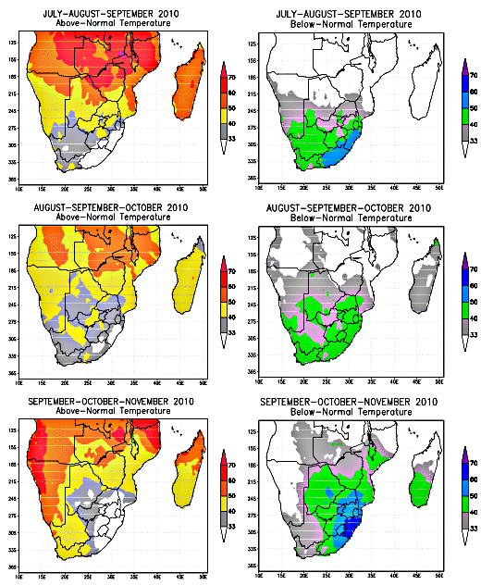
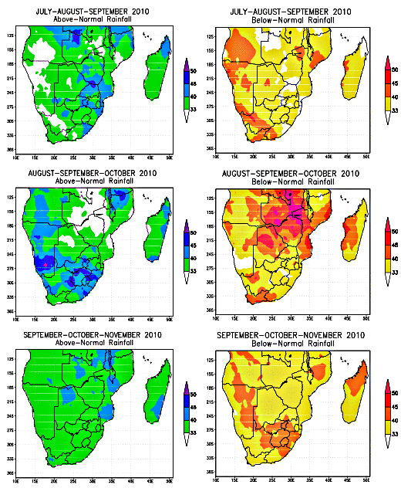
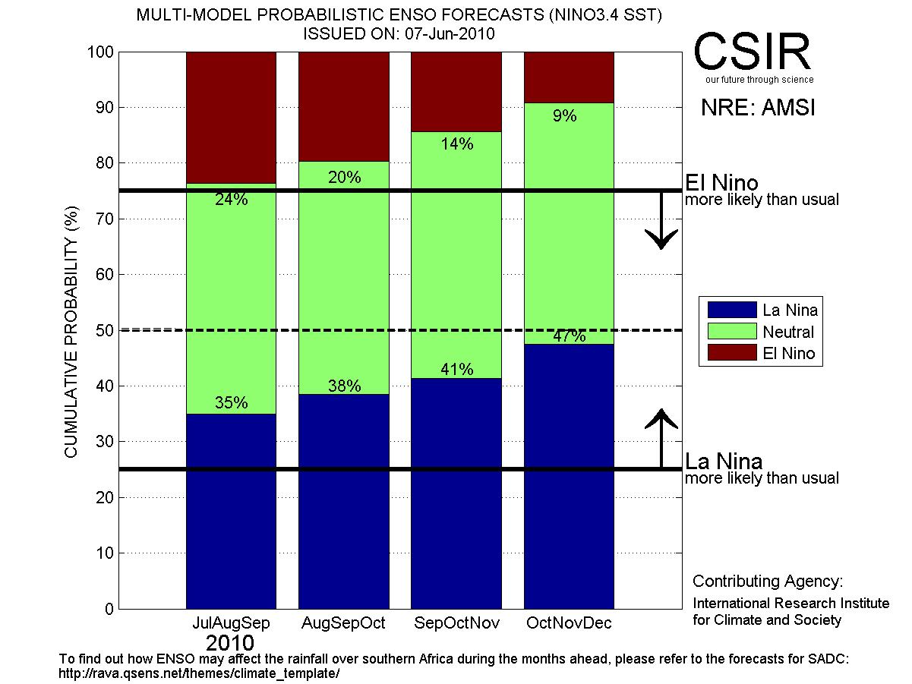
recent seasonal forecasts

Slide 9
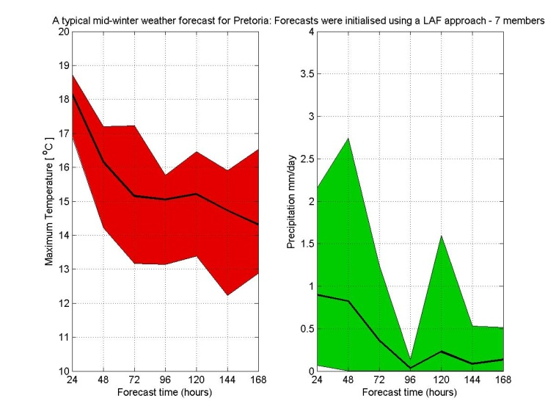
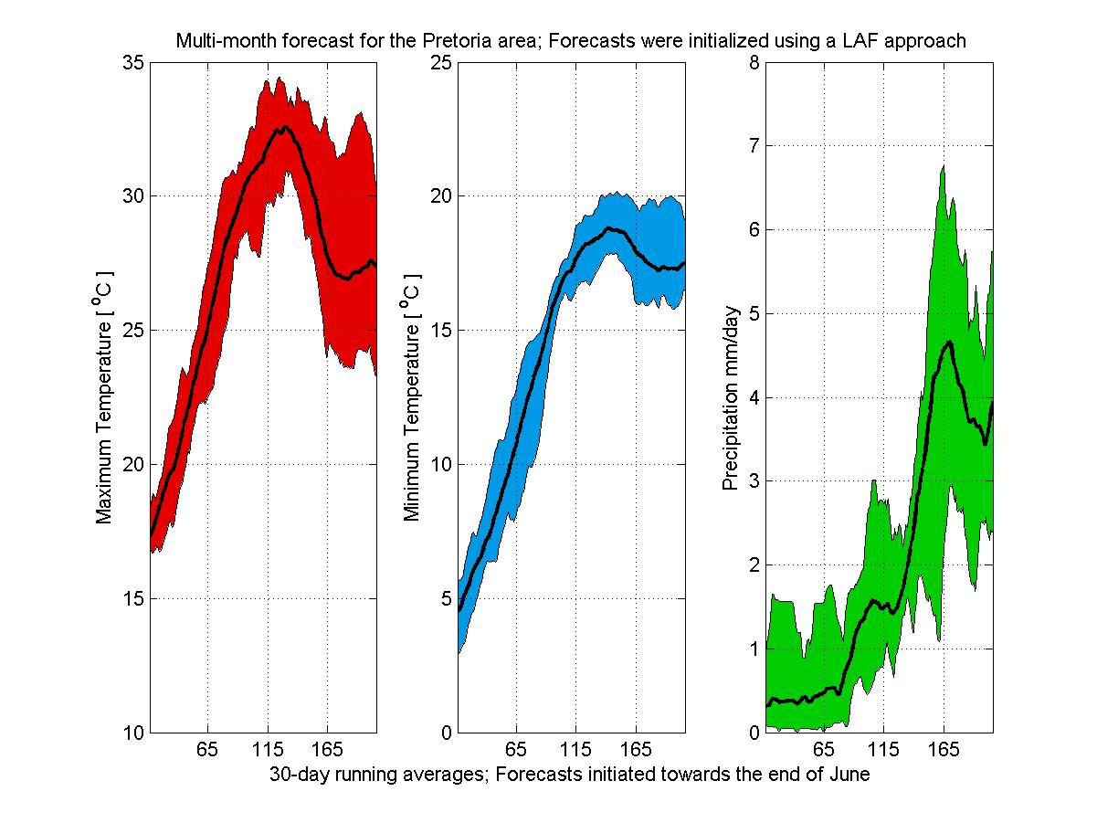
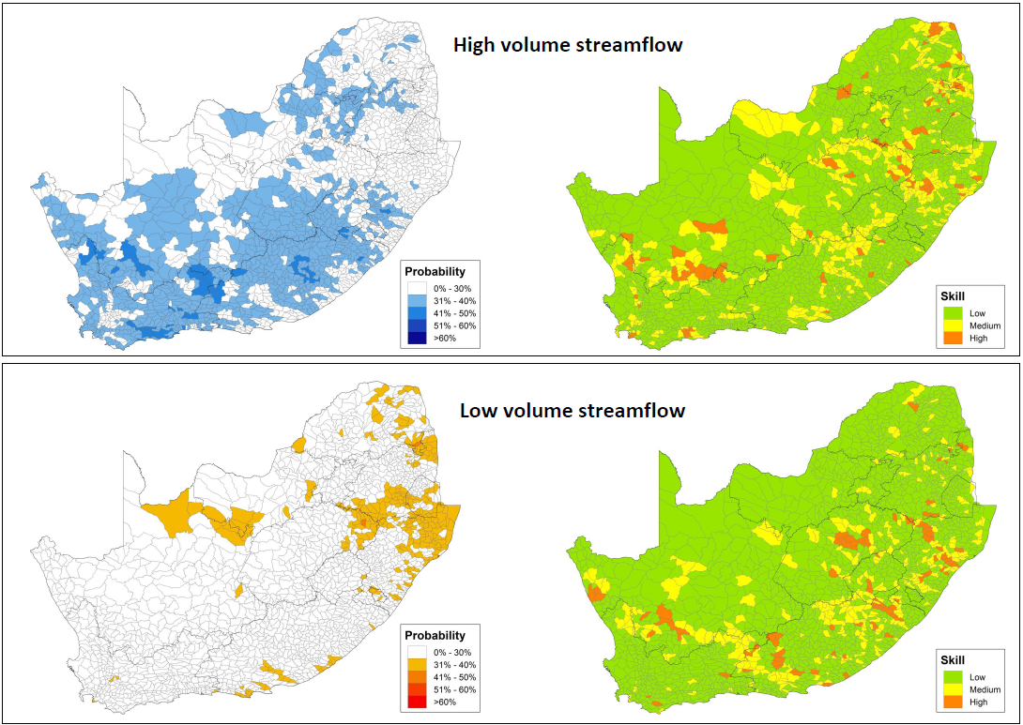
NEW & Future products
Nudging: 200 – 50 – 15 km

Slide 10
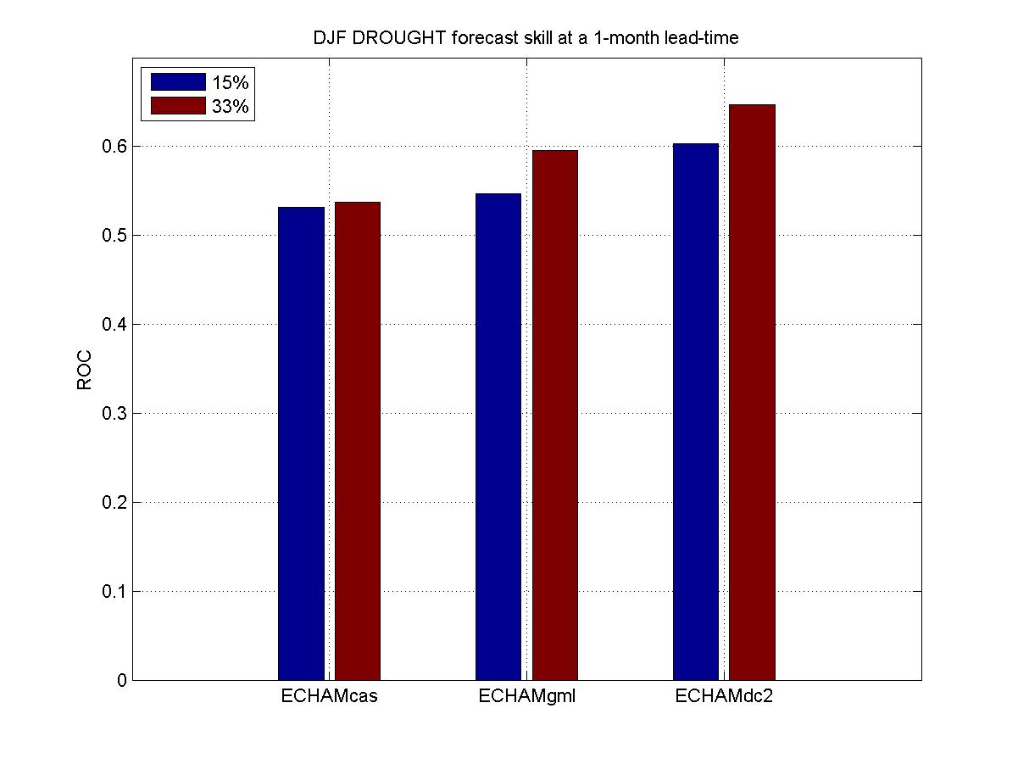

Slide 11
Cube-based AGCM
VCAM - CSIRO
Coupling
(CSIR)
Cube-based OGCM
(JAMSTEC)
Three-way collaborative agreement being compiled
A new cube-based coupled GCM: VCM
University of Tokyo Climate Model
(to be installed on multi-processor machine at CSIR)
JAMSTEC
(SINTEX-F)

Slide 12
What next...?
Forecast verification
Further optimizing of MOS forecasts for SADC
Seamless systems for intra-seasonal characteristics
Optimized global SST forecasts
Multi-institutional multi-model forecasts
Investing in coupled models for operational forecasting

