Slide 1
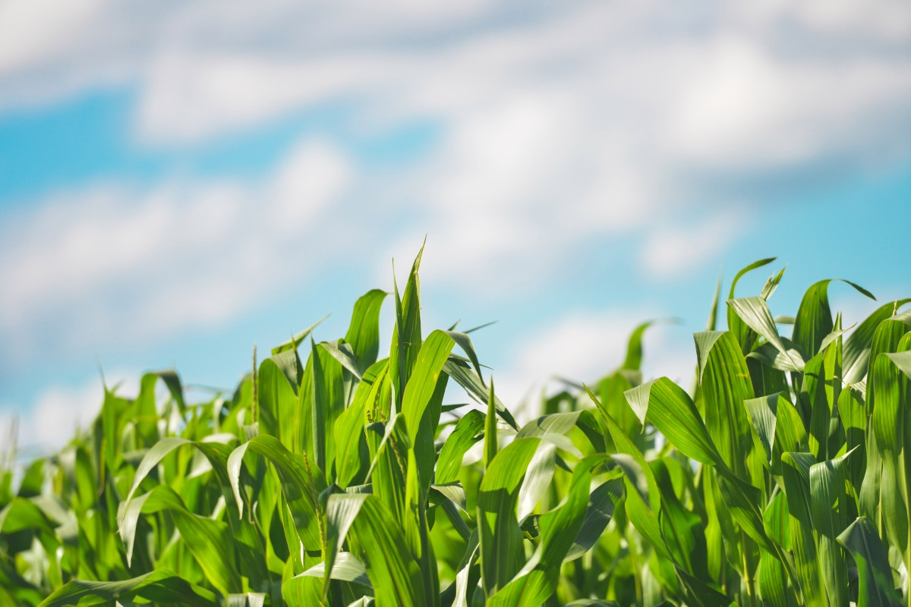
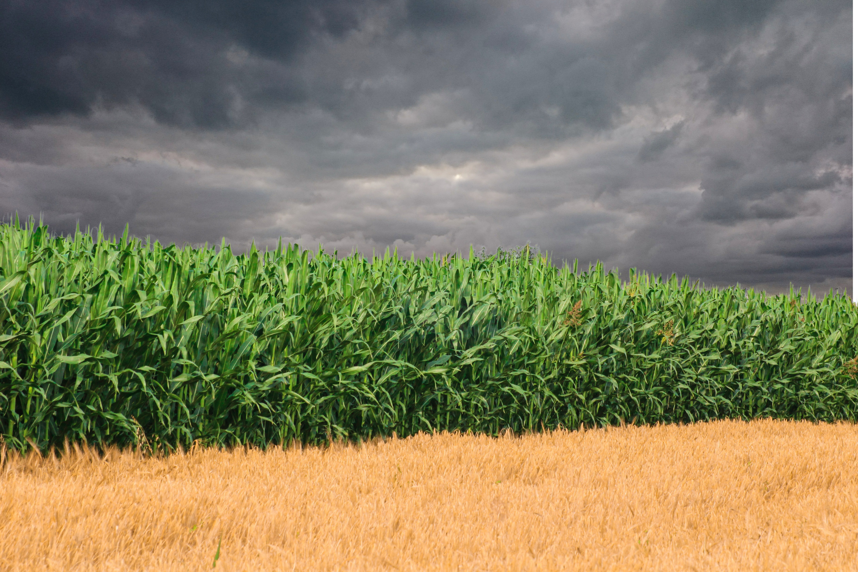
How compound extremes impact crops and what they mean for adaptation
WCRP Safe Landing Climates Discussion
20 November 2023
Notes:
8-8-8-6

Slide 2
Crops are the boundary conditions of the food system
Notes:
8-8-8-6

Slide 3
A good harvest does not ensure food security
But a bad harvest does increase food security risk
Notes:
8-8-8-6

Slide 4
A warming climate stresses crops in many ways
Notes:
8-8-8-6

Slide 5
The evolving focus of climate impacts (in the IPCC)
IPCC 2nd Report:
Extremes not mentioned in agricultural impacts
+2°C
1990s
2000s
2010s
2020s
Mean changes

Slide 6
The evolving focus of climate impacts (in the IPCC)
IPCC 2nd Report:
Extremes not mentioned in agricultural impacts
IPCC 3rd Report:
“Projected Changes in Climate Extremes could have Major Consequences”
1990s
2000s
2010s
2020s
Mean changes
Extremes

Slide 7
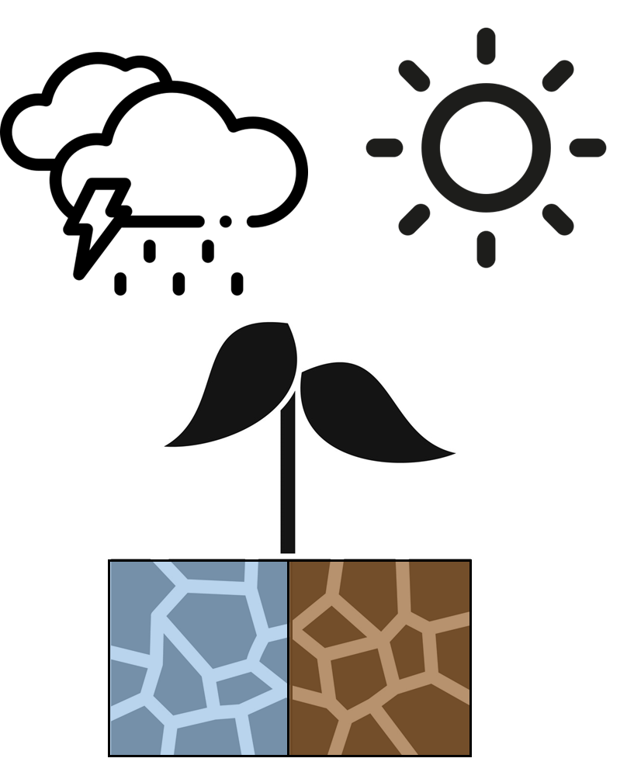
The evolving focus of climate impacts (in the IPCC)
IPCC 2nd Report:
Extremes not mentioned in agricultural impacts
IPCC 6th report:
First mention of ‘compound extremes’
IPCC 3rd Report:
“Projected Changes in Climate Extremes could have Major Consequences”
1990s
2000s
2010s
2020s
Mean changes
Extremes
Compound extremes

Slide 8
Under warming, crops are increasingly exposed to multiple stresses
Compound impacts
Distinct dynamics

Slide 9
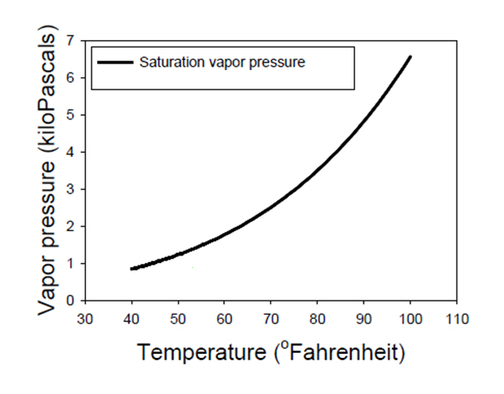
Physically, warming implies more compound extremes
Warmer air holds more water vapor at saturation
Steeply increasing (nonlinear)
A wetter atmosphere
A thirstier atmosphere
7%/°C
5 10 15 20 25 30 35
Temperature (°C)
5 10 15 20 25 30 35
Temperature (°C)
Westra et al. 2014

Slide 10
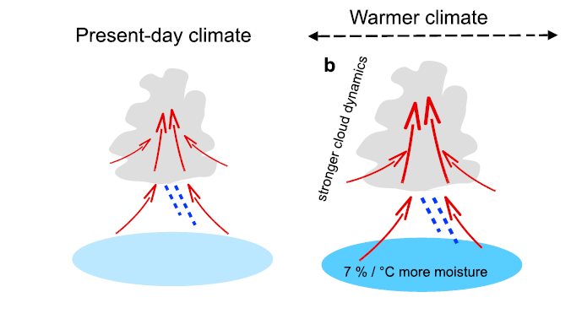
More extreme rainfall
A wetter atmosphere
7%/°C
5 10 15 20 25 30 35
Temperature (°C)
5 10 15 20 25 30 35
Temperature (°C)
Westra et al. 2014

Slide 11
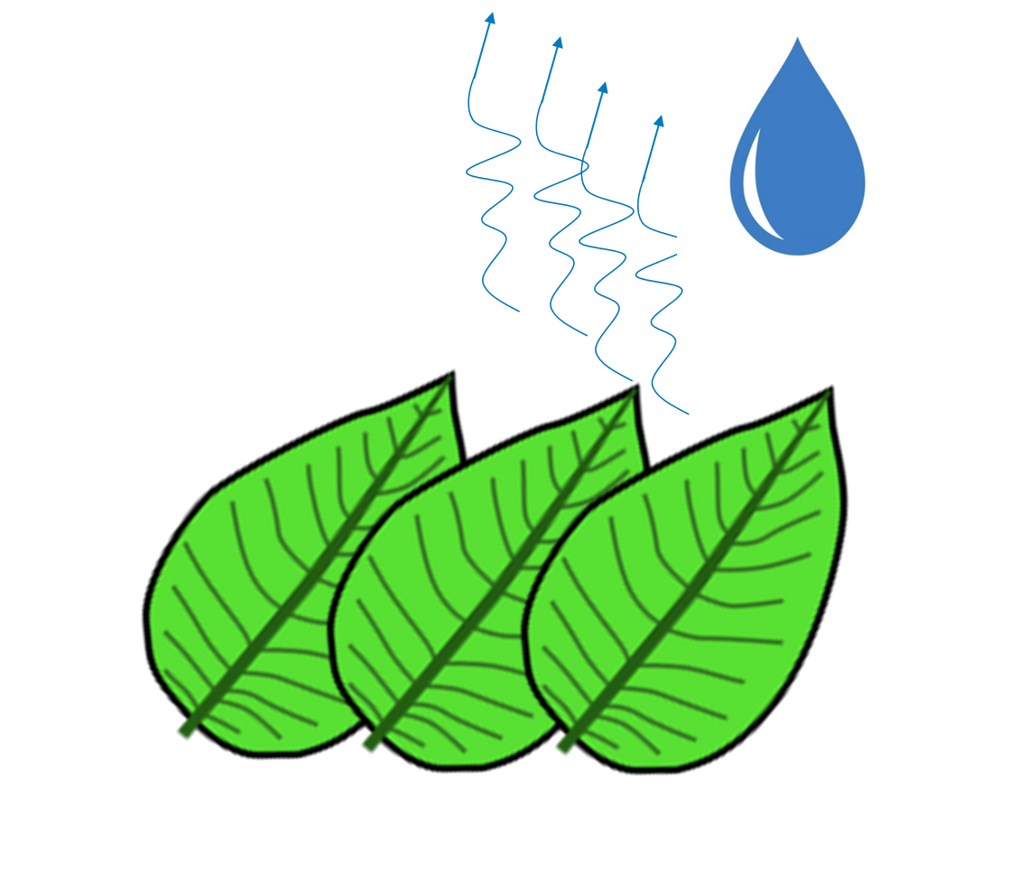
More moisture stress
A thirstier atmosphere
7%/°C
5 10 15 20 25 30 35
Temperature (°C)
5 10 15 20 25 30 35
Temperature (°C)
Grossiord al. 2020

Slide 12
Under warming, crops are increasingly exposed to multiple stresses
Warmer, more heat extremes
Also = more hydrologic extremes
Wet and Dry

Slide 13
Crop impacts fairly well understood
Warmer, more heat extremes
Also = more hydrologic extremes
Wet and Dry

Slide 14
Warmer, more heat extremes
Also = more hydrologic extremes
Wet and Dry
Crop impacts poorly understood

Slide 15
How do these compound stresses affect crop production?
More intense rainfall
Hotter droughts

Slide 16
Short answer (and the key message of this talk):
Increasingly compound heat+drought pose new risks to crops
Partially offset by more intense rainfall
Understanding these impacts clarifies how to effectively adapt

Slide 17
Rest of the talk:
Tools for understanding compound crop impacts
Crop impacts of hotter droughts and more intense rainfall
Implications for adaptation

Slide 18
Two ways to understand climate impacts on crops
1. Statistical models
Climate & Crop
Data
Regression
Crop sensitivities
Learning

Slide 19
Two ways to understand climate impacts on crops
1. Statistical models
Climate & Crop
Data
Regression
Climate projections
Crop sensitivities
Future impacts
Learning

Slide 20
Two ways to understand climate impacts on crops
2. Process-based models
Climate
Projections
Key process equations
Learning
Future impacts

Slide 21
Two ways to understand climate impacts on crops
2. Process-based models
Climate
Projections
In principle, the gold standard
But we don’t understand key processes of compound stress
Largely omitted from models
Key process equations
Learning
Future impacts
see Lesk et al. 2022, Nature Reviews Earth and Environment

Slide 22
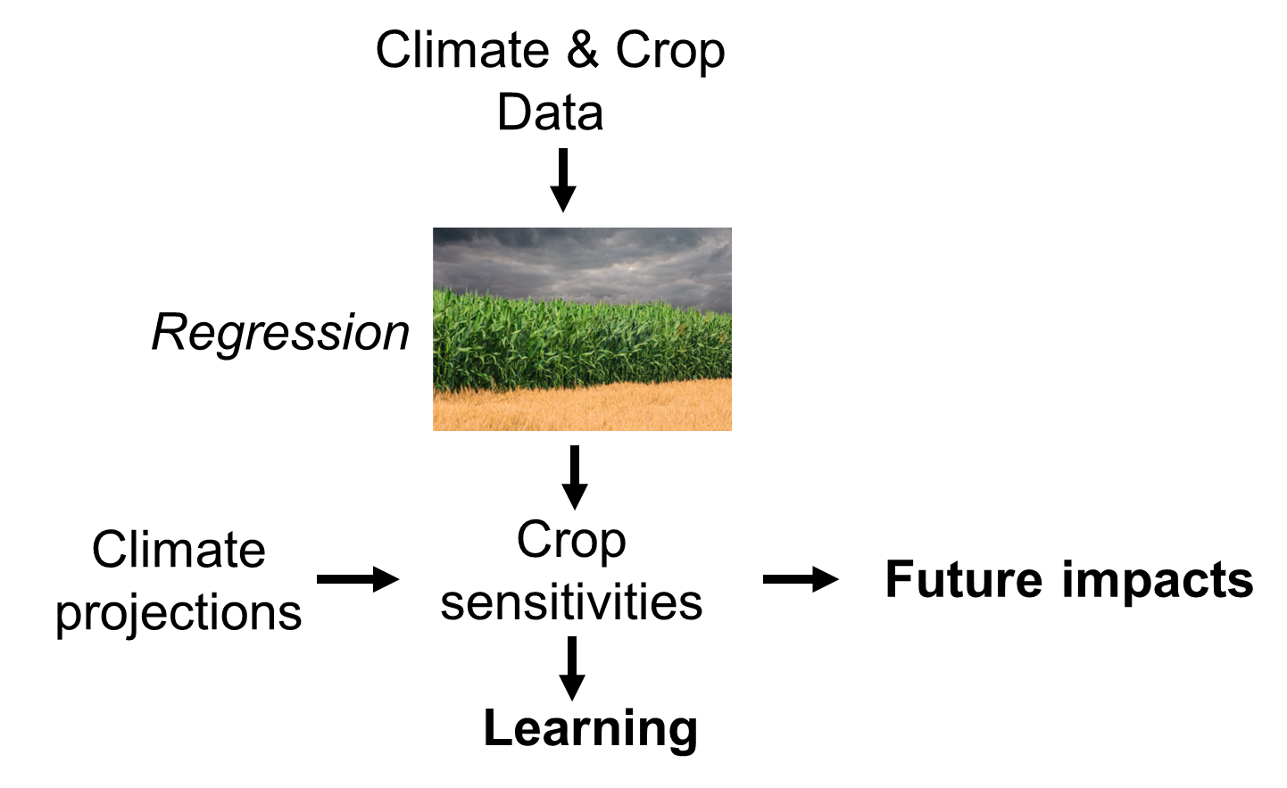
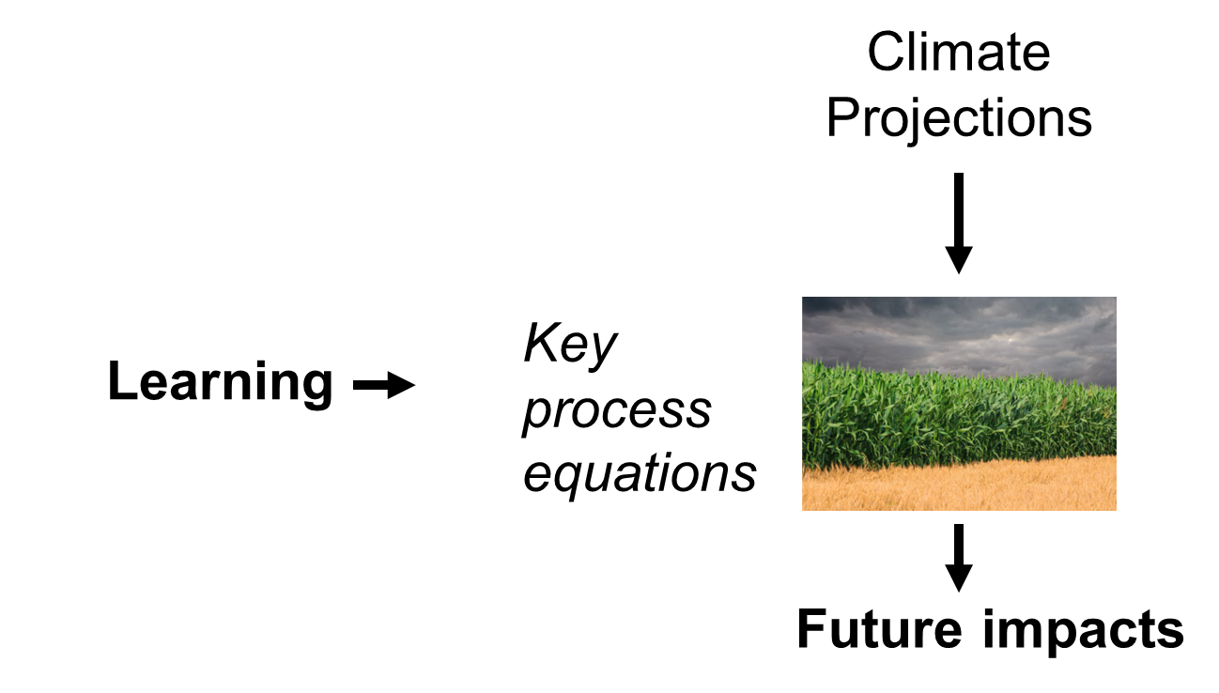
Statistical modeling to learn how compound extremes impact crops
Understand missing key processes

Slide 23
Statistical modeling to learn how compound extremes impact crops
Hotter droughts

Slide 24
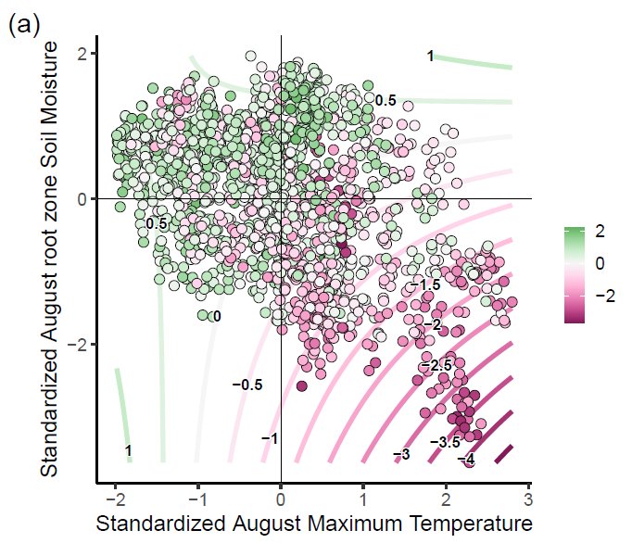
Indiana, USA
Soil moisture anomaly
Two key processes
-2 0 2
Soy yield
anomaly
Temperature anomaly
Hamed et al. 2022

Slide 25
Soil moisture anomaly
-2 0 2
Soy yield
anomaly
Hot + Dry
Temperature anomaly
Hamed et al. 2022

Slide 26
Soil moisture anomaly
-2 0 2
Soy yield
anomaly
Historically, hotter droughts have strongest crop yield impact
Temperature anomaly
Hamed et al. 2022

Slide 27
Soil moisture anomaly
-2 0 2
Soy yield
anomaly
Also, heat + drought are connected
Mutual intensification
Temperature anomaly
Hamed et al. 2022

Slide 28
Heat+Drought connections
Heating dries soils
Air warms more above dry soils

Slide 29
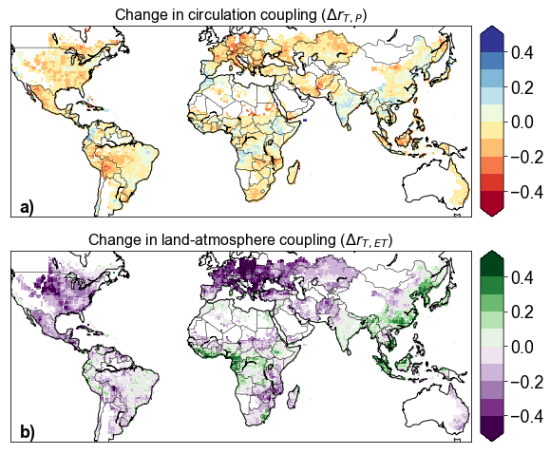
Stronger Heat+Drought connections under warming
Stronger Heat+Drought
Connection
Stronger Heat+Drought
Connection
Lesk et al. 2021 Nature Food
Multi-model median of 12 CMIP6 GCMs/ESMs, SSP2-4.5, 2050-2100

Slide 30
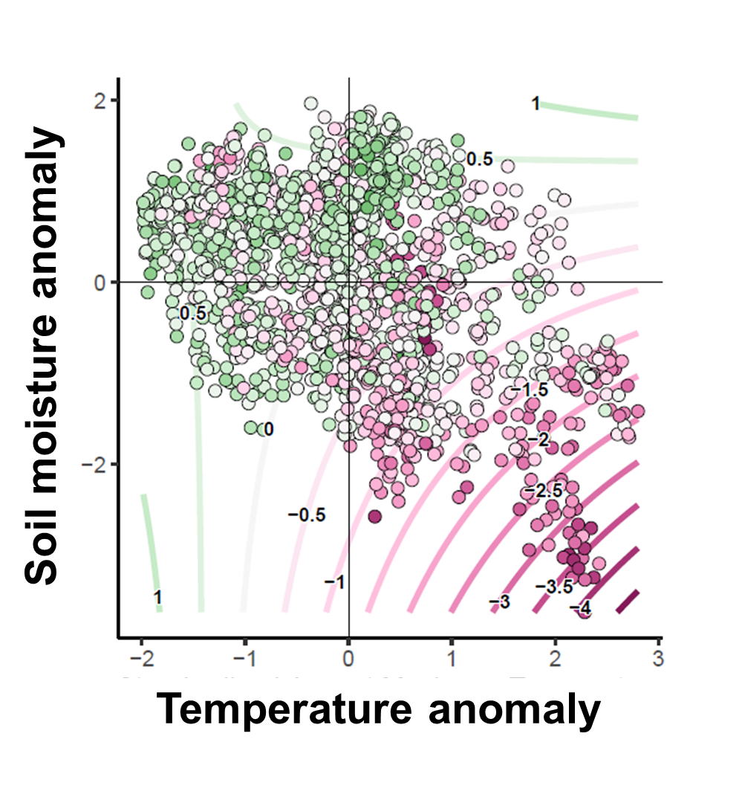
Historical trends suggest enhanced couplings will increase heat sensitivity of crops
Multi-model median of 12 CMIP6 GCMs/ESMs, 2050-2100

Slide 31
Future change in couplings exacerbates crop yield impacts of warming
Global average = 5%
Based on 12 CMIP6 GCMs/ESMs
Lesk et al. 2021 Nature Food

Slide 32
Not included in present risk assessments!
(for a variety of technical reasons we can talk about)
Lesk et al. 2021 Nature Food

Slide 33
More intense rainfall
Hotter droughts
Will this help or hurt?

Slide 34
Maize and Soy
Historically, heavy rainfall benefits yields
Yield
Hourly rainfall intensity
Lesk et al. 2020 Nature Climate Change

Slide 35
Maize and Soy
Historically, heavy rainfall benefits yields
Extremes are damaging, but very rare
small impact, on average
Yield
Hourly rainfall intensity
Lesk et al. 2020 Nature Climate Change

Slide 36
Heavier rainfall will likely benefits yields (slightly)
Benefits of more heavy rain outweigh damages from more extremes
Yield
Yield gains around 2%
Lesk et al. 2020 Nature Climate Change

Slide 37
Additional crop risks from compound extremes
Hotter droughts
More intense rainfall
+2% yields
-5% yields

Slide 38
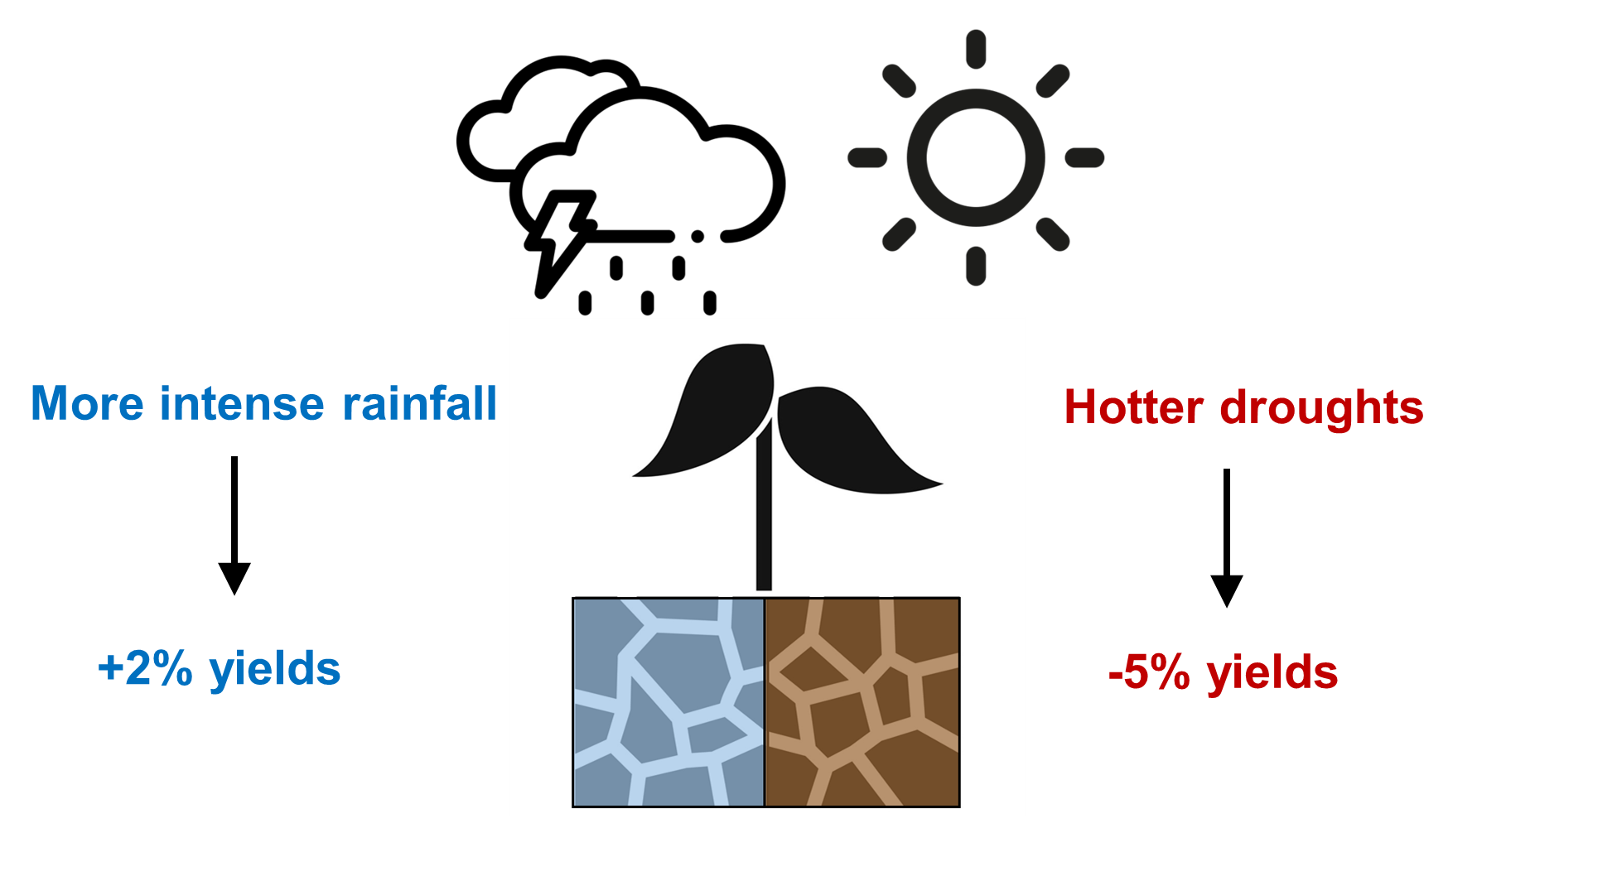
Additional crop risks from compound extremes
Only beginning to be considered in risk assessments
But clarifies effective adaptation

Slide 39
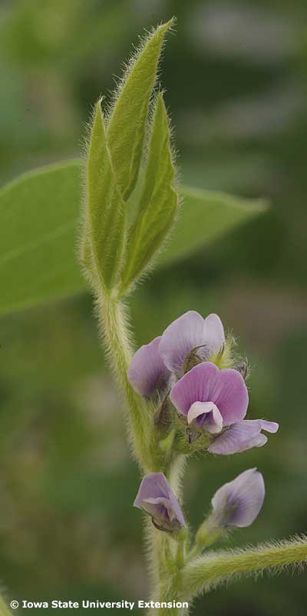
Multi-stress adaptation to climate change
Climate extremes are becoming increasingly compound
Some ‘traditional’ adaptation approaches may not work well

Slide 40
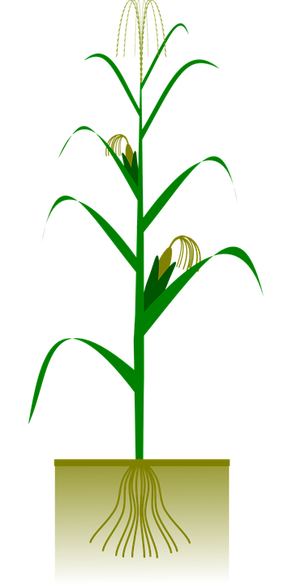
Breeding crops for drought: limit transpiration
Decrease water use
Maintain water status
Transpiration

Slide 41
Breeding crops for drought: limit transpiration
Decrease water use
Maintain water status
But crops sweat
May decrease a crop’s ability to cool itself
Transpiration

Slide 42
Potentially maladaptive for drought and heat
Drought adaptation amplifies heat stress
↓Transpiration
↑Crop temperature
Drought breeding targets at odds with heat!

Slide 43
But there are alternative targets!
Some soybean varieties limit leaf transpiration during combined heat and drought
But maintain flower transpiration (2-3°C cooling)
Flowers are very heat sensitive
Demonstrates wealth of genetic resources to breed for combined stresses
Sinha et al. 2022

Slide 44
But genetics are only a small piece
Plant-centric adaptations won’t address wider food system vulnerabilities
Are these technologies available to subsistence farmers?
Historically, mostly not
If so, often at the expense of food security (debt)

Slide 45
As ever in the climate crisis, no silver bullets

Slide 46
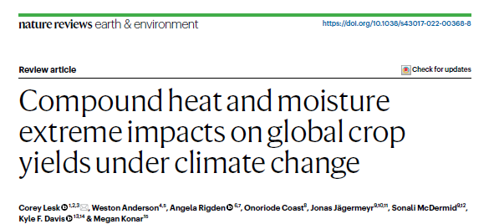
Check out review for more discussion
Corey.S.Lesk@dartmouth.edu
Thanks!
Collaborators: Radley Horton, Ethan Coffel, Jonathan Winter, Sonia Seneviratne, Jakob Zscheischler

Slide 47
2) Useful scholarship will need to be integrative
Concept of compound extremes goes much beyond heat and moisture

Slide 48
2) Useful scholarship will need to be integrative
Compound extremes = interactions among:
Climate
Water resources
Food trade
Institutional/industrial science
Geopolitics
Mitigation tradeoffs
Crops (or other essential human-natural systems)
Soils

Slide 49
Crops face increasing combinations of extremes
At the same time
Across the growing season

Slide 50
Current policies and pledges put us in the range of 2°C warming by 2100
Notes:
8-8-8-6

Slide 51
Current policies and pledges put us in the range of 2°C warming by 2100
How will that impact global crops?
Notes:
8-8-8-6

