Slide 1
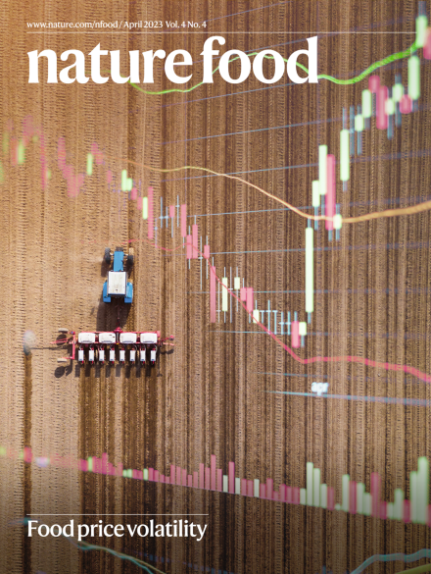
How shocks related to the war in Ukraine impact the global food system
Dr Peter Alexander
Senior Lecturer in Global Food Security
University of Edinburgh, UK
https://www.nature.com/articles/s43016-022-00659-9

Slide 2
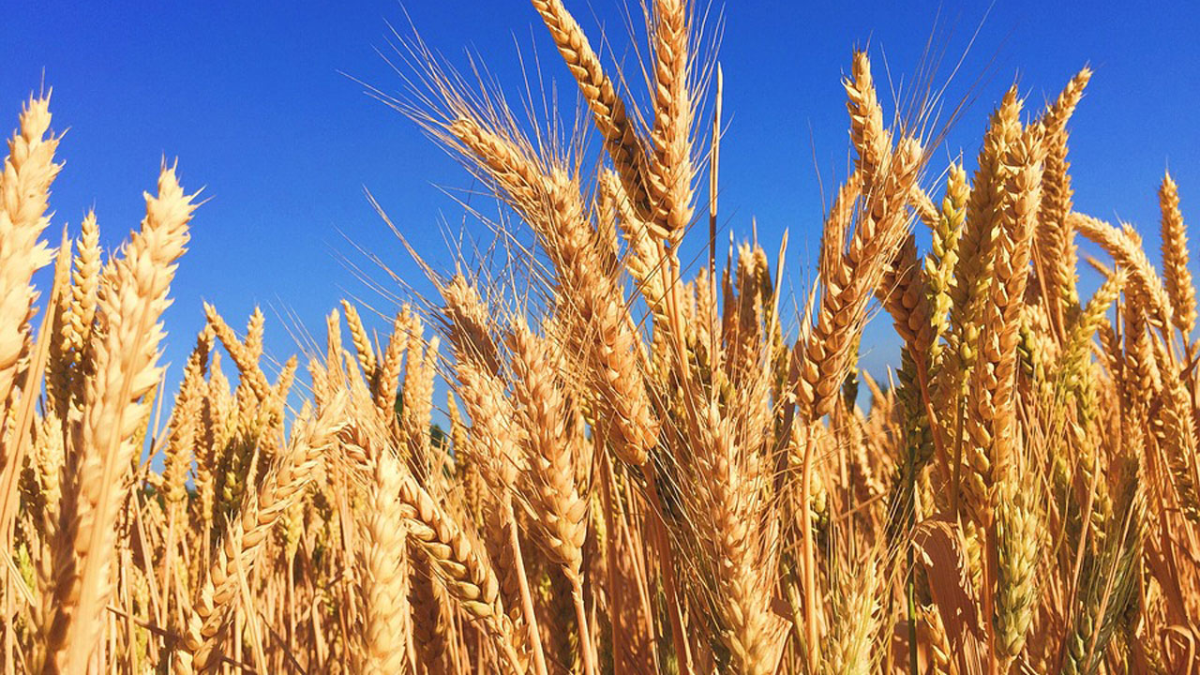
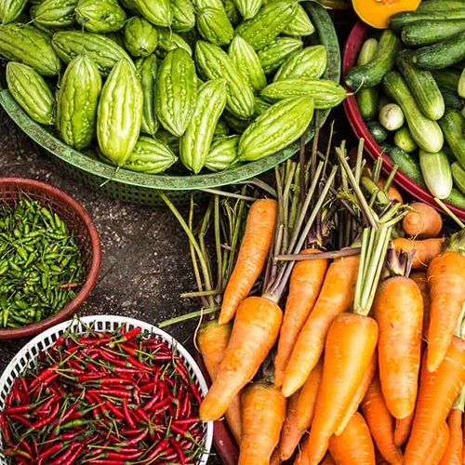
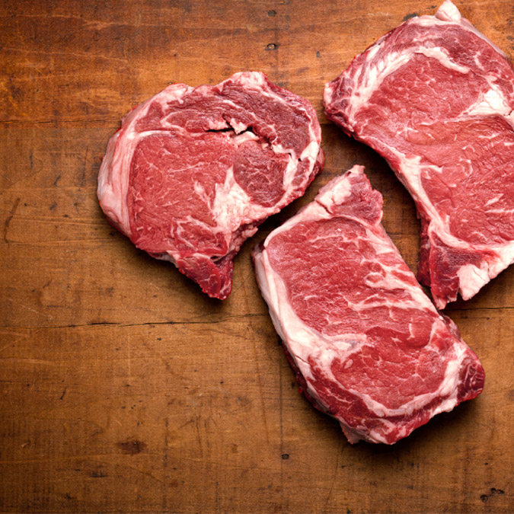
Contents
War in Ukraine as an example of trigger for cascading risks for the food system
Portrayal of food system implications of war in Ukraine
Scenarios and modelling conducted
Nutrition and environmental outcomes
Reflection on impacts from this type of shock

Slide 3
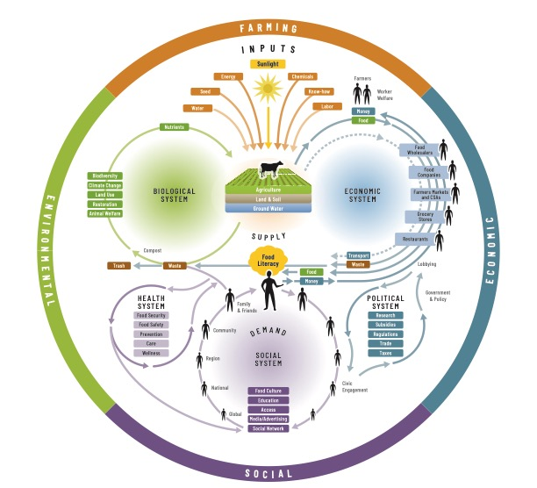
Shocks can affect different parts of the food system
Source: Nourish Life

Slide 4
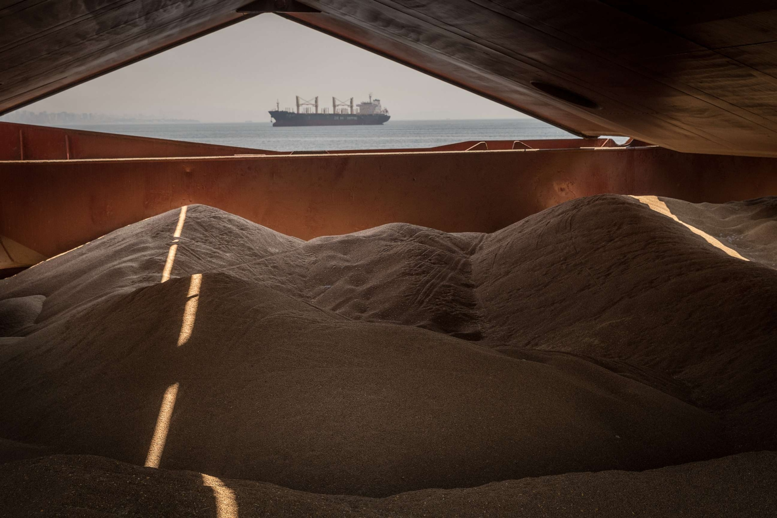
War in Ukraine: a shock to global food trade
Russia invaded Ukraine on 24 February 2022, but tensions had been building for some time.
“As a leading exporter of grain, Ukraine has seen a dramatic drop in its exports, resulting in major food security concerns for millions of people around the world”, European Council of the EU
“Russia and Ukraine produce 30% of the world's wheat supply and - prior to the war - Ukraine was seen as the world's bread basket”, BBC, May 2022
29% of global exports of wheat from Russia (20%) or Ukraine (9%), in 2021, Some countries highly exposed
  Egypt imported 84% of wheat imports from Russia and Ukraine
  WFP bought half of its grain from Ukraine
Black sea route critical for exports from Ukraine
  initially blockaded by Russia
Russia under sanctions (e.g. by EU and US)
  although not on food and fertilisers.
ABC News, 24 February 2023
Global wheat exports in 2021

Slide 5
War in Ukraine: trigger for higher agricultural input costs
  Fertiliser prices
    Inorganic N produced using natural gas
    Disruption to fertiliser exports
    Price tripled, in 12 months to May 2022
  Higher fuel prices
    Increased costs of machinery use
    Higher transport costs
  How much is caused by the war in Ukraine is unclear
Data from https://www.worldbank.org/en/research/commodity-markets

Slide 6
How is global food systems impacted and which are the main drivers?
Types of shocks
But, how are the different outcomes impacted by difference aspects of the shock? With implications for focus of responses
Example outcomes
Agricultural other land cover areas
International trade disruption
Fertiliser use and ag intensity
Fertiliser prices ↑
Food prices
Energy prices ↑
Diets
Transport costs ↑
Human nutrition and health
Need to use modelling to try to answer this question.

Slide 7
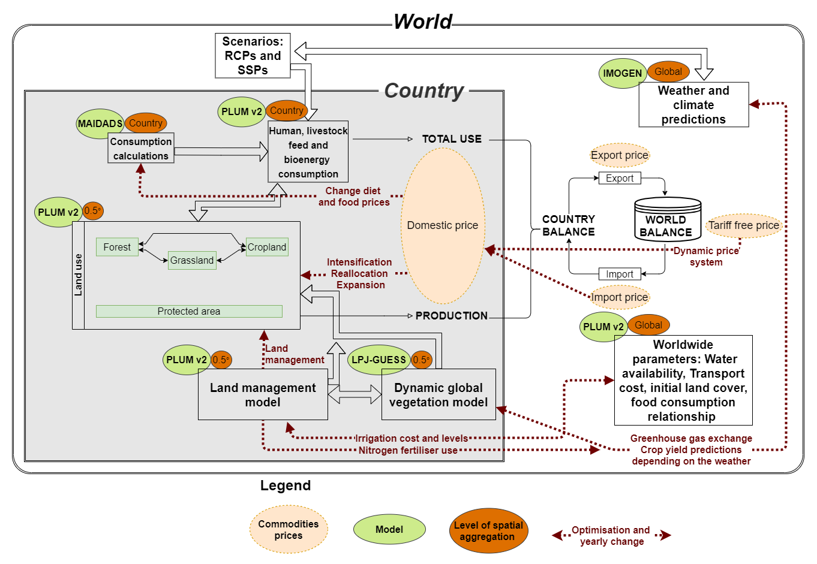
Land System Modular Model (LandSyMM)
Model of the global food and land system
  couples land use decision making, food demand, global trade, ecosystem processes, biodiversity, and the climate system.
For further details see https://landsymm.earth
Demand
Land use decisions
International trade
Vegetation/crop dynamics
Notes:
In PLUM, the first step is to use the socioeconomic inputs to estimate @ demand for 8 commodities. @ 6 crops—wheat, maize, rice, oilcrops, pulses, and starchy roots—@ and 2 livestock categories—ruminants (such as cattle) and monogastrics (such as pigs and chickens). Demand for each country can be satisfied by either @ domestic production or international trade—depending on potential yield, global commodity and input prices, and costs of land conversion. Outputs from PLUM include @ the fraction of a grid cell that should be converted to cropland, pasture, or unmanaged land, @ as well as how much nitrogen fertilizer and irrigation should be applied, what crops should be grown, and how much feed should be used to raise livestock.
Socioecon data → demand for commodities
Demand satisfied by domestic production or trade
Strategy depends on potential yield, commodity & input prices, and cost of land conversion
Outputs land use, inputs, crop mix, feed

Slide 8
Scenarios exploring two routes for impacts
Scenarios designed May 2022
Impact types
A. Impact on food export market
Restrict exports from Ukraine and Russia to between 50 and 100%
B. Energy prices
Tripling of fertiliser cost
Increase management intensity cost by 50% (for fuel)
Increase transport costs by 50% (for fuel)
Scenarios

Slide 9
Food commodity prices increased by shocks

Slide 10
Impact on total food price inflation
Percentage change 2021-2023 in food commodities consumed in each region with constant 2021 consumption quantities (i.e. a Laspeyres index). Median ensemble values, and 90% quantile range in bracket shown.
Region | Scenario
 | Export restriction shock | Energy price shock | Energy and export shocks
East Asia & Pacific | 2.4 (1.1-5.4) | 77.5 (62.6-97.7) | 83.8 (62.5-108.2)
Europe & Central Asia | 2.5 (1.4-5.5) | 69.4 (57.9-87.7) | 77.3 (58.1-100.5)
Latin America & Caribbean | 1.8 (0.8-4.3) | 66.8 (53.8-83.8) | 71.6 (52.4-92.0)
Middle East & North Africa | 3.2 (0.9-7.1) | 72.6 (58.7-87.4) | 82.1 (63.2-101.3)
North America | 2.8 (1.4-6.1) | 72.4 (60.2-87.9) | 81.0 (61.6-100.9)
South Asia | 3.3 (0.5-6.7) | 75.4 (61.2-91.0) | 84.7 (65.4-101.4)
Sub-Saharan Africa | 2.6 (0.5-5.0) | 72.2 (57.1-85.0) | 79.1 (60.6-96.3)
World | 2.6 (0.8-5.9) | 74.1 (59.2-89.8) | 81.2 (61.5-100.4)
Implies an annual food price inflation of 34.6%

Slide 11
Large price increases create human health and nutritional consequences
Rising malnourishment and related deaths.
Undernourishment of 60-110 million additional people
0.4 – 1.0 million net annual additional deaths globally, despite some reduction in obesity related deaths.

Slide 12
Global environmental impacts: deforestation

Slide 13
Environmental impacts: production input substitution
Land use changes at 2030 for energy and export shocks

Slide 14
Telling the story another way: Domestic production, stocks and substitution
Reporting, e.g. “Russia and Ukraine produce 30% of the world's wheat supply” (BBC), is wrong
  Even when correctly stated as global exports emphasis is quite misleading
International trade only part of food supply
  76% of wheat produced and consumed domestically (83% for cereals)
  Exports from Russia and Ukraine provided 7.6% of rest of the world supply for wheat (3.5% for cereals)

Slide 15
Telling the story another way: Domestic production, stocks and substitution
Stocks - Buffer losses
  Wheat: 278 Mt stock in rest of world - equiv. 5 years RUS+UKR export
  Cereals: 803 Mt stock in rest of world - equiv. 8 years RUS+UKR export
Substitution - Cereals not just used for food
  Wheat: 148 Mt feed and 92 Mt other uses (total 31%)
  Cereals: 1020 Mt feed and 481 Mt other uses (total 53%)

Slide 16
More recently
  Inputs prices shock largely gone
  Food commodity prices have also returned closer to historical levels
  Evidence of reductions in fertiliser demand and crop planting, which may having contributed to price spikes
  Model work did not simulate removal (or moderation) of energy price shock
Data from https://www.worldbank.org/en/research/commodity-markets

Slide 17
Final remarks
War in Ukraine is an example of shock triggering cascading impacts to the food system
Need to consider not just climate/weather events, but geopolitical, economic, technological, etc. shocks/stresses
In the case of war in Ukraine, energy price rises a much greater impact on global food supply, health & environment than Ukraine/Russia export restrictions
Potential for health of millions to be impacted, as well as environmental harms
Academic publication cycle not good at responding to real-world events

Slide 18
Thank you
https://landsymm.earth/
https://www.nature.com/articles/s43016-022-00659-9

