Slide 1
Read Me
This slide contains guidance and information for presenters. It is hidden and can be deleted for presentations, if needed.
Each slide has key points, messages and background information in the notes section below the slide.
Presenters are respectfully requested to ensure that these key messages are included in their speaking notes / presentation.
That said, we also understand that presenters may choose to add content to enhance the relevance and currency of these slides for the particular audience. Indeed we encourage presenters to do this.
If you have any questions or require clarity on any aspects, please contact:
climatefuture@wcrp-climate.org

Slide 2
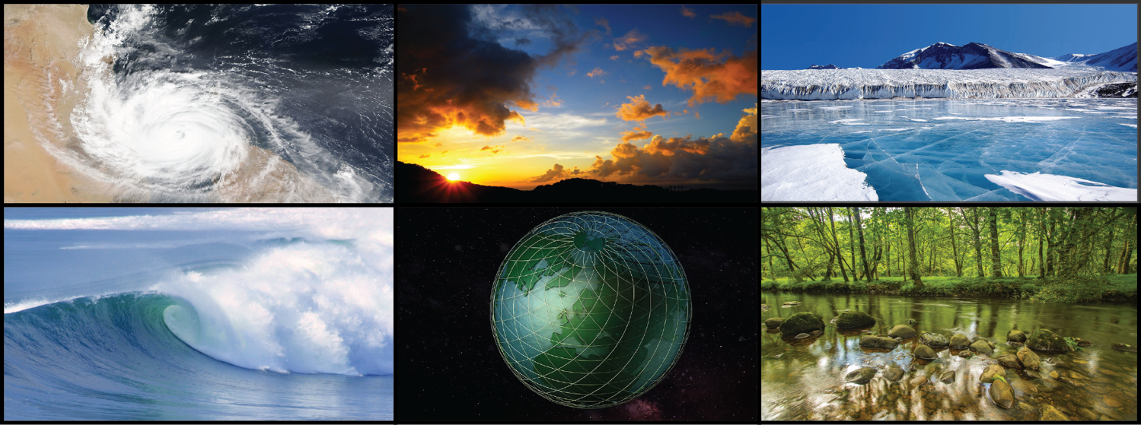
WORLD CLIMATE RESEARCH PROGRAMME
Our Climate Future
Speaker Name
Notes:
Introduction to the Presentation
Key Points:
Welcome participants; Speaker to introduce themselves, including their link to WCRP.
Preamble about WCRP (if appropriate to context of talk):
The World Climate Research Programme (WCRP hereafter) is taking the lead in ensuring that the global, regional and national climate research communities create the enduring, rigorous and scientific foundation required to meet the urgent demand for robust and useful regional climate information.
Through its new Strategic Plan, the WCRP is reorienting itself to ensure that there is the science, knowledge and understanding to target frontier problems, such as disaster risk reduction, climate adaptation, mitigation, and intervention strategies, that need to be solved together with partners, for which WCRP’s core research continues to be essential for developing answers. The integral role of WCRP in developing knowledge of the climate system will result in an increased understanding of the Earth system, including the complex interactions between the physical environment and human society.
3. Purpose of talk:
Through this talk, and slides, our aim is to introduce and describe WCRP’s new Strategic Plan, for the period 2019 to 2028.
In this way, we are providing “a roadmap” for future climate research and priorities. It is very important that the WCRP brings our broader research community along with us on this journey; and its equally as important that we bring partners sponsors along as well; that we engage with our national funding agencies and users of climate knowledge and information in regions, at national levels (e.g. National governments) and globally (e.g. IPCC).
4. Structure of talk/slides:
This is a high-level presentation – so it doesn’t go into detail. It is designed to encourage questions, discussion both at the end of the talk as well as among our community after this presentation has been given.
There are about 20 slides, so it will take 20 – 30 mins.
It is organised into a high level WCRP strategic overview (Slides 4 – 7); an introduction to our emerging plan for implementing the Strategy (Slides 8 – 16); and finishes with our timeline and how we would like to engage with our research community, our partners and co-sponsors, and our funders and national agencies.

Slide 3

Introduction
The World Climate Research Programme (WCRP) leads the way in addressing frontier scientific questions related to the coupled climate system — questions that are too large and too complex to be tackled by a single nation, agency or scientific discipline.
Notes:
Introduction to the WCRP
WCRP is pursuing – through international coordination – frontier scientific questions related to the coupled climate system that are too large and too complex to be tackled by a single nation, agency, institution, or scientific discipline.
This is really the unique “value proposition” for WCRP – because it takes a WORLD research program to do this scientific research into the global climate system, which includes the oceans and atmosphere; land and cryosphere; their interactions and feedbacks with human systems and natural ecosystems. It involves observations, analyses, simulation and modelling.
Most importantly it requires not only cooperation and coordination , but also deep collaboration around the world and across disciplines. WCRP brings together scientists from (<your country or region>, if appropriate) and around the world, at all stages of their careers, to advance our understanding of the multi-scale dynamic interactions between components of the climate system and external forcing, as well as addressing and studying the role of humans on climate and society.
NB: Text on slide is from the opening introduction in the WCRP Strategic Plan

Slide 4
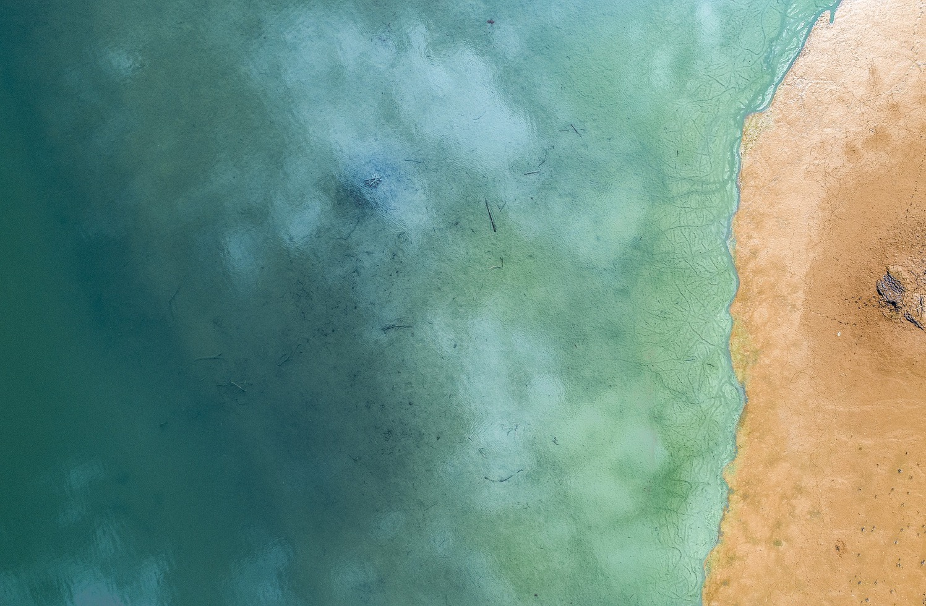
Introduction
For almost 40 years WCRP has been the leading initiative dedicated to coordinating international climate research and advancing our understanding of the climate system and how it is affected by human activities.
The next decade will bring challenges that can only be addressed through a worldwide coordinated effort; involving co-design and stakeholder engagement conducted by a prepared scientific workforce.
Society requires decision-relevant, evidence-based climate information to support mitigation strategies and adaptation choices.
Notes:
Introduction to the WCRP cont.
WCRP was established over 40 years ago, in 1980; to provide the leadership and organizational structure to facilitate this coordination and therefore advance our understanding of the Earth’s climate system and how it is being modified by human activities.
The focus over the last four decades was on understanding the role of human activities on the climate system and advancing the predictability of the climate system.
Now, looking forward to the decades ahead; international research will continue to be needed to advance this understanding. WCRP also recognizes that there are new challenges emerging to meet society’s needs for climate information that can be used in decision-making, managing climate risks, and supporting climate mitigation and adaptation strategies.
These new challenges require new science, new technologies, and new ways of co-designing knowledge and information so that it is relevant for our user communities.
It will require a worldwide coordinated effort conducted by a prepared scientific workforce; and supported by strong global partnerships.
This means that there are exciting opportunities as well, to develop new partnerships for research and operations, to build and use exciting observing and computing technologies, and to develop scientific capabilities and deeper global collaboration.
NB: Text on slide is from the WCRP Strategic Plan

Slide 5
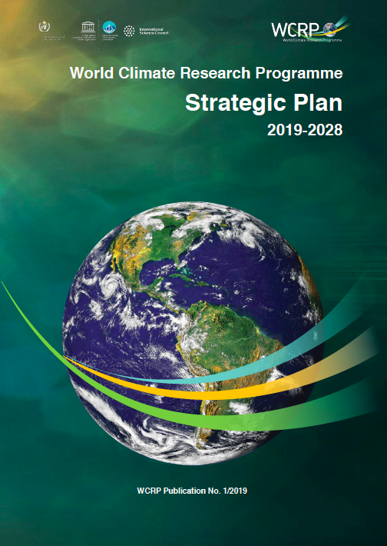
The Future of WCRP
WCRP Strategic Plan
2019 - 2028
www.wcrp-climate.org/wcrp-sp-overview
Notes:
To meet these challenges and opportunities over the coming decades, WCRP has developed its decadal Strategic Plan; to ensure that climate science provides the information necessary to achieve a more resilient, sustainable and equitable world.
Our Strategic Plan is available online; we encourage anyone who has not seen it to take a look…
Some background notes (for the Presenter):
This Strategic Plan was developed over several years (starting 2018 or earlier) and shaped very much by the findings of an independent and external review of the WCRP in 2017.
WCRP received many comments from the scientific community as it developed the Strategic Plan
Our co-sponsors also reviewed and commented
This Plan was launched in 2019, as part of celebrating WCRP’s 40th Anniversary [and the video that provides an overview and introduction to the WCRP. Its 3.26 mins in length]
If you wish, you may wish to show the WCRP Film (it is just over 3 mins): https://www.wcrp-climate.org/about-wcrp/wcrpfilm

Slide 6

The New WCRP Strategy
The Vision (our aspiration)
A world that uses sound, relevant, and timely climate science to ensure a more resilient present and sustainable future for humankind.
The Mission (what we do, our purpose)
Coordinate and facilitate international climate research to develop, share, and apply the climate knowledge that contributes to societal well-being.
Notes:
Our new WCRP Strategy therefore envisages a world that uses sound, relevant, and timely climate science to ensure a more resilient present and sustainable future for humankind [VISION]
And the WCRP’s purpose, or Mission, is to coordinate and facilitate international climate research to develop, share, and apply the climate knowledge that contributes to societal wellbeing [MISSION]

Slide 7
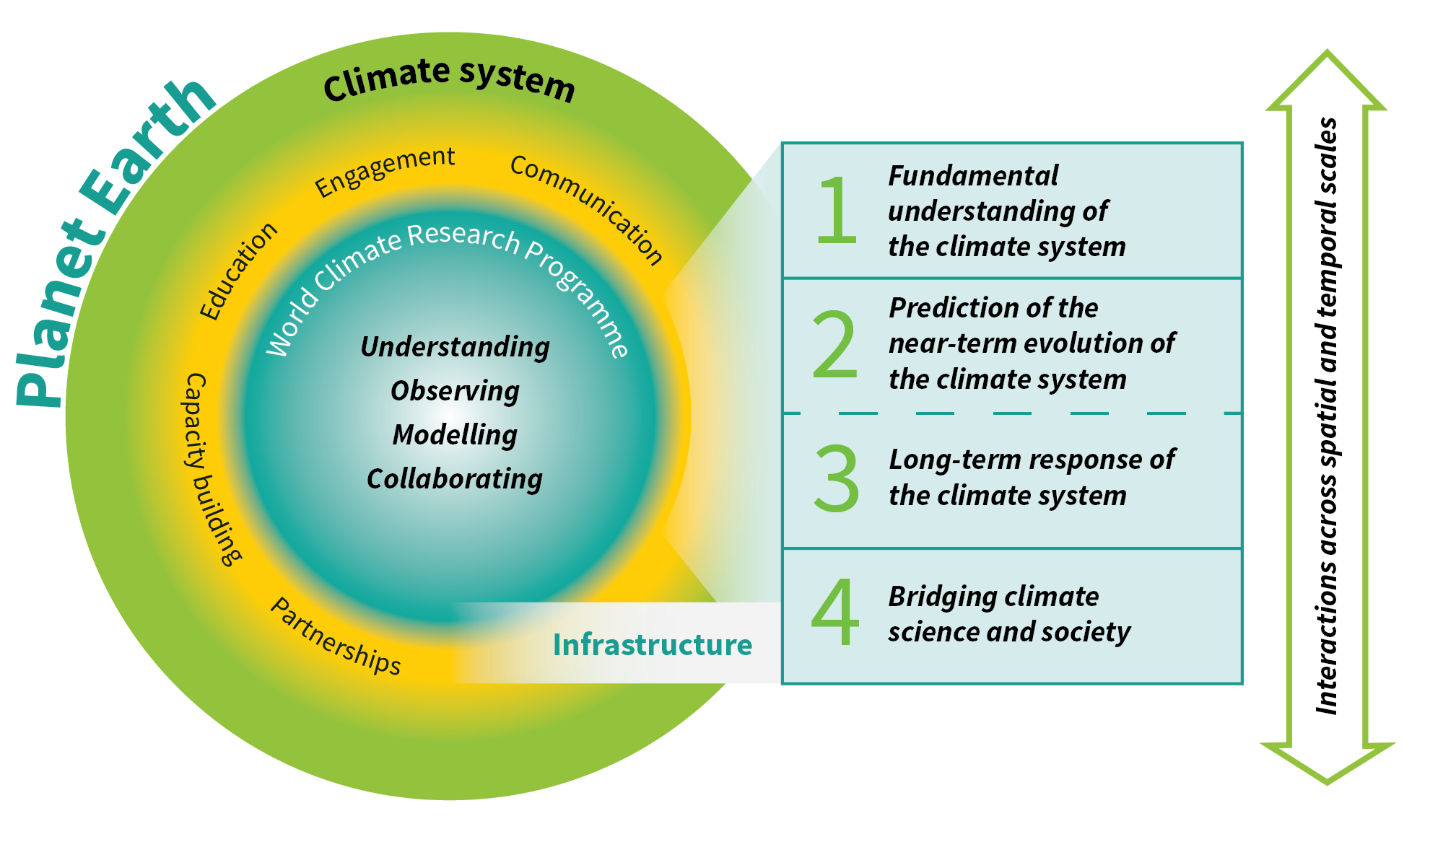
WCRP Strategic Plan: Overview
Scientific Objectives
A hierarchy of simulation tools
Sustained observations and reference data sets
Need for open access
High-end computing and data management
www.wcrp-climate.org/wcrp-sp
Notes:
The WCRP Strategic Plan is based on four scientific objectives that will underpin the next decade of climate science. These objectives are informed by the most pressing contemporary climate knowledge needs, as well as advancing the core science and capability needed to prepare for those challenges that society cannot foresee:
To advance fundamental understanding of processes, variations and changes in the climate system
To predict the near-term evolution of the climate system
To refine our ability to anticipate future trajectories of climate system change
To support the development of theory and practice in integrating natural and social sciences, and thereby more effectively build a bridge between climate science and societal needs
Achieving these objectives relies on the WCRP community working together to facilitate Collaboration and advance Understanding, Observing and Modelling and Collaborating – these are at the very core of the WCRP [inner circle]
WCRP research spans a range of spatial and temporal scales, and especially interactions across this range of scales, [arrow on RHS] and depends critically on robust infrastructure (e.g. observing and modelling infrastructure, but also for data sharing and management communication and outreach [infrastructure text box]
WCRP connects with the wider science community and with a range of stakeholders through Partnerships, Capacity building, Education, Engagement, and Communication [middle circle]. This is important because the WCRP also informs the development of policies and operationally focused climate services; and it promotes science capacity building and education - often through partnerships with other programs such as Future Earth.
Background Note: Could point out if needed that the circle describes the scope of the WCRP, i.e. the climate system as part of the global Earth System. This highlights the importance of the inter-connectedness of the Earth System [outer circle]

Slide 8
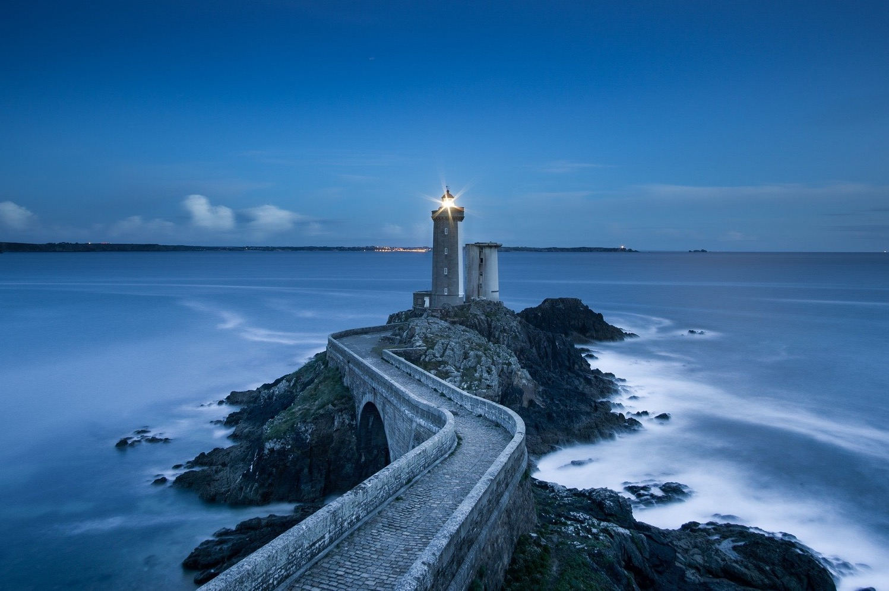
Implementing the WCRP Strategy
WCRP will prioritize its science and implement its Strategy by pursuing a series of Lighthouse Activities, along with other core research activities, to deliver and achieve critical outcomes over the next decade
Notes:
While the Strategic Plan provides a high-level view of the science, infrastructure, and collaborations needed to ensure our climate science will meet the knowledge and information needs of society; our task since 2019 is to develop a plan for implementing the Strategy.
This requires us to identify and prioritize those critical research activities needed over the next decade to achieve the outcomes and aspirations of our Strategy.
The next set of slides describe these critical research activities – our Lighthouse Activities and the research priorities that these activities will address.
Some Background Notes (for the Presenter):
Pursuing those Lighthouse Activities will empower WCRP, over the next decade and beyond, to provide scientific outcomes that are critical to support emergent societal needs for robust and actionable regional to local climate information. Delivery of robust and consistent regional climate information to stakeholders is needed to inform, for example, the implementation of the Sustainable Development Goals, disaster risk reduction, and climate adaptation, mitigation and intervention strategies. In recognition of this need, WCRP identifies the following Implementation Priorities (next two slides)

Slide 9
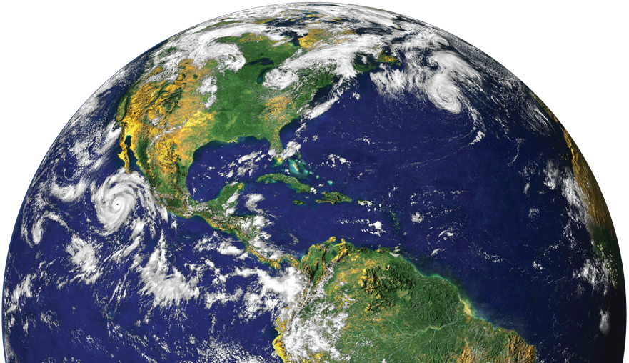
Implementation Priorities
Foster and deliver the scientific advances and future technologies required to:
  Advance understanding of the multi-scale dynamics of Earth’s climate system
  Quantify climate risks and opportunities
Notes:
Our implementation plan needs to clearly articulate those research priorities that will guide and direct the science needed to enable rapid progress towards providing societally-relevant climate information.
After consultation and discussion with the WCRP leadership and community, we landed on two high level research priorities, that we call our “Implementation priorities”.
These provide guidance and direction to the science needed so that robust and actionable regional to local climate information can be delivered, in support of, for example:
Implementing the UN’s SDGs
Informing Disaster Risk Reduction plans such as the Sendai Framework
Climate adaptation and mitigation policies and agreements (noting that mitigation does include climate intervention)
These Implementation Priorities are consistent with, but not the same as, the Scientific Objectives in the WCRP Strategy.
The first Implementation Priority (shown here) acknowledges the ongoing and critical need for science and technological advances required to improve our understanding of the climate system; especially the multi-scale dynamics and feedbacks. This is consistent with, and aligned to, several of the scientific objectives in the WCRP Strategy, and reflects that there are still significant, fundamental knowledge gaps.
Furthermore, our stakeholders are asking for climate information that helps quantify risks associated with a changing climate. And so we have prioritized research into:
Understanding how extremes change with climate change
How climate knowledge, data and information can best be used to quantify risk
How this knowledge and information can be integrated into risk assessment frameworks and also enable opportunities to also be identified.

Slide 10

Implementation Priorities
  Develop new institutional and scientific approaches required to:
  Co-produce cross-disciplinary regional to local climate information for decision support and adaptation
  Inform and evaluate mitigation strategies
Notes:
The second Implementation Priority is intended to provide direction to the climate science and / or institutions needed to effectively inform societal actions and decisions.
For example, when considering climate mitigation approaches and policies:
It is not for WCRP to develop or implement mitigation policies; but those organisations and societal actors who do design and implement such policies need to be guided and informed by the latest and best quality climate science – alongside other sciences and technologies of course.
Mitigation includes geoengineering; a form of climate intervention that absolutely needs WCRP science (along with consideration of liabilities, ethics, technologies etc).
“Evaluate” includes the advice we provide on how to best to monitor and track the efficacy of mitigation policies and agreements like the Paris Agreement (as is already done, for example in the case of the Montreal Protocol or Stockholm convention)
WCRP are also very aware that to co-produce knowledge and information, and ensure this is used to improve decision making and adaptation responses, new or changed institutional approaches are often required. Can we, with our partners, provide guidance and lead the innovation required, to build or propose such new institutions?
We welcome your questions and discussions about these priorities

Slide 11






First Draft of a New WCRP Structure
Joint Scientific Committee
WCRP Secretariat
Lighthouse Activities
Major experiments, high visibility projects,
infrastructure building blocks
Ambitious and exciting
Fixed-term Projects
Conferences and Workshops
Reference Datasets,
Evaluations and Benchmarking
Diversity- and Capacity-building: ECRs, Regions
Rapid Updates, Syntheses
Assessments, Gap Analyses
Communications and Outreach
Ongoing and additional activities and fora
International Offices
WCRP Communities
Enduring Capabilities, Homes for Expertise
Climate and Cryosphere
Climate and Ocean Variability, Predictability and Change
Global Energy and Water Exchanges
Stratosphere-troposphere Processes And their Role in Climate
Earth System Modelling and Observational Capabilities (new)
Regional Climate Information for Societies (new)
Notes:
Our Implementation Plan also considers the structure of WCRP, and the need to modernize this structure so that it is “fit-for-purpose” to meet the challenges and opportunities described in our Strategy.
After several rounds of consultation with the WCRP leadership and some of the WCRP community, we have developed this first draft of a new WCRP structure.
Key Points:
Overseeing the science directions of the WCRP is the Joint Scientific Committee, or JSC. “Joint” refers to the fact that the WCRP has three sponsors: the World Meteorological Organization; the International Science Council, and the Intergovernmental Oceanographic Commission of UNESCO.
The WCRP Secretariat supports both the JSC and the WCRP’s research activities and groups.
The yellow pillars represent the foundation of WCRP, which are our scientific communities – across oceans, cryosphere, land and atmospheric science domains; process studies, modelling and observations; and regional climate information. While meeting our research priorities requires these discipline-based communities to work together to advance multi-disciplinary research; these communities also need a home where their capabilities are nurtured and sustained. These homes are currently our Core Projects and CORDEX. As part of our implementation,
Our Core Projects will be doing their own review and assessment to consider ways that they can refurbish and renovate their disciplinary homes. But regardless, our structure will always ensure that these enduring core capabilities will be represented in our structure
We are proposing the addition of two new “homes”: One for our Earth System Modelling and Observational Capabilities and one for our Regional Climate Information capabilities. These new homes reflect the contemporary research needs of WCRP: i.e. the fusion of models and data; and the importance of regional information that meets societal needs.
4. A new initiative are the Lighthouse Activities – these are major experiments, or high-level projects, or infrastructure building blocks that are critically important for addressing our research (Implementation) priorities and our scientific objectives. The next two slides describe these Lighthouse activities in more detail. For here, its important to note that these Lighthouse Activities are where much of the multi-disciplinary research will be done – drawing on all of the capabilities across our WCRP communities.
5. Our International (Project) Offices will continue to support our WCRP Communities, but also support the Lighthouse Activities.
6. And lastly, it is very important to say that there are many other ongoing activities and fora that WCRP will continue to do – under both the Lighthouse Activities and by WCRP communities.
This is still a draft – our soft implementation process will seek feedback and through this, we will refine this draft structure

Slide 12
Proposed Lighthouse Activities
Explaining and Predicting Earth System Change
My Climate Risk
Safe Landing Climates
WCRP Academy
Digital Earths
Provisional
Names
These draw on WCRP’s fundamental science, critical
infrastructure and strategic partnerships
Notes:
One of the most exciting new ideas being developed are the Lighthouse Activities. They are intended to be:
Major experiments, high-visibility projects, or infrastructure building blocks
Activities that truly bring together the capabilities (scientific, technical, infrastructure) from across the whole of WCRP and will likely only be able to be done with partners.
So there is a need to develop enabling structures and for a that enable partnerships and engagement – “interfaces” to other disciplines and programs.
We expect that the five proposed Lighthouse Activities will provide the science required by WCRP to deliver its outcomes, and to ensure that societal needs are being addressed, over the coming decades.
At this stage, they exist as 2-page proposals and are fully described in the Hamburg Workshop Report: https://www.wcrp-climate.org/WCRP-publications/2020/0220-WCRP_Hamburg_Workshop_Report.pdf
Three of these (Earth System Change, My Climate Risk, and Safe Landing Climates) are clearly focussed with their own objectives and outcomes; while two of them (Digital Earths and WCRP Academy) are more cross-cutting in that they will both support and draw upon the research done in the three “vertical” Lighthouse activities.

Slide 13
Proposed Lighthouse Activities
To design, and take major steps toward delivery of, an integrated capability for quantitative observation, explanation, early warning and prediction of Earth System Change on global and regional scales, with a focus on multi-annual to decadal timescales.
Earth System Change
To develop a new framework for assessing and explaining regional climate risk to deliver climate information that is meaningful at the local scale.
My Climate Risk
To explore the routes to climate-safe landing 'spaces’ for human and natural systems, on multi-decadal to centennial timescales; connecting climate, Earth system and socio-economic sciences. Explore present-to-future “pathways” for achievement of key SDGs.
Safe Landing Climates
To develop a digital and dynamic representation of the Earth system, optimally blending models and observations, to enable an exploration of past, present and possible futures of the Earth system.
Digital Earths
To establish one or more targeted capacity exchange climate programmes, working with one or more of the other lighthouses and established climate education providers, including universities.
WCRP Academy
Notes:
The Lighthouse Activities need further “fleshing out” especially:
Review and refine the titles – these are provisional names for now
Detailed science plans
Key partners
Etc ...
But here are the proposed, high level, objectives for each activity.

Slide 14


High-level Science Questions
Aggregation and scaling
Aerosols
How can we better understand climate sensitivity?
How to improve climate modelling and process understanding?
What is the impact of different forcings?
What fundamental
science is needed?
How can we communicate uncertainty better?
How can we make predictions more useful and relevant to society’s needs?
Disruptive technology
Parameterization
How can we improve climate predictions?
What opportunities do new technologies provide?
What will happen in the high latitudes?
Considering all scales
What will be the impact of Geoengineering?
Is response action needed?
What does society need to know?
Data-model fusion
What can we expect in regional climate hotspots?
What will happen to low-lying islands?
Prediction
Attribution
How will reservoirs change in the future?
Heat
How will climate extremes occur in the future?
What is the interaction between climate and development trends?
Urbanization
Carbon
Evolution
Water
Land-use
Change
Notes:
The Lighthouse Activities provide a framework for addressing many of the high-level science questions that were identified as high priorities by the WCRP.
We fully anticipate that the more detailed science plans of these Lighthouse Activities will include answering these science questions.

Slide 15
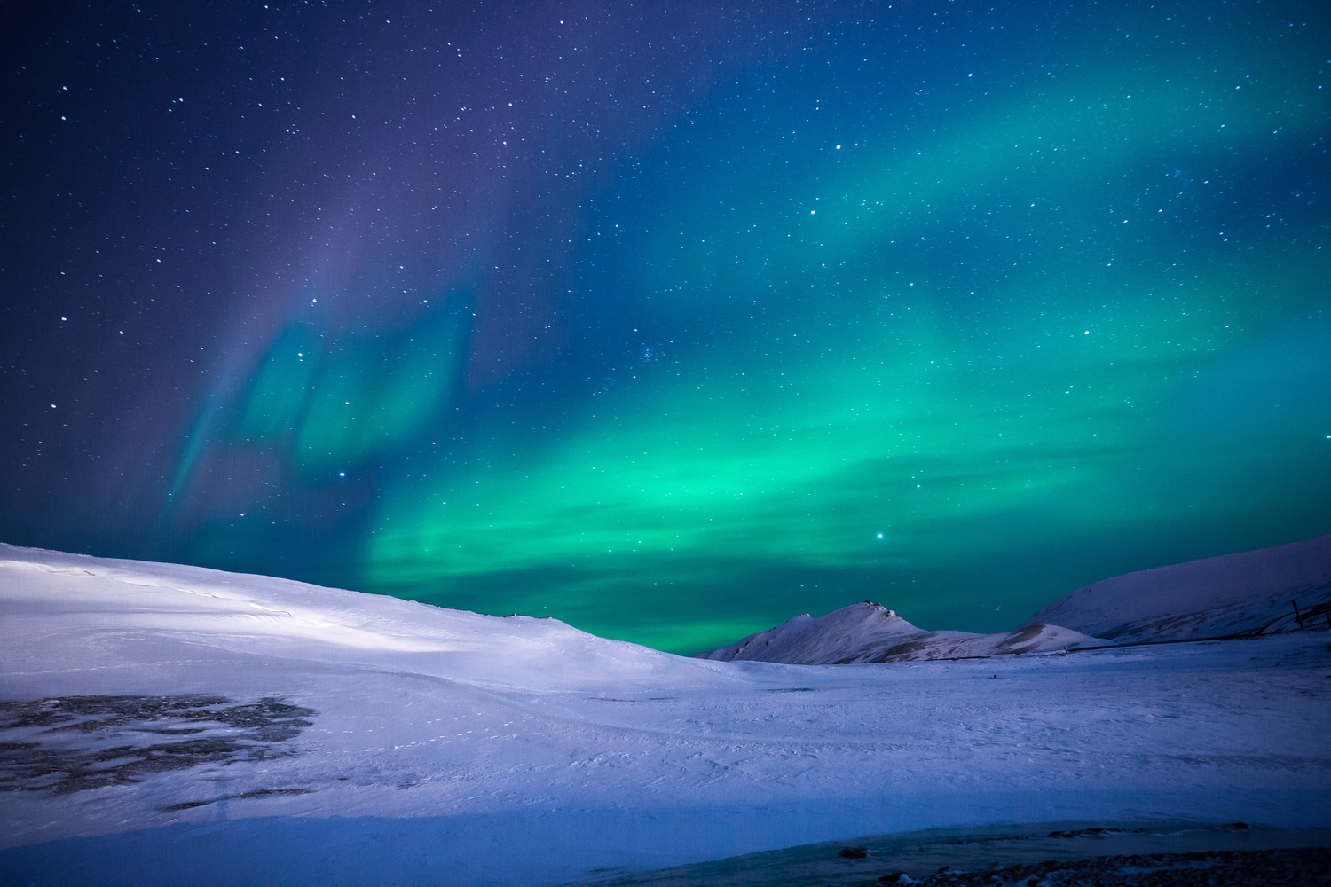
Consultation and Co-design
In the coming months, WCRP will be consulting with the global community on its strategy, new activities and proposed new structure.
We will create new “homes” for modelling and observations and for regional climate information for society.
Lighthouse Activities and other core research activities will be co-designed with our community and partners to ensure that the outcomes meet the urgent needs of society.
Notes:
The next phase of our implementation involves outreach and engagement; consultation and co-design.
The next few slides explain the timing for this and how you can join us on this journey.
In the coming months, we will also be creating our two new homes … but actually we will likely be occupying these homes before they are fully finished. This is because the challenges ahead of us are so pressing that we cannot afford a hiatus.
And importantly, we will also be co-designing our priority research activities – especially the Lighthouse Activities – with our community and partners.

Slide 16
Soft Transition Timeline
JSC-41 JSC-42 JSC-43
Consultation on proposed WCRP structure and elements
Assessment of all existing WCRP activities
New “homes” decided and in place
Lighthouse Activities initiated
Old elements fade out
New WCRP structure in place
Implementation plan written and continuously updated
2020 2021 2022
WCRP Extraordinary
Session
Late 2020
Sunsetting WCRP Grand Challenges and activities
JSC-n = WCRP Joint Scientific Committee Sessions (meetings)
Notes:
Here is the timeline.
Note / Key Points:
We have already soft-launched the Implementation Plan, with a 2-year timeline to transition us from here to a the new WCRP structure in full operation by late 2022
This year (2020), we will focus on consultations, to explain and get feedback on our proposed new structure and elements, and to review all existing activities – like our Core projects
Over the next 12 months (i.e. now to mid-2021) we will be:
Signing off (deciding) on the new homes and establishing these
Co-designing and initiating the Lighthouse Activities
And starting to transition out of those projects, activities and structures that are not part of the new WCRP
4. Starting in 2021, we will also being “sunsetting” the WCRP Grand Challenges and activities
5. So that from mid-2021, we anticipate that the new WCRP will be in place, and fully operational
Two further important pieces of information for our community:
We are planning a WCRP Conference to report on and celebrate the achievements of the science done under the current WCRP (especially the Grand Challenges). This is planned for late 2022.
The Implementation Plan is not a set and forget document; rather it is a living plan that will be written over the next 1-2 years, and continuously updated

Slide 17


Our Joint Climate Future
WCRP’s community stands ready to work with co-sponsors and partners, and support Nations, to ensure that society can access the climate knowledge and information needed.
To achieve this, WCRP seeks to engage the next generation of scientists and welcomes the support of sponsors and funders.
Notes:
The WCRP community wants to work with all of our partners and co-sponsors, and support our national agencies, towards a common goal of ensuring that our climate knowledge and information is accessible and relevant to meeting your needs.
To do this will require the best minds across the physical climate sciences, social sciences and beyond; and actively engaging early career researchers – the next generation of scientists.
We also need ongoing support from our sponsors and funders.

Slide 18
We need you!
Here is how you can help shape
the future of WCRP…
Engage with us to co-design and co-develop the Lighthouse Activities and other projects via a series of virtual brainstorming workshops involving our partners and the global community of climate researchers - from early career to our most experienced scientists.
We welcome your suggestions, feedback or questions on our proposed new WCRP structure and elements.
Sponsors, Partners and Nations: WCRP is ready and willing to support your needs for better decision-making, risk management and climate adaptation by:
Working with you to jointly identify research frontiers
Directing our scientific expertise towards new institutional, scientific, and technological approaches
So you can take advantage of new opportunities, and develop and evaluate climate mitigation strategies (including proposals for climate intervention)
See last slide for information on how you can connect with us
Notes:
So, obviously, the WCRP communities cannot do this alone; we need you to join with us on this journey …
Here is how you can help shape the future of the WCRP:
Engage with us via a series of virtual brainstorming workshops that we will be running to co-design new research activities, especially our Lighthouse Activities
Provide suggestions and feedback, or ask us questions, about our proposed new WCRP structure – this is the structure described earlier
To our Sponsors, Partners and National Agencies: we stand ready to work with you to:
Identify new research frontiers
Direct our scientific expertise to new scientific, technological and institutional approaches
All so that you are better able to quantify and manage climate risk; take advantage of opportunities; and develop and evaluate climate mitigation strategies.
We are keen to hear from you:
Are these areas of interest, that we can work with you to refine and develop?
Are you interested in investing resources to help realise significant benefits for you, for a modest investment?

Slide 19
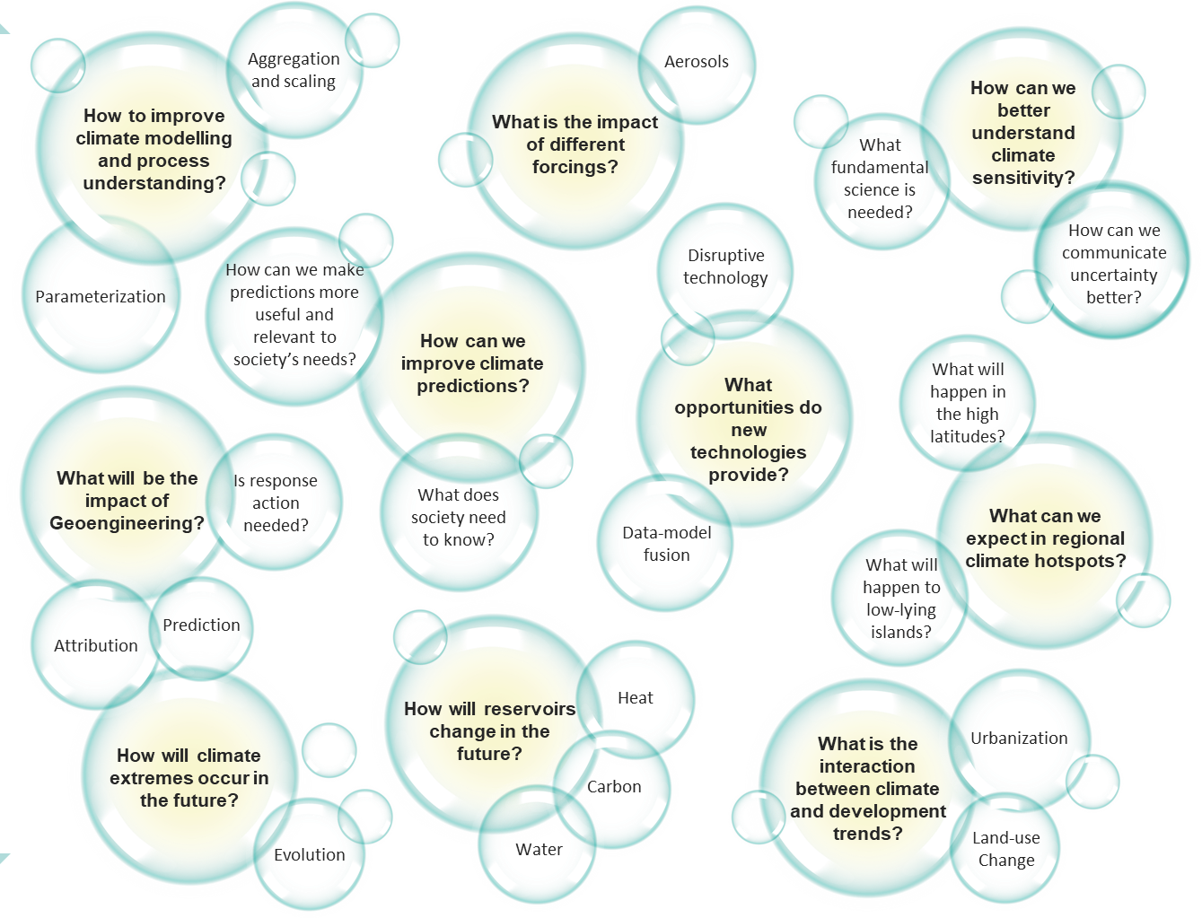
We Need You!
Working with our Sponsors
New institutional, scientific and technological approaches to better manage climate risks and opportunities; and develop and evaluate mitigation strategies.
Together we will build the infrastructure to blend observations and models in support of better decision-making, risk management and climate adaptation.
This includes identifying new scientific breakthroughs that should be prioritized in our new Lighthouse Activities; e.g. that will reduce stubborn model biases and/or address troubling model uncertainties
WCRP is keen to work with you to explore new research frontiers, collaborations and funding opportunities.
See last slide for information on how you can connect with us
Notes:
Note: this slide is animated.
We are particularly keen to work with our sponsors, both our current sponsors and prospective ones, on:
What new scientific approaches are needed to address climate risks and opportunities?
For example scientific breakthroughs that will reduce model biases that have hindered our progress for decades; and troublesome model uncertainties. This requires coordinated research that combines advances in knowledge and understanding of predictability; improved process-level understanding along with sustained and enhanced observations, improved prediction systems, and enhanced user engagement. These are some of the goals envisaged under our "Explaining and Predicting Earth System Change" Lighthouse Activity.
The priority science questions shown earlier, and repeated here, provide more examples of the kind of scientific advances and breakthroughs that are needed to better address climate risk, climate adaptation and climate mitigation
What technological developments and new technologies can support this new science?
CLICK
We are keen to work with you to explore new research frontiers, new research collaborations and new funding opportunities - that aligns with your priorities and outcomes.
Note to Presenters: Please use relevant examples from the high-level science questions “bubbles”

Slide 20
We Need You!
Nations, we are here to support you
WCRP is very grateful to all those agencies and nations who have supported us so far. We welcome you to continue on this journey with us to ...
Foster and deliver the science required to provide the climate information that is important for your regional to local decision support and adaptation outcomes.
Jointly co-design and co-produce climate knowledge and information, to ensure that it is relevant and accessible for supporting your national needs and priorities.
See last slide for information on how you can connect with us
Notes:
And finally, WCRP has had the generous support of many nations and agencies over its forty-year lifetime.
We’d like to take this opportunity to sincerely thank all those funding agencies and nations who have supported us; and helped to answer fundamental questions such as “what affect are human activities having on the climate system, and what does this mean for future climate and climate risk into the future”; this science has underpinned global agreements like the Paris Agreement and national climate strategies.
We welcome you, and others, to continue on this journey with us; co-designing and co-delivering research that meets your needs for regional to local climate information for better decision support and adaptation outcomes.

Slide 21
Our Climate Future – Key Contacts
If you want to know more, or wish to be involved in any of our new activities, then you can:
Email us with questions or ideas:
climatefuture@wcrp-climate.org
2. Join or start a discussion on Slack: bit.ly/WCRPClimate
3. Register for email updates:
www.wcrp-climate.org/wcrp-ip-connect
4. Check the WCRP website for updates:
www.wcrp-climate.org/wcrp-ip-overview
Notes:
Here is how you can contact us …
This connection information is also all available on www.wcrp-climate.org/wcrp-ip-connect

Slide 22



Thank You
World Climate Research Programme (WCRP)
Notes:
In closing:
Today, there is an unprecedented and greater than ever demand for actionable climate information across many sectors of our society e.g. the economy, finance, health, energy, as well as humanitarian, security, and other areas.
The World Climate Research Programme is taking the lead in ensuring that the global, regional and national climate research communities create the enduring, rigorous and scientific foundation required to meet this urgent demand for robust and useful regional climate information.
This requires the best scientists; exploiting modern technologies and infrastructure, and collaboration across the physical and social sciences.
Partnerships are essential because our vision of a sustainable and resilient world cannot be achieved on our own.
We welcome you to join with us – whether it be as a researcher or a team; a sponsor or a funder. We also welcome your feedback on our research priorities, our new “lighthouse activities” that will deliver new science, and the proposed new WCRP structure.
Thank you for your time.
Open the floor for questions as needed

