Slide 1
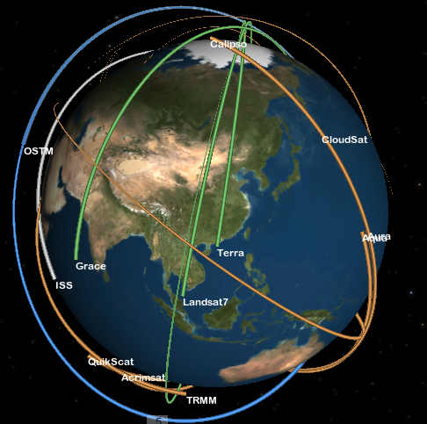
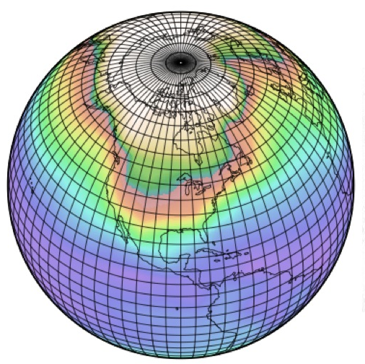
obs4MIPs: An Overview and Update
Obs4MIPs
Obs4MIPs is a pilot effort to improve the connection between data experts and scientists involved in climate model evaluation. It is closely aligned with CMIP5, with encouragement from the WGCM and WGNE. NASA and the U.S. DOE have initiated the project with significant contributions of appropriate NASA products. An overarching goal is to enable other data communities to contribute data to Obs4MIPs, but guidance and endorsement of this activity is now needed.
for presentation to the
WCRP Data Advisory Group (WDAC)
Prepared June 2012
Notes:
Heavy emphasis and acknowledgement given to speaker - *Stephens :)

Slide 2
Acknowledgements
D. Waliser, J. Teixeira, R. Ferraro, D. Crichton, L. Cinquini, others....
Jet Propulsion Laboratory, California Institute of Technology, Pasadena, CA
P. Gleckler, K. Taylor, D. Williams
Program on Climate Modeling Diagnostics and Intercomparison (PCMDI/DOE), Livermore, CA
G. Potter, P. Webster
Goddard Space Flight Center, Greenbelt, MD
T. Lee, J. Kaye, M. Maiden, S. Berrick
NASA HQ
AIRS, AMSR-E, CERES, MLS, MODIS, OSTM, OVW, TRMM, (PO)DAAC, others…
MANY OTHERS
NASA obs4MIPs Science Working Group
Members: J. Bates (NOAA), K. Bowman, A. da Silva, P. Gleckler (PCMDI), F. Landerer,
C. Peters-Lidard, N. Loeb, R. Nemani, S. Platnick, D. Waliser (chair)
Program Executive: T. Lee, Program Manager: Robert Ferraro
Notes:
Heavy emphasis and acknowledgement given to speaker - *Stephens :)

Slide 3
Observations for CMIP5 Simulations
History/Timeline
Mid 2007-Mid 2009: JPL discussions on how to improve satellite usage in CMIPx/IPCC ARx.
July 2009: JPL/PCMDI IT for Climate Research Workshop held in Pasadena to discuss technical challenges and progress of sharing observations.
September 2009: Briefing to WGCM on plans to make satellite observations more accessible for CMIP5/AR5; received WGCM support and encouragement.
December 2009: Brief NASA HQ (Lee, Kaye) on plan, solicit support for pilot effort (JPL, GSFC, PCMDI present)
March 2010: Briefings to WOAP Meeting & NOAA-led IPCC-observation meeting, Asheville, NC.
Spr-Sum 2010: Start work at JPL for prototyping data preparation, documentation and ESG implementation.
October 2010: Briefing/update to WGCM on initiative progress.
October 2010 : NASA Datasets for IPCC Workshop hosted by PCMDI – identify requirements and NASA or closely-related data sets readily available for CMIP5/AR5 analysis.
November 2010 : NASA IT for IPCC Workshop hosted by GSFC – identify IT resources and requirements.
December 2010: Update NASA HQ on status of activity, securing continued support for pilot effort.
June 2011: JPL/NASA ESG Gateway online and ready to accept/serve obs4MIPs data sets.
October 2011: Briefing/update to WGCM & WGNE on initiative progress.
Fall 2011: Deliver a number of satellite datasets that are formatted, documented, sampled (e.g. monthly, daily) in a manner analogous to the model outputs, make available via ESG – tagged as “obs4MIPs”
October 2011: Recommendation to WCRP to foster activity via Observation Data Council.
December 2012: NASA forms Science Steering Group to shepherd NASA component of activity and provide guidance/leadership for including additional agencies/datasets. Meeting at AGU with most members and NASA HQ program executive.
March 2012: Obs4MIPs wiki page made public and highlighted at CMIP5 Hawaii Workshop.
April 2012: Obs4MIPs briefing at CEOS-Climate Workshop, Asheville to broaden agency participation.
May 2012: 1st NASA obs4MIPs Science Steering Group Meeting

Slide 4

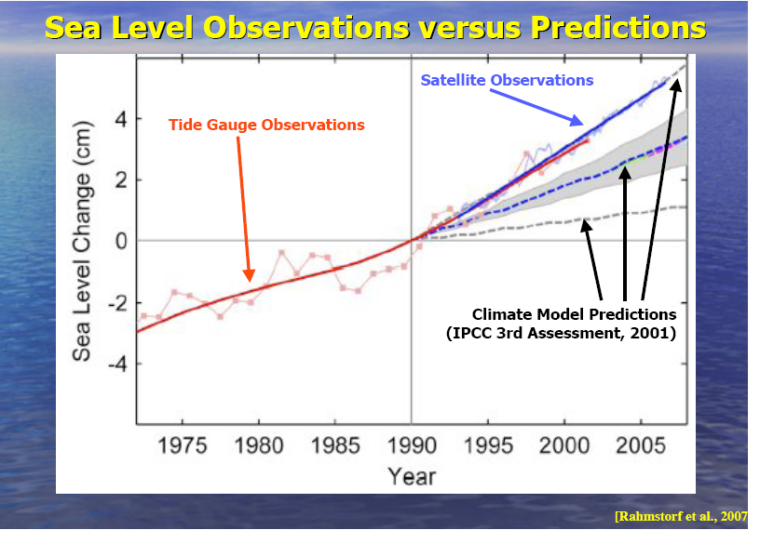
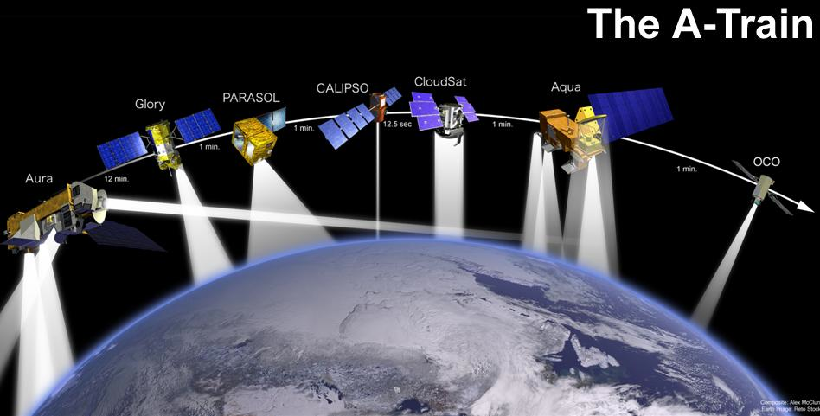
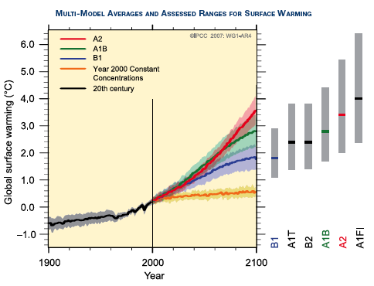
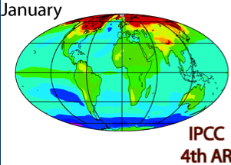
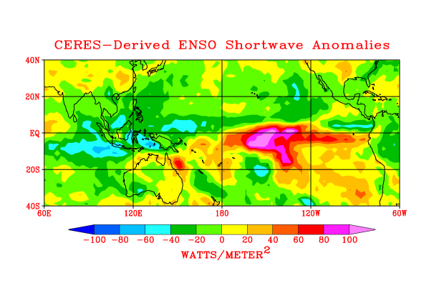
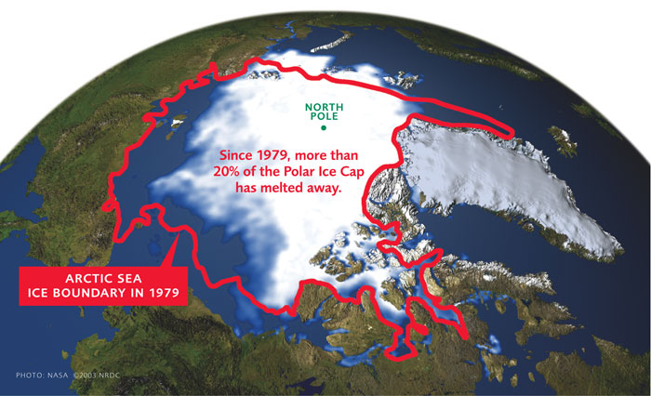
(Satellite) Observations and CMIP/IPCC: Better Linkage
How to bring as much observational scrutiny as possible to the IPCC process?
How to best utilize the wealth of Earth observations for the IPCC process?
AR5 – initial target
AR6 and other MIPs – long-term targets

Slide 5
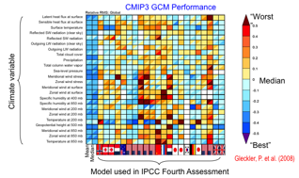
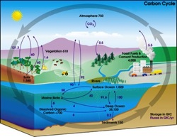
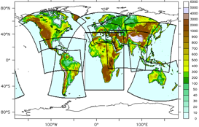
Observations for CMIP and IPCC ARs
Why is this timely for AR5 and beyond?
Model Scoring w/ Observations: “1 model – 1 vote” to weighting projections based on observation metrics.
Earth System Modeling (e.g. Coupled Carbon-Climate): added complexity, more degrees of freedom, need for observational constraints
Decadal Predictions: Downscaling GCMs with regional models is key to many decision-support issues.
CORDEX

Slide 6
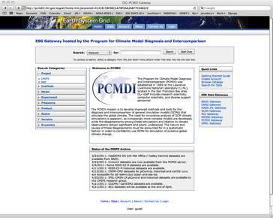
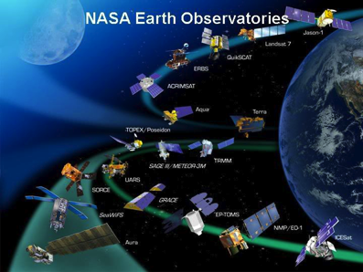

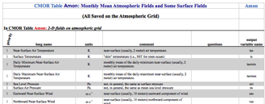
Model and Observation Overlap
For what quantities are comparisons viable?
Taylor et al. 2008
Example: Current NASA Missions ~14
Total Missions Flown ~ 60
Many with multiple instruments
Most with multiple products (e.g. 10-100s)
Many cases with the same products
Over 1000 satellite-
derived quantities
~120 ocean
~60 land
~90 atmos
~50 cryosphere
Over 300 Variables in
(monthly) CMIP Database

Slide 7
Some Basic Tenets of the Initial Activity
Use the CMIP5 simulation protocol (Taylor et al. 2009) as guideline for deciding which observations to select.
Initial Target was monthly averaged (OMON, AMON) products on 1 x 1 degree grid
Convert (Satellite) Observations to CMIP model output format
CMOR output, NetCDF files, CF Convention Metadata, CMIP standard pressure levels, etc. Not a new product. Independent QC check before release.
Includes a 6-8 page Technical Note describing strengths/weaknesses, uncertainties, caveats regardingcomparisons with models. (at graduate student level)
Host side by side on the ESG with CMIP5
Modelers
Satellite
Experts
Analysis
Community
Main Target Community

Slide 8



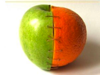
Model and Observation Overlap
For what quantities are these comparisons viable?
Target Quantities
Model Output
Variables
Satellite Retrieval
Variables
After much scrutiny and two workshops, only ~20 satellite variables were identified as being “safely” comparable in the pilot effort.

Slide 9
NASA-related Datasets for CMIP5
Datasets are Gridded Monthly Averages – Unless otherwise noted
Separate files containing Nobs & StdErr for each grid cell are available
CMIP Protocol Variables | Data Source | Time Period | Comments
ta - Atm Temp | AIRS (≥ 300 hPa) MLS ( < 300 hPa) | 9/02 – 8/04 - | AIRS +MLS needed to cover all pressure levels
hus - Specific Humidity | AIRS (≥ 300 hPa) MLS ( < 300 hPa) | 9/02 – 8/04 -
tro3 – Mole Fraction of Ozone | TES | 2004 - | Undergoing QC checks
tos - Sea Surface Temperature | AMSR-E | 6/02 - | SST science team recommends multiple products
rlut, rlutcs, rsdt, rsut, rsutcs – TOA outgoing LW & SW Radiation, Incident SW Radiation | CERES | 3/00 -
clt – Total Cloud Fraction | MODIS | 2/00 -
zos - Sea Surface Height Above Geoid | TOPEX/JASON series | 10/92 - | AVISO Product
pr - Total precipitation | TRMM | 1997 - | Monthly Ave + 3 hourly products
sfcWind, uas, vas - Surface (10m) zonal wind | QuikSCAT | 1999 – 2009 | Oceans only. No land products.
Land Surface products (TBD) | MODIS | 2/00 - | Perhaps 2 CMIP variables, TBD
Match up of available NASA datasets to PCMDI priority list
Orange datasets are still in process

Slide 10
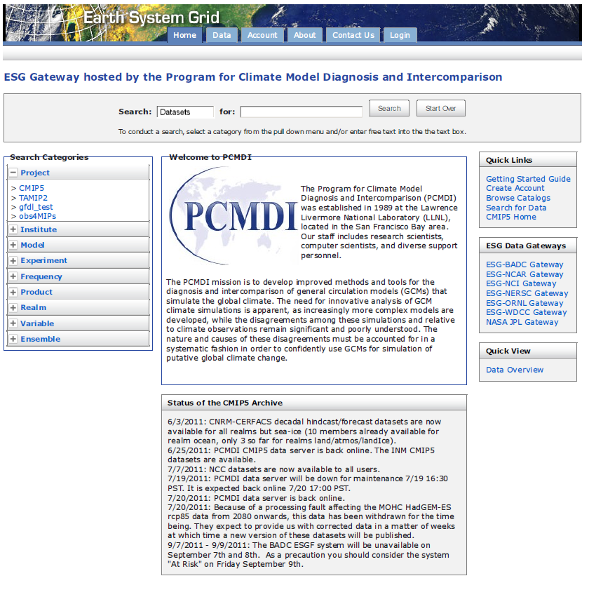
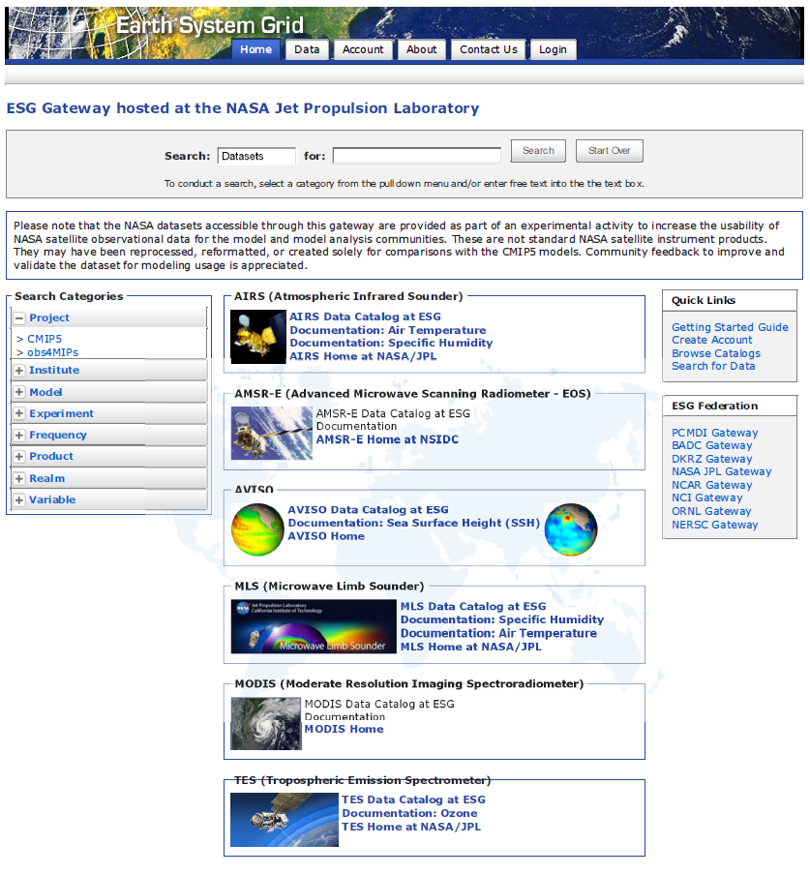
ESG Gateway : Side by Side Archive with CMIP
obs4MIPS
Project

Slide 11
“Technical Note”
(See Appendix II)
Each Dataset has an accompanying Technical Note
Target audience is modeling and model-evaluation community members who often have little experience with the given dataset of interest.
Content
Intent of the Document/POC
Data Field Description
Data Origin
Validation and Uncertainty Estimate
Considerations for Model – Observation Intercomparison
Instrument Overview
References
Revision History

Slide 12
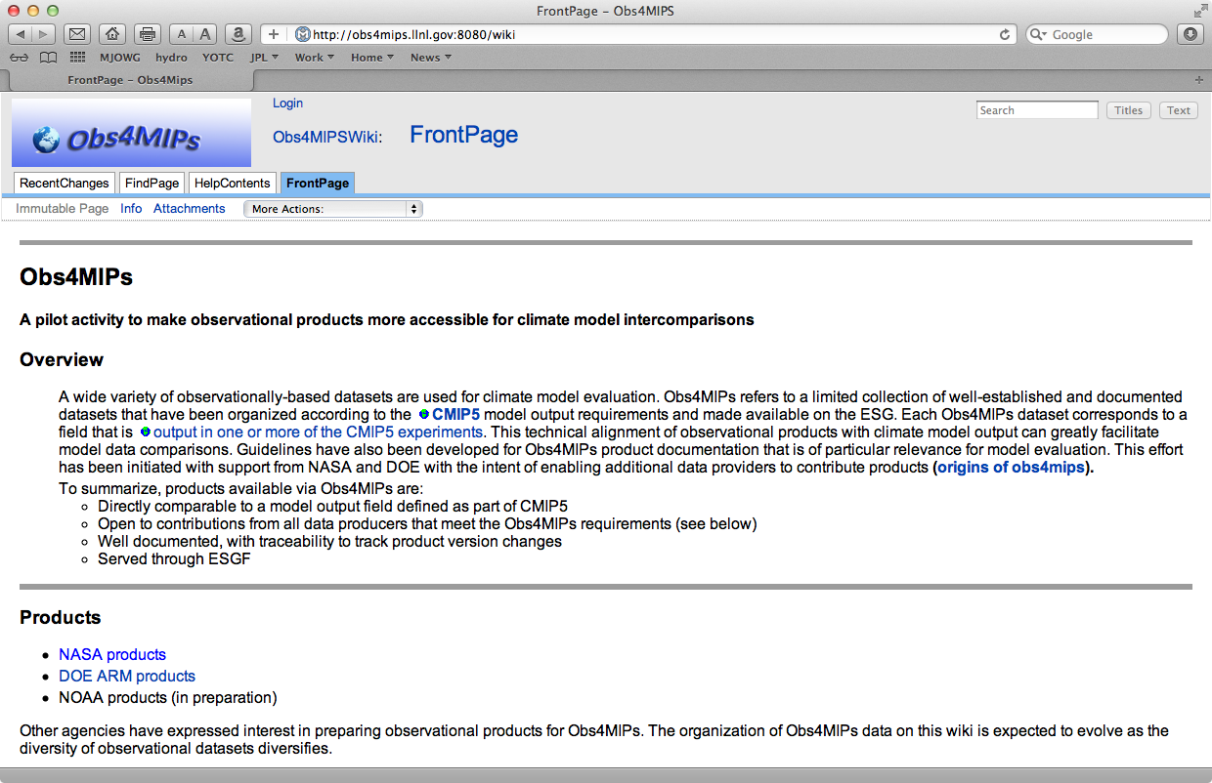
obs4mips Wiki : Documentation and Expansion

Slide 13
Satellite Observations for Evaluating CMIP5
SUMMARY
NASA-PCMDI pilot Project to establish a (satellite) observation capability for the climate modeling community to support model-to-data intercomparison. This involves IT, satellite retrieval, data set, modeling and science expertise.
~13 satellite-based datasets currently available on the ESG – more coming; including sea ice, with near-term effort to identify a snow cover, aerosol, additional land and composition products, and CFMIP cloud products.
We are seeking inputs with CMUG/ESA, have engaged CEOS-Climate Working Group and work closely with the WGNE/WGCM Climate Metrics Panel.
A priority now is to increase collaboration with other agencies and international partners to expand this effort and solicit feedback from model analysis community.
NASA has formed a Science Working Group, including rep from PCMDI and NOAA to help guide the expansion and direction of this activity. The activity has already expanded to include ARM and reanalysis data sets.

Slide 14
(Satellite) Observations for IPCC / Climate Modeling
Future Emphases and Needs
Identify additional observations to include in this activity.
Continue to develop cultivate collaboration / data utilization from NOAA and international (e.g. ESA CCI) partner data sets.
Maintain/Strengthen links to WGCM/WGNE Climate Metrics Panel.
Continue to work with the ESG community and PCMDI to facilitate the means to utilize the observations for model evaluation.
Encourage satellite and other observing programs to develop products analogous to model output.
Encourage modeling community to develop the means to output quantities analogous to satellite retrieved or other observed quantities.
Encourage satellite programs to provide modeling community with satellite simulators for more direct comparisons with observations (e.g. CFMIP).
Provide guidance on future funding solicitations.
Cultivate more coherent input from the modeling community on observations critical to model development/evaluation.

Slide 15
Challenges and Questions
Specific areas that present challenges and questions include:
What observations go into obs4MIPs? A fundamental criteria is there has to be a 1-to-1 correspondence with a CMIP model output variable. A second criteria is that the product be well documented with peer-reviewed publications, ideally with examples of use for model evaluation.
What to do when there is more than one observation product for a given variable – 1) keep it simple for the user and attempt to choose the “best”, 2) select the “best” two to account for some observational uncertainty, 3) select more than two if available but run the risk of the offerings become overly complex for the non-expert. For 1) and 2) – by what criteria is this decided?
What if the data sets don’t quite match e.g. product is total column (ozone) but CMIP only requests the vertically resolved profile?
What guidelines should there be regarding update frequency and process?
Who provides quality control over the technical documentation and data set content?
Thus far technical documents were made one per variable, in some cases it may be advantageous to document more than one in the same technical note, how is this decided?
For more details: see Notes/Action Items from recent NASA obs4MIPs Science Working Group Meeting.

Slide 16
Recommendation
What role could WDAC play for Obs4MIPs?
  General oversight on the advancement of Obs4MIPs
  e.g., via annual updates to WDAC, similar to AMIP/CMIP panels established by the WGNE and WGCM to guide climate model intercomparisons.
WDAC establish an Obs4MIPS panel to:
  Ensure that datasets contributed to Obs4MIPs are appropriate for model evaluation
  Advance guidelines that are used to recommend, select and document the data
  Identify the highest priority observations for model diagnostics and evaluation
  Encourage additional contributions to Obs4MIPs and promote activity
WDAC Obs4MIPs panel membership and organization
  NASA volunteer to chair the group and provide some support for annual meetings, PCMDI volunteers continued support, membership and/or co-chair responsibilities
  Membership should consist of a mix of observation providers and model experts
  WDAC/WCRP to recommend members
  Obs4MIPs to report annually to WDAC and WMAC

Slide 17
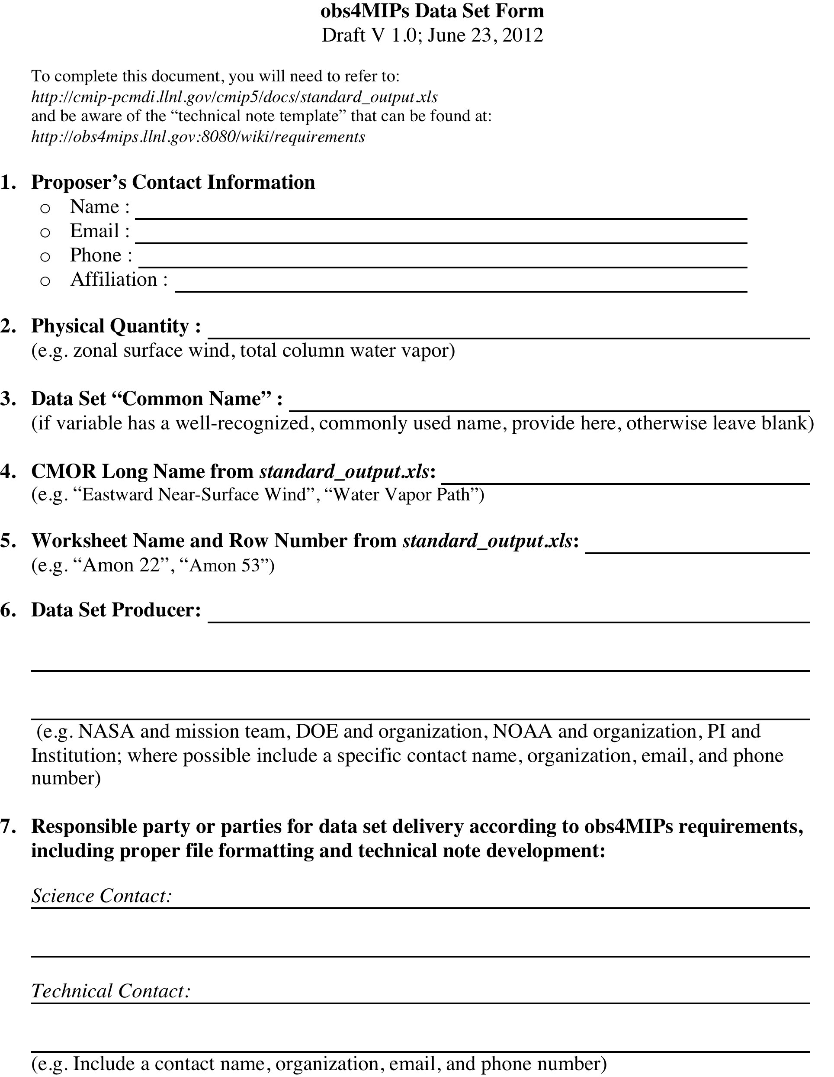
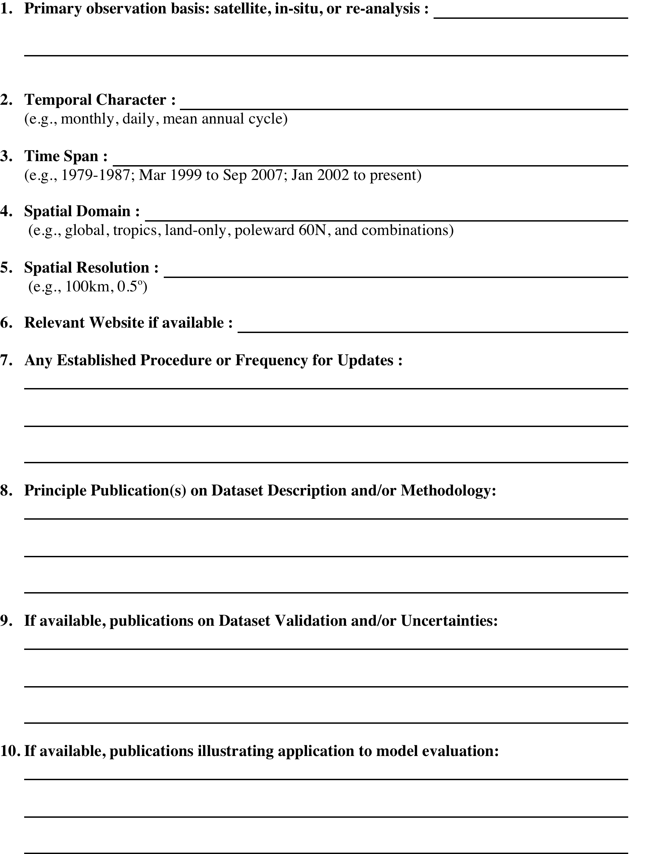
Appendix I
Data Set Recommendation Form

Slide 18
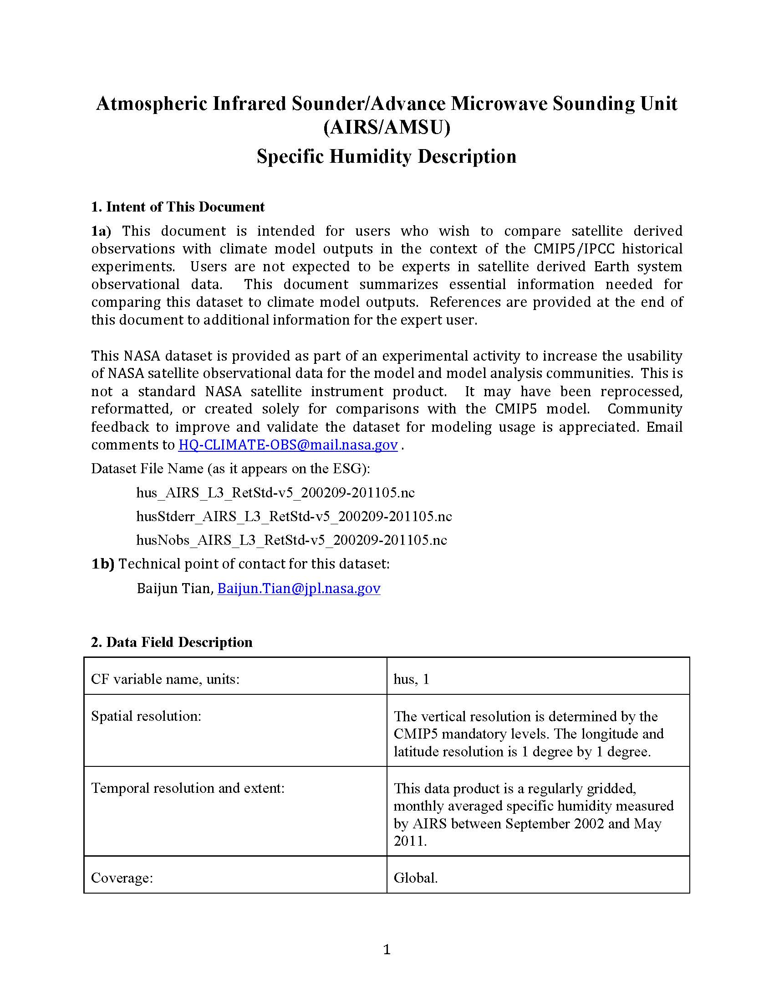
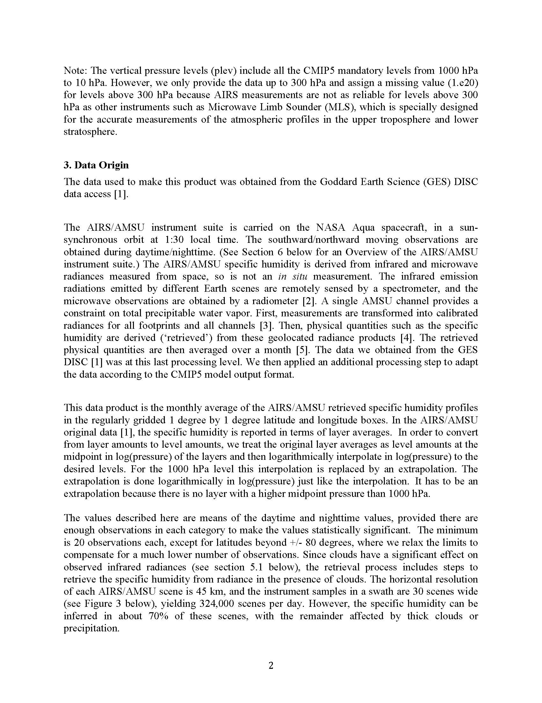
Appendix II
Example Technical Documentation: AIRS Specific Humidity

Slide 19
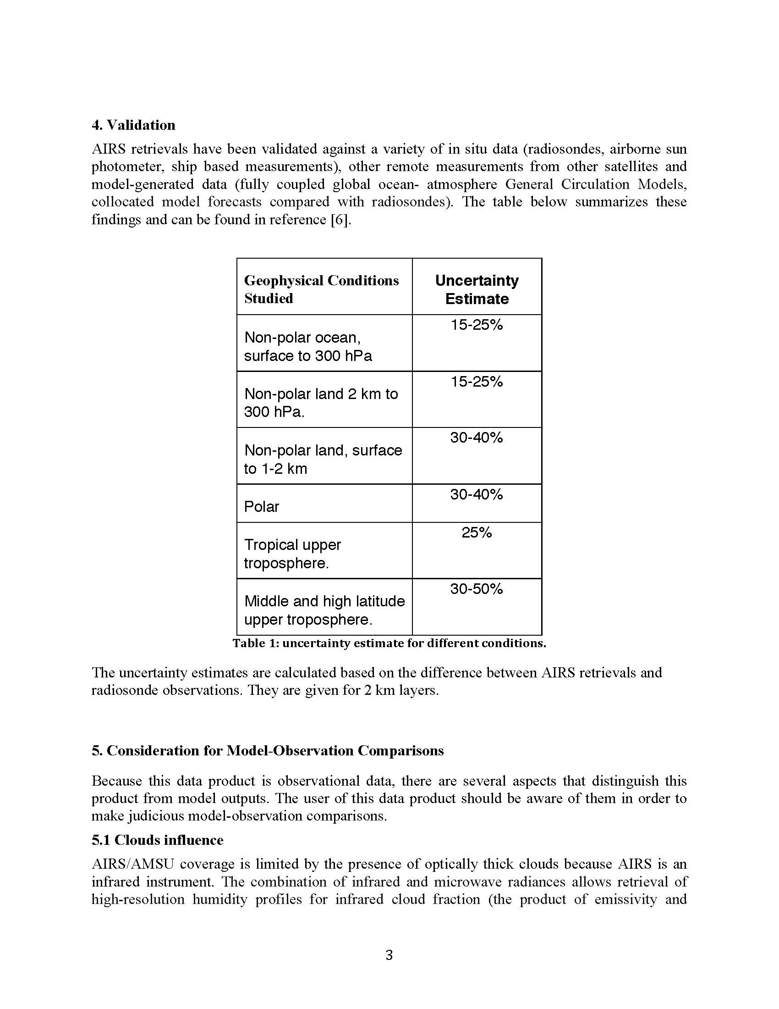
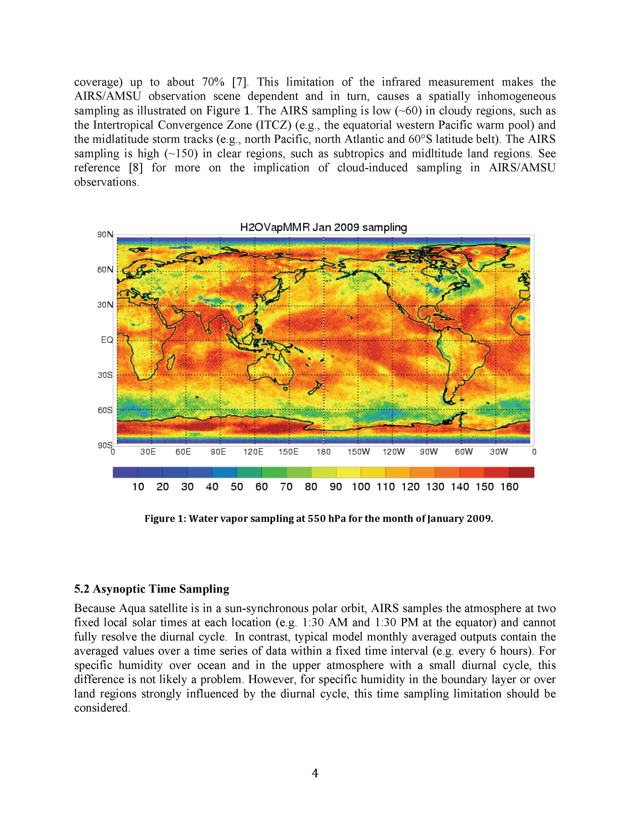
Appendix II…cont
Example Technical Documentation: AIRS Specific Humidity

Slide 20
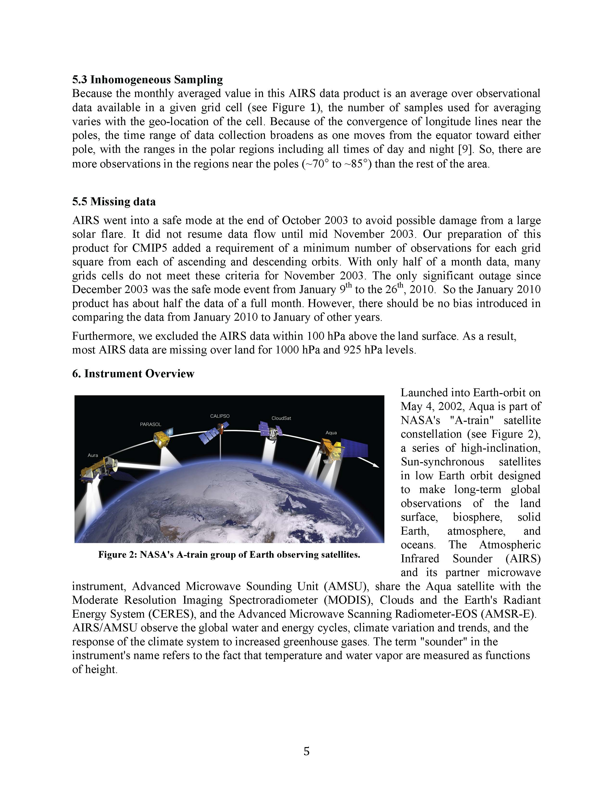
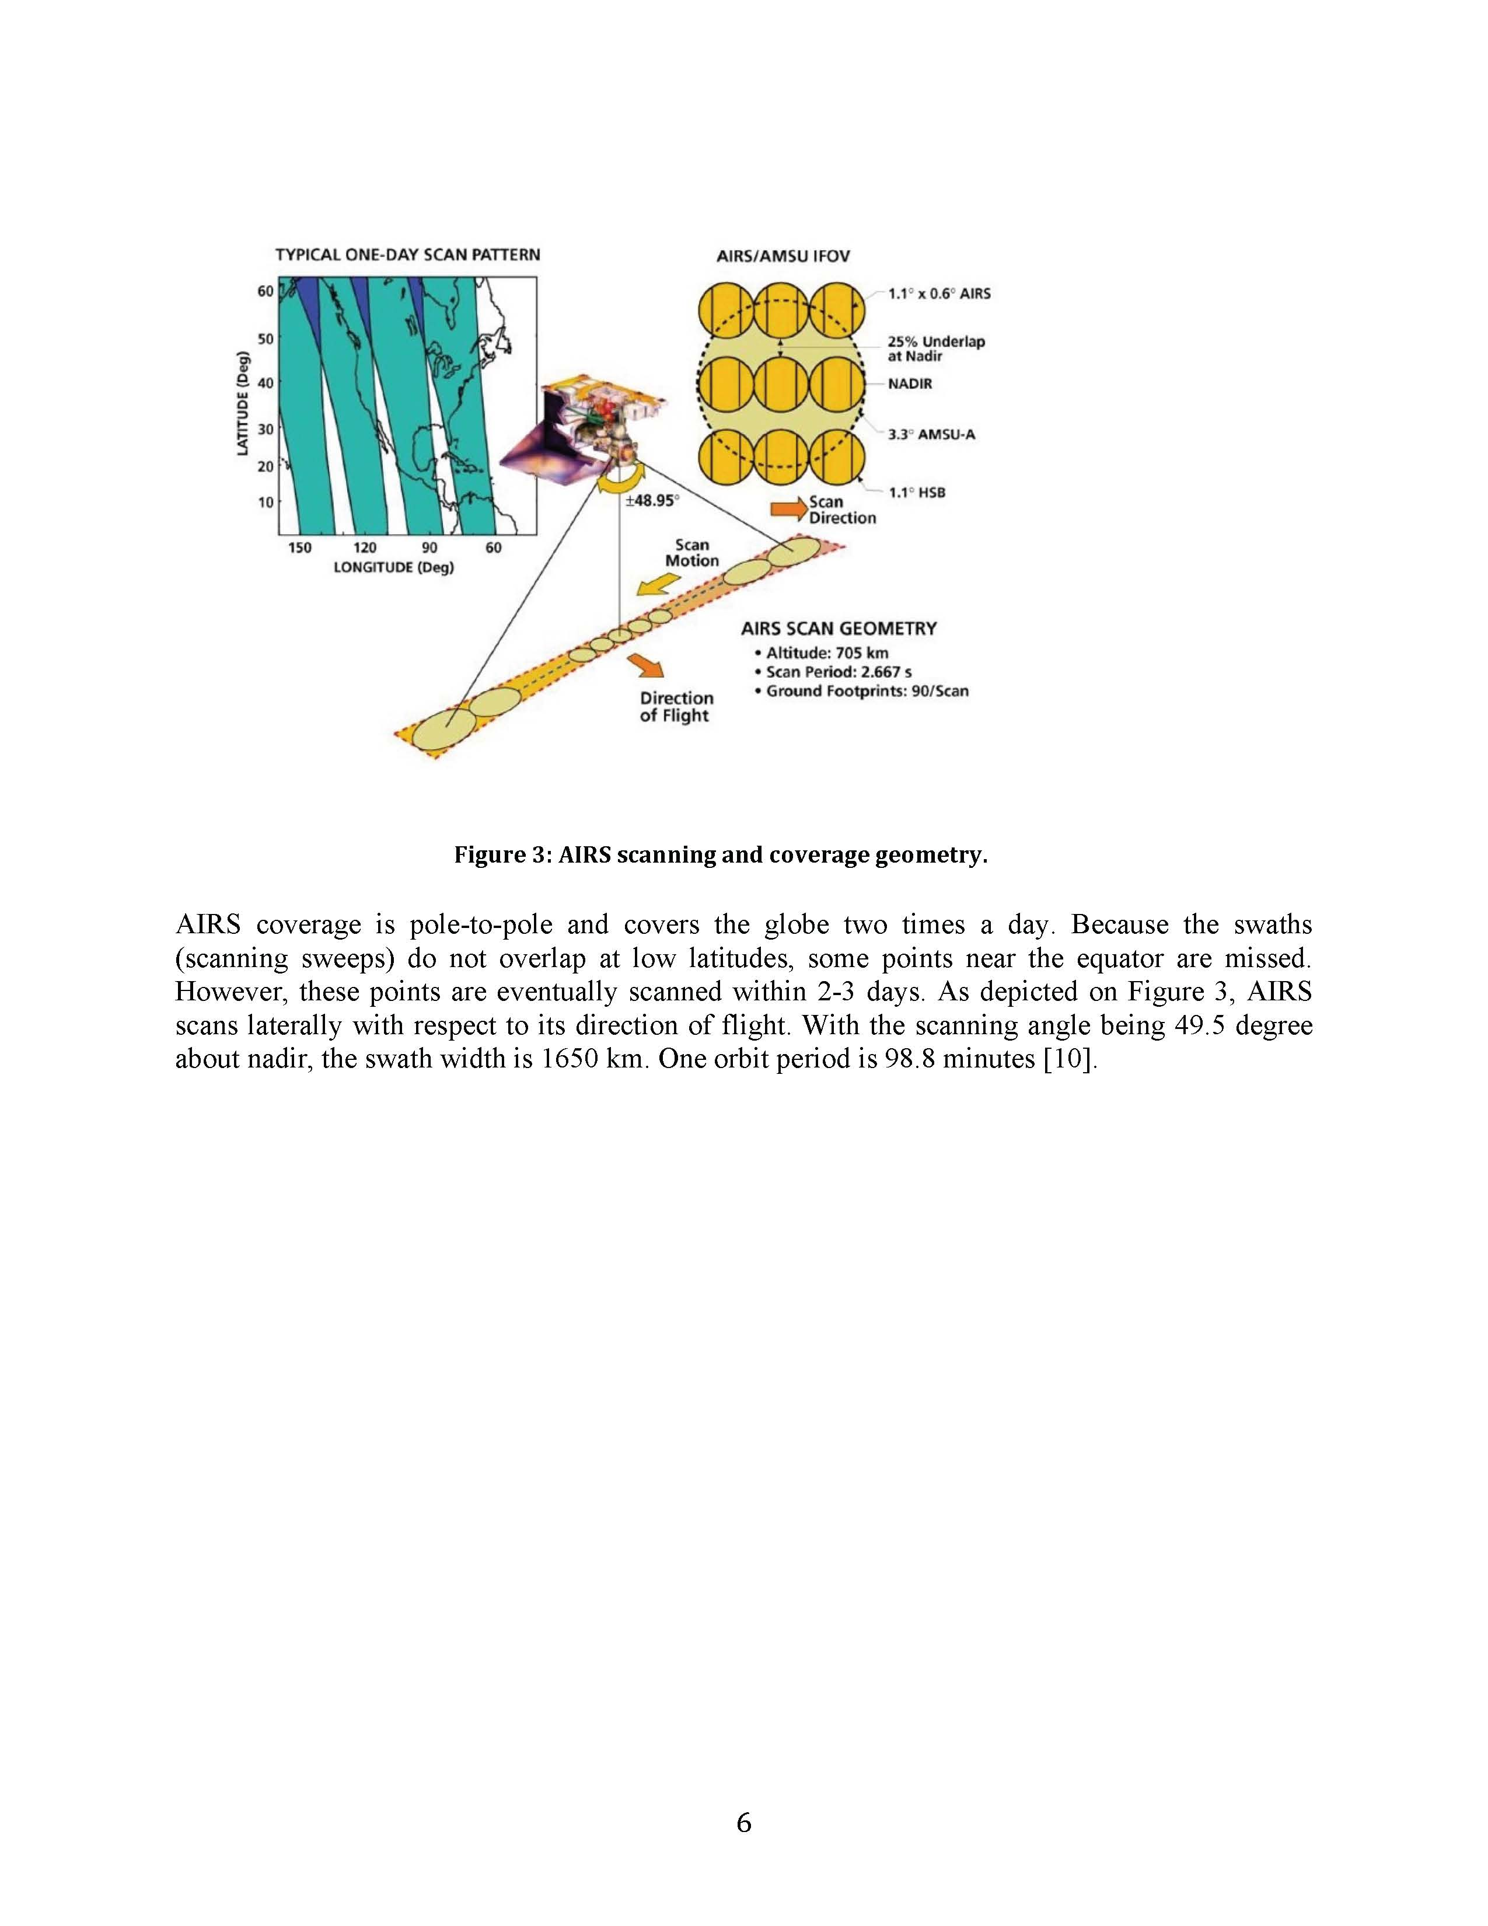
Appendix II…cont
Example Technical Documentation: AIRS Specific Humidity

Slide 21
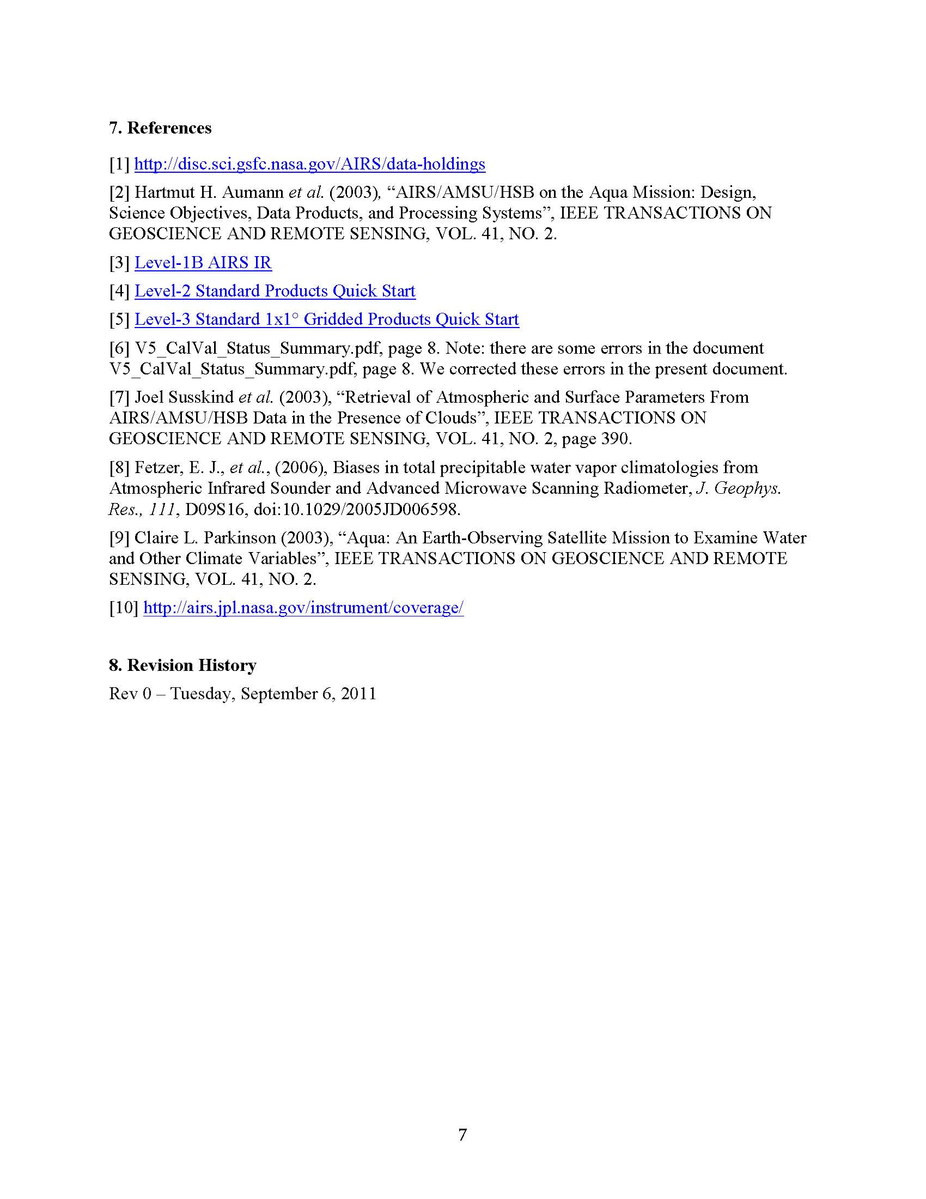
Appendix II…cont
Example Technical Documentation: AIRS Specific Humidity

