Slide 1
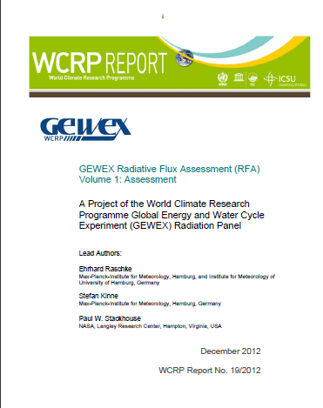
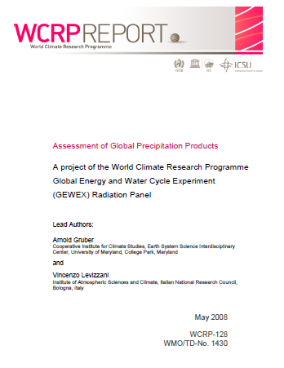
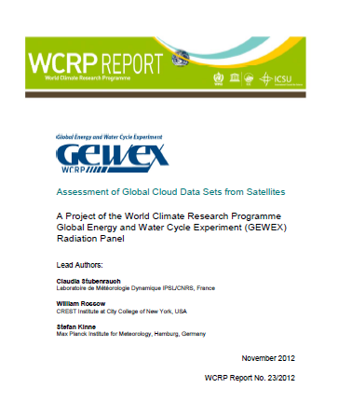
A Proposal for Structured Data Set Quality Assessments
Jörg Schulz (EUMETSAT)

Slide 2
Data Set Assessments
Data set diversity can be confusing for users, and without the proper background information and understanding of the limitations of available data, there is a danger that these data may be incorrectly applied or misinterpreted;
Users need to realise that it is often difficult to define a single best climate data source. Data sets are instead most often complementary in nature with varying strengths and weaknesses;
Essential elements that define the usefulness of a data set are certainly its accuracy and error characterization, but data products can be evaluated too favourably by the developers themselves in order to encourage data usage;
Assessments have benefits for both science and applications as well as product providers.

Slide 3
Background
IPCC assessments reveal important gaps in geographic and temporal observations, understanding of system processes, and confidence in observations and projections themselves;
IPCC data record selections are depending on many things such as access to products, formats, author knowledge, best friend advice, etc.;
IPCC did not make much use of GEWEX assessments (only clouds) which might be because satellite data products are not used much in the IPCC report;
Obs4mips workshop revealed potential need for more assessments to guide the usage of data for model evaluation;
Climate monitoring architecture developed by space agencies requires quality assessments for data records;
CEOS-CGMS WG Climate has started to consider how and who shall undertake assessments. Leadership of WCRP through WDAC may be envisaged for this undertaking.
This proposal is to establish assessments throughout the core projects inclusive of adopting high-level best practises to keep key elements of assessment outcomes comparable.

Slide 4
Types of Assessments
Panels as the GEWEX GDAP currently consider two types of assessments that have value for user communities:
  Development of review articles on data records considering specific science aspects spanning from process understanding to trend analysis, specific geophysical variables, e.g., GCOS ECVs or topics of importance for IPCC climate assessments.
  Dedicated data record quality assessment projects that perform a scientific analysis of existing data records and publish results in peer reviewed literature.
Both types of assessments should not be viewed as static but rather as dynamic activities that may need to be repeated every ~5 years.
Notes:
Such review articles can be written by a group of experts selected by a panel such as GDAP and reviewed by the panel members not involved in writing the article and of course the journal reviewers. The result can be of immediate use for instance to IPCC report authors also avoiding too restrictive approaches on data selections for IPCC reports. It provides balanced and peer reviewed judgement of the existing knowledge;
Both types of assessments should not be viewed as static but rather as dynamic activities that may need to be repeated every 5-10 years. depending upon the rate at which data records are being added or modified within a given discipline. Type one assessments may follow cycles of IPCC assessments and can also be pointing to the need for a type two assessment, e.g., if the available information for a review article is insufficient and/or incomplete.

Slide 5
Benefits of Assessments
  Comprehensive assessments are critical to move the science in a field forward in a systematic way.
For the science and user communities, assessments:
  provide independent and transparent quality assurance for data records;
  endorse the use and the credibility of data records to a broader community;
  identify key limitations in data records to stimulate improvements;
  allow objective selections of appropriate data records;
and for the data record providers the assessments:
  provide background information on available data records;
  provide easy access to data in a common user friendly format;
  establish reference data test-beds and tools for external evaluations that can be reused for further developments.
Benefits also to the assessment of the strengths and deficiencies of the current observing system and facilitates planning;
In particular type one assessments can be of immediate use for instance to IPCC report authors as the should provide a balanced and peer reviewed judgement of the existing knowledge.

Slide 6
High Level Best Practises
A general procedure, e.g., to ensure at least a certain degree of independency to avoid that data products be evaluated too favourably by the developers themselves in order to encourage data usage;
A general structure of an individual assessment including the definition of a certain set of mandatory sections in the assessment report but not preventing the publication of additional results. For instance, essential elements that define the usefulness of a data record are certainly its accuracy and uncertainty characterization;
A lexicon of best practises to create climate data records also including practises on data comparisons and nomenclature used for characterising uncertainties;
Metrics to assess how far best practises have been followed.

Slide 7
1. General Procedure for Independency
Each assessment should be hosted by a scientific body such as the GDAP where the group that performs the assessment is reporting to and that signs responsible for the assessment report.
It helps to involve the scientists that created the data records so that sufficient background information on involved instruments, applied methods, and underlying assumptions and limitations can be more fully understood and conveyed to the user.
To keep independency findings and reports shall be reviewed by independent experts to prevent too favorable results for specific data records,.
Avoid broadening the goal of the assessment from its original intent of informing the user community to one of using the assessment itself as a diagnostic to help investigators improve their respective data products.
Notes:
Although this is not easy to achieve GDAP is practicing this with the Panel acting as reviewer whereas the assessment group appears as a GDAP project that reports annually to the Panel and receives feedback and help for the continuation of the assessment.
Although this is a clear benefit for the data producers and may ascertain their participation, GDAP has found that these two objectives are, in fact, compatible with one another but should always be kept distinct in the assessment to keep the assessment manageable. Thus, in general a data quality assessment should concentrate on providing information to the science and user community first and then move to updates outside of the assessment.

Slide 8
2. General Structure
As a general structure an assessment of geophysical products should always cover the following elements:
A survey of available data records and background information about these;
A quantitative examination of strengths and limitations against reference data (especially if data of higher accuracy are available) at different time and space scales;
Recommendation for intended data record uses and identification of areas for which data should “not” be applied;
Open, full and easy access to the assessment report and all examined data records and methods.
Furthermore assessments should include:
A dedicated, motivated, and respected person to lead the effort;
Complementary assessment team members with specialized knowledge;
Regular team meetings – open and closed workshops;
A centralized data depot for data sets created specifically for the assessment.
Notes:
GDAP has found that including model and reanalyses data sets in the comparisons is often useful in that it immediately incorporates needs of an eventual user community;

Slide 9
3. Lexicon of best practises
A lexicon of best practises to ensure coherent use of nomenclature could be developed and hosted by a subgroup of WDAC.
It would be needed to coordinate such a lexicon with other bodies such as GCOS and the CEOS-CGMS Working Group Climate.
Such a development could take benefit of ongoing initiatives such as QA4EO and related projects such as the European QA4ECV project.

Slide 10
4. Metrics to assess how far best practises have been followed.
A metric to assess how far best practises have been followed in generating the climate data records is useful in the survey of available data records;
It helps to keep the assessment activity manageable by concentrating on data records having a certain maturity that measures the sustainability of data record production;
Progress on such metrics based on that published by Bates and Privette (2012) has been made in projects such as the European Union project CORE-CLIMAX.

Slide 11
Funding
Past and current assessment activities usually relied on pure voluntary efforts;
They took a too long time to finish and can collapse unless there is strong leadership.
Assuming that a full funding of assessment activities is out of scope for most funding agencies, it is however mandatory that at least some seed funding for centralized activities is provided;
Assessment workshops may also be funded by WCRP;
It is recognised that funding practises strongly differ across the world but the membership of WDAC including the CEOS-CGMS WG Climate representing space agencies can certainly help to improve the situation if convincing cases for assessments are brought forward.

Slide 12
Governance Aspects I
Who should initiate an assessment?
It is suggested that data record quality assessments can be initiated by any scientific or organisational body that identifies a need for an assessment. But then an assessment needs a ‘harbour’ to anchor and to get support as well as independent review.
Who should organise it?
Within WCRP the Core Projects may task their panels to act as initiator, organiser and reviewer of data record quality assessments following the model of GDAP.
For assessments requested from outside, WDAC could become the known receiver of such requests and can help to channel it within WCRP.
Notes:
The organisation of an assessment is best placed at the level of panels such as GDAP because this is the place where the scientific knowledge is concentrated and lead scientists for assessments can most easily be identified.
Scientific groups undertaking the assessments should be formed in an open way to assure broad participation but should pay attention to the selection of data records to not end up with only one off activities that have limited value for the users. The assessment lead scientists need to report to the responsible panel in regular intervals, e.g., annually. The panels themselves are reporting to their specific Steering Groups (SG) and the SGs present these activities to the JSC as done today.
Organisation of assessments will not be restricted to WCRP as other domain/topic specific competence bodies (e.g., CGMS working groups as ITWG, IPWG, CEOS Virtual Constellations) exist that may organise their own assessments.

Slide 13
Governance Aspects II
Who should undertake the assessment?
The organisation of an assessment is best placed at the level of panels such as GDAP because this is the place where the scientific knowledge is concentrated and lead scientists for assessments can most easily be identified.
Scientific groups undertaking the assessments should be formed in an open way to assure broad participation but should pay attention to the selection of data records to not end up with only one off activities that have limited value for the users. The assessment lead scientists need to report to the responsible panel in regular intervals, e.g., annually. The panels themselves are reporting to their specific Steering Groups (SG) and the SGs present these activities to the JSC as done today.
Organisation of assessments will and shall not be restricted to WCRP as other domain/topic specific competence bodies (e.g., CGMS working groups as ITWG, IPWG, CEOS Virtual Constellations) exist that may organise their own assessments.

Slide 14
Governance III
Who should overlook quality assessments?
The role of WDAC should be to overlook assessments performed within and outside of WCRP from a higher level in particular pointing to missing assessments in critical areas for science, IPCC and climate services;
The membership of WDAC is favourably to do this in coordination with GCOS and the space sector. WDAC should build an assessment inventory to become capable to provide such information to the WCRP JSC;
By identifying missing assessments WDAC can also act as initiator of data quality assessments, e.g., later performed by WCRP core projects;
WDAC also should be active in supporting the funding of data quality assessments as this is important.

Slide 15
Issues
Did not receive a lot of feedback – GDAP was fine with it;
Most comprehensive review from NCAR climate data guide project:
  Shall state that GDAP activities are very limited;
  Document is to European Centric, shall cite US activities on CDRs;
  Documents speaks to limited audience (IPCC);
  The document is vague on what constitutes an assessment and what constitutes good data. The types of questions that the assessment will address should be clearly spelled out and/or a concrete example given;
  There needs to be a clear dissemination pathway that is not ad hoc – proposed that the Climate Data Guide should be key pathway;
  Assessment process is slow, how to update with new results and new community input. Again proposed the climate data guide is the platform;
  There should be a way to set priorities for the assessments, which will likely be faced with limited resources. Meeting and workshops only reach small number of people. Proposed to use climate data guide analytics as key input into decision process on priorities.

Slide 16
Issues
Kevin Trenberth sent me a bunch of papers providing some material to frame the questions better;
Need to add a Introduction and Purpose section in the beginning to clearly state origin of the task and addresses and purpose of the paper;
Missed out the relation to obs4mips which I will add to the Background;
Shall we submit to JSC or distribute first to other Core Projects for review?
Shall we involve GCOS panels as well?

