Slide 1
What is GEO?
launched in response to calls for action by the 2002 World Summit on Sustainable Development, Earth Observation Summits, and by the G8 (Group of Eight) leading industrialized countries
voluntary partnership of governments and international organizations
  89 member governments + EC
  77 Participating Organizations (PO)
provides a framework within which these partners can develop new projects and coordinate their strategies and investments
charged with developing GEOSS
Notes:
The 10-year Implementation Plan is the implicit convention that glues together all Members and POs.

Slide 2
What is GEOSS?
Global Earth Observation System of Systems
an integrating public infrastructure, interconnecting a diverse, growing array of Earth observing instruments and information systems for monitoring and forecasting changes in the global environment
supports policymakers, resource managers, science researchers and other experts to support informed decision making for society
10-year implementation plan
2015: Global, Coordinated, Comprehensive and Sustained System of Observing Systems
Notes:
Idea is to build a shared, end-to-end information system. Previously, each SBA had its own observing system operating in quasi-isolation. It would make more sense to share observing systems because a given problem can benefit from multiple observations. Likewise a single data set can serve multiple purposes. The scientific community is needed to help build the system of systems, which is designed for the broadest use possible.

Slide 3
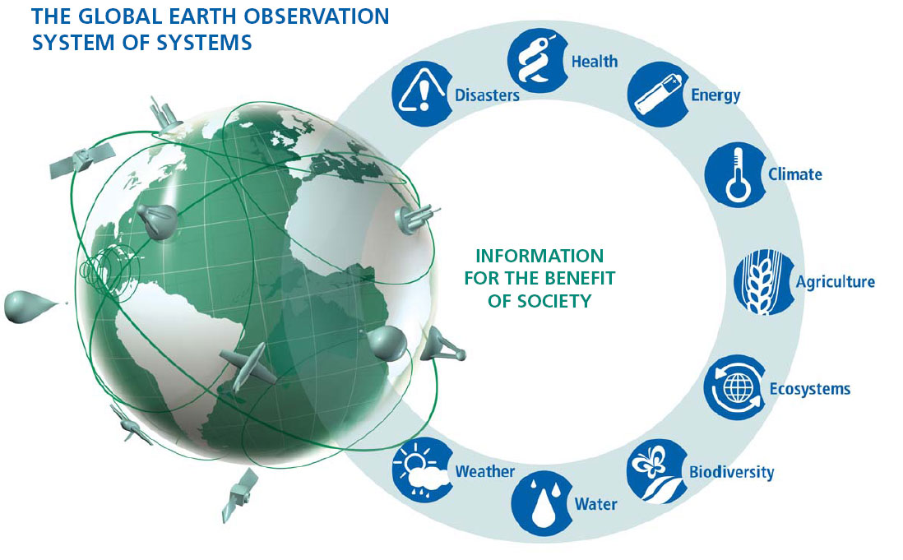
GEOSS: A Global, Coordinated, Comprehensive and Sustained System of Observing Systems
Notes:
GEOSS is a global distributed system, including satellite observation systems, Global in situ networks and systems, And local and regional in situ networks.
GEOSS will deliver the benefits of EO to both data & information providers and consumers world wide.

Slide 4
GEOSS: main objectives
Improve and Coordinate Observation Systems
Provide Easier & More Open Data Access
Foster Use (Science, Applications)
Building Capacity
Identify gaps in observations (based on user requirements)
…Earth Observation Systems should be
coordinated and shared internationally
… to answer Society’s need for informed
decision making
Notes:
4
Seven shortcoming were identified as target areas that GEOSS could address:
Lack of access to data and associated benefits in the developing world
Eroding technical infrastructure
Large spatial and temporal gaps in specific data sets
Inadequate data integration and interoperability
Uncertainty over continuity of observations
Inadequate user involvement
Lack of relevant processing systems to transform data into useful information

Slide 5
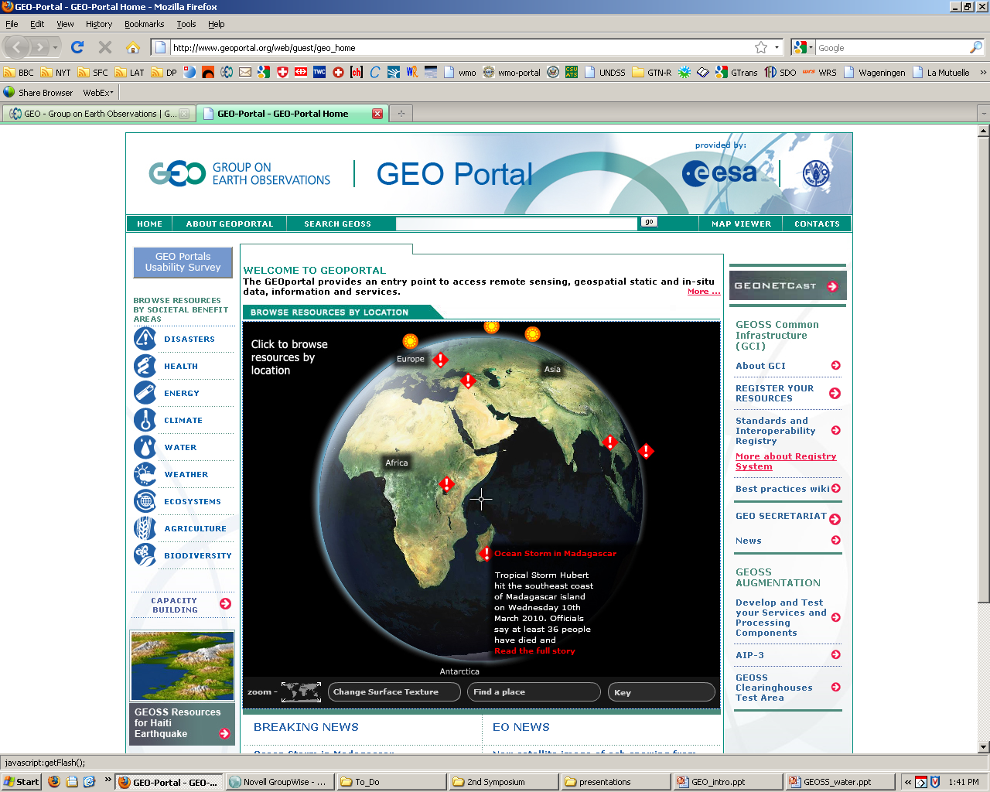

Slide 6
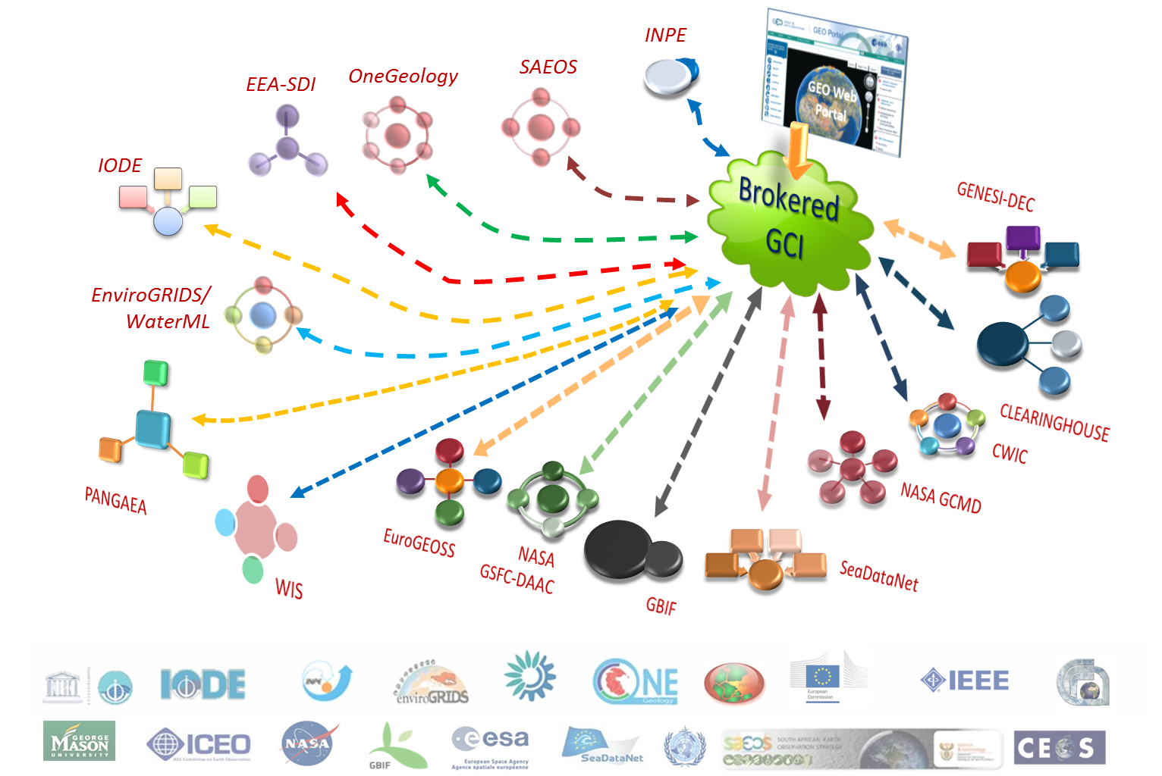
Interoperability Brokers

Slide 7

GEOSS Implementation requires:
Data Sharing Principles
Full and Open Exchange of Data…
  Recognizing Relevant International Instruments and National Policies and Legislation
Data and Products at Minimum Time delay and Minimum Cost
Free of Charge or Cost of Reproduction for Research and Education
Notes:
See slide text

Slide 8
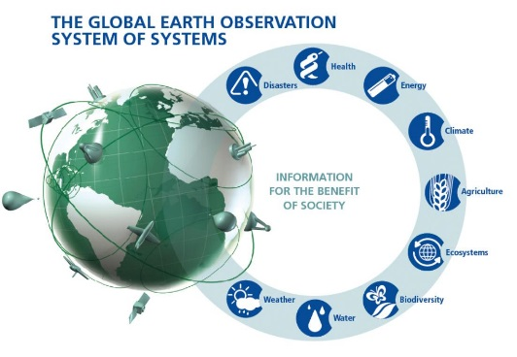
Climate
Before 2015, GEO aims to:
Achieve effective and sustained operation of the global climate observing system and reliable delivery of climate information of a quality needed for predicting, mitigating and adapting to climate variability and change, including for better understanding of the global carbon cycle.
This will be achieved through:
the full implementation of the GCOS as the climate observing component of GEOSS, and especially through strong support for the climate-relevant functions and activities of GOOS, GTOS, GOS and GAW, WCRP, and CEOS.
promotion of data sharing as well as coordination of data management and exchange systems;
contributions to major advances in the monitoring and prediction of climate on seasonal, interannual and decadal time scales, including the occurrence of extreme events;
strengthened GCOS support for the assessment role of the IPCC and the policy development role of the UNFCCC;
enhanced efforts for data rescue and digitization.

Slide 9
Water
Before 2015, GEO aims to:
Produce comprehensive sets of data and information products to support decision-making for efficient management of the world's water resources, based on coordinated, sustained observations of the water cycle on multiple scales.
WA-01 Integrated Water Information (incl. Floods and Droughts)
C1: Integrated Water-cycle Products and Services
C2: Information Systems for Hydro-meteorological Extremes C3: Information Service for Cold Regions
C4: Global Water-Quality Products and Services
C5: Information System Development and Capacity Building

Slide 10
GEO post-2015: Strategic Objectives
GEO will function as a catalyst for Earth observations, coordinating Earth observations, seeking active collaboration with other initiatives having EO mandate
GEO will commit appropriate resources to implement and sustain a more robust and expanded GEOSS information system including repositories of “big data”…
GEO will cultivate specific global initiatives, applications and services based on Earth observations, to be adopted, supported, and managed by specific governments and organizations

Slide 11
for WCRP
GEO is a framework to promote international cooperation.
  bringing together data architecture experts, scientists, users, and capacity-building specialists.
  visibility as data/networks/systems contributing to society.
  developing capacity to collect and use Earth observations, and promoting regional coordination in collaboration with Member countries
  facilitating the delivery of global datasets to improve modeling, e.g. virtual constellations
  engaging with users and decision-makers
  supporting research and development of integrated applications of Earth observations;
    but GEO is not a funding mechanism!

