Slide 1
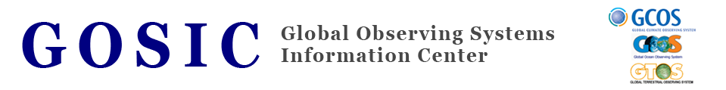


Essential Climate Variables (ECV)
Inventory
Christina J. de Groot-Lief
Program Manager
WCRP Data Advisory Council 3rd Session
May 6-7, 2014
Galway, Ireland
NOAA/NESDIS
National Climatic Data Center
Asheville, NC

Slide 2
Essential Climate Variable (ECV) Inventory History:
Effort started in January 2011
Endorsed by CEOS Working Group on Climate, the Global Climate Observing System (GCOS) and WMO Space Programme
Initial workshop: “Continuity and Architecture Requirements for Climate Monitoring – First Workshop on Space-based Architecture for Climate.”
Workshop produced strategy document that focuses on satellite observations for climate monitoring from space, and the need for an international architecture that ensures delivery of these observations over the timeframes required for analysis of the Earth’s climate system.

Slide 3
Essential Climate Variable (ECV) Inventory History (cont’d):
Need to evaluate the current data capability through a systematic and granular assessment of the production of the Thematic Climate Data Records at the level of the individual agencies using questionnaire
Online CEOS ECV Questionnaire for Satellite data was designed by the CEOS Systems Engineering Office (SEO) at the NASA Langley Research Center in Hampton, VA
The questionnaire is in two parts:
  The first part documenting the present and historic datasets
  The second addressing the future/planned datasets.
The focus of the questionnaire is on ECV Products/Thematic Climate Data Records (TCDR) and not Fundamental Climate Data Records (FCDR).

Slide 4
In-situ Questionnaire development History:
The ECV questionnaire for in-situ data was based on the ECV questionnaire for Satellite data
A joint effort between NCDC, GOSIC and CICS adapted the questionnaire for in-situ data
CEOS SEO developed the online in-situ questionnaire
Beta version of in-situ questionnaire has been completed and is presently going through initial quality control
Once this stage is completed, in-situ questionnaire will be made available through googledocs for evaluation and comments to the International Panels

Slide 5
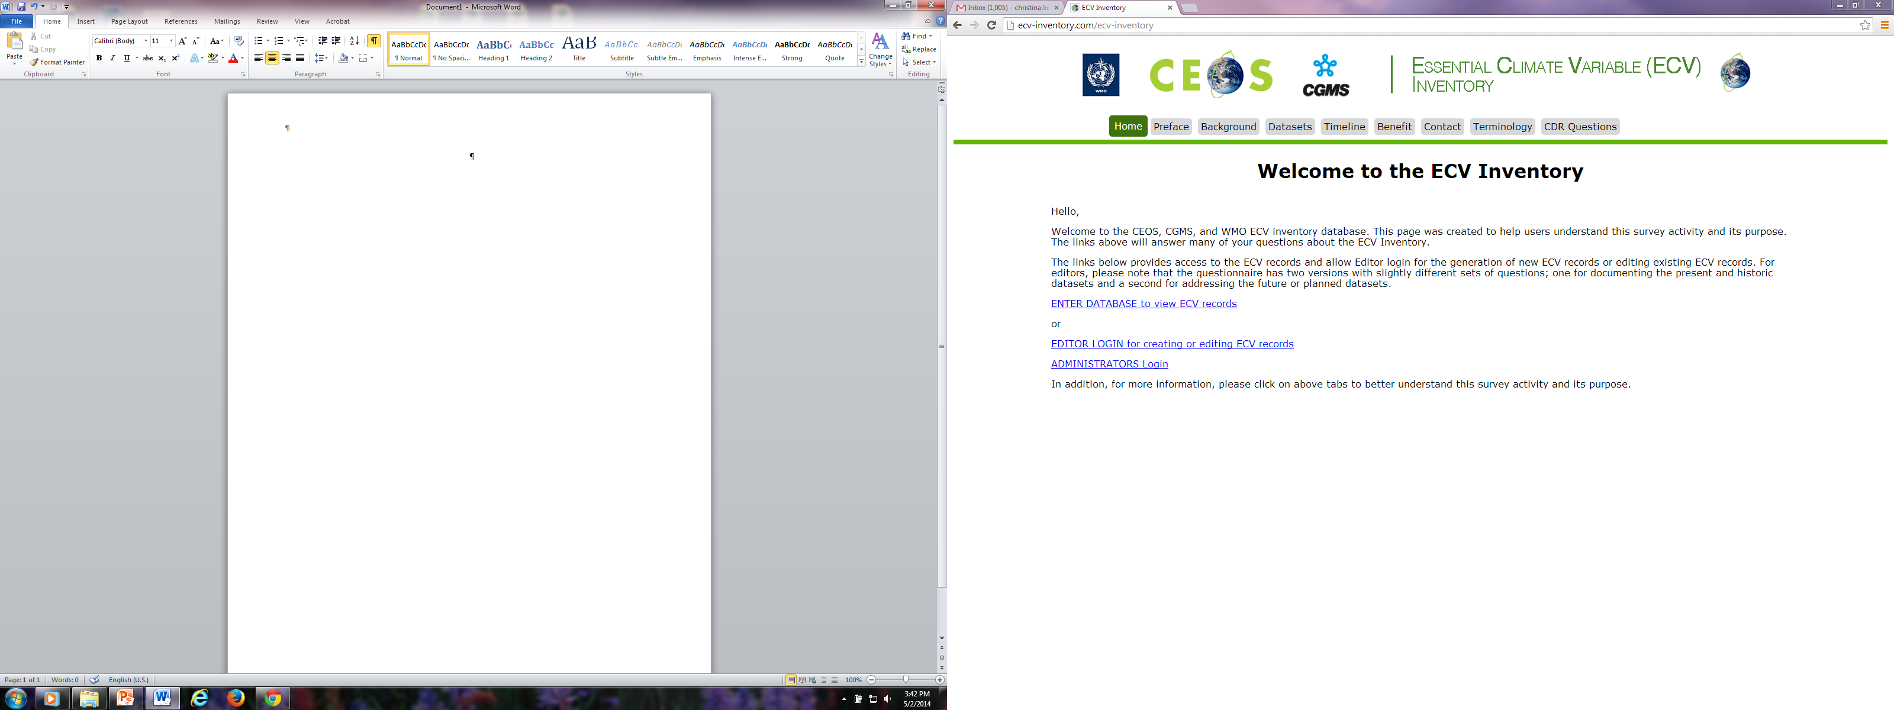
Online ECV Inventory
http://ecv-inventory.com
Notes:
This is a partial illustration of the GOSIC Home Page. It is a partial view.

Slide 6
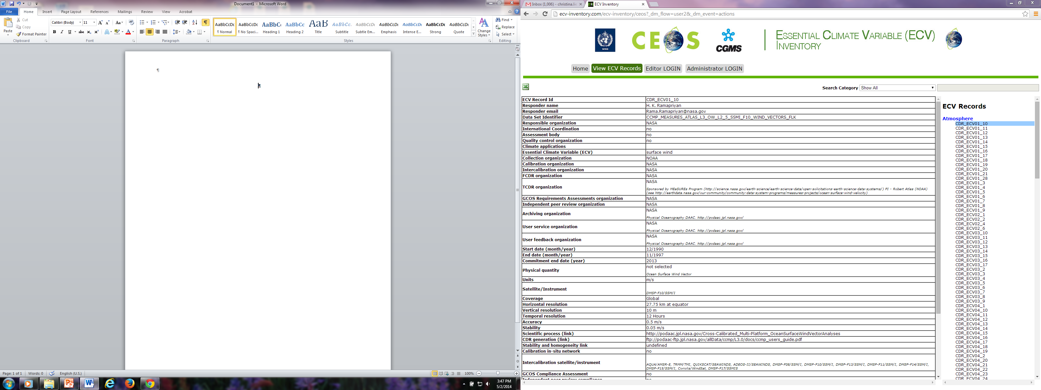
Listing of Individual ECV Records
Notes:
This is a partial illustration of the GOSIC Home Page. It is a partial view.

Slide 7
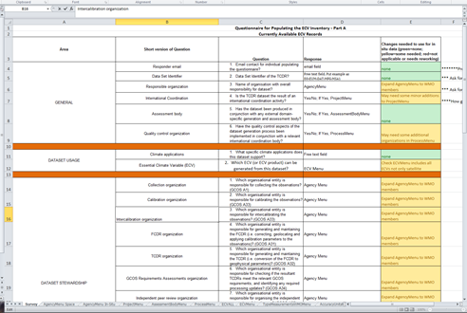
View of in-situ Questionnaire in MS Excel Spreadsheet
Notes:
This is a partial illustration of the GOSIC Home Page. It is a partial view.

Slide 8
  Where the GOSIC can contribute:
  Provide an ECV Data and Information clearinghouse Portal
  Provide data access and discovery tool(s) to in-situ and satellites ECV data sets and documentation working with a diverse group of organizations and groups (e.g., WCRP, TOPC, GEO, and CEOS)
  Provide tools to document data sets such as the ATRAC metadata creation tools
  Facilitate communication

Slide 9


Christina J. de Groot-Lief
NOAA/NESDIS/NCDC
Asheville, NC
Phone: +1-828-271-4101
e-mail: christina.lief@noaa.gov

