Slide 1

CORE-CLIMAX activities relevant to WDAC3
P. Poli

Slide 2
Outline
CORE-CLIMAX project
Components relevant to WDAC3:
(other than dataset maturity – already covered at last meeting by J. Schulz)
Reanalysis user and application survey results
Feed-back of reanalysis improvements to CDR generation
Capacity building
Reanalysis inter-comparison procedure
Conclusions

Slide 3
CORE-CLIMAX project
Funded by EU FP7 for 2.5 years (Q1 2012-Q2 2014) , grant agreement Nº 313085, 2M€ funding
A coordination activity
  Not to carry out research and development activities
Offers us the possibility to catch-up on items usually left to “best-effort business”, in particular:
  In connection with users
  In connection with how we exchange information between each another (reanalysis producers, CDR providers)
  In connection with how we try to come up with ‘standards’ between ourselves

Slide 4
CORE-CLIMAX consortium
9 partners
  ITC U. Twente, NL
  EUMETSAT
  ECMWF
  Deutscher WetterDienst
  VITO, Belgium
  Finnish Meteorological Institute
  Meteo-France
  Institute of Tibetean Plateau Research (ITP)
  Cold and Arid Regions Environment and Engineering Research Institute (CAREERI)

Slide 5
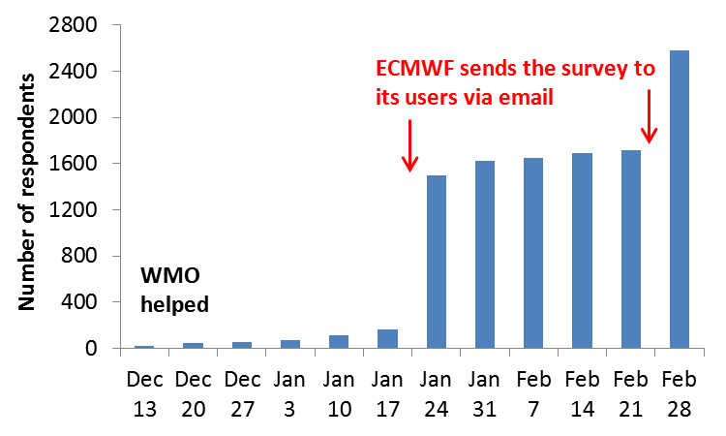
Engaging with users
Reanalysis user and application survey
  Last wide survey known to us was the ERA-40 user survey, which had attracted <200 respondents
  About 2600 respondents for this survey, organised by FMI
  We contacted about 23,000 users of ECMWF products (16,000 of which registered for ERA-Interim), and NOAA CIRES contacted 20CR users
Figure excerpt from Core-Climax D5.52, under responsibility of FMI, 2014

Slide 6
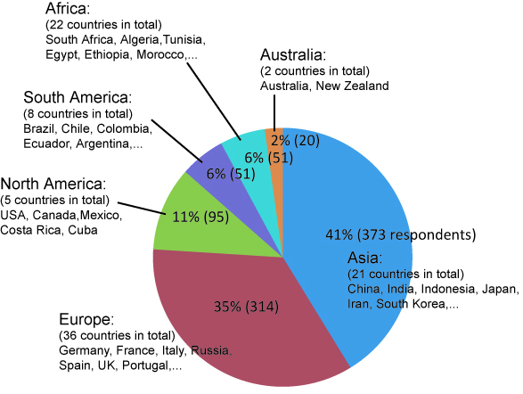
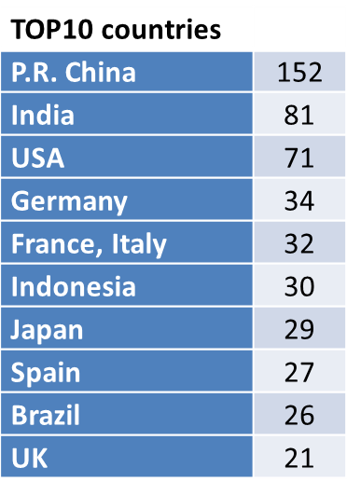
Reanalysis and user application survey results: who responded
Based on 904 responses
Figure excerpt from Core-Climax D5.52, under responsibility of FMI, 2014

Slide 7
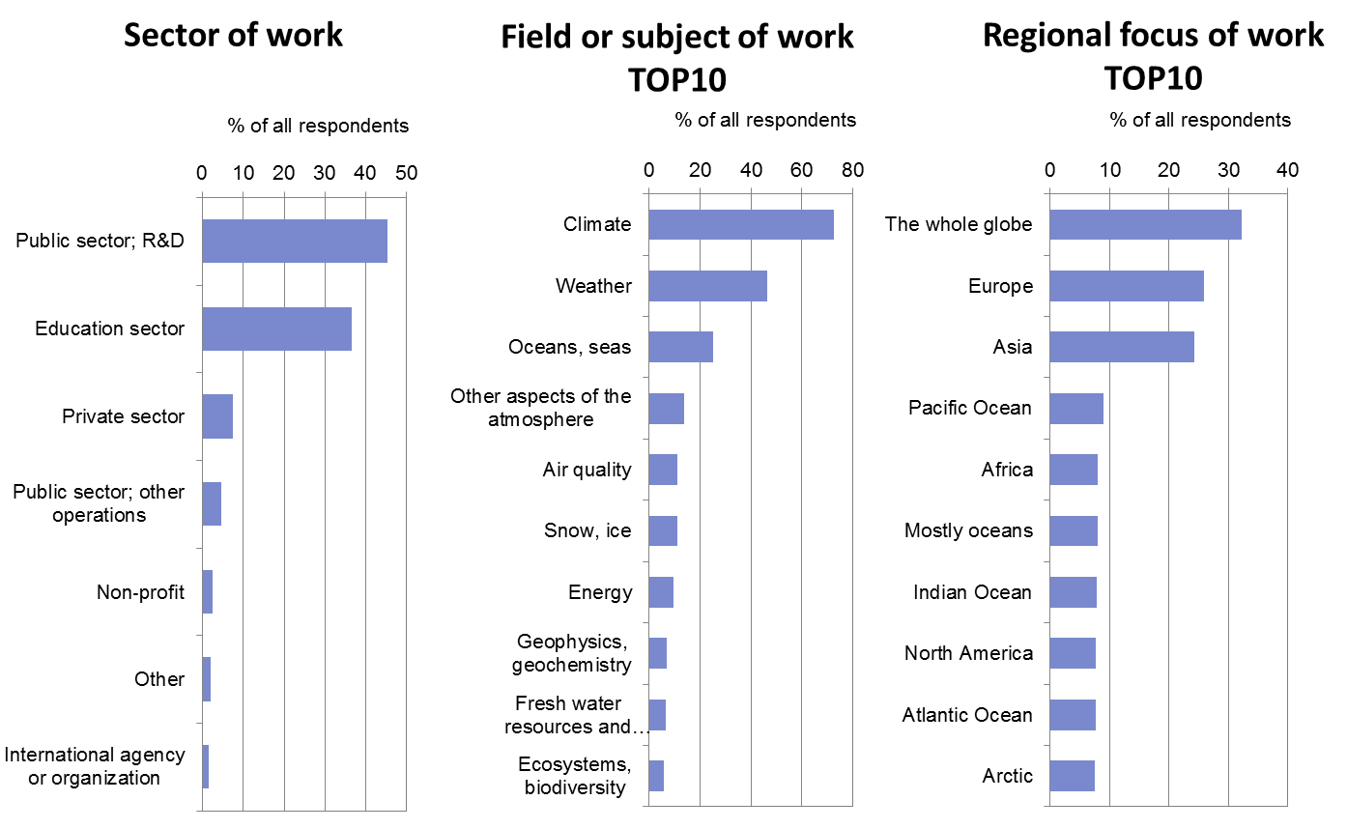
Reanalysis and user application survey results: who responded
Based on 2567 responses
Figure excerpt from Core-Climax D5.52, under responsibility of FMI, 2014

Slide 8
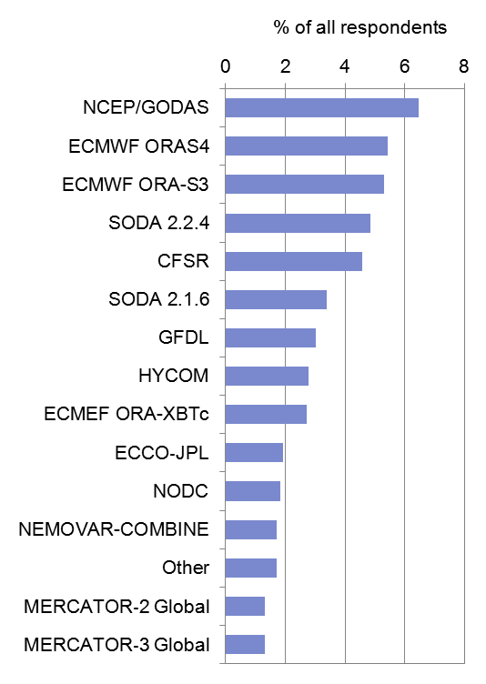
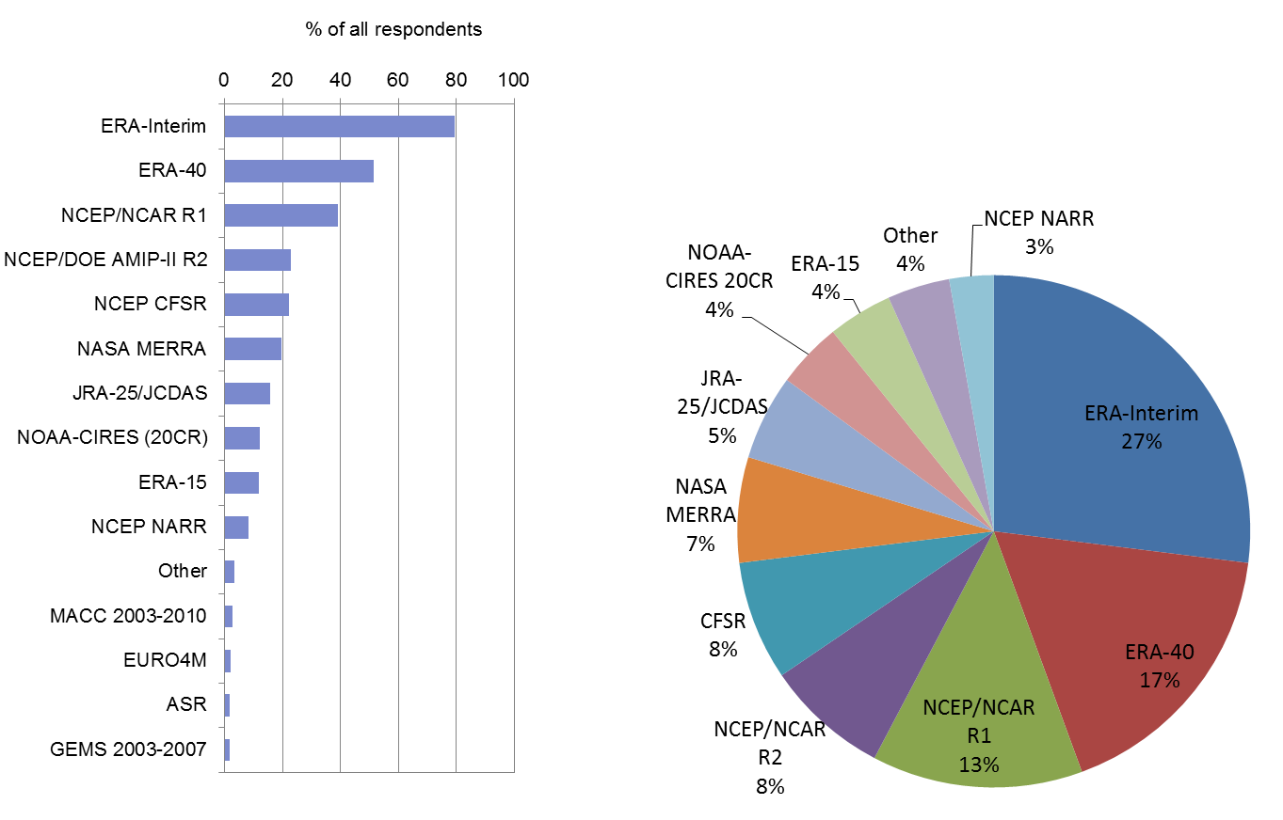
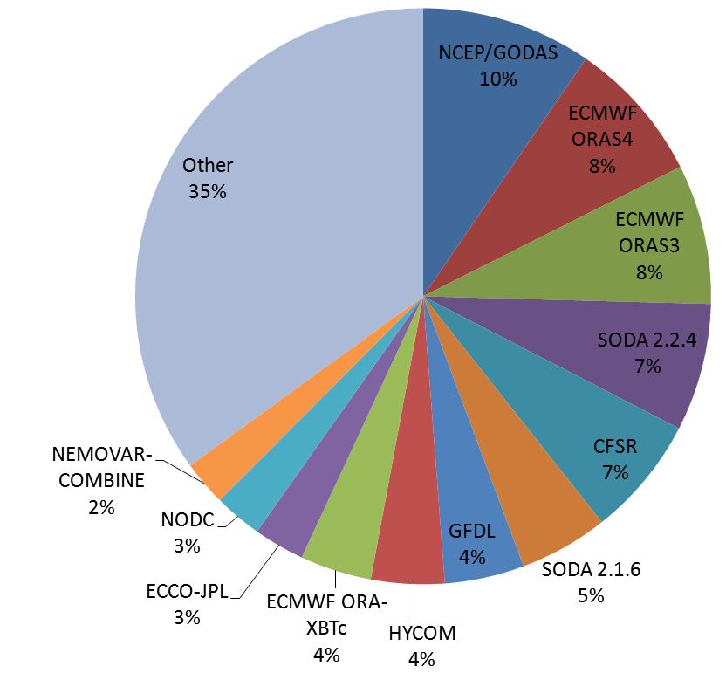
Which reanalyses do they use?
Beware that most respondents, ECMWF product users, participated very likely because the survey was advertised to them by email.
Based on 2502 responses
Figure excerpt from Core-Climax D5.52, under responsibility of FMI, 2014

Slide 9
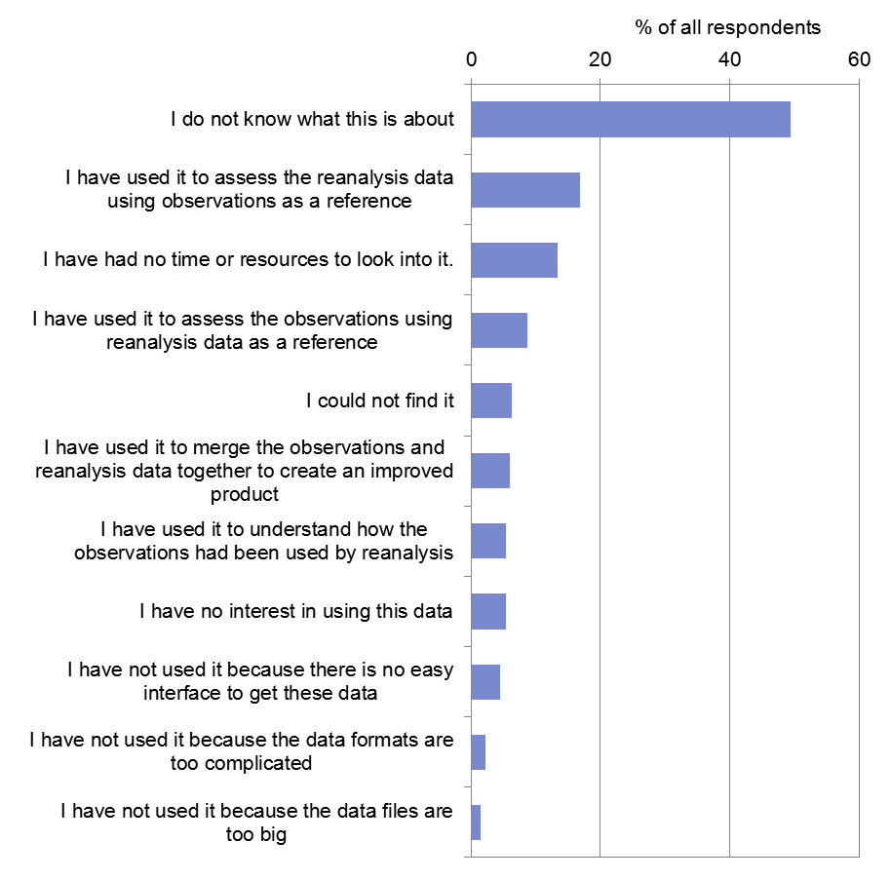
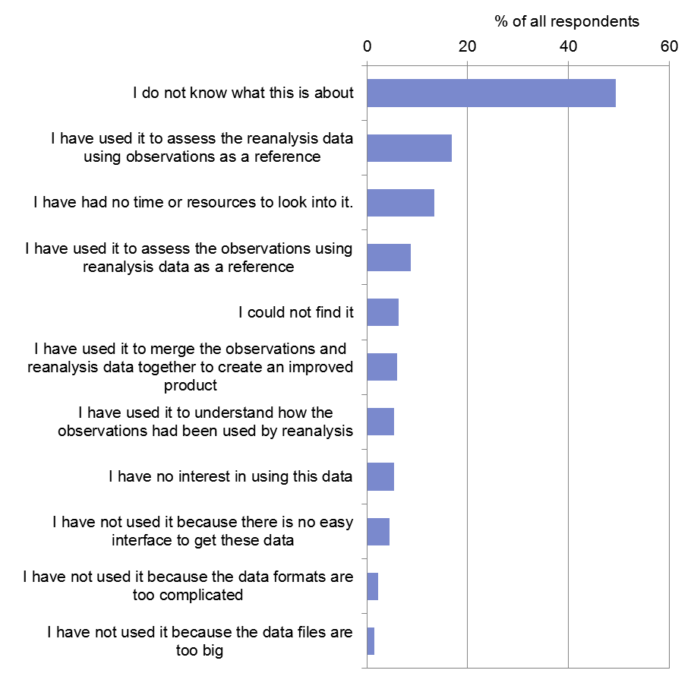
About reanalysis input observations and feedback data
Based on 2473 responses
Either unknown, or plenty of valid reasons why it’s not usable at present
Figure excerpt from Core-Climax D5.52, under responsibility of FMI, 2014

Slide 10
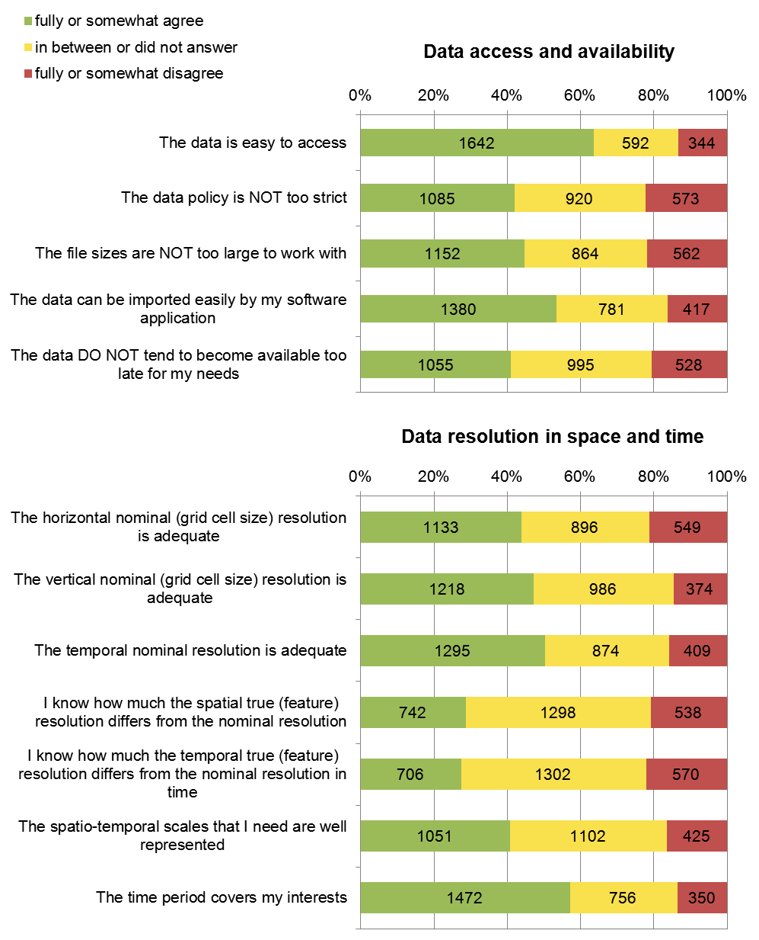
Another conclusion
More than half the users already admit problems dealing with data sizes... Also more than half asks for greater spatio-temporal resolution! (not sure they are the same users…).
The answer cannot be to provide Nx larger datasets to meet their needs.
Instead, it is probably time to seriously start exploring subsetting, processing, and visualization on-demand so users can reliably extract just what they need.
Based on 2486 responses
Figure excerpt from Core-Climax D5.52, under responsibility of FMI, 2014

Slide 11
Looking to formalize processes or encourage ‘best-practice’
1. Observing systems
2. Observation records
3. Climate data records
4. Essential climate variable products
5. Climate services
The WPs of the project explore some of the steps above.
WP4 in particular explores the feedback of reanalysis to updates of CDRs

Slide 12
WP4 initial conclusions
Based on consulting (thanks to visits) with various CDR data providers who use reanalysis as ancillary data in their processes:
There is a need to better identify reanalysis products uniquely and adopt traceability
  Possible solution is for all reanalysis producers to adopt Digitial Objet Identifiers (DOIs)
  Beforehand it would be nice if they agreed between themselves, so a single system gets adopted (e.g., Tag individual fields? Tag by geophysical variable? Tag by post-processed resolution?)
There are multiple needs for data formats.
  Reanalysis data providers need to support them all or come up with standard data format converters

Slide 13
WP4 initial conclusions (cont.)
Data access is still a major problem
  Should we explore solutions to allow for users’ processing where the data are, rather than trying to push ever-more data to users who are, yes, interested in resolution, but only at some locations or to compute some grand averages/budgets anyway?
  Side thought: as trends are for computing capacity to double faster than archiving capacity, there will become a point when it is not practically feasible to imagine that users have to download masses of data to do their processing. Raises many questions…
“How good are the reanalysis products?”
  Long-standing question which further justifies the move toward ensemble of reanalyses, whereby the spread is a first proxy for uncertainty
  Consequences/opportunity for regional reanalyses to also propagate/build upon this ensemble information and add value

Slide 14
Capacity building
First capacity building workshop was held at FMI in March 2014. Topics covered include:
  Existing datasets and tools for climate services
  Reanalysis and data assimilation
  Choosing data fit for application
  Format was 1/3 lecture, 2/3 hands-on practical
A second workshop, opened to everyone, is planned for the EMS in Prague.
Please advertise and mention to contact <w.j.timmermans@utwente.nl> to register interest.

Slide 15
Procedure for inter-comparison of reanalyses
Not an R&D activity
First draft in progress, document to be delivered in 2014
Don’t expect miracles: when it comes to covering the full scope of data produced by reanalyses = hard work (and sometimes even possibly non-conclusive)
For gridded fields the comparisons may be deceptively easier than for fit to observations (observation feedback)
Comparing observation feedback could prove more conclusive to evaluate one reanalysis dataset against another (and understand strengths & weaknesses in each)
  Each reanalysis system tries to look its best to form quantities equivalent to the observations, because departures drive increments
  Observation feedback access in the works (e.g., ERA-CLIM2)
  Simple problem, however: no standards to get feedback that we can compare between reanalysis systems

Slide 16
CORE-CLIMAX-sponsored coordination meetings
Planned at ECMWF
Pending formal acceptance, but hopefully in 2014
Coordination Meeting Towards Exchanging Reanalysis Observation Feedback and Blacklists
  Focus on global atmospheric reanalyses for a practical start
  Very likely during the week starting 10 November 2014
Coordination Meeting Towards a Global Archive of Historical In Situ Snow Data
  Difficult to find single point of contact at national levels, archives are not always consolidated nationally

Slide 17
Selected take-home points
The effectiveness of this coordination project (without R&D) in isolating simple, effective tracks for improvements is far beyond our expectations
  European research on climate change needs more of this (ESF?)
“Access” stands out as a buzzword in all issues discussed:
  Access to training and information about reanalysis product limitations and applicability
    1 remaining capacity building ahead: EMS Prague
  Access to increasingly large datasets
    Would the way forward be to move user processing to the data servers?
  Access to observation feedback
    Coordination meeting to agree on a way forward to exchange feedback between 4 global atm. reanalysis producers

