Slide 1
WDAC3, Agenda item 3. Flux analysis and modeling
Data Assimilation, Uncertainties
Paul Poli
Participation to WDAC3 on behalf of Jean-Noel Thépaut
WCRP Data Advisory Council 3rd Session
6-7 May 2014
AULA MAXIMA, National University of Ireland, Galway, IRELAND

Slide 2
Outline
Uncertainties are central to the problem of data assimilation
Uncertainties in fluxes produced: example with ERA-20C
  Wave energy flux into the ocean
  Downward radiation at a buoy
  Snowfall over Siberia
Conclusions

Slide 3

Introduction to the estimation problem
“Observations-only”
data record
Gross exaggeration towards discontinuity
“outliers”
Analysis
(ensemble)
“Model only”
integration
(ensemble)
Gross exaggeration towards ‘lack of realism’

Slide 4
(explanation of the previous slide)
Data assimilation
  Historically used to reduce uncertainties in a system state estimate
  So that resulting state estimate would be of better quality, so as to initialize forecasts
Data assimilation is thus a particular case of estimation problem, optimally combining observations with a model-based estimate, to produce the best so-called analysis state estimate which would subsequently yield the best forecasts
This is very different from the problem of estimating statically a series of states from observations without the help of physical model
It is complementary to other such methods that estimate a series of past states of the Earth’s fluid envelope using statistical filters
However, data assimilation carries in it the legacy of a step-wise, forward-looking reconstruction, adapted to and geared towards NWP needs

Slide 5
What we know… and what we don’t…
Examples
Known knowns
Observations
Physical laws (dynamics, radiation, spectroscopy…)
Quality control procedures
Known unknowns
Observation errors
Forecast model behavior
Boundary, forcing conditions
Initial conditions
Unknown unknowns
Lu and Bell, 2014: microwave sounders frequency shifts are so large that they impact instrument responses
Meunier al., 2013: whitecaps over ocean (wave foam) impact microwave emissivity
Kobayashi et al., 2009: SSU cell pressure changes are so large that they impact RT response
Numerical forecast models
Deterministic verification (yes/no)
Fast pace of progress
This presentation
Examples
Ensemble verification (statistical measures)
Former examples (now known):
Conceptual justification (good reasons why…)
Very slow pace of progress (break-throughs)

Slide 6
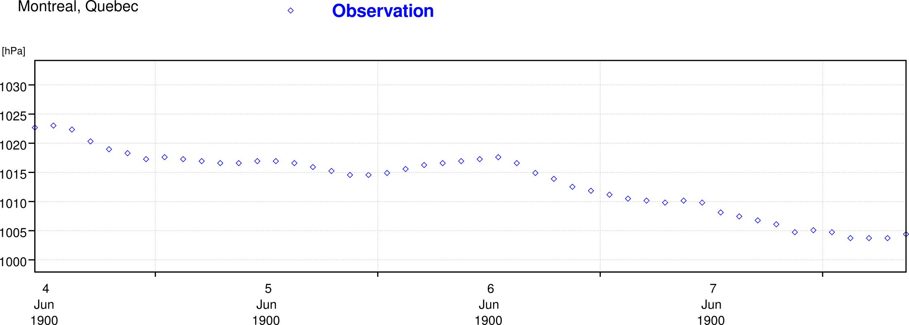
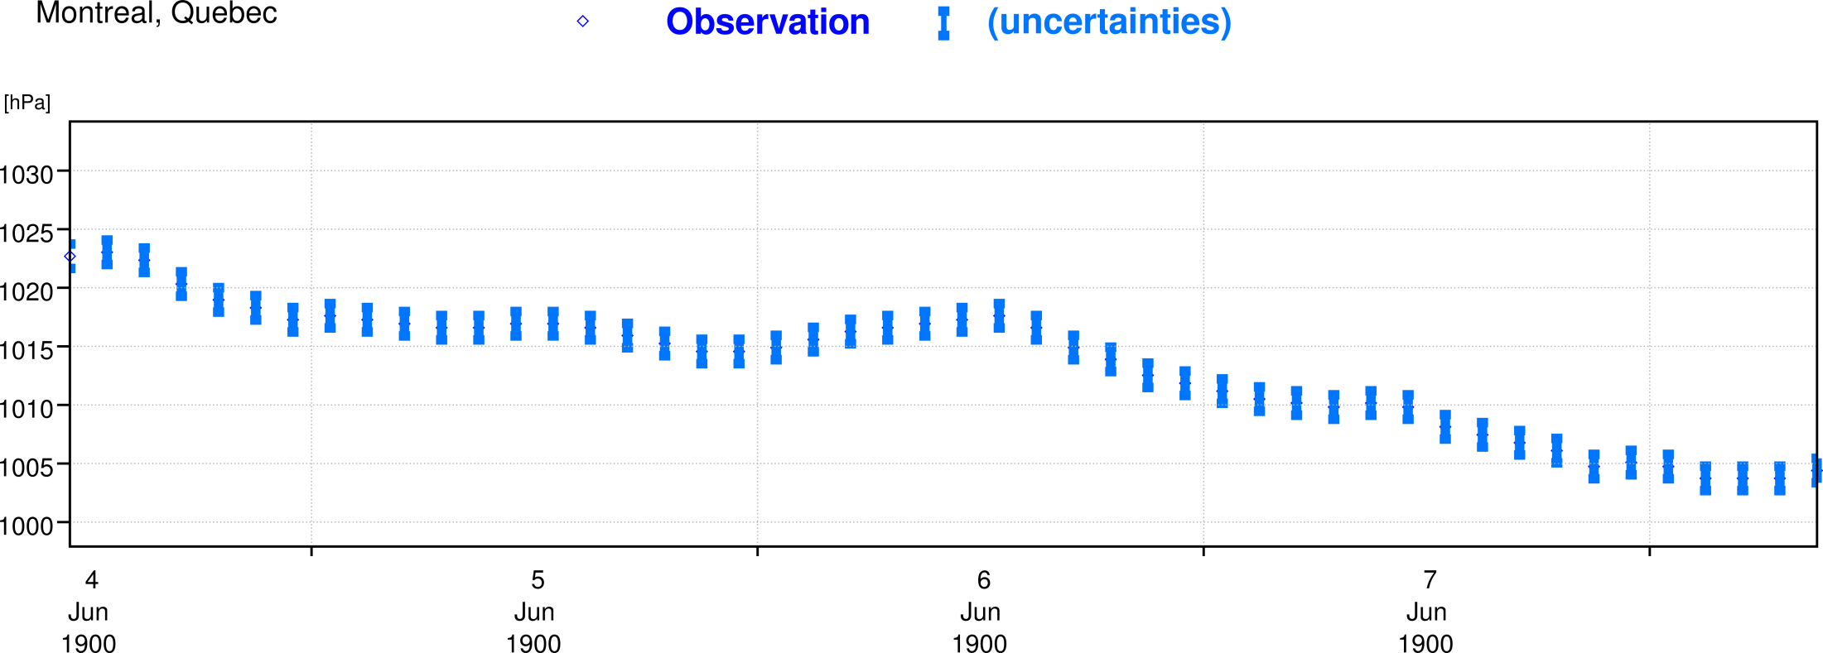
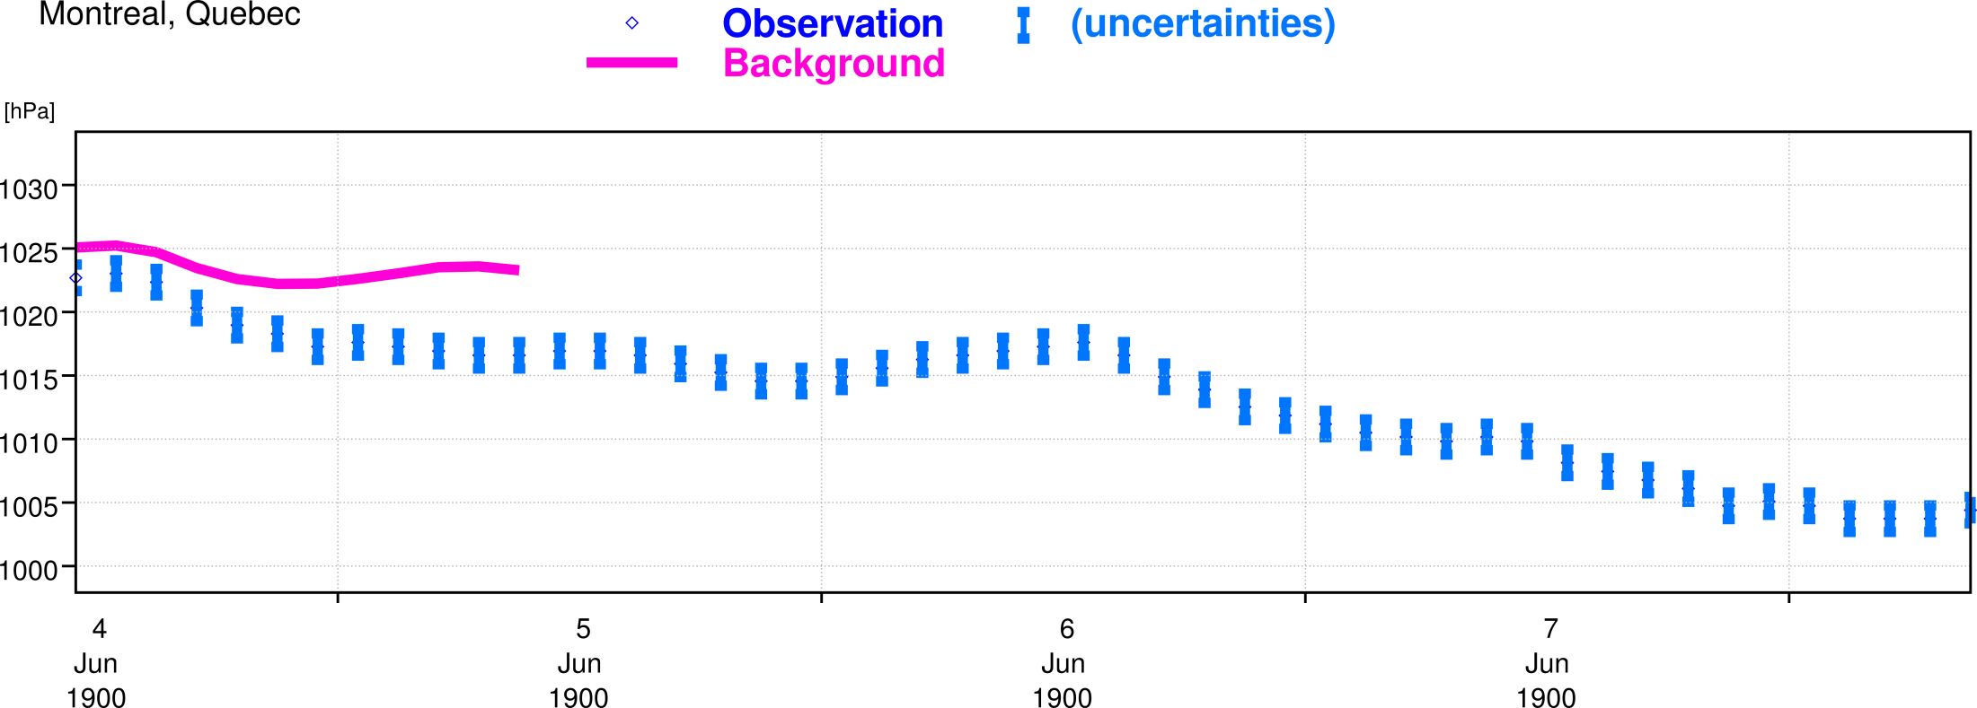
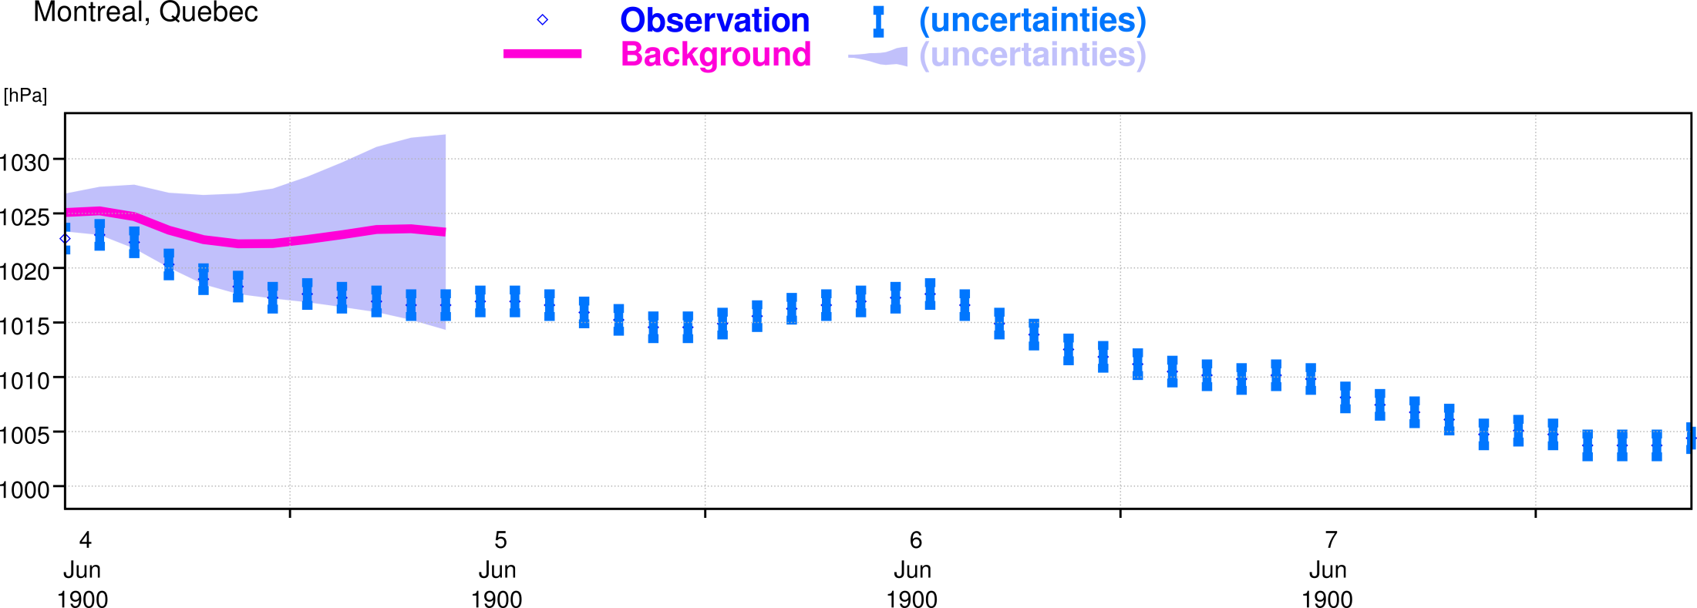
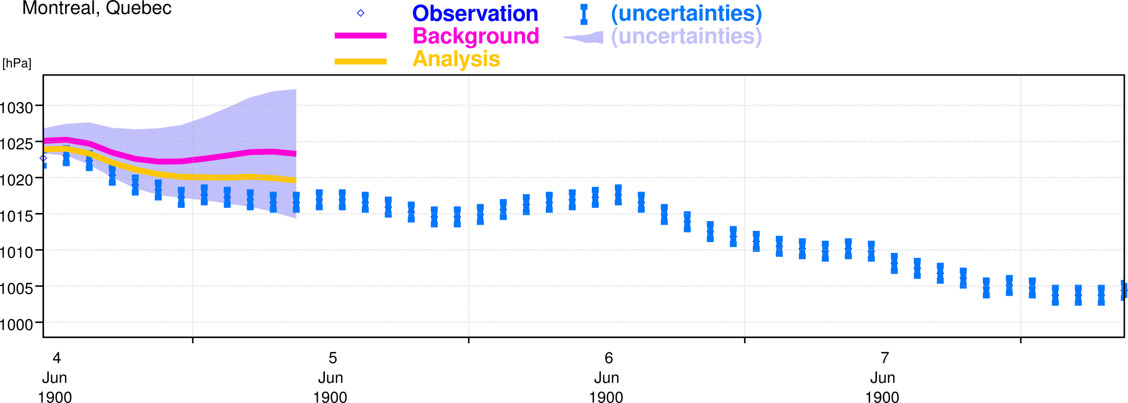
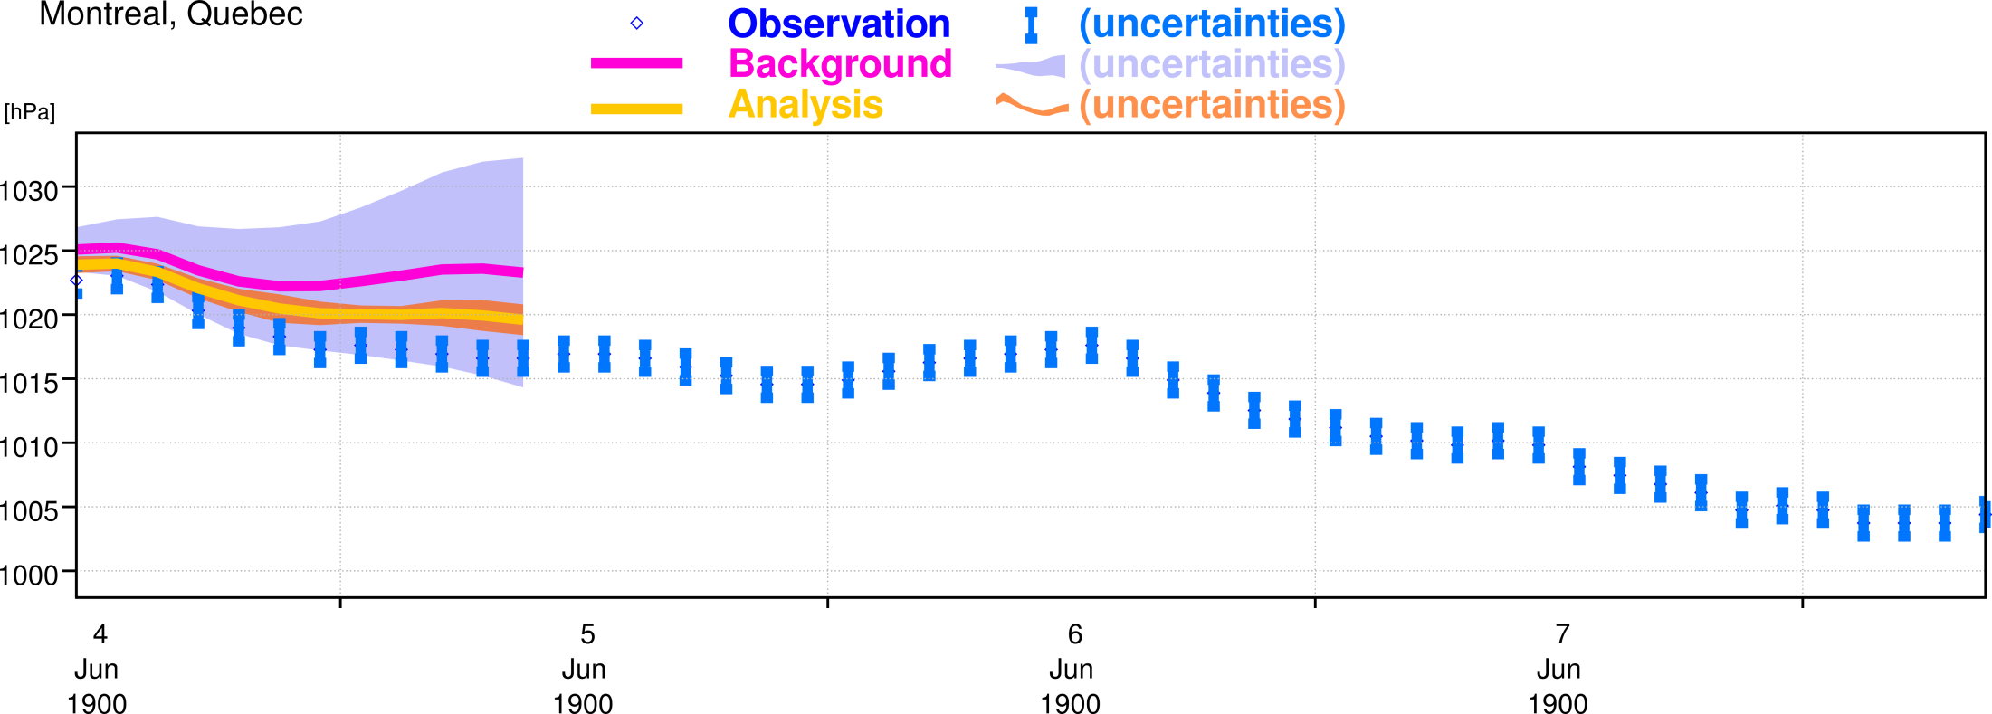
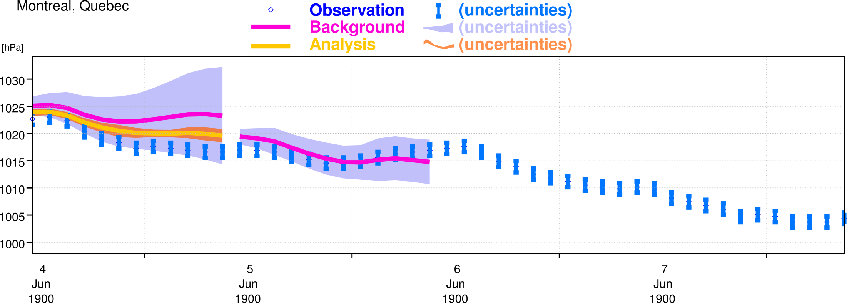
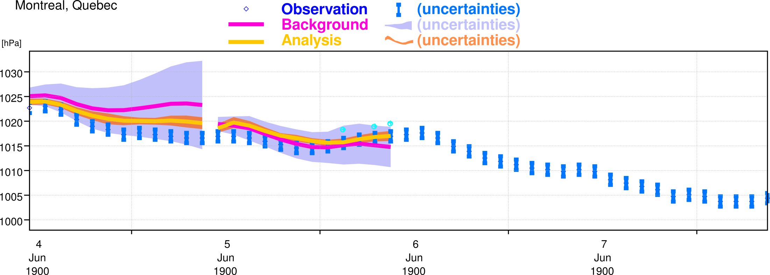
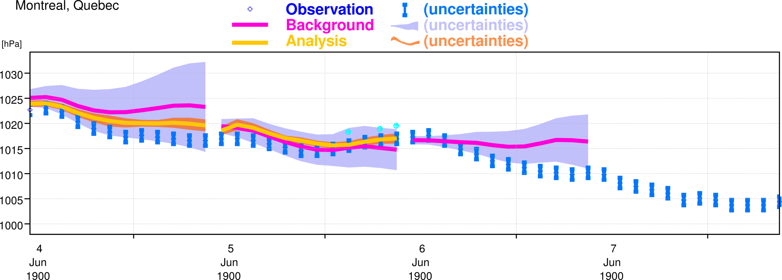
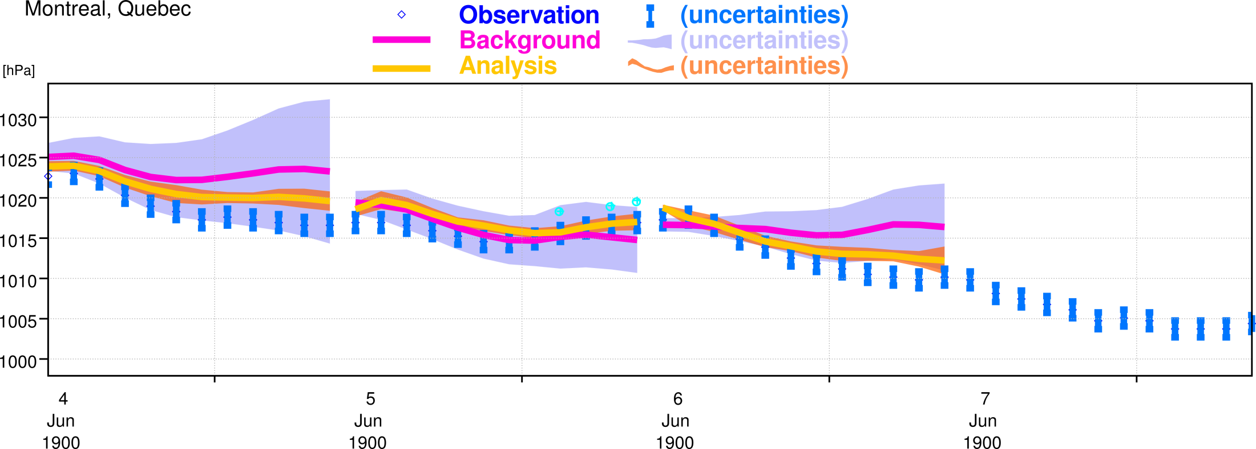
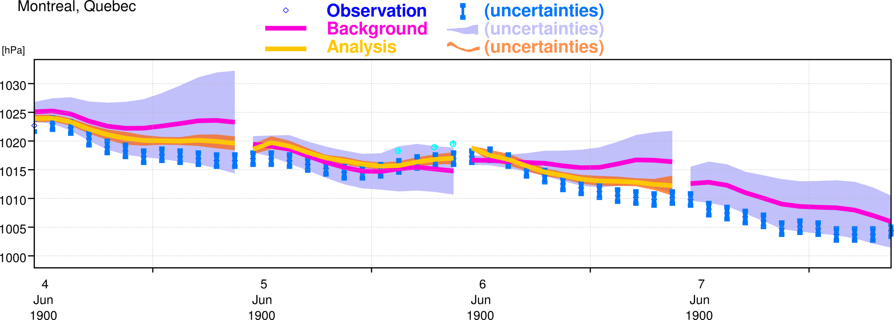
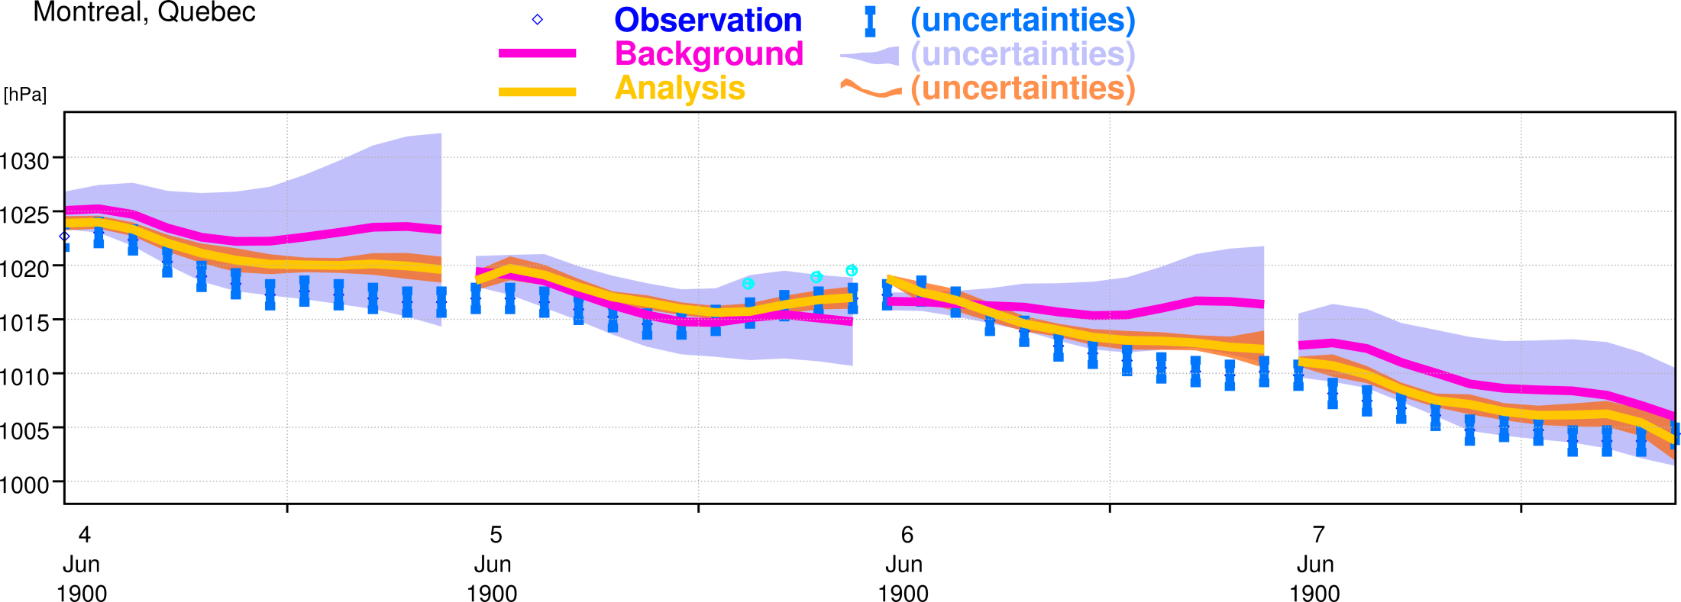
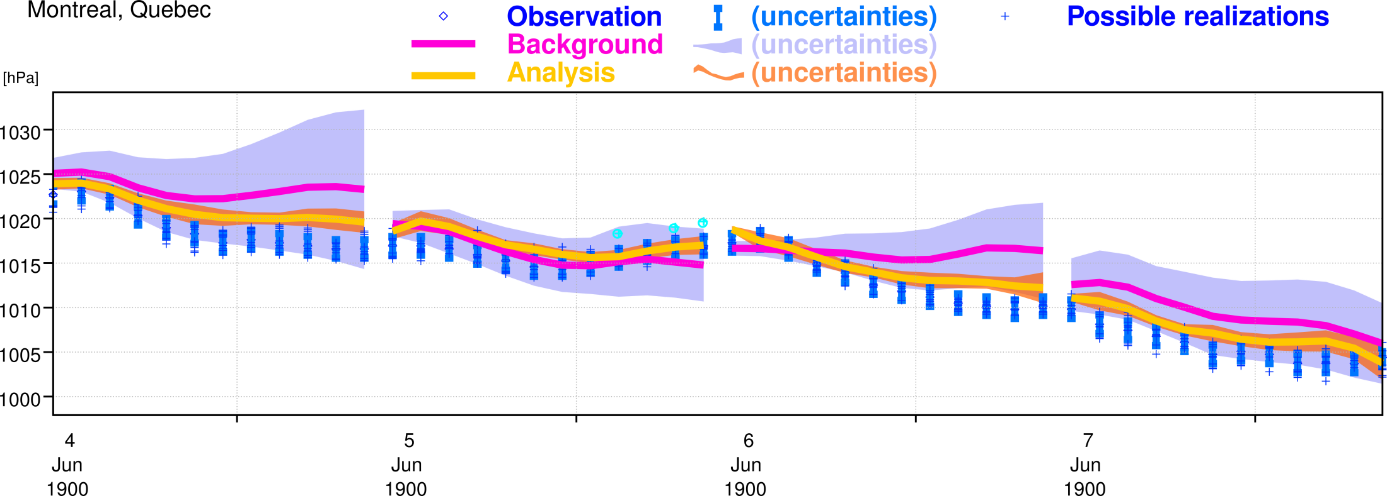
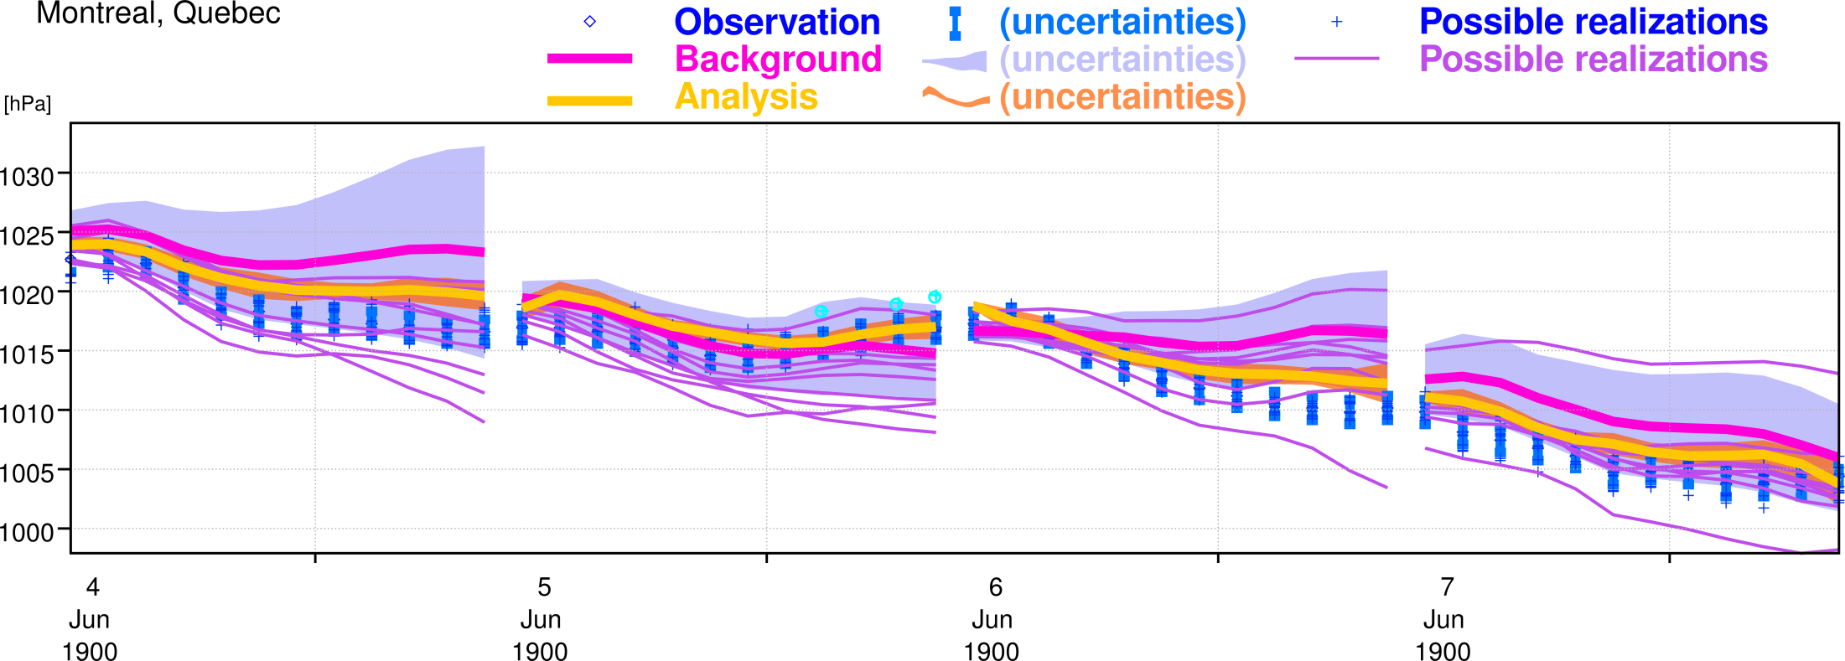
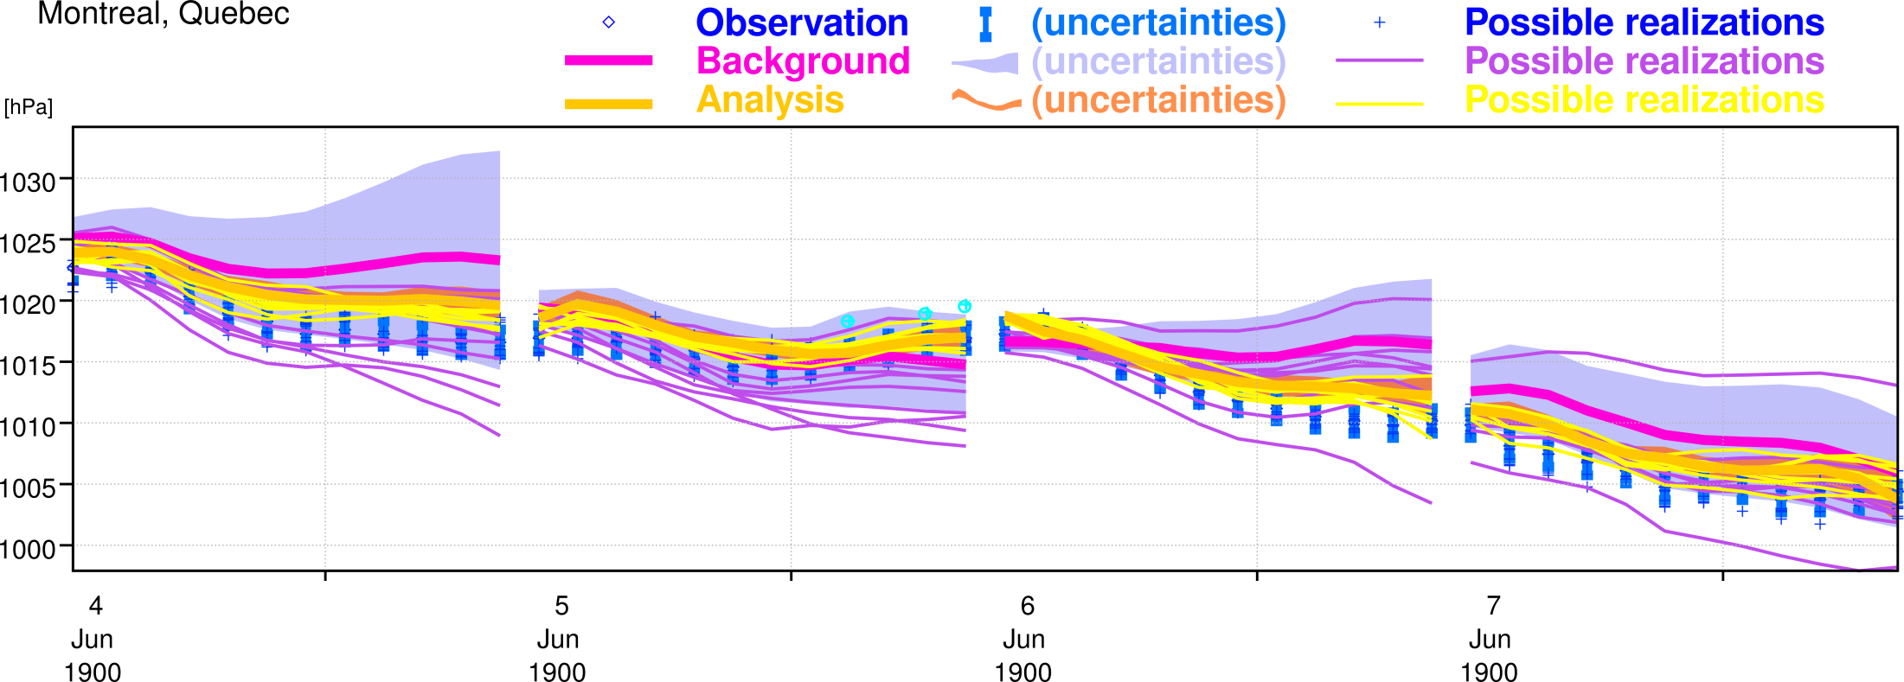
Using uncertainties in (24-h) 4DVAR data assimilation
10 members

Slide 7
Explicit representation of uncertainties
ERA-Interim (~ECMWF OPS NWP circa 2006) | ERA-20C (~ECMWF OPS NWP circa 2014)
Observation error variances Biases estimated for some observables | Observation error variances Biases estimated for some observables
 | Forecast model stochastic physics
 | SST forcing dataset ensemble (HadISST.2.1.0.0)
Background error covariances estimated once and for all (~constant with time and location) | Background error covariances estimated by the ensemble (variable with time and location)
Note: ERA-20C only uses a subset of the observing system, namely surface observations of pressure (ISPD 3.2.6) and marine winds (ICOADS 2.5.1)
See animation of data coverage in terms of surface pressure (or http://www.youtube.com/watch?v=NUfdFCHoxHM ) and animation of data coverage in terms of surface marine wind (or http://youtu.be/Qsy_ZvH7Bjw)

Slide 8
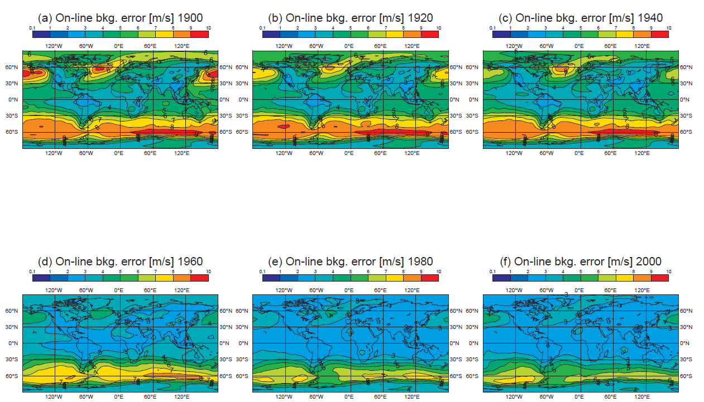
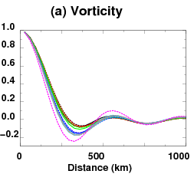
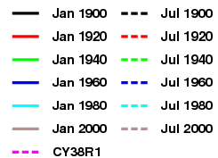
Background errors estimated by ERA-20C ensemble
Over the course of the century, background error variances become smaller, horizontal structure functions become sharper
[m/s]
Zonal wind
1900
1960
2000

Slide 9
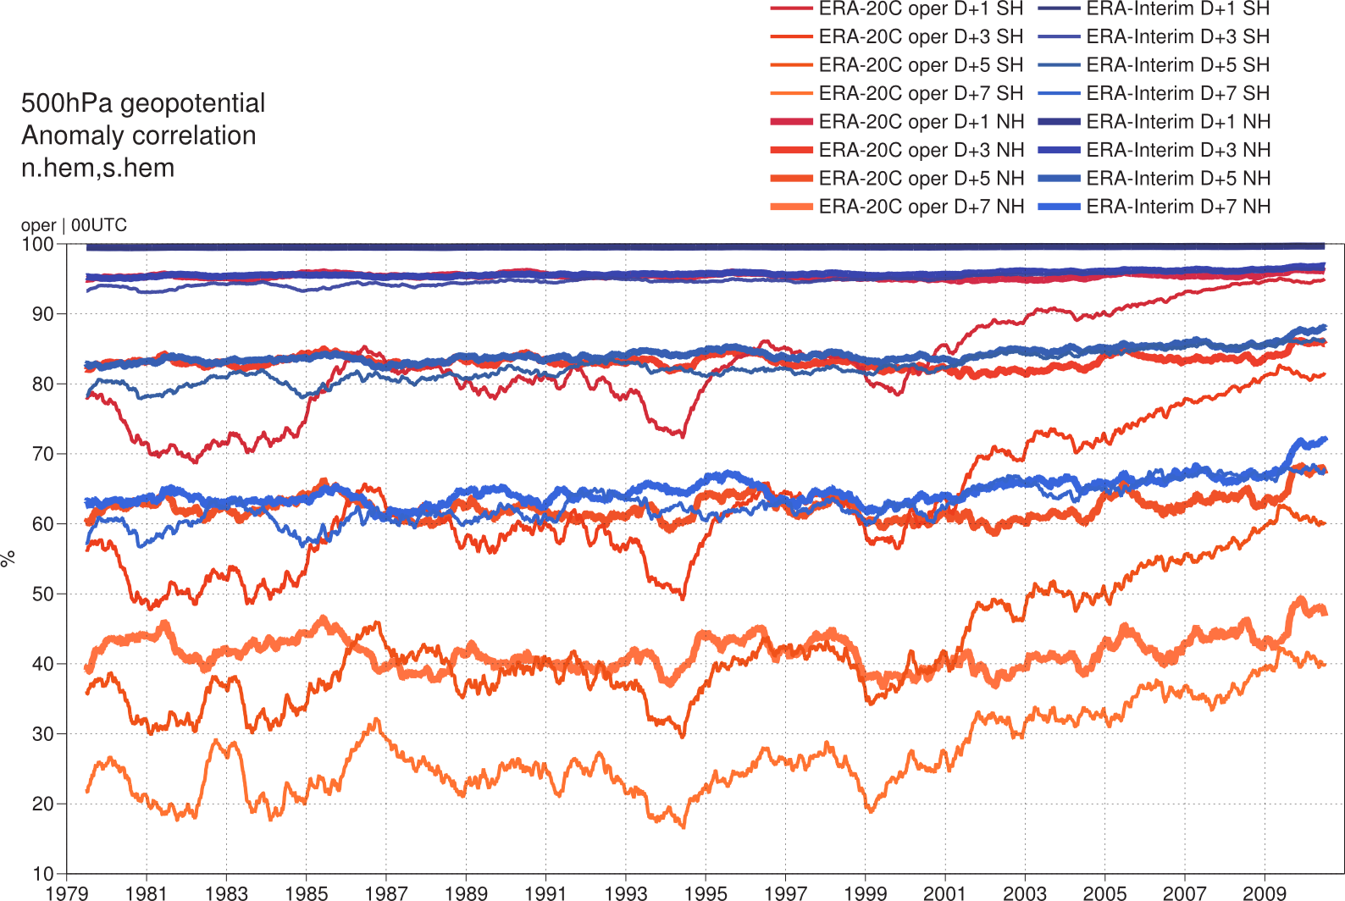
A measure of total uncertainty: 1- to 7-day forecast scores, verified w.r.t analyses
Removing all observations from the assimilation except for PS & marine U10 results in about 2 day-loss in forecast skill for Z500
D+1 ~ D+3
D+3 ~ D+5
D+5 ~ D+7
Impact of buoys/ southern ocean drifters?
Such metrics, although important, don’t really give users a quantitative measure of product uncertainties which they can directly use in their application.

Slide 10
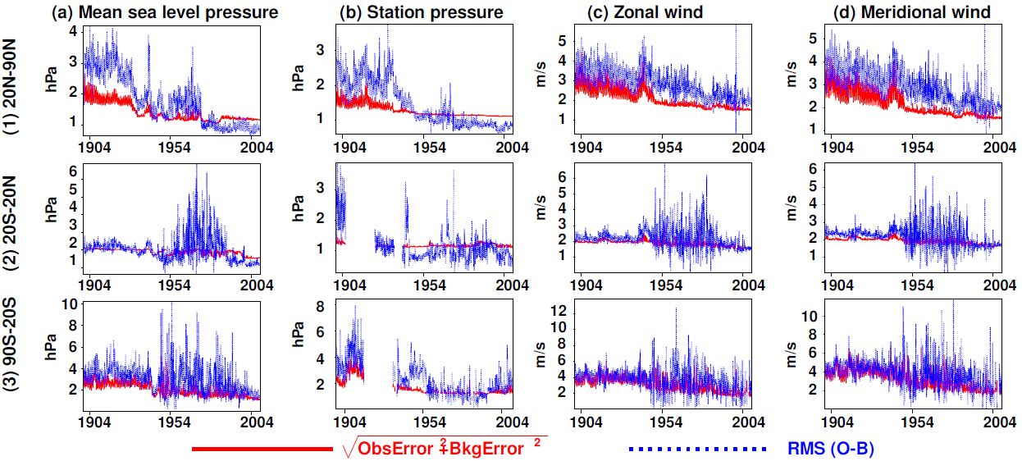
Another measure of total uncertainty, but for observations assimilated: error budget closure
Showing only observations assimilated in the first 90 minutes of the 24-hour 4DVAR window
Assumed
Actual

Slide 11
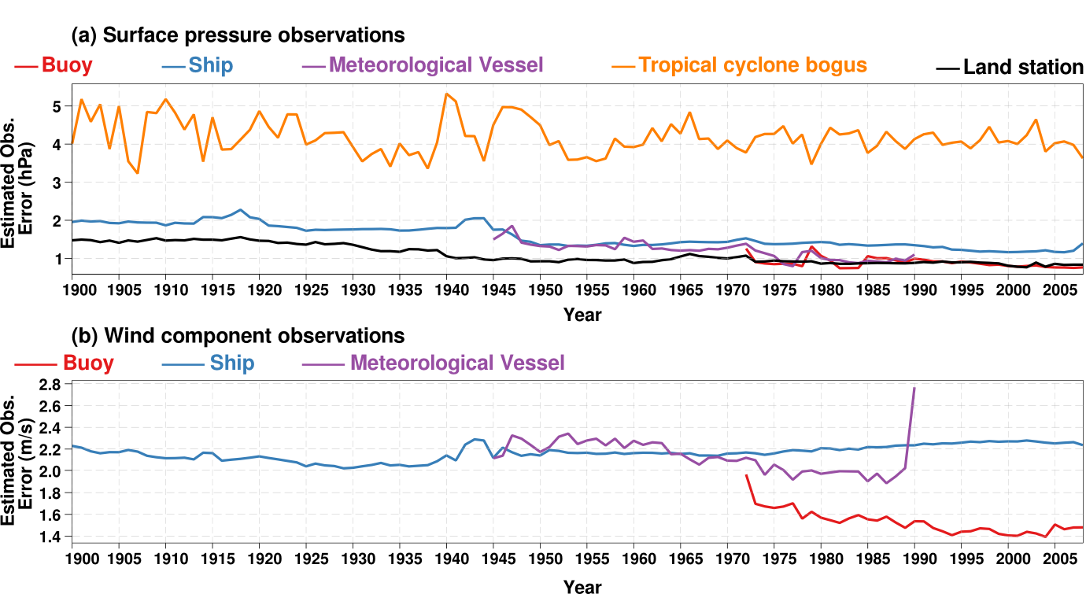
Uncertainties lessons learnt from ERA-20C: a posteriori observation error estimates
(Assumption for assimilation was … hPa)
(0.9)
(1.5)
(1.5)
(1.6)
(1.1)
(Assumption for assimilation was … m/s)
(1.3)
(1.5)
(1.5)
Difference with assumptions (indicated in parentheses) point to need to differentiate between ships and meteorological vessels, and to recognize in some cases that the observation quality improved over time.
So future users know when and why observation quality change(d), it would be useful to regularly track quantitative improvements in the quality in global individual observations

Slide 12
Wave energy flux into the ocean
ERA-20C, like ECMWF NWP OPS, includes a coupled atmosphere and wave model
Wave energy flux into the ocean is a measure of wave breaking energy
  Currently a sink term for the wave model
  No coupling with ocean model yet – such developments are underway in the ECMWF marine section
  Not incorporating wave breaking caused by bathymetry or current changes
Value:
  Should lead eventually to better energy budget when coupled with ocean model (energy released by breaking contributing to turbulence in the upper ocean layers)
  Locations of increased sea-atmosphere mixing?
No observations known to compare with?
See 111-second animation (@12 frames/second)
  Also (hidden link) on http://www.youtube.com/watch?v=FPip4BKujmM
Notes:
Flux computed as phi * rho * U_star**3
where phi is unitless
U_star = 10-m wind speed * sqrt(C_D)
C_D = Coefficient of drag with waves [unitless]
rho = air density at the lowermost model level (91)

Slide 13
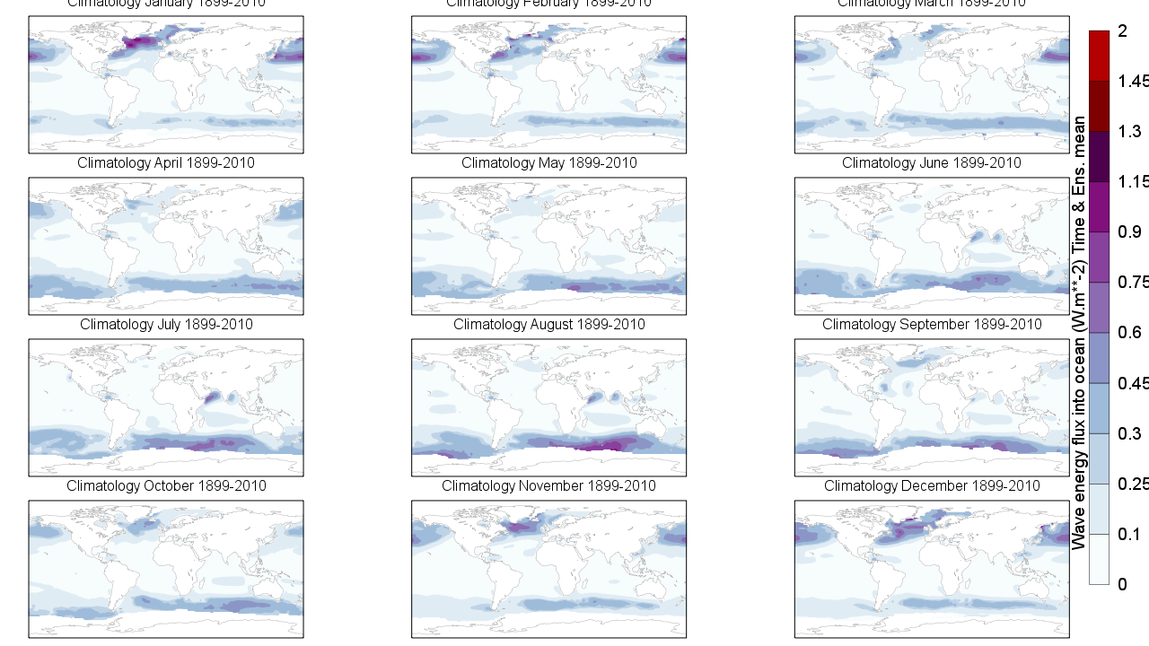
Mean wave energy flux into the ocean (climatology)
Oceans wave break when they become unstable under acceleration by near-surface wind, e.g. blowing away from land masses (Western sides of Atlantic and Pacific oceans, Somali jet) or intense weather (Tropical, mid-latitude storms)

Slide 14
(explanation of results seen in animation)
Each map (1 per month) is generated from 10 members and 3-hourly fields (total of ~10 x 8 x 30 fields per month)
Ensemble monthly mean (average over all members and within a month) shows where waves beak, on average
Intra-month variability of the ensemble mean shows locations where intra-month (3-hourly) variability is important to users keen on using data to feed non-linear downstream models. See for example signature of Tehuano wind.
Ensemble mean of the intra-month variability is larger than the previous quantity, also useful to spot locations and months which exhibit large intra-month variability
Monthly mean of the ensemble spread is a good proxy for the average 3-hourly variability. It collapses over time as more observations are assimilated.
Ensemble spread of the monthly mean shows differences between ensemble members on montlhy time-scales. It is near-zero, suggesting that the ERA-20C ensemble is lacking representation of uncertainties on monthly time-scales
Ensemble and intra-month variability is useful as a proxy for total uncertainty for users of the monthly ensemble mean. However, it only seems to represent reflect 3-hourly variability, the contribution of the 3-hourly ensemble spread is small.

Slide 15
Downwelling radiation at the surface
In situ direct measurements at selected sites:
  WCRP BSRN, GEWEX CEOP, FLUXNET
Otherwise obtained from formulae applied to
  In situ meteorological measurements
  Satellite retrievals in the lower atmosphere
A few NOAA's National Data Buoy Center (NDBC) buoys are augmented by dedicated in situ radiation sensors. For example project "New England Shelf Fluxes", sponsored by JAII: Massachusetts Technology Collaborative's John Adams Innovation Institute. Time-series retrieved from Woods Hole Oceanographic Institution website http://www.whoi.edu/
  “SWRAD is measured by an ASIMet SWR module employing an Eppley Precision Spectral Pyranometer (PSP)”
  “LWRAD is measured by an ASIMet LWR module employing an Eppley Precision Infrared Radiometer (PIR)”
  In the following, compare such observations from NDBC buoy#44008 for April – December 2010 with estimates produced by several ERA reanalyses

Slide 16
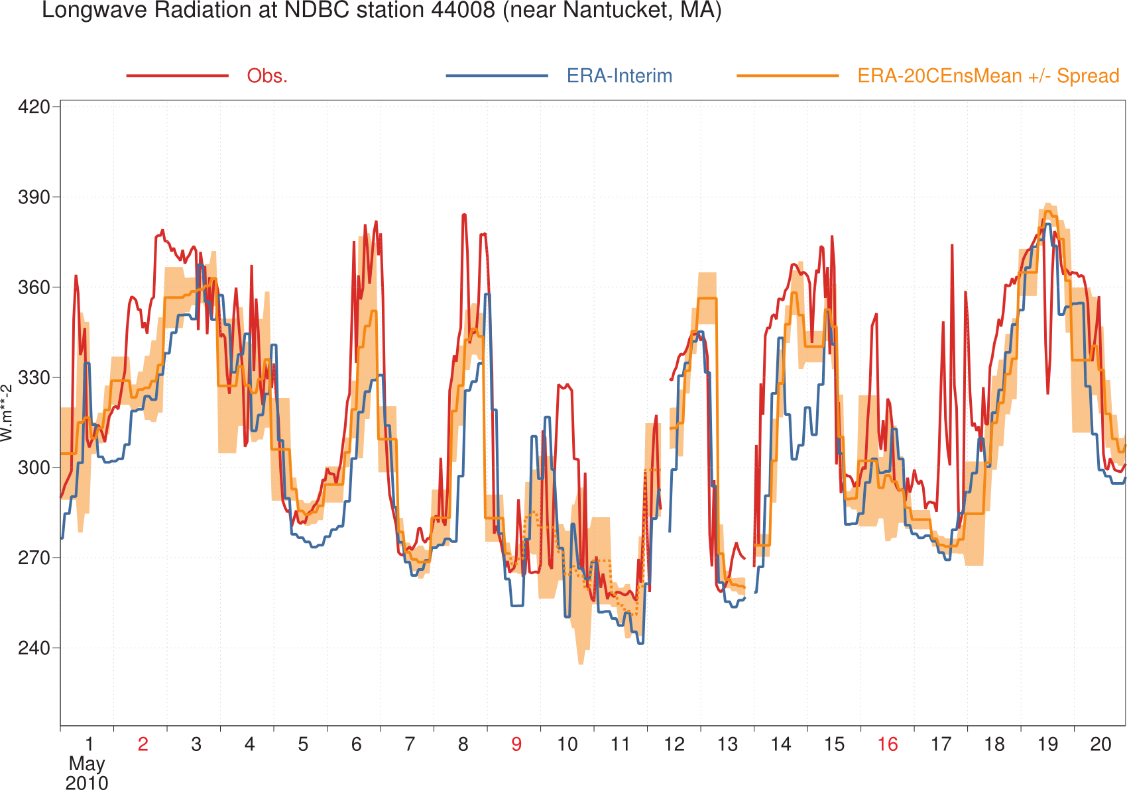
Longwave downwelling radiation at buoy#44008
(hourly)
Observations (in red) come from a NDBC buoy augmented by sensors funded by project "New England Shelf Fluxes“ sponsored by JAII: Massachusetts Technology Collaborative's John Adams Innovation Institute. Data retrieved from Woods Hole Oceanographic Institution website on 26 April 2014

Slide 17
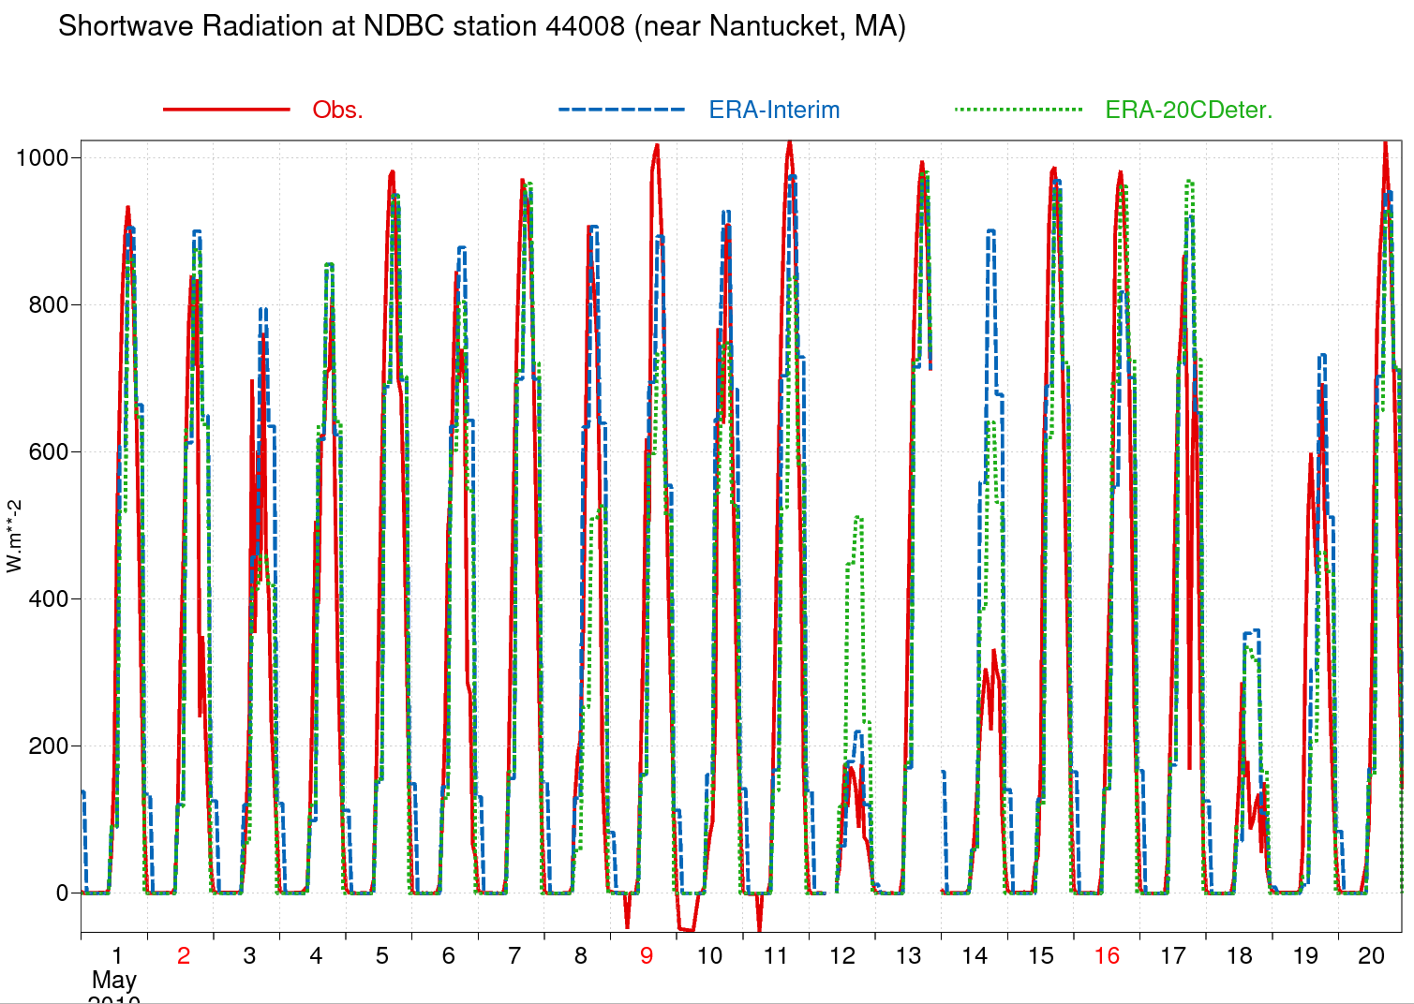
Shortwave downwelling radiation at buoy#44008
Observations (in red) come from a NDBC buoy augmented by sensors funded by project "New England Shelf Fluxes“ sponsored by JAII: Massachusetts Technology Collaborative's John Adams Innovation Institute. Data retrieved from Woods Hole Oceanographic Institution website on 26 April 2014

Slide 18
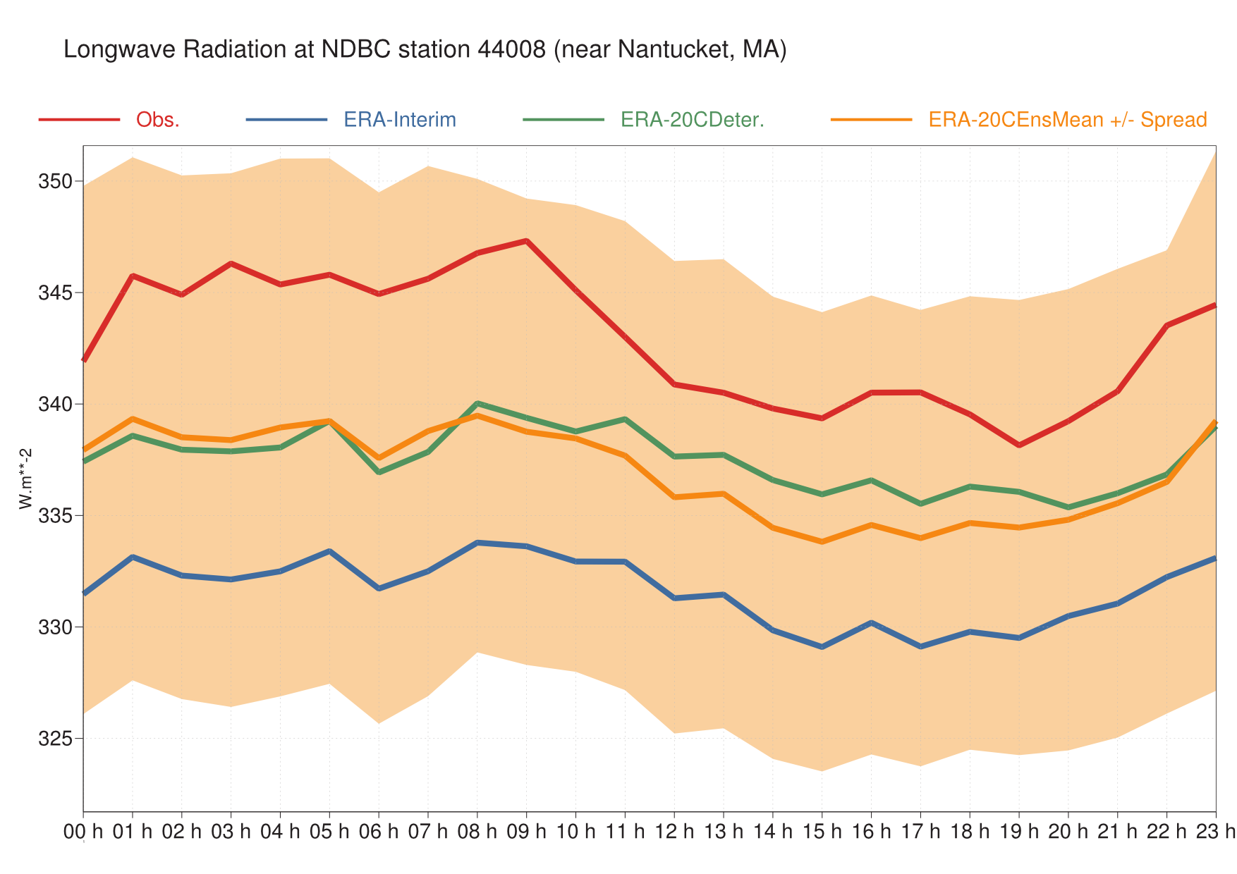
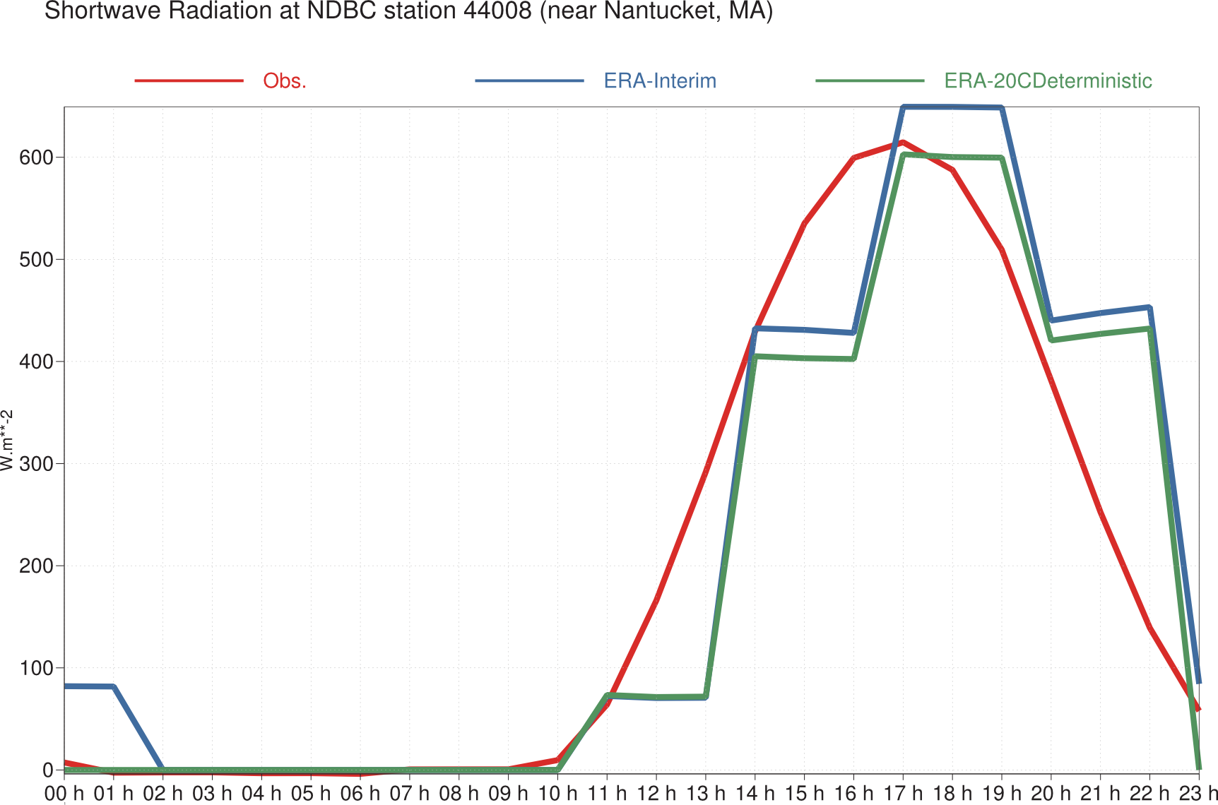
Systematic differences: diurnal cycle average
Average all collocations by hour of the day, for April – December 2010
Hour of the day
Hour of the day

Slide 19
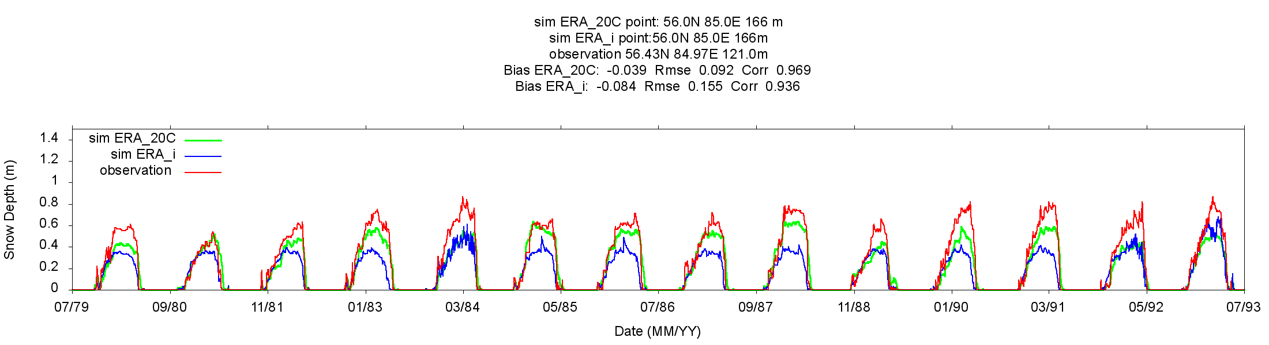
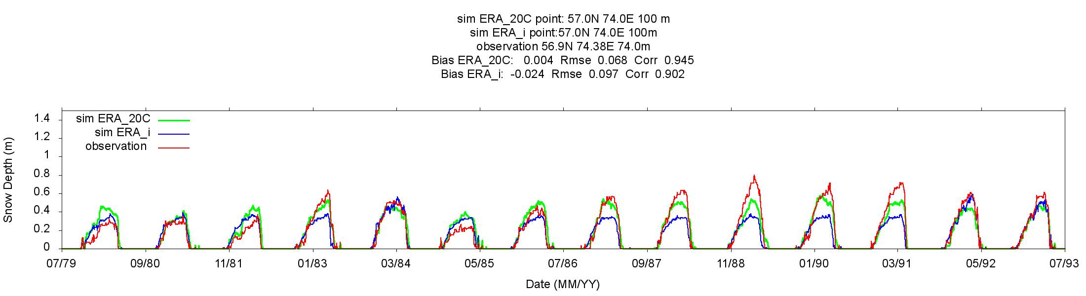
Snowfall comparisons with in situ measurements
E. Brun, Meteo-France

Slide 20
Conclusions
Known knowns improve all the time at a fairly rapid pace
  e.g. model developments seem to lead to better fluxes
Known unknowns, or the study of uncertainties, have become active areas of development with data assimilation techniques
  e.g. ensemble spread, observation errors (biases also part of it)
Unknown unknowns start to become more systematically tracked down, as differences between expected and observed match to observations point to yet-to-be-understood problems
Ways forward
  Observations, and their uncertainties characterizations, are paramount to progress. (e.g. difficult to find repositories of flux observations)
  Would an “Annual State of the Observing System” help?
  Making available systematically collocations/comparisons in observation space with state-of-the-art models and reanalyses could also help

Slide 21
Example: data assimilation uncertainties introduced in ERA-20C, to represent ‘known unknowns’
Observations
  Apply perturbations according to assumed observation errors
Model
  Stochastic physics as in ECMWF model version CY38R1
Forcing and boundary conditions
  Sea-ice and sea-surface temperature: 10-member ensemble HadISST.2.1.0.0 (Kennedy, Rayner, Titchner, et al.)
  CMIP5 recommended time evolution of solar irradiance
  CMIP5 recommended time evolution of CO₂ , CH₄, N₂O , CFC-11 and CFC-12
  AC&C/SPARC time evolution of O₃
  CMIP5 recommended time evolution of tropospheric sulfate aerosols
  GISS dataset time evolution of stratospheric (volcanic) aerosols
  2. to 6. above are assumed perfect – contribute no uncertainties to (re)analyses

Slide 22
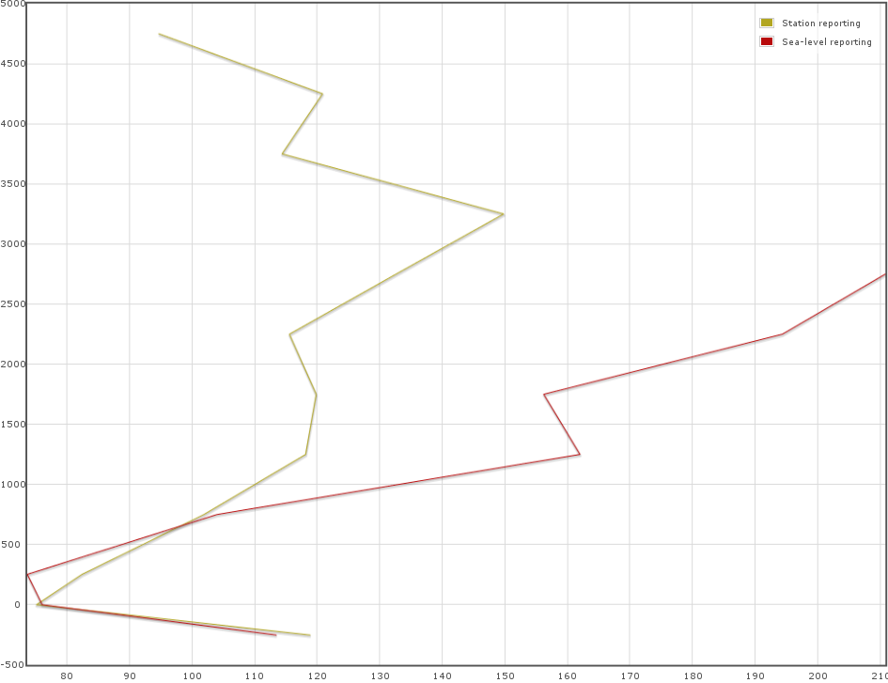
Surface pressure observation error estimates w.r.t station altitude
Station level report estimated errors seem to increase with altitude
  Representativeness issues in mountains, not really observation error
Sea level report estimated errors show much increased height dependence
  Normal to expect that reduction to sea-level would introduces errors
  Especially if the observation operator applies a pressure reduction formula different from that used by observer
4000m
3000m
2000m
1000m
0m
1 hPa
1.5 hPa
Pressure reduction formulae have been discussed for a while (WMO, 1954; 1964; 1968).
Last I looked into it (2013), the World Meteorological Organisation still recommended a single practice only for stations below 750 m altitude (WMO Commission for Instruments and Methods of Observation Expert Team on Standardisation, 2012).
For stations located above 750 m altitude, there still seems to be no global standard.
The resulting differences reach a few hPa for high-altitude stations.

Slide 23
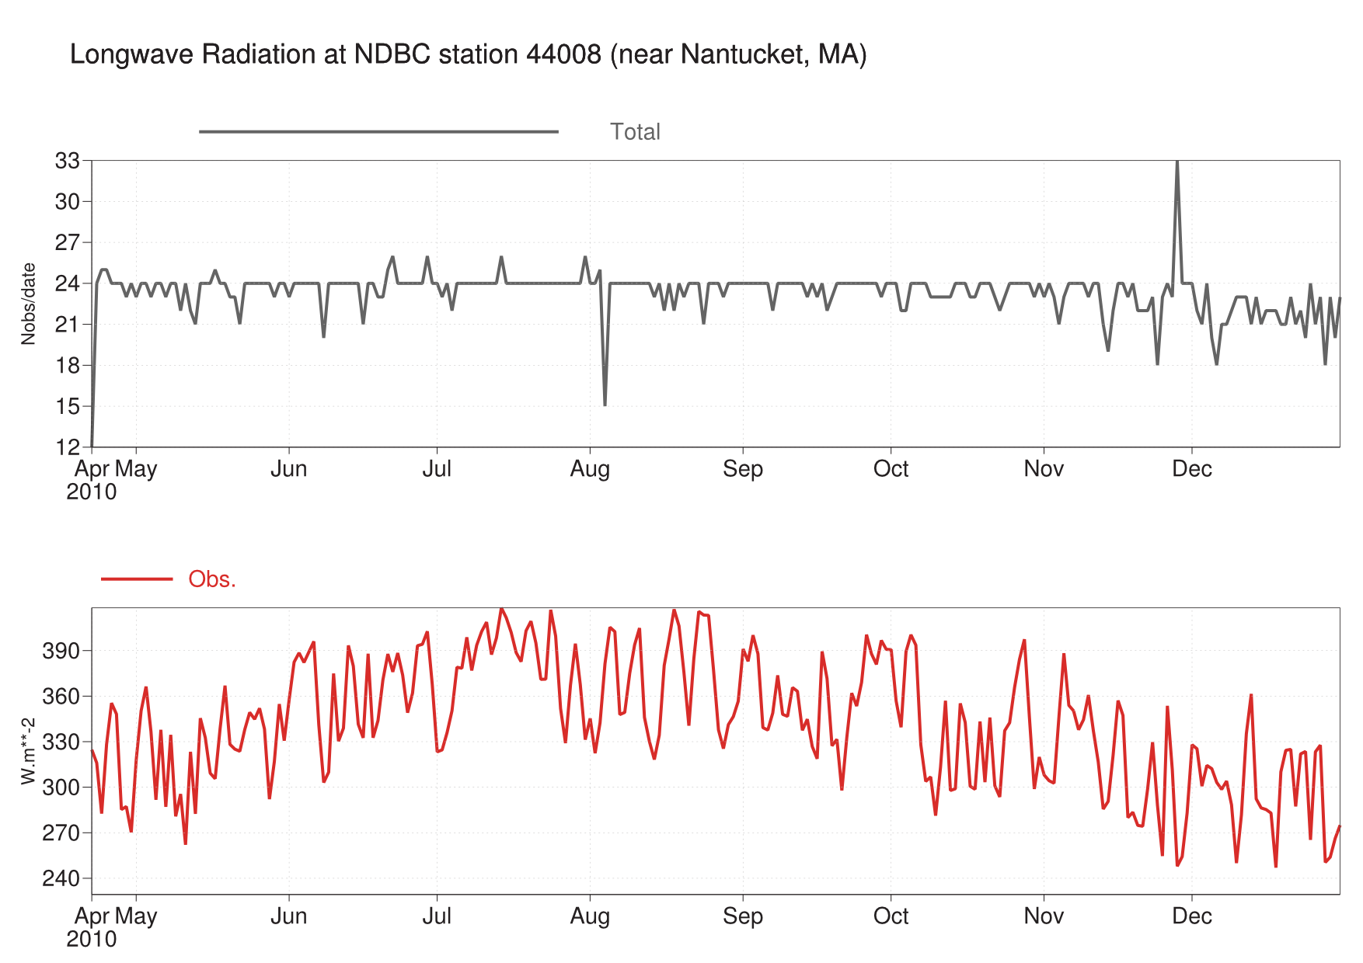
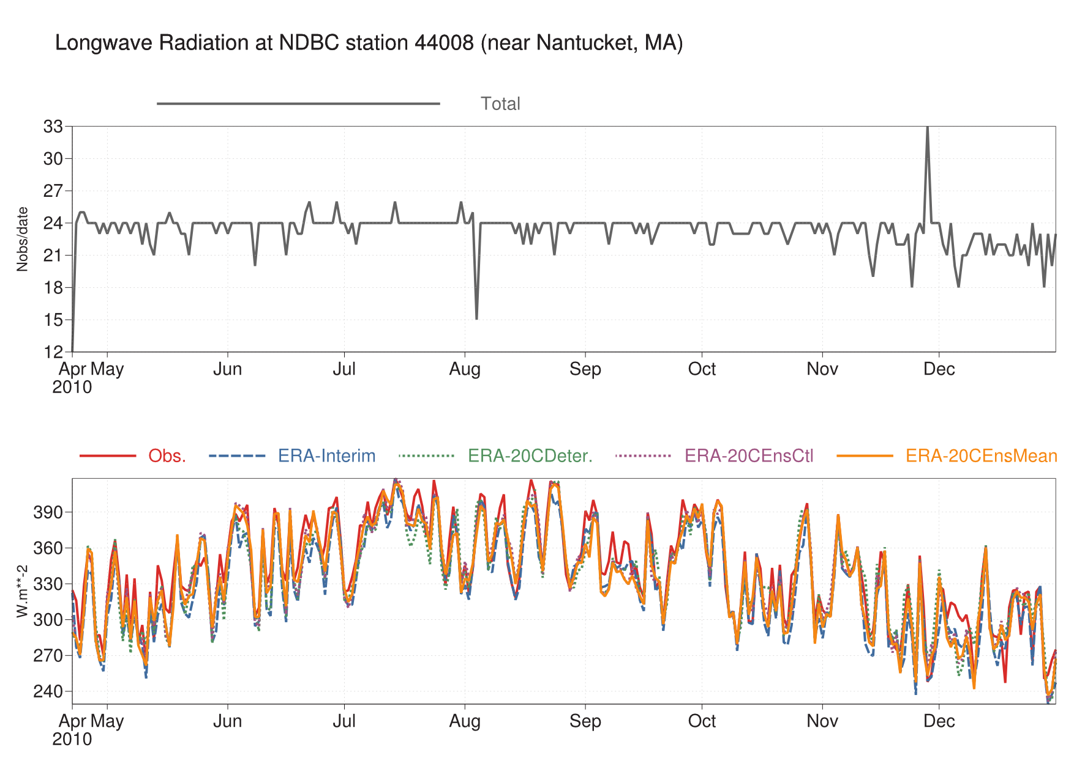
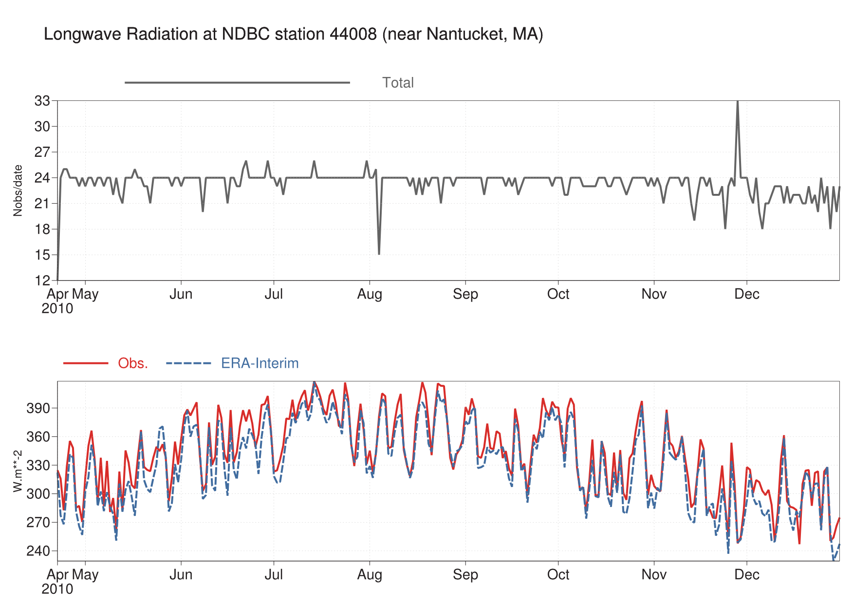
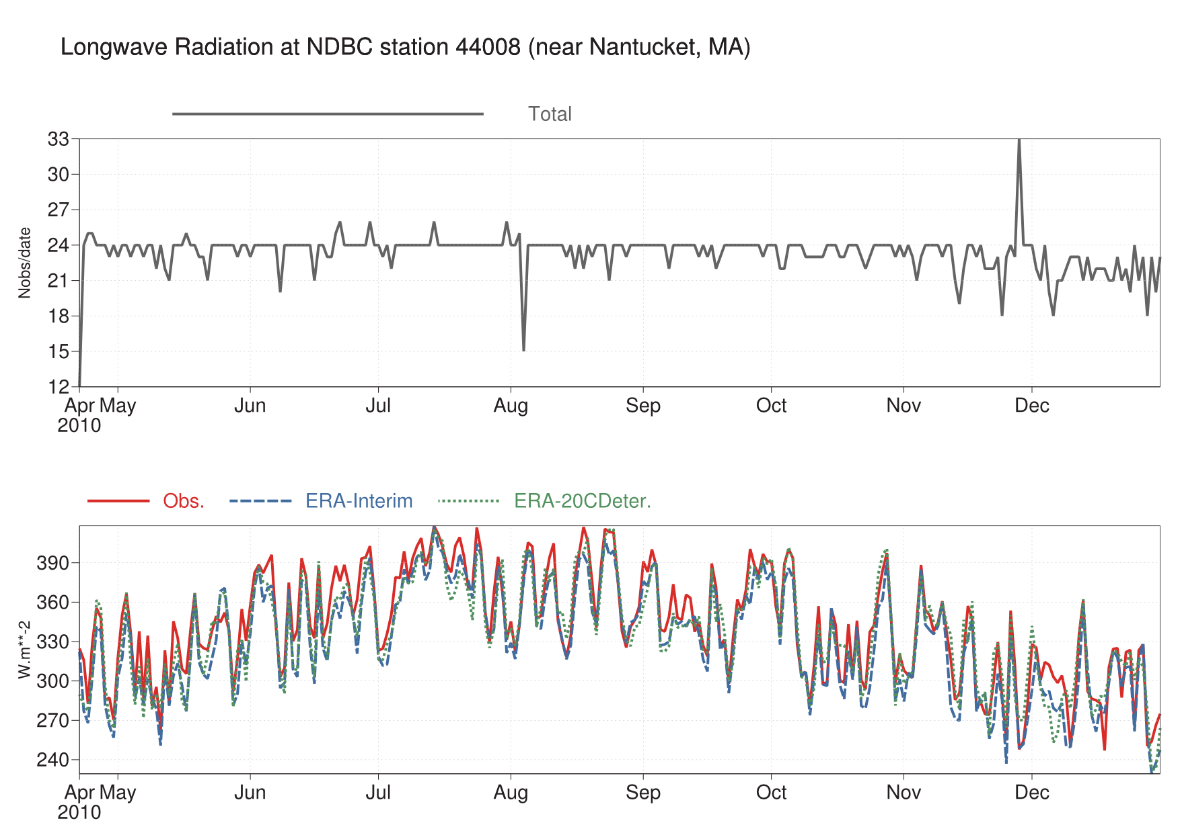
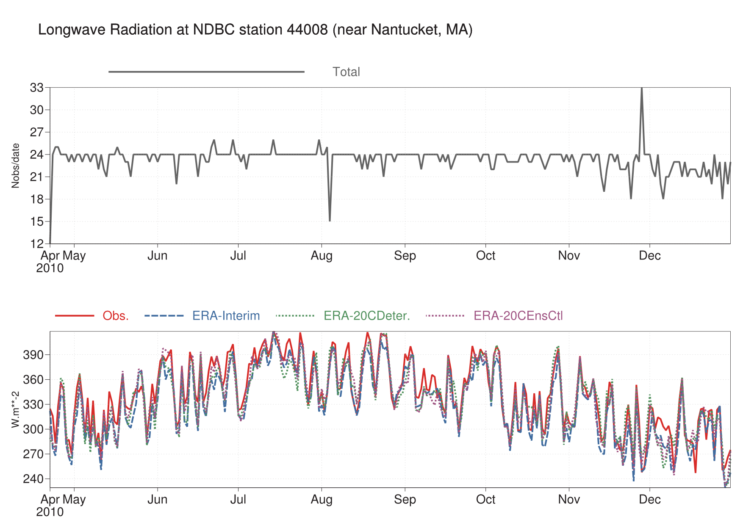
Longwave downwelling radiation at buoy#44008

