Slide 1
The Merton Report an AIMES/IGBP-ESA partnership
As Earth System science advances and matures, it must be supported by robust and integrated observation systems
Dave Schimel past chair, AIMES
and
Peter Cox, Chair AIMES

Slide 2
The Merton Report
http://www.igbp.net/publications/themertoninitiative.4.7815fd3f14373a7f24c256.html

Slide 3
Model uncertainties
What is the modern carbon budget?
What processes result in the modern carbon budget?
How will this change in the future?
Existing data for benchmarking are grossly inadequate and do not constrain fluxes are critical scales.
Detection – attribution - prediction

Slide 4
What controls the airborne fraction: what will cause it to change?

Slide 5
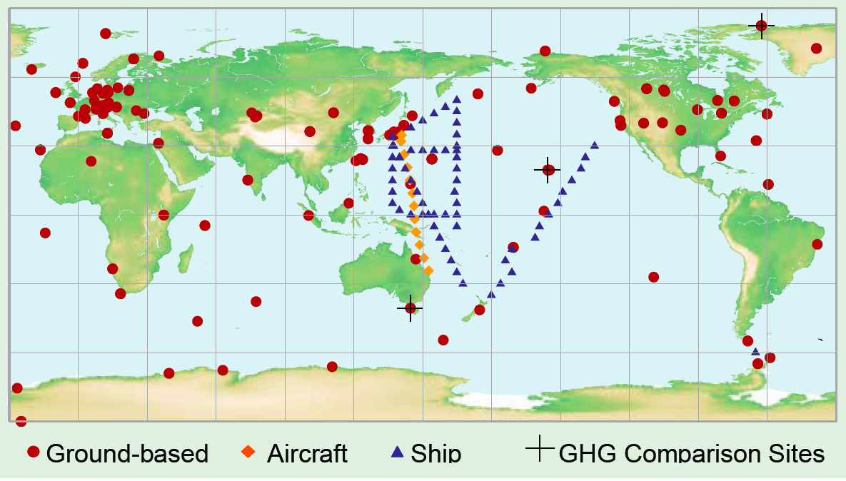
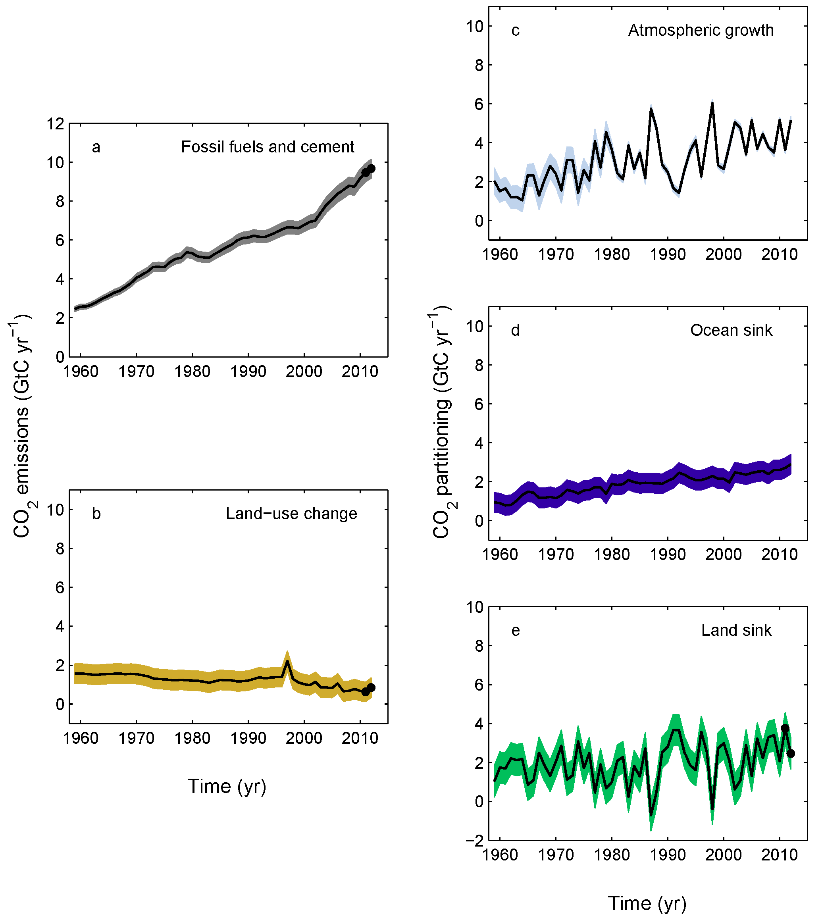
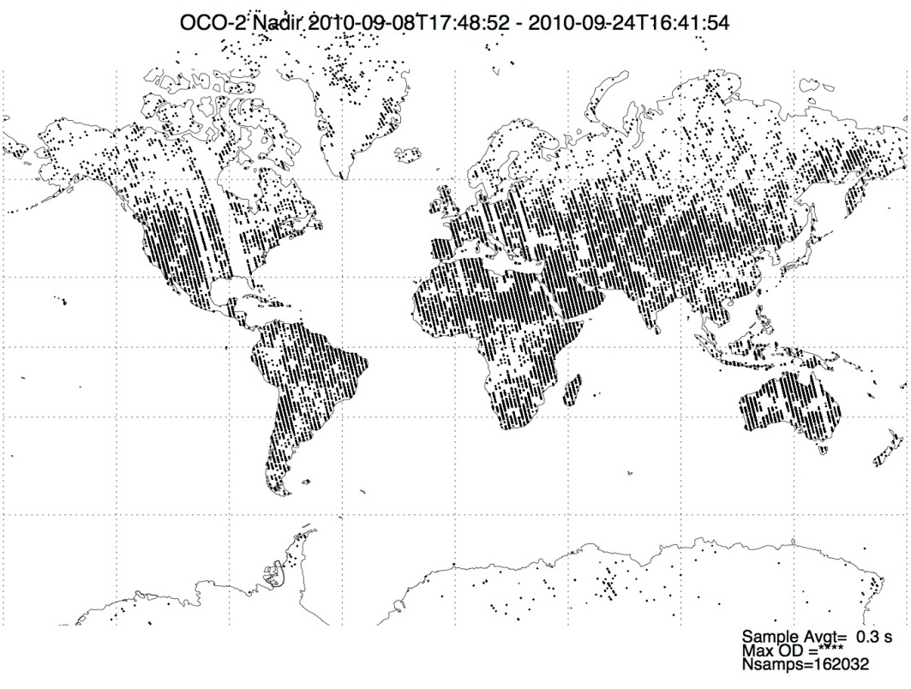
Fossil emissions: growing uncertainty
OCO-2 will collect ~380 Soundings/degree of latitude (>10⁶ soundings/day). With Dave Keeling’s flask sampling strategy that would be equivalent to 800 years of data.

Slide 6
Framework
Emissions from fossil and land use (forcing)
β(CO₂) = response to changing concentration (partitioned into land and ocean).
γ (T, ppt, circulation…) = climate response (partitioned into land and ocean, futher partitioned by climate term).

Slide 7
Terrestrial “tipping elements”
The two “poles” of the carbon cycle

Slide 8
β
Key observations
GPP
NEE
Biomass
Plant function
Land cover

Slide 9
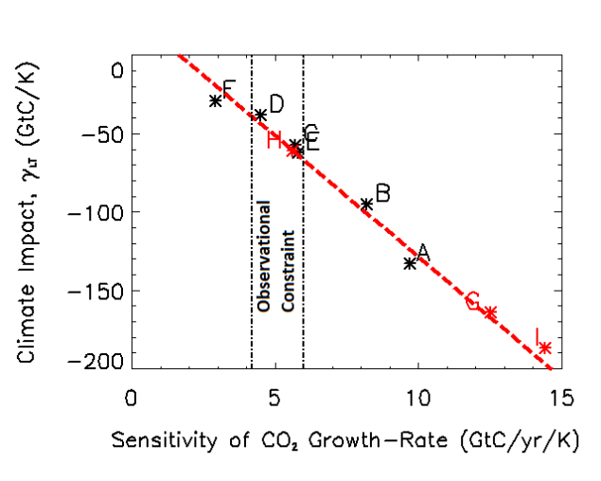
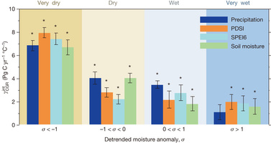
γ_{land}
Key observations:
GPP
NEE
Biomass
LAI/FPAR
Plant function
Fire frequency
Burned area
Water stress
Freeze-thaw

Slide 10
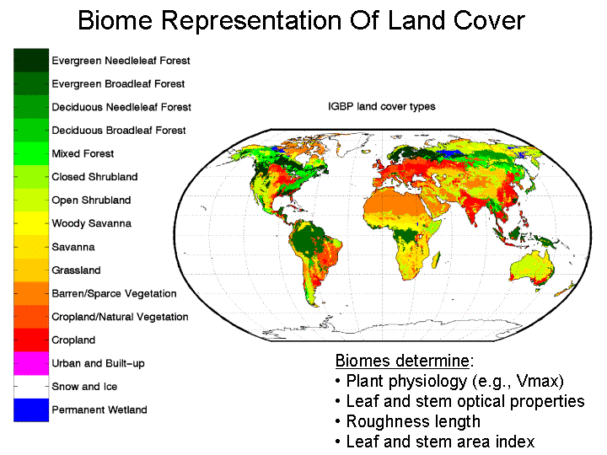
Terrestrial models depend on PFT-specific parameters

Slide 11
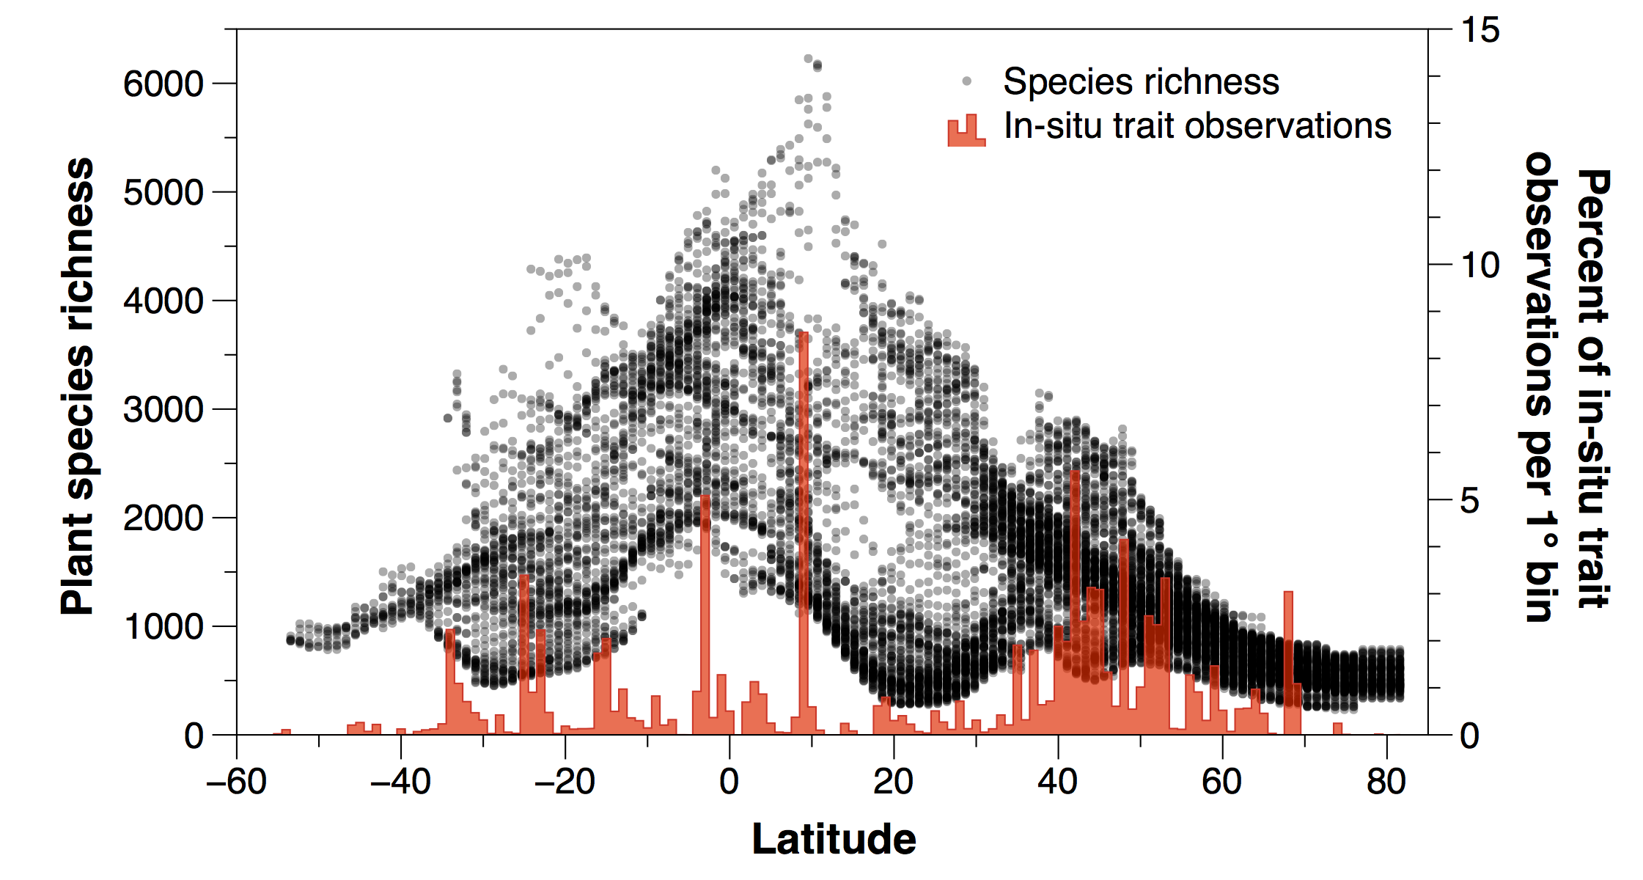
Plant functional types: CMIP6 improvements needed extrapolation using airborne as the near-term solution?
Currently ~20 globally, 16,000 species in the Amazon alone. Most key land model parameters depend on PFT definition.
Change in data density with HyspIRI
HyspIRI will increase the amount of information from 10²/degree to 10⁸.

Slide 12
Data gaps
Fluxes
Stocks Parameters

Slide 13
Ocean observations

Slide 14
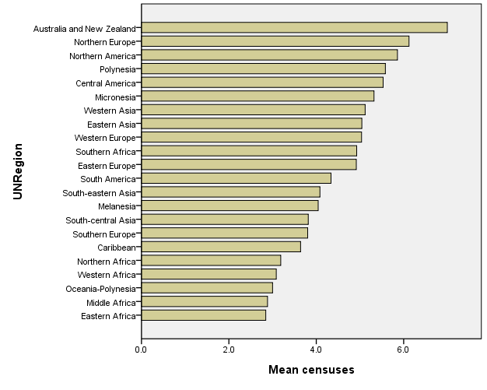
Human system data

Slide 15
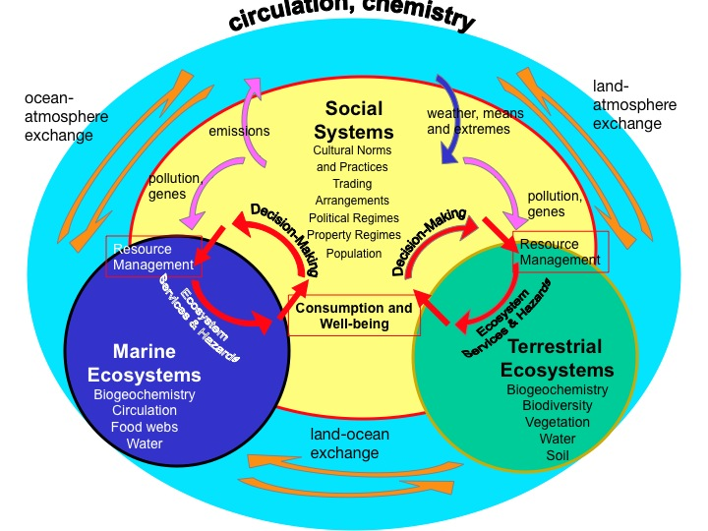
Observations for Future Earth

Slide 16
Merton High Level Requirements
The observing system shall be free, open, and interoperable
The observing system shall collect data and provide information on the Earth System at a scale that is suitable to advance science and inform policy and management.
The observing system shall provide usable information from its observations to enable its access and use for education, scientific discovery, and to inform policy and management.
The observing system shall produce data with the appropriate temporal and spatial resolution, extent and duration, accuracy, and precision to allow detection, attribution, and forecasting
Standardization of information products in a global context is required, to allow common information to be drawn from a globally distributed network of sites.
Data collected and archived to allow aggregation and disaggregation in a consistent and traceable manner e.g. in situ measurements should be collected to allow calibration and validation of space-based observations used for extrapolation.
Data shall be traceable with provenance and include characterization of uncertainty.

Slide 17
Requirements..
The observing system shall provide the observations of Earth System drivers and response that are required to establish the links between cause and effect as a basis for attribution and prediction
Observations should allow the detection and attribution of interactive processes at multiple scales e.g. a farmer’s decisions are influenced by global commodity prices and local environmental conditions, such as soil moisture.
The priority will be to establish observing systems in data-poor regions with high Earth System impact, to maximize the science value for each increment of new data.
The system shall be designed with human and technological capacity building as a priority.
The system should be flexible and adaptable to changing questions, scales, conditions and technology to allow for decadal-centennial operation.

