Slide 1
CliC Cryosphere Interactions
Walt Meier
NASA Goddard Space Flight Center
WDAC Meeting, Galway, Ireland
6 May 2014

Slide 2
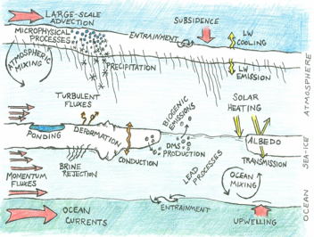
Fluxes in the Cryosphere
Surface albedo (reflected SW)
Melt/freeze (latent)
Clouds (SW, LW)
Snow, ice interfaces (sensible, conductive and LW)
Winds over ice/snow (turbulent)
Winds/currents (momentum)
Sea ice, snow, glaciers, ice sheets (freshwater)
Biogeochemical (carbon, e.g., thawing permafrost)
Fluxes over/under/in sea ice
Figure from MOSAiC project, http://www.mosaicobservatory.org

Slide 3
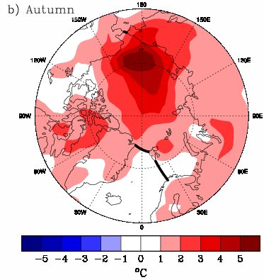
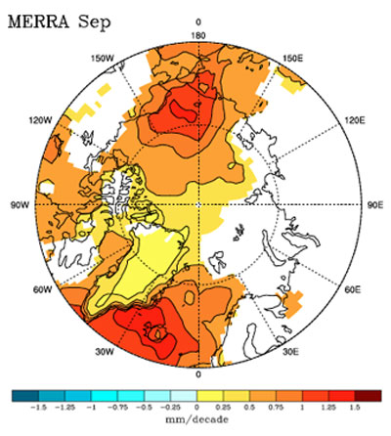
Cryosphere and fluxes
Fluxes in the cryosphere have a strong seasonal cycle
Fluxes vary on a variety of spatial scales
  e.g. sea ice leads of 10s or 100s of meters
Fluxes in the cryosphere play a significant role in local conditions (boundary layer), regional climate (heat, moisture sources), and controversially on hemispheric weather (influence on jet stream)
  Summer sea ice loss in the Arctic
  Earlier spring snow melt
Figure: [top] (2003-2007) minus (1979-2007) for autumn air temps and [bottom] Sep. water vapor trend 1979-2007, from Serreze et al., 2008 and 2012.

Slide 4
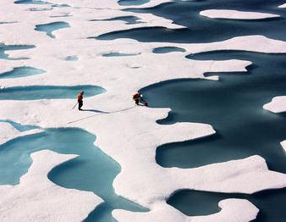
Cryosphere and fluxes
Data and modeling of fluxes is still relatively unsophisticated, e.g.,
  Melt ponds in the Arctic are too small to resolve with most satellites
  Melt ponds not explicitly included in models (at most a simple parameterization is included)
  Many key snow properties (wetness, grain size, etc.) not observed or modeled in detail

Slide 5
CliC Science Steering Group
Greg Flato, Univ. Victoria, new SSG chair; several new members
Meeting, 17-20 February 2014, Geneva
Update CliC science/implementation plan
Developing new “targeted activities”, e.g.,
  Polar CORDEX
  Snow in Earth System Models
  Ice sheet and ocean interactions

Slide 6
Polar CORDEX
Arctic CORDEX
  Regional climate model simulations of the Arctic: historical and RCP 4.5 and 8.5 future scenarios
  Several modeling groups involved, e.g., SMHI, CCCma, EMUT, AWI, Univ. Colorado, DMI, Iowa St. Univ., DMI, MGO, BCCR, Ulg
  Most runs are finished, a few still planned
  http://www.climate-cryosphere.org/activities/targeted/polar-cordex/arctic
  J. Cassano (Univ. Colorado) and A. Rinke (AWI)
  Meeting in Brussels, 8 November 2013
Antarctic CORDEX – smaller number of participants and fewer experiments
  http://www.climate-cryosphere.org/activities/targeted/polar-cordex/antarctic

Slide 7
ESM-SnowMIP
Snow-albedo feedback an important climate factor
  How to improve knowledge of physical properties and temporal dynamics as part of coupled climate system?
  How to improve understanding of snow as an active component of the global climate system?
February 2014 telecon (E. Brun, C. Derksen, M. Sturm, R. Essery, G. Krinner) to discuss scope and roadmap
Plan to write white paper to feed into CMIP6, writing workshop planned for July 2014 in conjunction with GEWEX Conference
http://www.climate-cryosphere.org/activities/targeted/esm-snowmip

Slide 8
West Antarctic Glacier-Ocean Modeling
Model intercomparison for West Antarctic Ice Sheet
  Increasing mass loss in recent years
  Significant ocean interaction with ice shelves
  Ice shelf collapse (e.g., Larsen-B)
  Limited observations (under shelves, grounding lines)
First goal is to develop a common-year forcing data set for baseline comparisons
D. Holland, New York Univ., lead
First workshop, 27-29 October 2014, Abu Dhabi, UAE

Slide 9
Cryosphere in a Changing Climate Workshop
16-18 October 2013, Tromsø, Norway
Address WCRP Grand Challenges relating to the cryosphere: http://www.climate-cryosphere.org/activities/grand-challenges
Key scientific research areas:
  Predictions and projections of polar climate
  Cryosphere model biases and shortcomings
  Ice sheet models, dynamics, and sea level rise
  Permafrost and carbon for Earth System Models

Slide 10

CliC Sea Ice Working Group
Two recent workshops: Tromsø, 5-7 June 2013 & Hobart, 15 March 2014
  Brought together modelers, observationalists, remote sensing scientists
  Improving coordination of field expeditions
    Ship observation protocols
    Coordination website – being updated, iceplan.org
  Improve linkages between models and observations
    Improving use of observations in models
    What do models need?
  Temporal and spatial scaling essential for linking in situ, observations, and models
    Estimates of fluxes are scale dependent
10

Slide 11
MOSAiC
Multidisciplinary drifting Observatory for the Study of Arctic Climate
http://www.mosaicobservatory.org
  Focus on transfer of heat, moisture, density, momentum, and nutrients through the Arctic system
Intensive international field campaign
  Icebreaker frozen in for a full year with various surrounding observing platforms
  Follow-on from SHEBA – update from 20 years ago, particularly dramatic changes in ice cover (e.g., loss of multi-year ice)
IASC and CliC sponsors
Plan for 2017 or 2018 deployment
Science plan being drafted

Slide 12
Southern Ocean data survey
Co-sponsored by CliC and SOOS
Focus on satellite observations
Currently open, until 30 May
http://www.climate-cryosphere.org/activities/targeted/so-sat-req

Slide 13
Arctic Freshwater Synthesis
Assess freshwater sources, fluxes, storage, and effects
Water vapor transport, P/E, river flow, glacier and ice cap ablation, sea ice melt/growth, ocean salinity/density transports
IASC and AMAP are co-sponsors
T. Prowse (Univ. Victoria), Chair
Science co-leads meeting, 4-6 May, Stockholm

Slide 14
ISMASS
Ice-Sheet Mass Balance and Sea Level
  IASC/SCAR/WCRP sponsored – renewed and expanded from initial SCAR project
  Kick-off workshop, July 2012, Portland, Oregon; report published
    http://www.climate-cryosphere.org/en/events/2012/ISMASS/Home.html
  Facilitate international coordination of observation and modeling of ice sheet mass balance and contribution to sea level rise
  Steering committee: Francisco Navarro, Frank Pattyn, and Edward Hanna
Freshwater flux, sea level rise
14

Slide 15

ICARP III
Third International Conference on Arctic Research Planning
  Toyama, Japan, April 2015
  Goals are to identify Arctic science priorities for the next decade, coordinate research agendas, inform policymakers
    Unlike ICARP II, will not develop new science plans
    Coordinate and focus existing plans
  CliC is a co-sponsor with IASC (lead sponsor), AMAP, APECS, IACS, FARO, IPA
  http://icarp.arcticportal.org
15

Slide 16
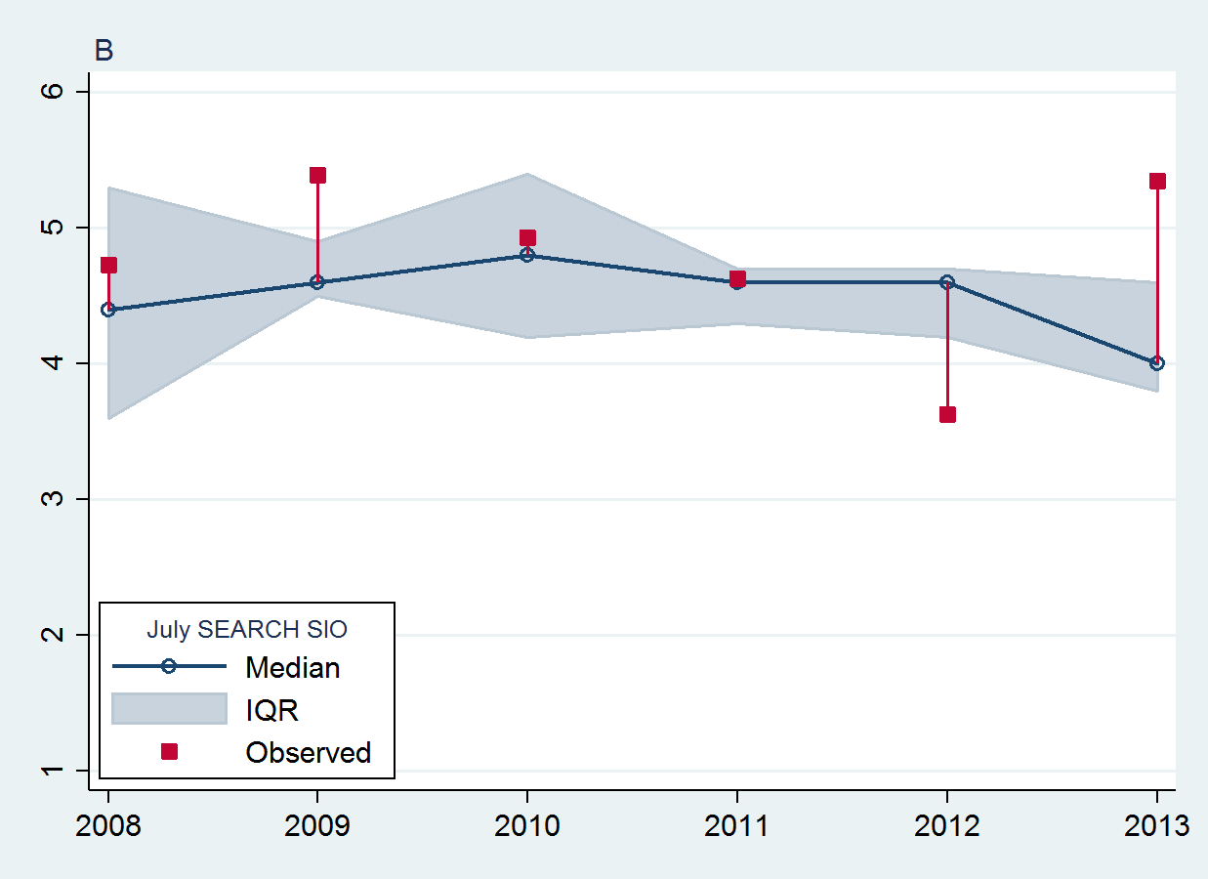
Sea Ice Prediction Network
U.S. supported project (NSF, ONR, DOE, NASA): http://www.arcus.org/sipn
Focus on seasonal sea ice prediction
  Sea Ice Outlook: http://www.arcus.org/search-program/seaiceoutlook
  Framework for model intercomparison and evaluation
  Provide resource for observations to initialize and validate models: http://nsidc.org/data/sipn/
  Design metrics to assess model performance
Kick-off meeting 1-2 April 2014, Boulder
Will collaborate with other prediction efforts
  WMO Polar Prediction Project
  WCRP Polar Climate Predictability Initiative
  THORPEX
Median and interquartile range of July SIO predictions compared with observed mean September extent
Figure from Stroeve et al., GRL, 2014

Slide 17
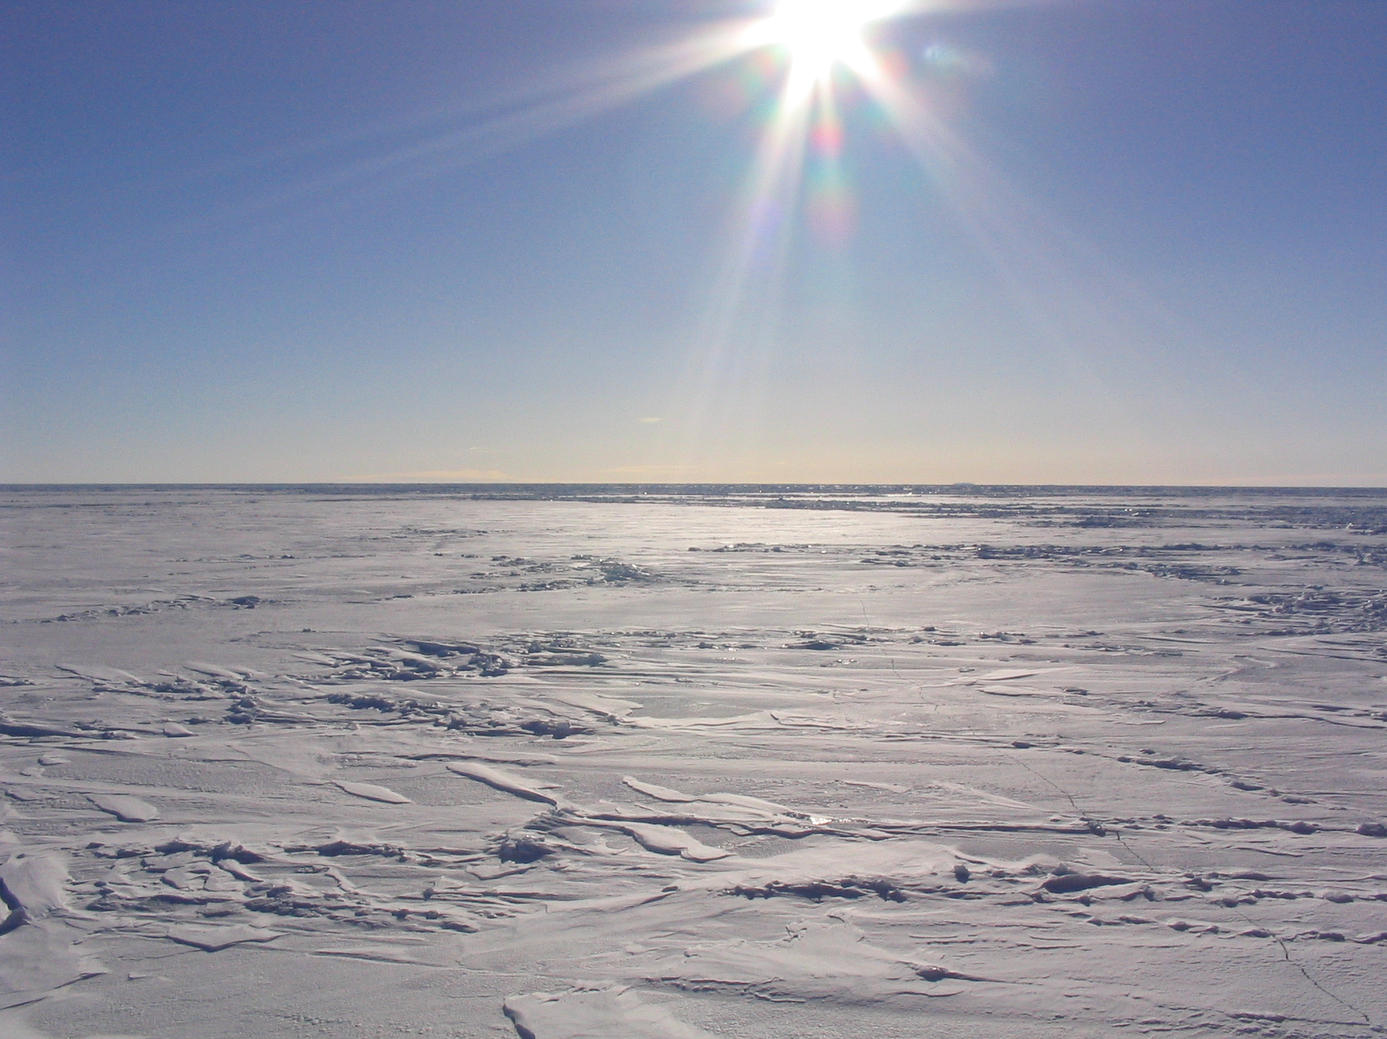

Thanks!
17
Photo by Terry Haran, NSIDC

