Slide 1
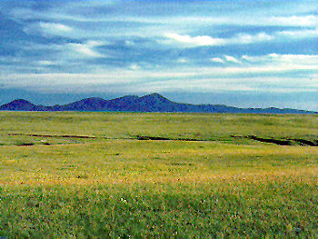
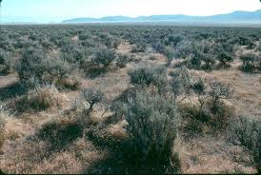
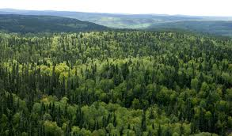
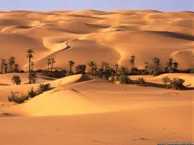

The GEWEX LandFlux Initiative: development and analysis of a global land surface heat flux product
2013 American Geophysical Union • San Francisco, USA• H24E-02
Matthew McCabe¹, Eric Wood², Carlos Jimenez³, Diego Miralles⁴, Ali Ershadi⁵, Miaoling Liang²,
Brigitte Mueller⁶, Sonia Seneviratne⁶ and Chris Kummerow⁷ + MANY OTHER CONTRIBUTORS & DATA PROVIDERS
¹ King Abdullah University of Science and Technology, Saudi Arabia
² Princeton University, United States of America
³ Observatoire de Paris, France
⁴ University of Bristol, United Kingdom
⁵ University of New South Wales, Australia
⁶ ETH Zurich, Switzerland
⁷ Colorado State University, United States of America
Presented to WDAC by J. Schulz, EUMETSAT

Slide 2


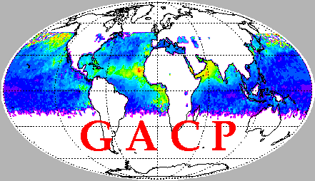



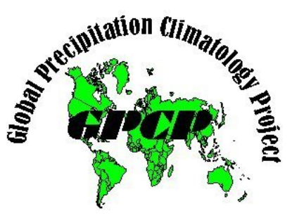
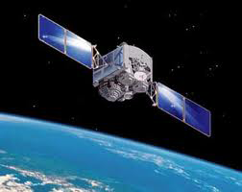
GEWEX Reference Products
Validation
BSRN
Validation
Ships and Buoys
Validation
Towers

Slide 3
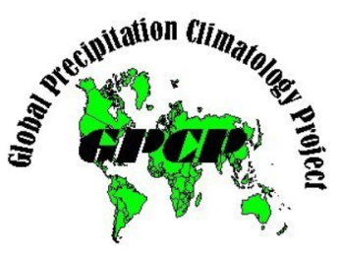
Value added by GDAP: GEWEX Integrated Products
Validation
BSRN
Validation
Ships and Buoys
Common Output with uncertainty
Common Ancillary Data
Validation
Towers
+

Slide 4
LandFLUX Introduction
GEWEX Data and Assessments Panel (GDAP):
Goal: Develop global observationally based products to allow independent water and energy cycle assessment (1984-2007).
:
Challenge(s): Heat fluxes cannot be remotely detected – need an interpretive model to infer them:
What model to use?
What forcing to choose?
What scale and resolution is appropriate?
How to evaluate and assess model (and forcing) data?

Slide 5

Background
4
Challenge: heat fluxes do not have a unique signature that can be remotely detected, so satellite observations need to be combined by a model (process-based, empirical,….) to infer them.
Sink for vapour
ATMOS. DEMAND
ATMOSPHERE
Source of energy
SATELLITE OBSERVATIONS
MODEL
ET
Short/Long-wave radiation
Source of water
WATER SUPPLY
SOIL
VEGETATION

Slide 6
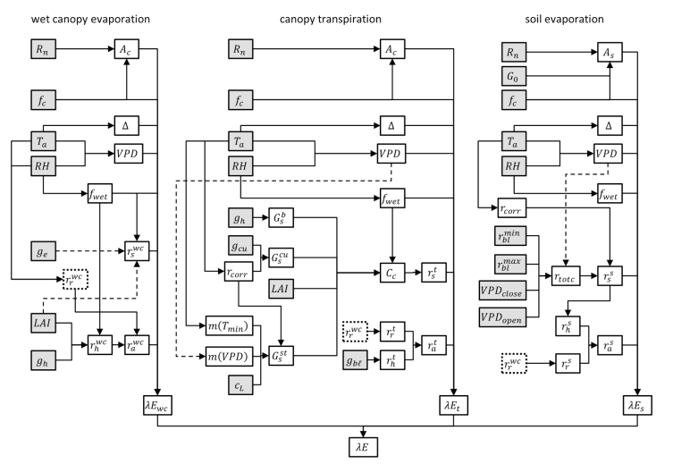
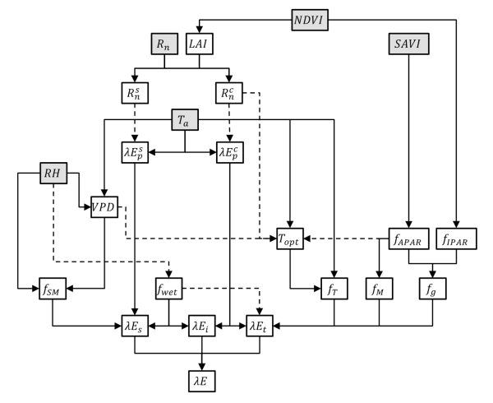
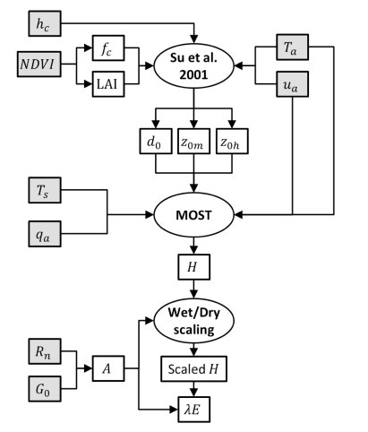
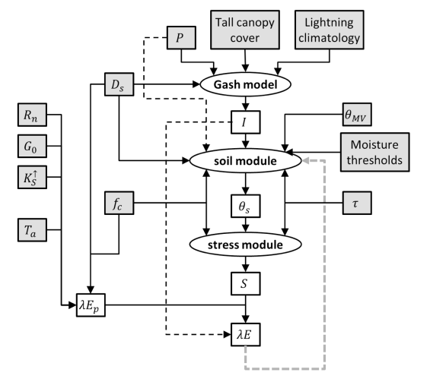
Identifying an Interpretive Model
Range of potential model types available:
Many options with different data/parameter needs
Is one model able to reproduce all biome/land types?
Opportunity to undertake model inter-comparison
PM-Mu
PT-JPL
SEBS
GLEAM
Mu et al. 2007; 2011
Fisher et al. 2008
Su, 2002
Miralles et al. 2010
Notes:
Penman-Monteith equation (eliminating surface temperature)
Prisley-Taylor simplification (α parameterizing resistance to evaporation)

Slide 7


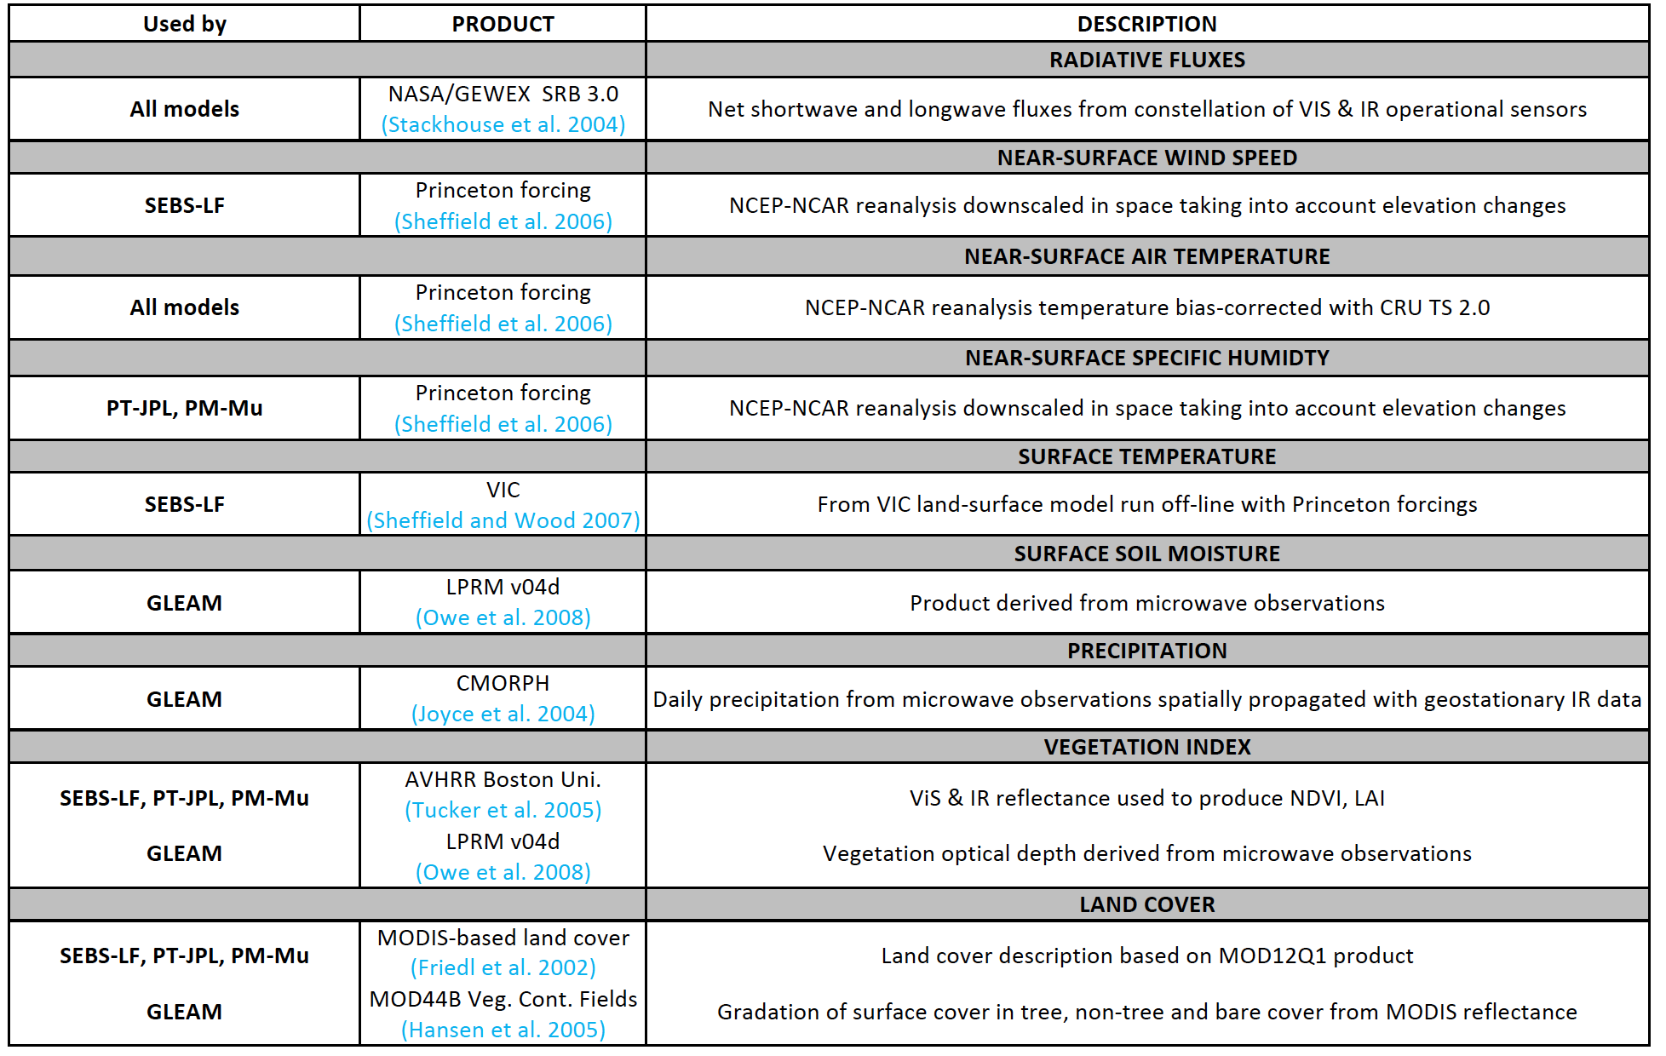
Tower and Model Forcing Data
Forcing and common parameters - led by Princeton
Grid based data derived from a combination of reanalysis, satellite products and VIC model data
Tower Data
Flux tower and site information from http://www.fluxdata.org/DataInfo/
Meteorology
Vegetation height
Radiation components
LST from LWU
Satellite based NDVI
INTERCEPTION!!!???
Notes:
Variable Infiltration Capacity (VIC) Macroscale Hydrologic Model
VIC (Liang et al., 1994) is a macroscale hydrologic model that solves full water and energy balances,

Slide 8

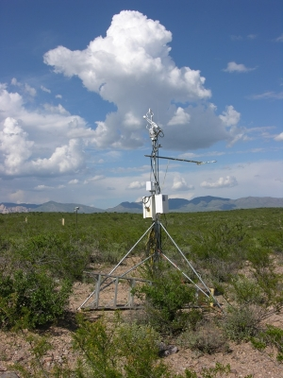

Progress in Product Assessment
Developing a long-term record of global heat fluxes
Examine global scale response
Assess region-to-catchment scales
Evaluate model grid-to-tower based observations

Slide 9
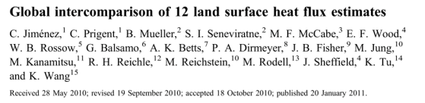

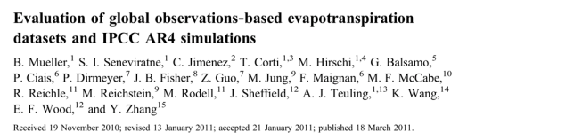

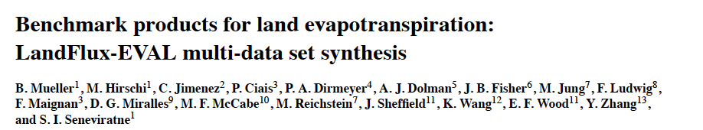

Progress in Global Assessment
Global scale evaluation and inter-comparison:

Slide 10
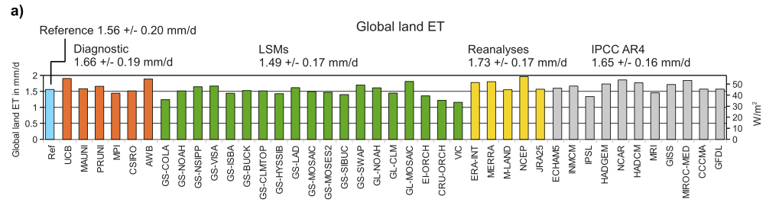
Progress in Global Assessment
Findings from global scale inter-comparisons:
Large number of existing ET datasets (GCM, LSM, reanalysis)
Observation based products largely consistent with others
Globally consistent but regionally variable
Product synthesis provides a benchmark dataset
See http://www.iac.ethz.ch/url/research/LandFlux-EVAL

Slide 11
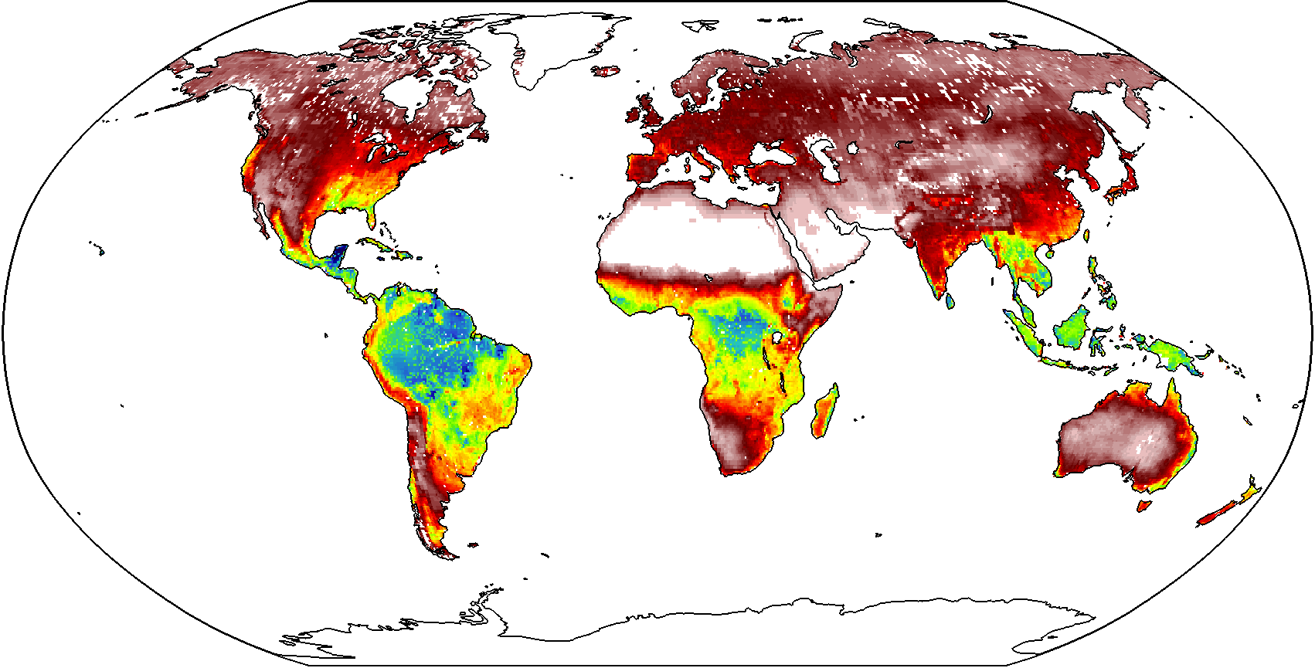
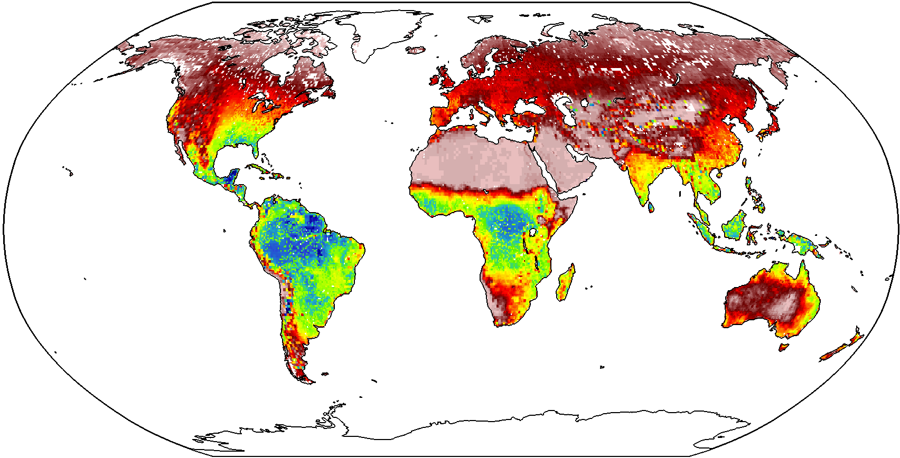
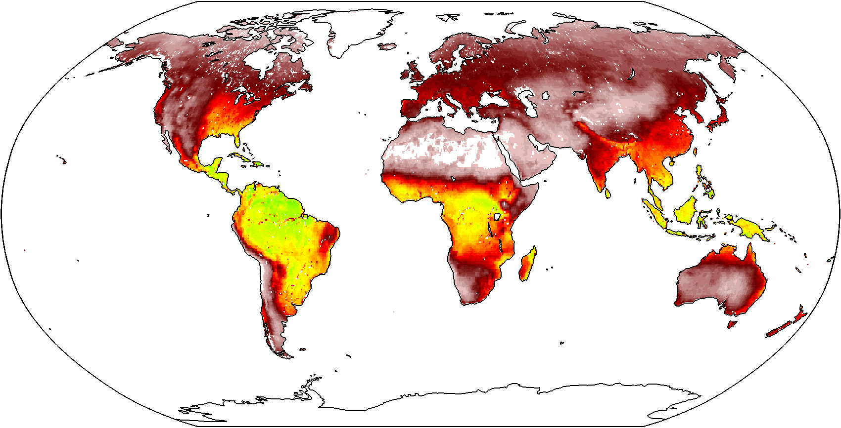
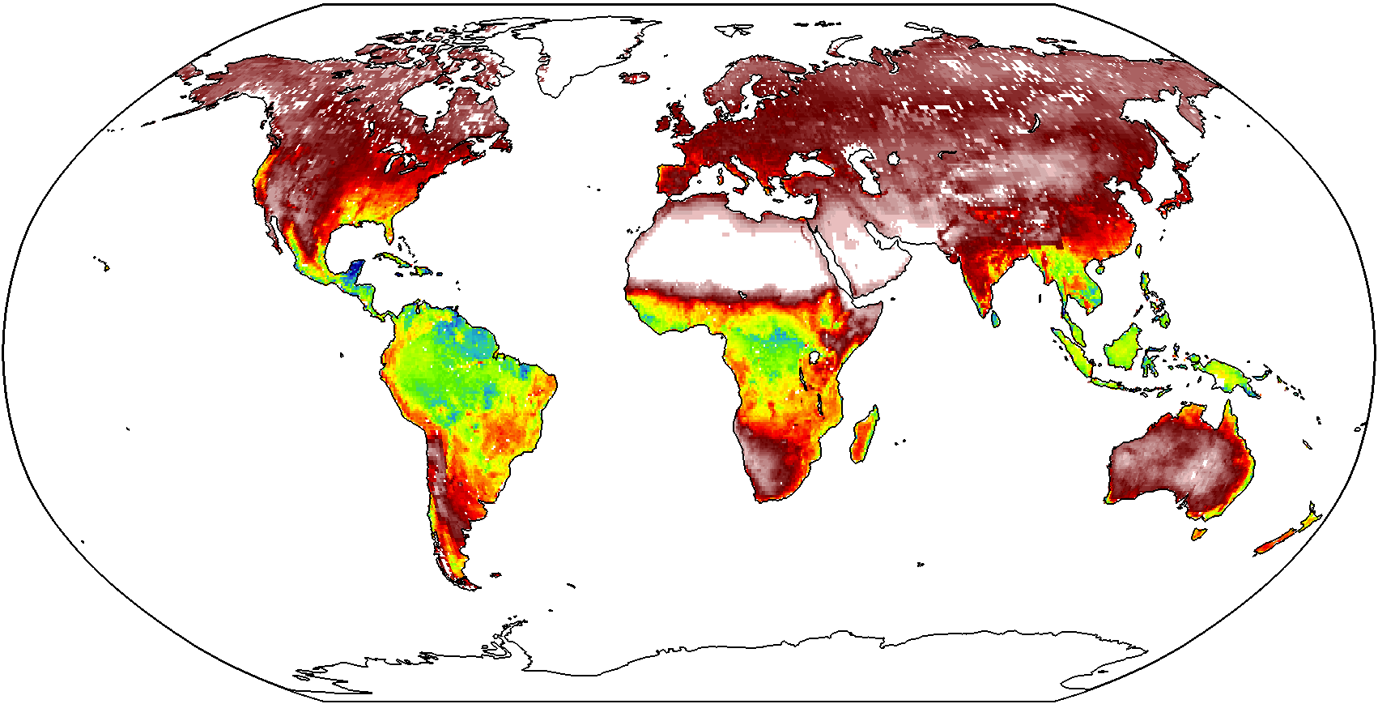
Progress in Global Assessment
Findings from global scale inter-comparisons:
PM-Mu
SEBS
GLEAM
PT-JPL
[mm day⁻¹]
1984-2007 mean annual ET (soil+transpiration)
0 1 2 3 4 5 6
Notes:
Note that Carlos global flux numbers (km3) are different to Eric’s

Slide 12
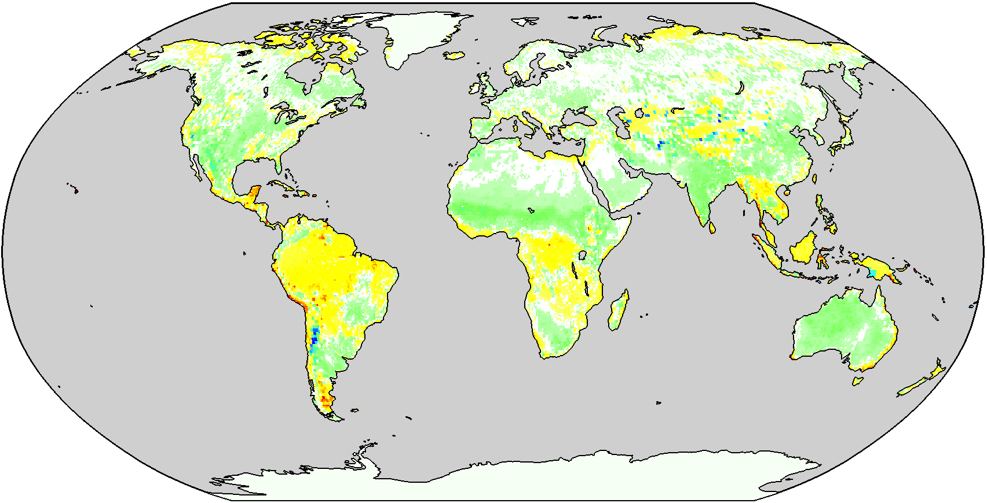
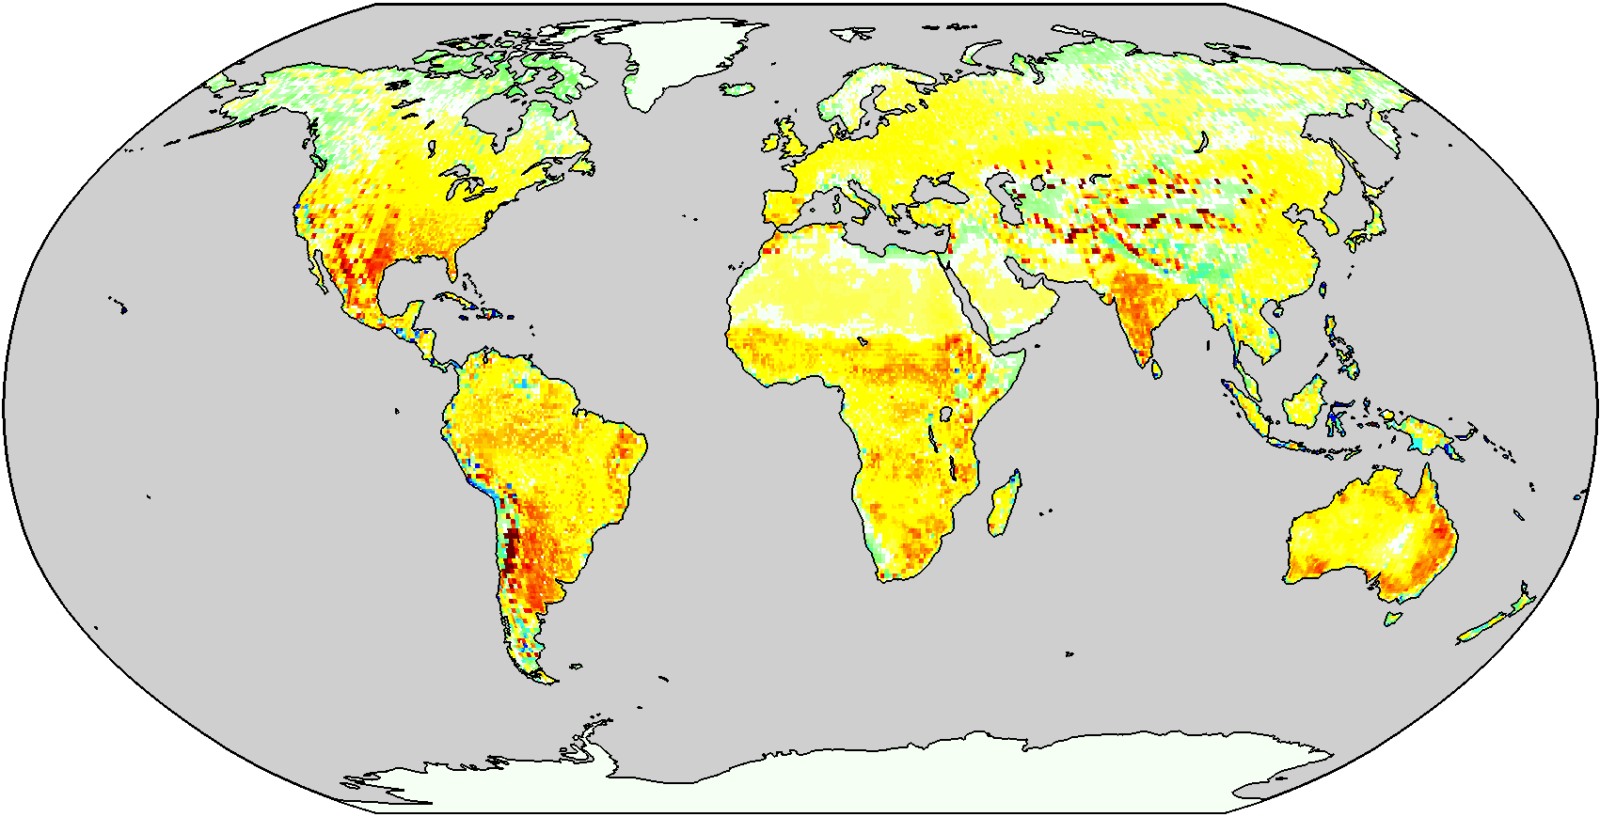
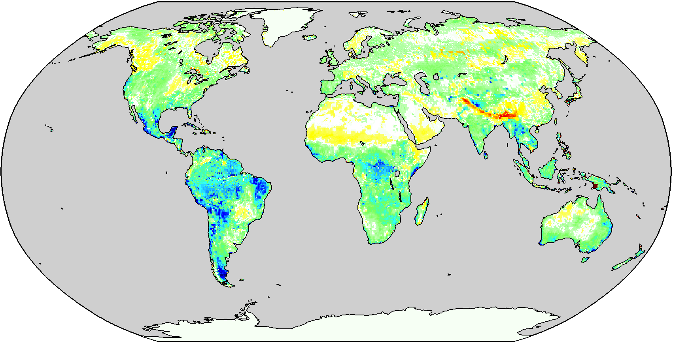
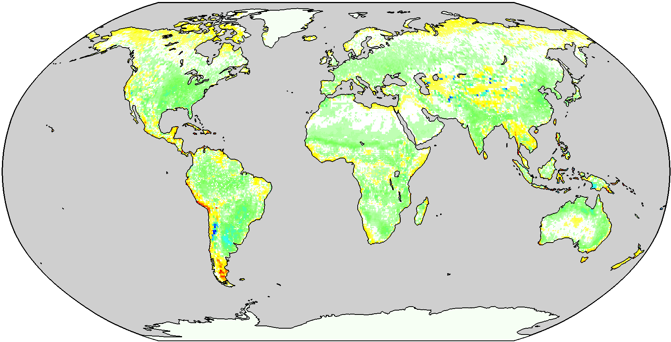
Progress in Global Assessment
Findings from global scale inter-comparisons:
PM-Mu
SEBS
GLEAM
PT-JPL
[mm day⁻¹]
Differences of annual mean ET with 4-model annual average
-2 -1 0 1 2

Slide 13
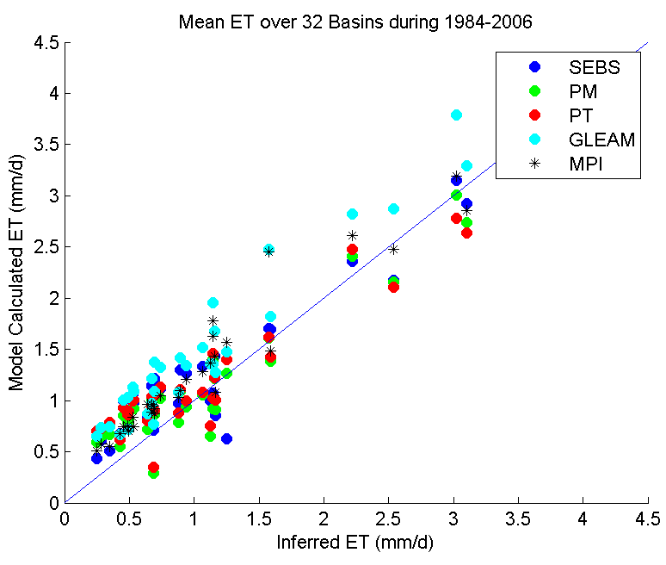
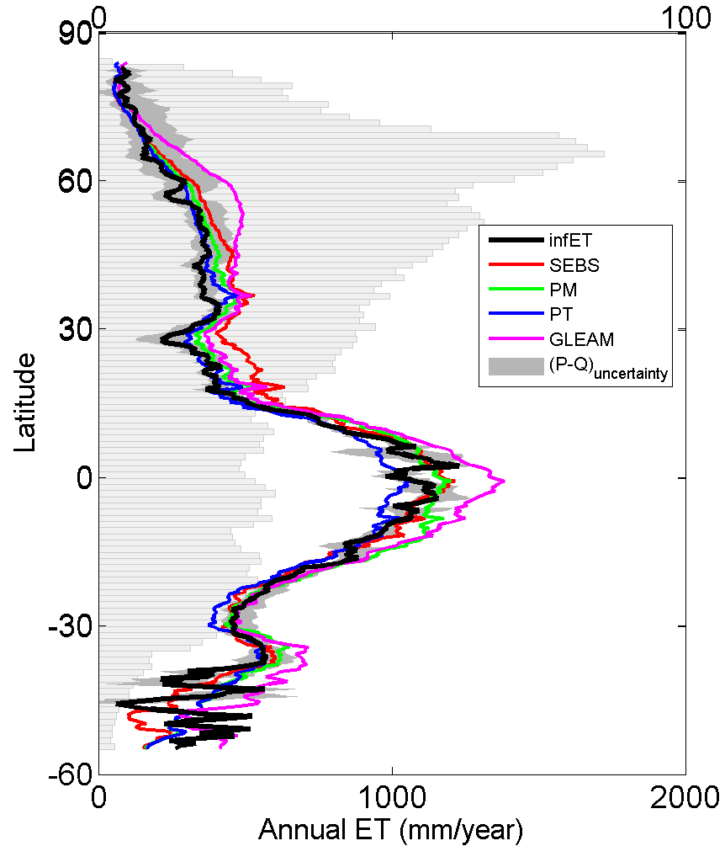
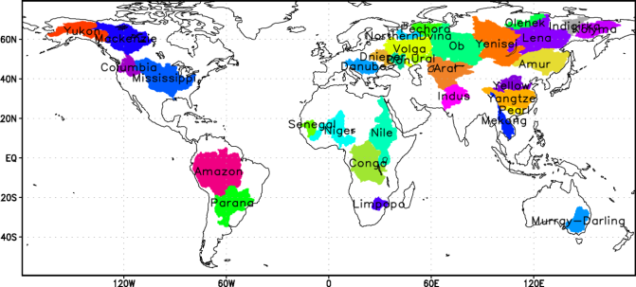
Progress in Regional Assessment
Basin scale inter-comparison and latitudinal change
Generally good agreement at basin scales (P-Q vs ET)
Considerable variation in tropics (interception issue)
Notes:
Over 1400 GRDC gauging stations

Slide 14
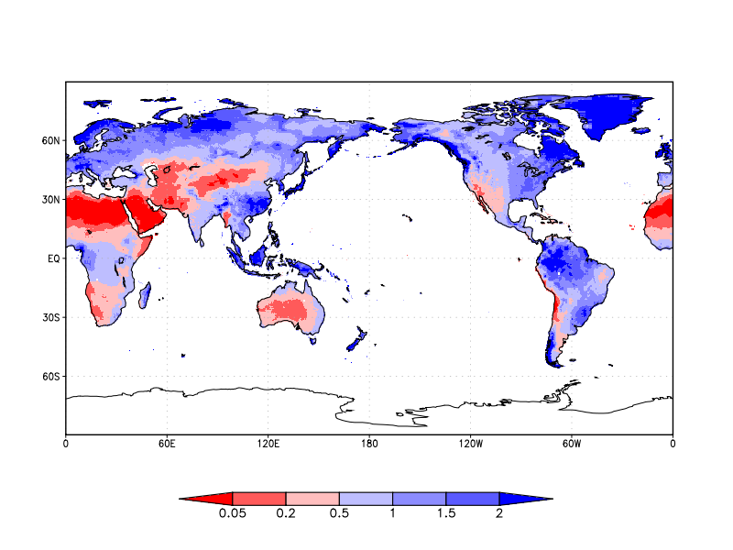
Progress in Regional Assessment
Findings from regional scale inter-comparisons:
Comparisons stratified by water or energy limited regions
Dry-Wet Index (P/PET)
Categories:
Extreme dry: <0.05
Dry : 0.05～0.2
Semi-dry: 0.2～0.5
Semi-wet: 0.5～1.0
Wet: 1.0～1.5
Moist: 1.5～2.0
Extreme wet: >2.0
Notes:
Over 1400 GRDC gauging stations

Slide 15
Progress in Grid-Tower Assessment
Intercomparison of the GEWEX LandFLUX models:
Common forcing: LandFLUX V0 and 116 (45) FLUXNET sites
Models assessed at 3 hourly, daily and monthly scales
7 land cover types and 7 climate types
PM-Mu
PT-JPL
SEBS
GLEAM
Mu et al. 2007; 2011
Fisher et al. 2008
Su, 2002
Miralles et al. 2010

Slide 16
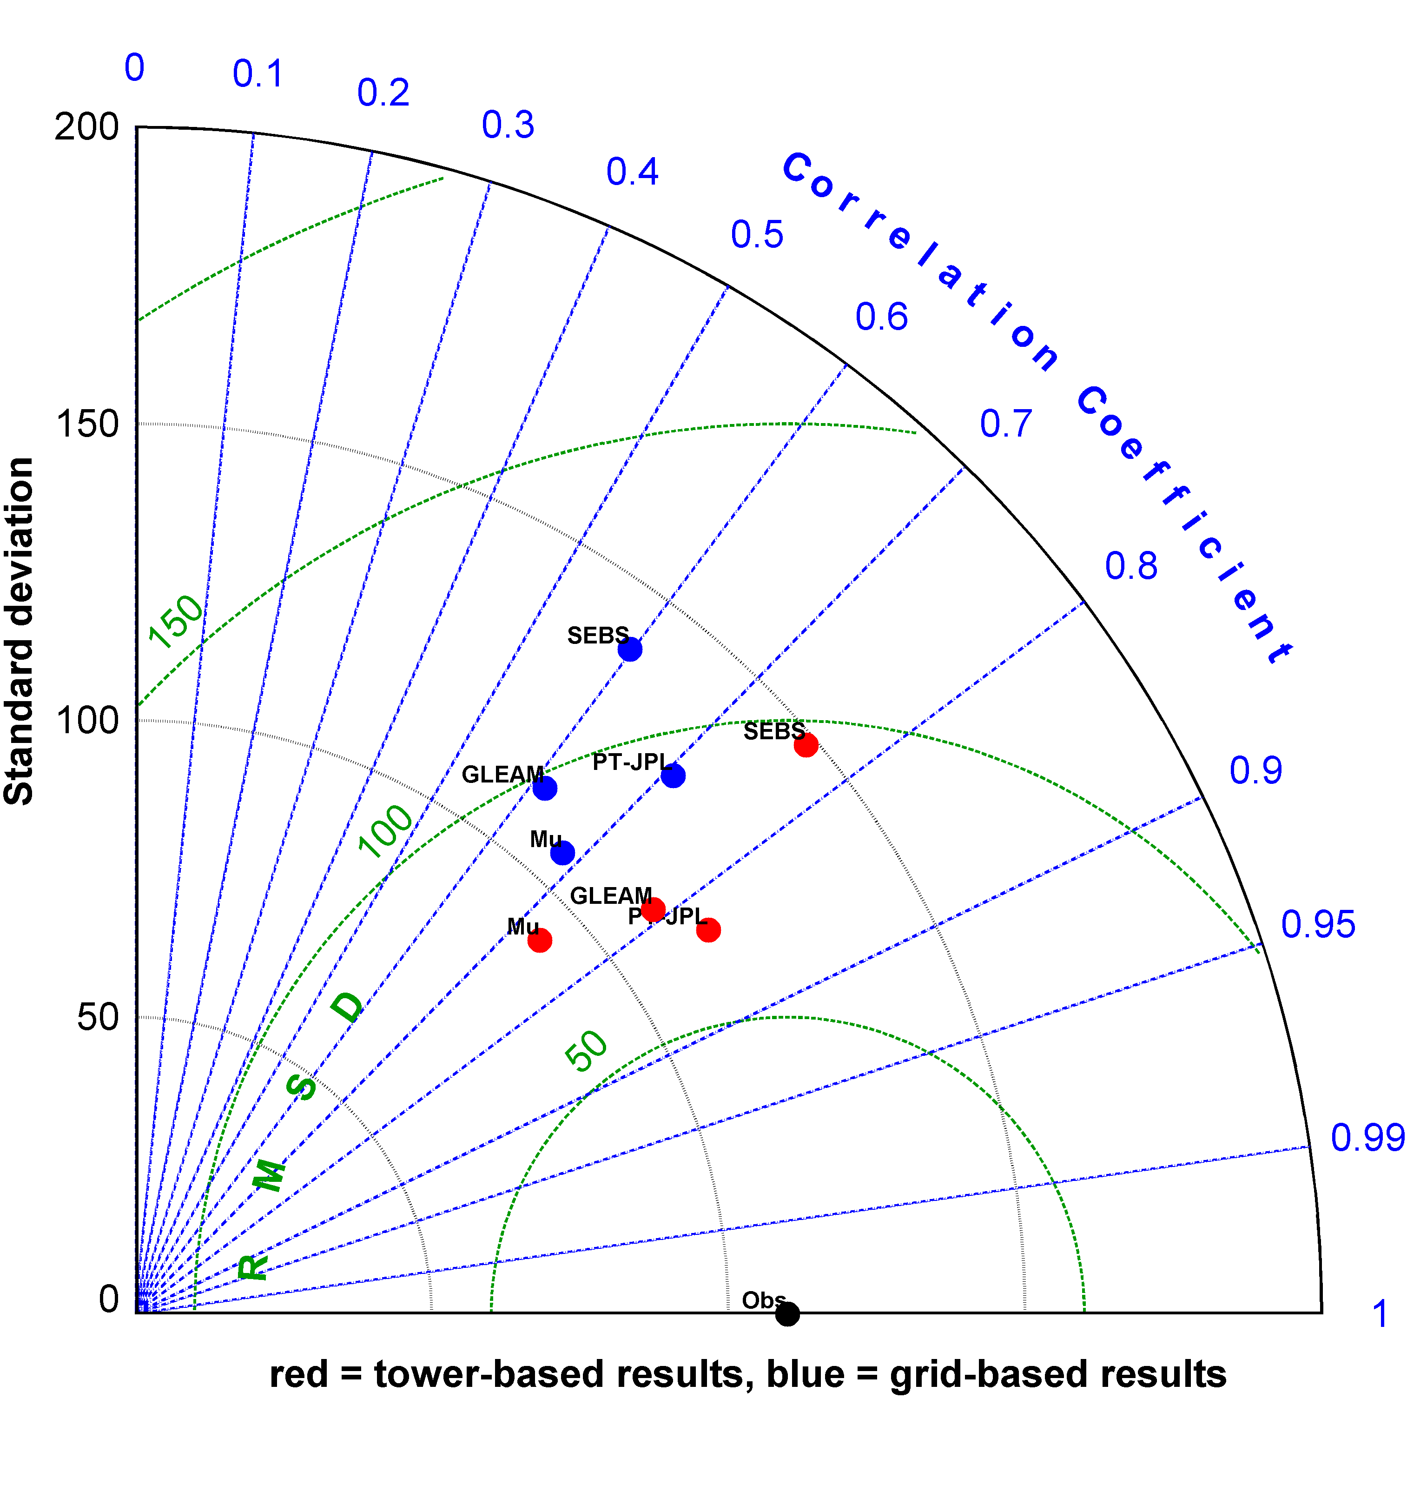
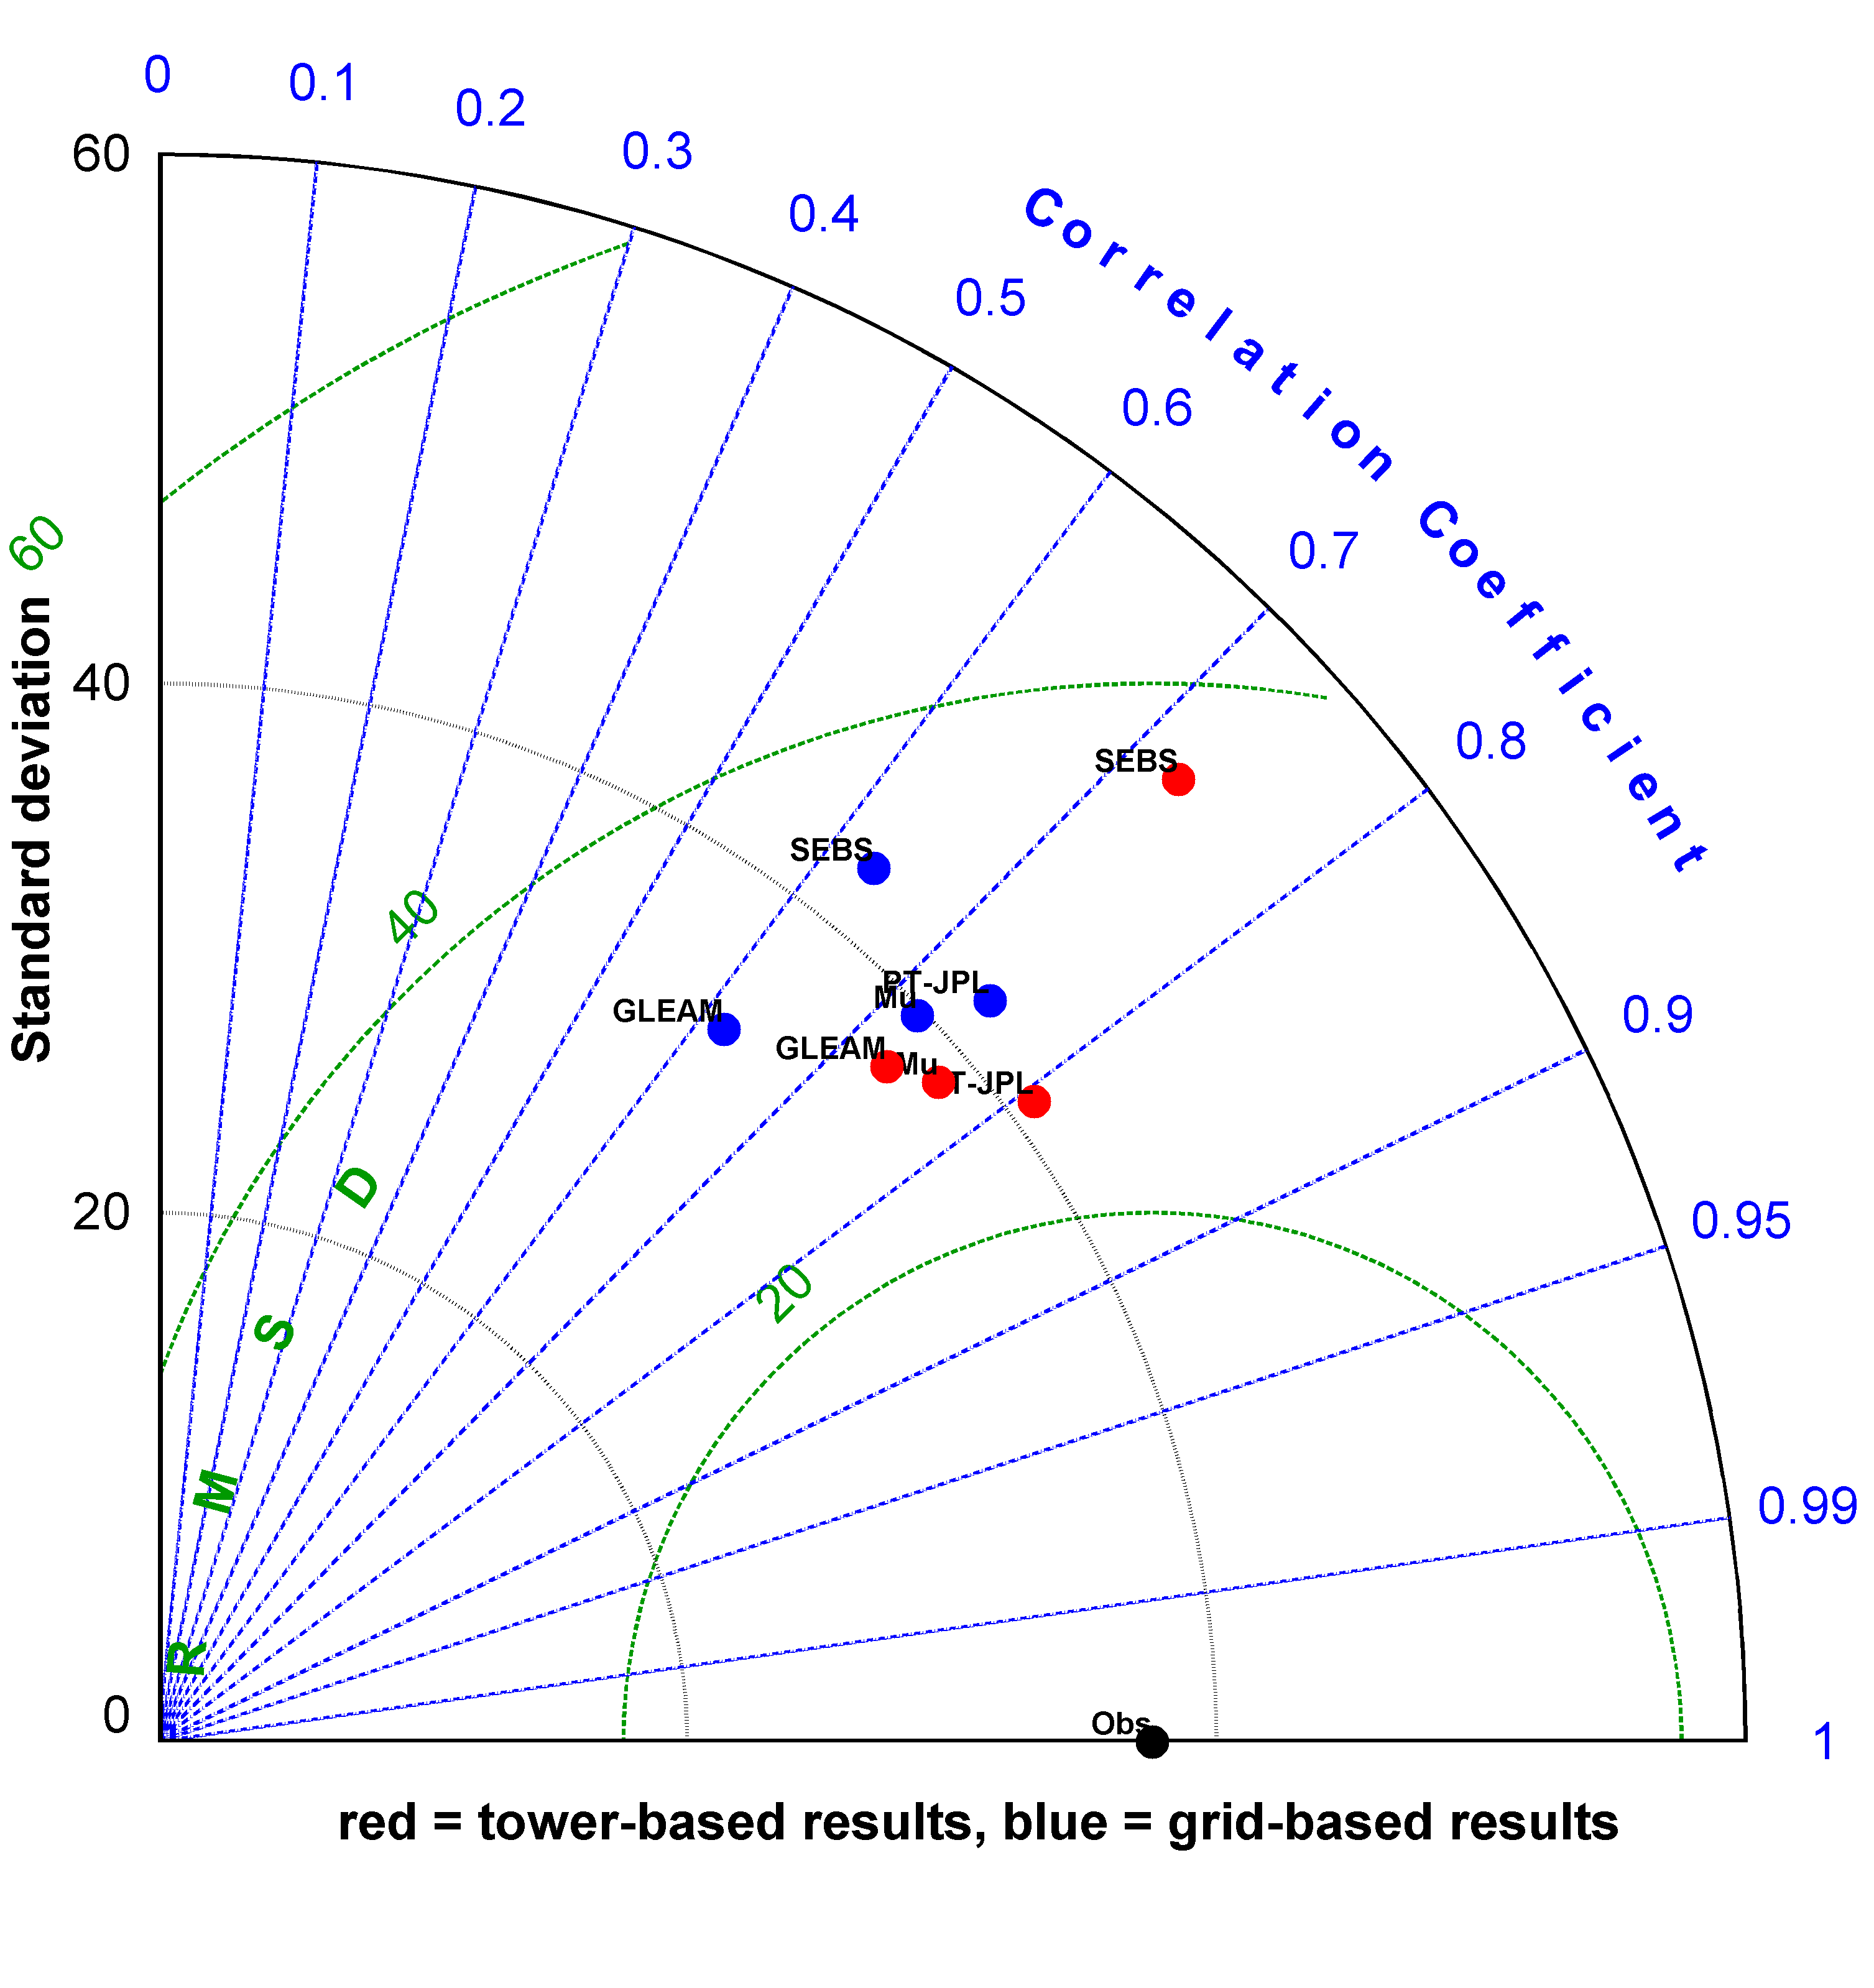
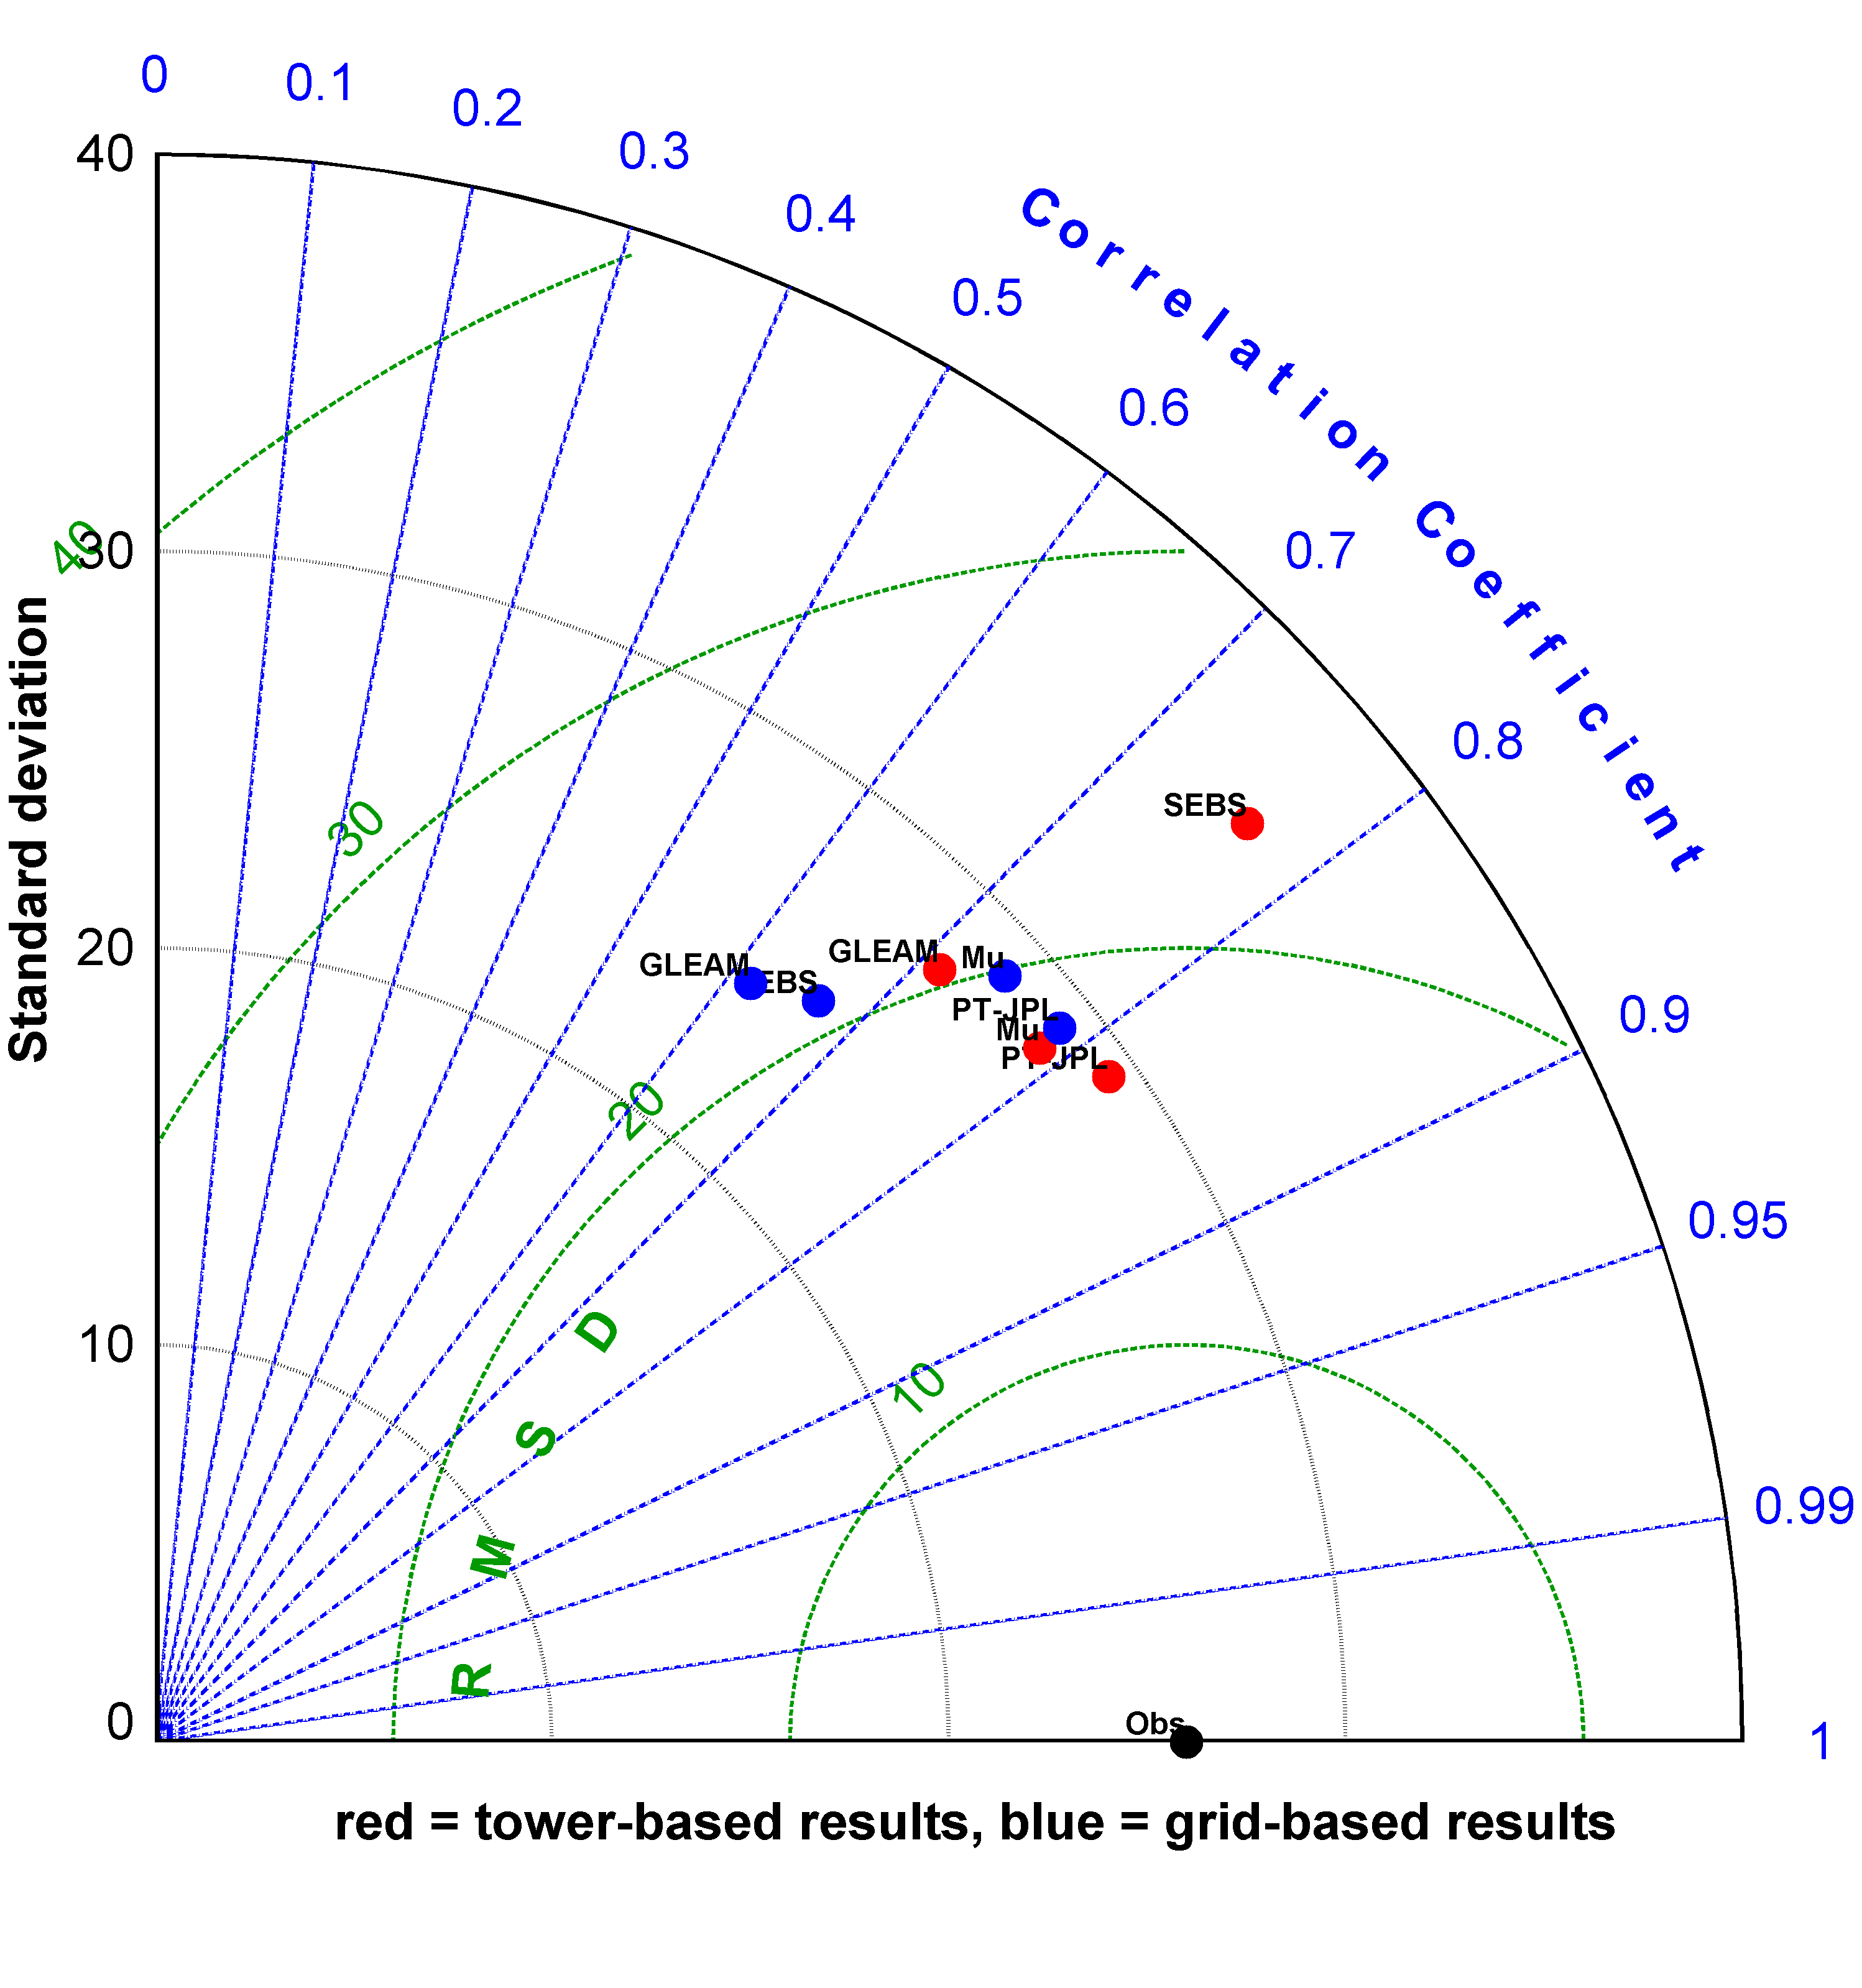
Model Inter-comparison Results
Statistical analysis based on Taylor diagrams
Scatter plots are largely useless: need better metrics
All models improve when run with tower data
Need to examine within biome/climate variation
45 Common Towers
Model clustering/convergence with increasing temporal resolution
3 hourly
Daily
Monthly
Notes:
Winner PT-JPL

Slide 17
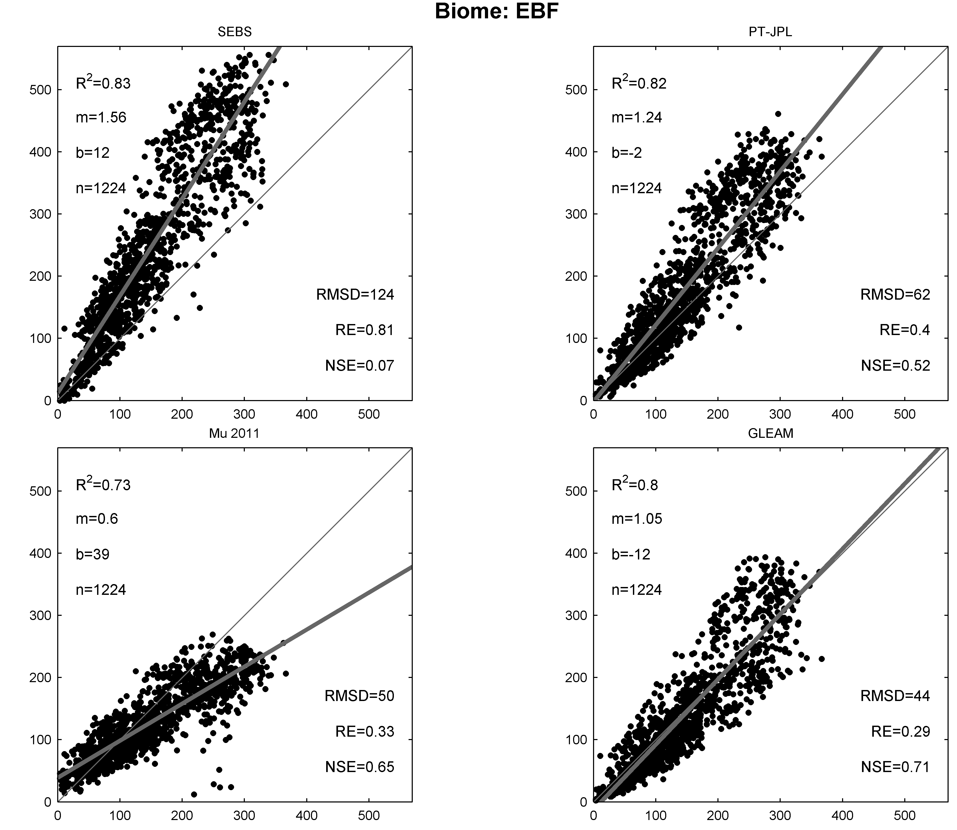
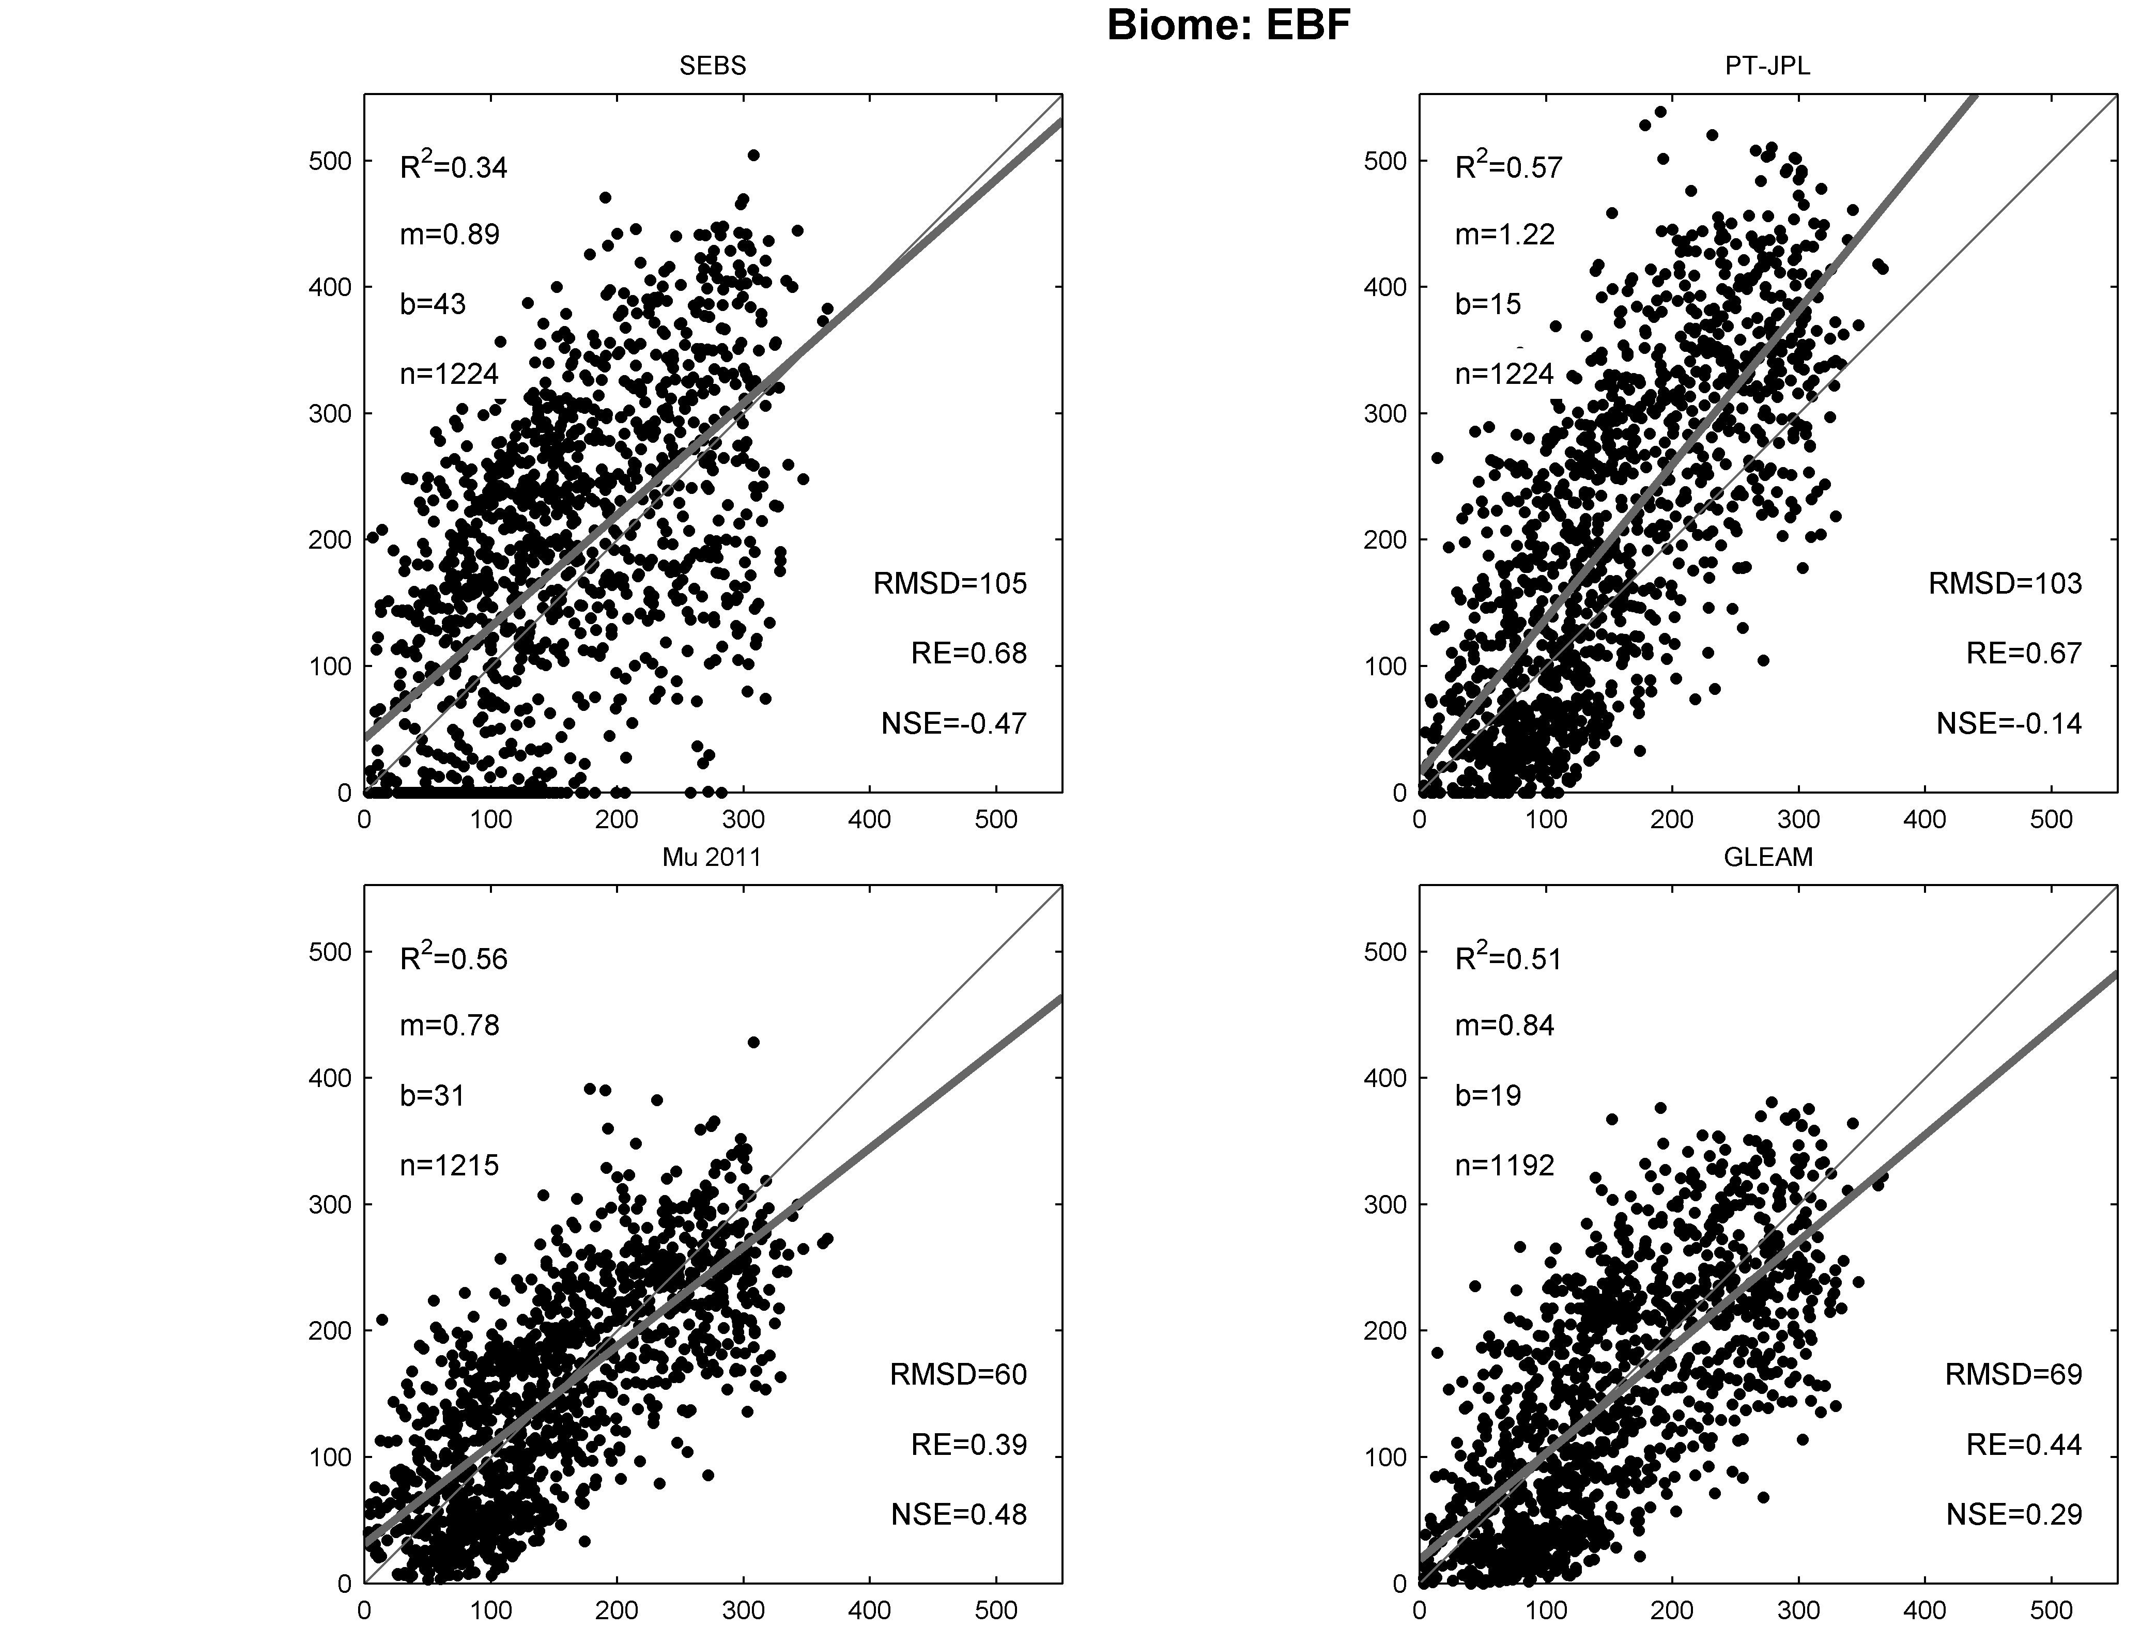
Scatter Plots of LULC Type
Variation via biome type at GRID and TOWER scales
Filtered to 45 “common” towers to simulate ALL models
Flux Tower: 3hr
LandFLUX: 3hr

Slide 18
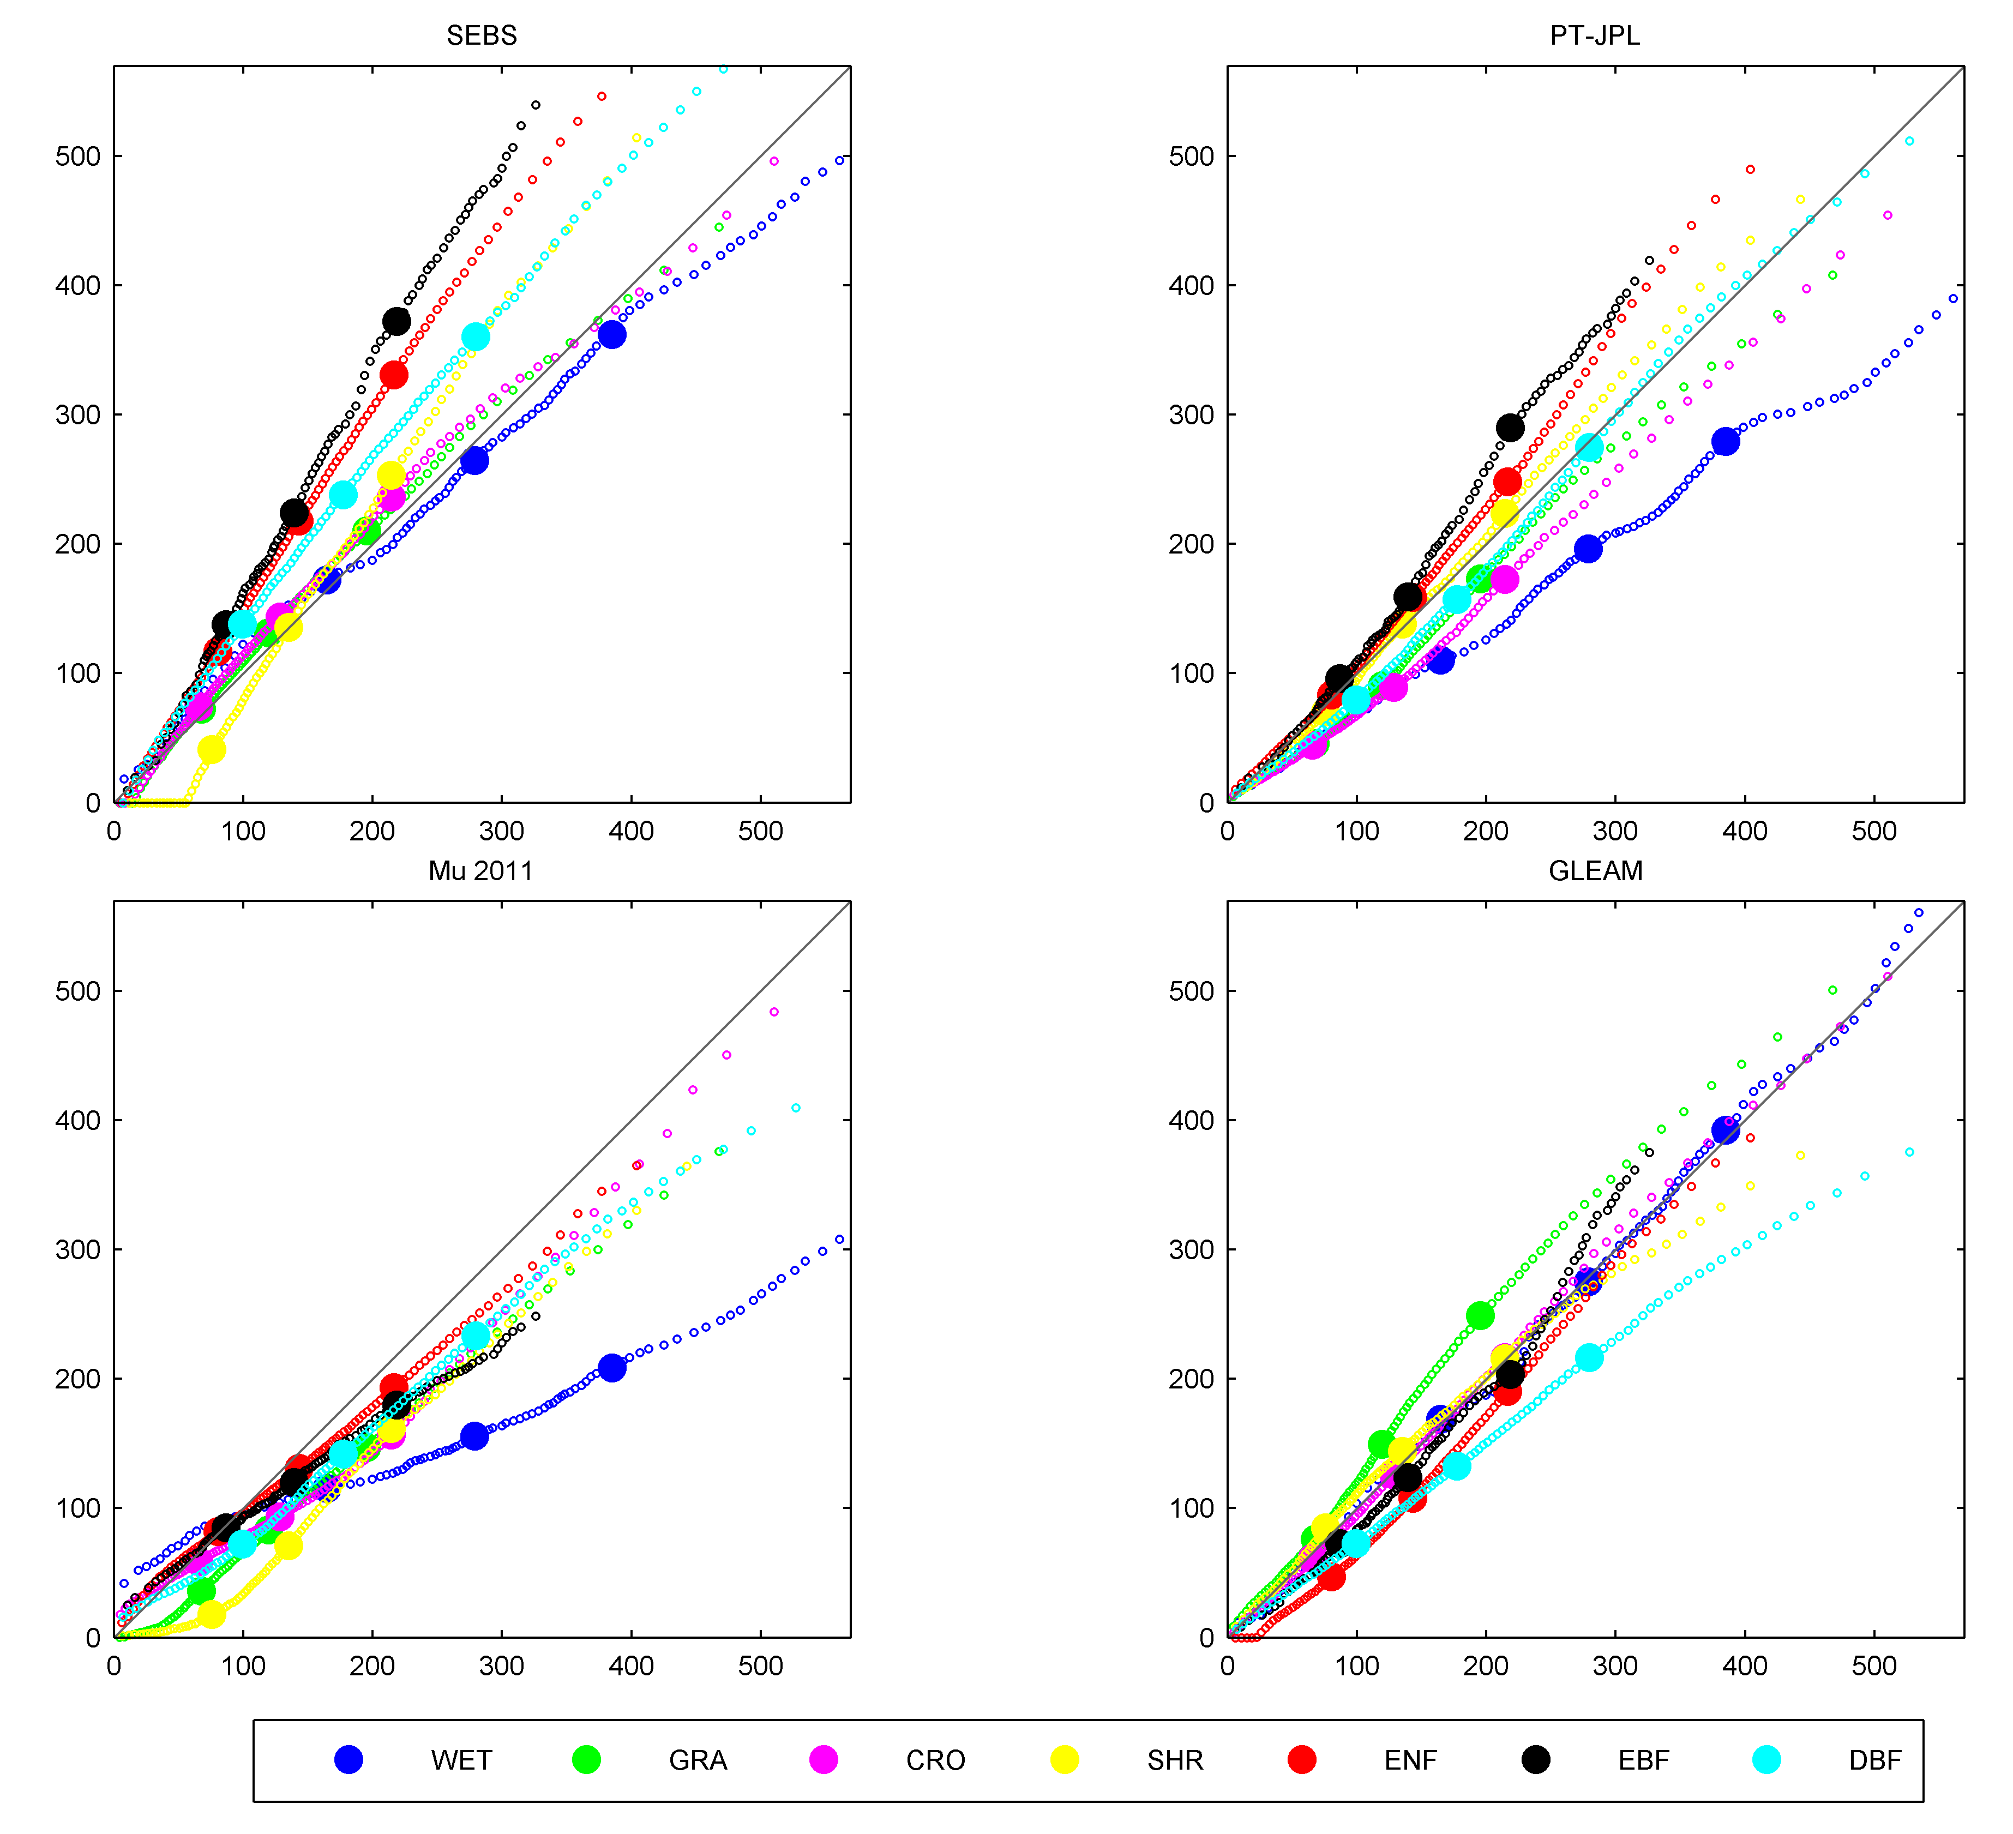
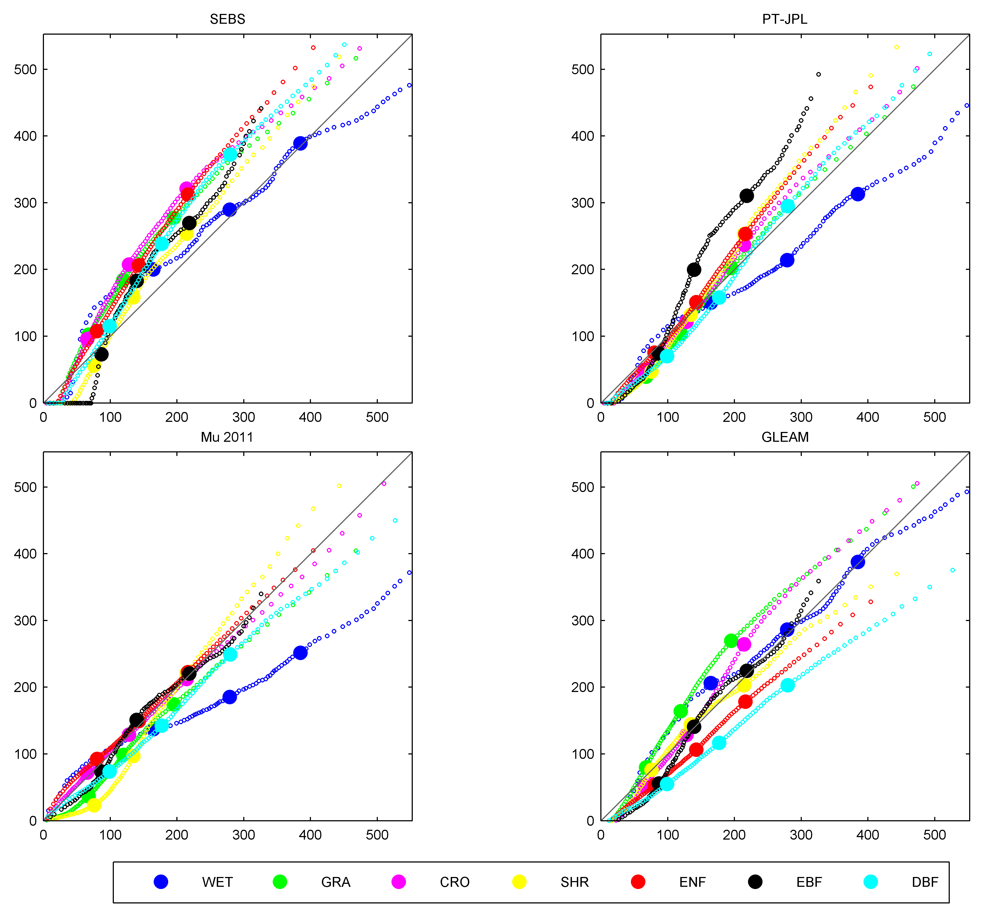
Assessing the Distributions: Biomes
How well do distributions match the observations?
Construct P-P plots (comparing shape of the distributions)
Flux Tower: 3hr
45 Common Towers
LandFLUX: 3hr
model
obs
Notes:
In statistics, a P–P plot (probability–probability plot or percent–percent plot) is a probability plot for assessing how closely two data sets agree, which plots the two cumulative distribution functionsagainst each other.
WET=WETLAND
GRA=Grasland
CRO=Crop
SHR=shrublands
ENF=Evergreen needleleaf Forest
EBF=Evergreen broadleaf Forest
DBF=deciduous broadleaf forest

Slide 19
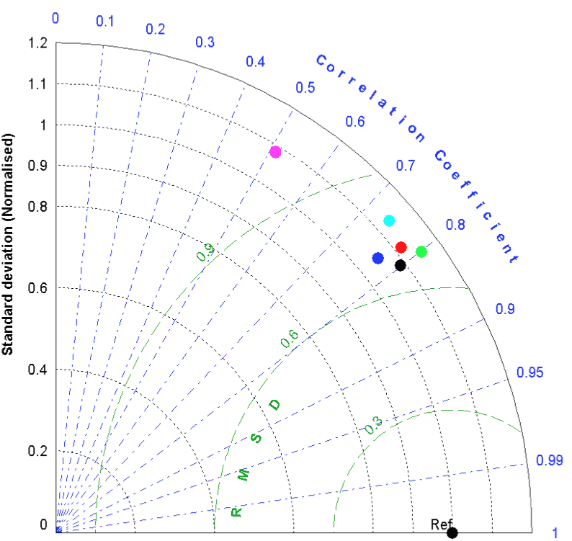

Single Model Response to Forcing
What is the impact of different forcing data?
|R|
.77
.78
.80
.74
.51
.80
GLEAM: AIRS + SRB daily + CMORPH
GLEAM with ERA-Interim inputs
GLEAM with Princeton + SRB (3h)
ERA-Interim
NCEP-NCAR
GLEAM with Princeton + SRB (daily)
Reference data based on
200 Fluxnet sites
from Diego Miralles

Slide 20
Summary and Conclusion
Some take home messages:
A difficult product to derive, as it merges products with their own uncertainties and models with their own assumptions.
Global products require multiple metric and multiple evaluation scales (incl. spatial and temporal).
Ground data have their own issues.
Model performance linked to metric, scale and zone/type
- model sensitivity to forcing v’s forcing uncertainty.
Issue of forcing quality constrains achievable accuracy.
Influence of seasonality on model response (not shown)
- better performance spring/autumn v’s summer/winter.
No model works everywhere, every time!
- an ensemble product/model weighting/new models?
Data being pre-released for ongoing assessment

Slide 21
Future Work and Opportunities
Still some outstanding challenges:
Production of sensible heat and ground heat fluxes
Frozen/snow-covered areas are still missing
Ongoing algorithm development (soil moisture stress term, better surface resistance/vegetation params)
… need to keep in mind:
Satellite products respond to different needs, e.g., LandFLUX is targeting climatological applications and consistency with other GDAP products
opening opportunities:
Water and energy budget studies with GDAP products
Needed community involvement and product development (Version 2+…)
LandFLUX Version 0 to be released in July, 2014

