Slide 1
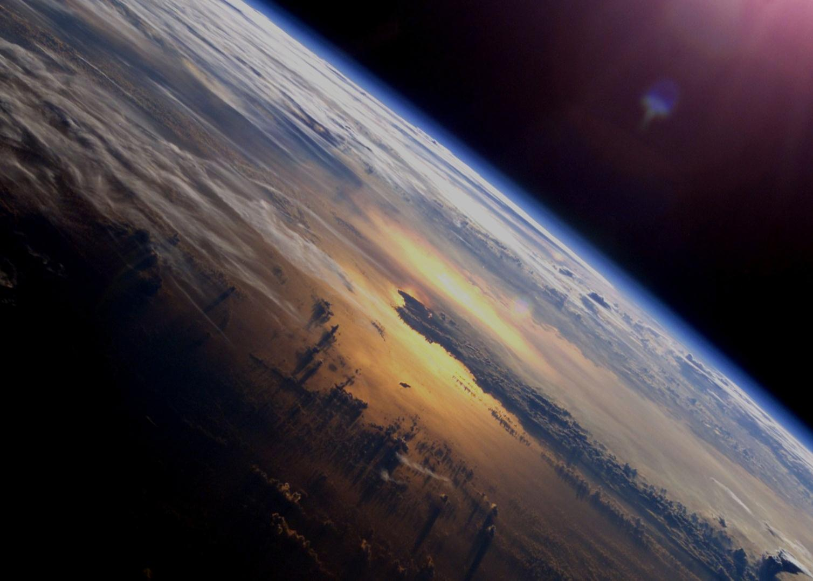
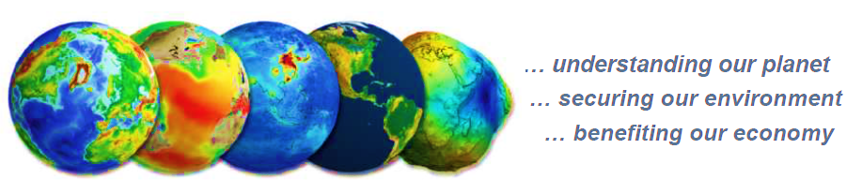
Ocean Heat Flux
Pierre-Philippe Mathieu, ESA/ESRIN, Frascati, Italy.
pierre.philippe.mathieu@esa.int
WCRP WDAC, Gallway, Ireland, 5 May 2014
Many thanks to contributions of Abderahim Bentamy, Caroline Clayson, Lisan Yu, Bertrand Chapron, Raymond Zaharia, Axel Anderrson, Mark Bourassa, Michael Brunke, Chris Fairall, Sarah Gille, Simon Josey, Fennig Karsten, Liz Kent, Chris Merchant, Brent Roberts, Chung-Lin Shie, Andrea Storto, Keith Haines, Magdalena Alonso, Kathy Hill, Tony Lee & colleagues …

Slide 2

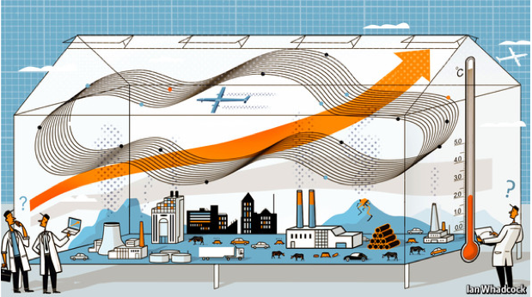
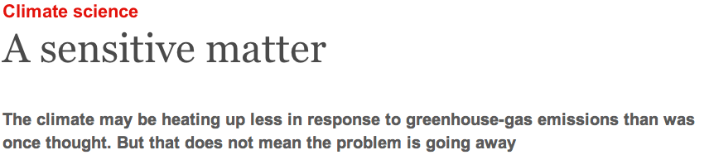
The Temperature Plateau
Source: The Economist, March 2013

Slide 3
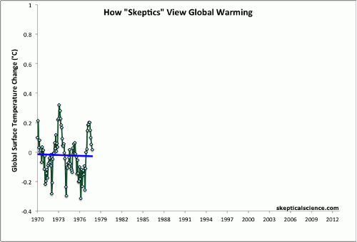
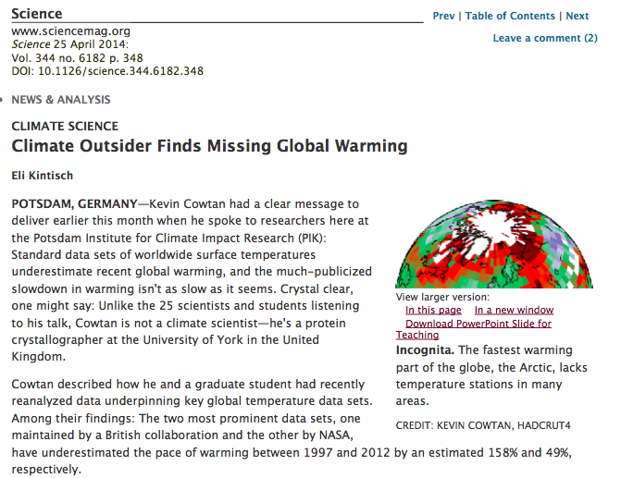
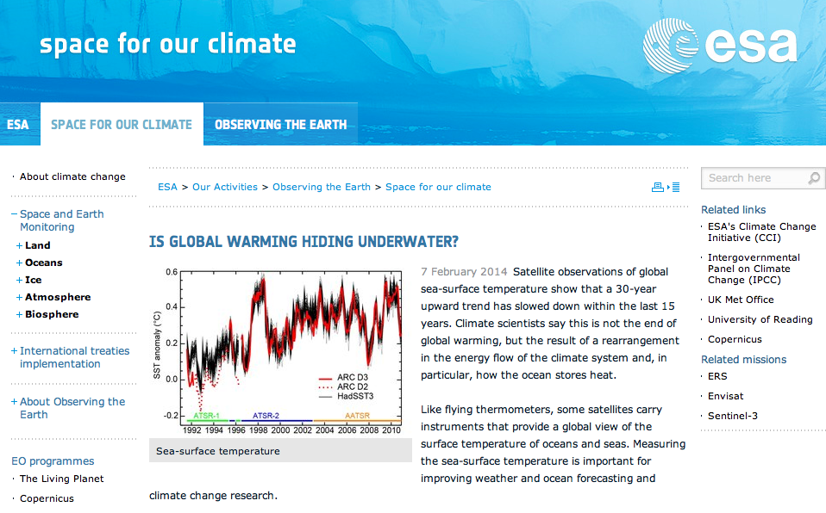
Attribution of Possible Causes of Hiatus period
Natural Climate Variability?
Reduced Solar Variability?
ENSO?
Increased Stratospheric Aerosols?
Asian Pollution?
Deep ocean?
Sampling Bias?
Obs quality?
How Climate Deniers view global warming
Source: skepticalscience.com
Source: Science, 2014

Slide 4
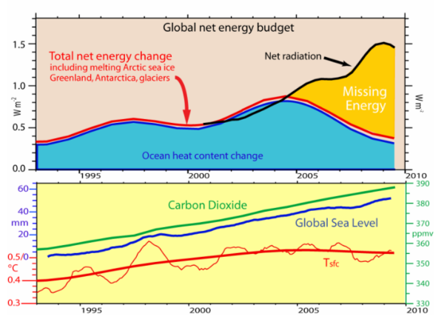
Missing Energy?
Source: Trenbert et al.,
ESA UNCLASSIFIED - For Official Use

Slide 5
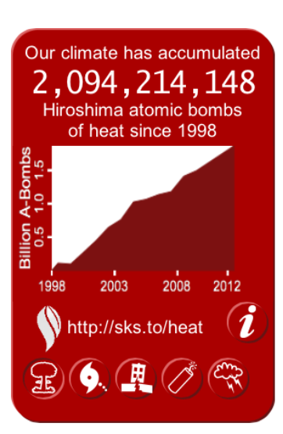
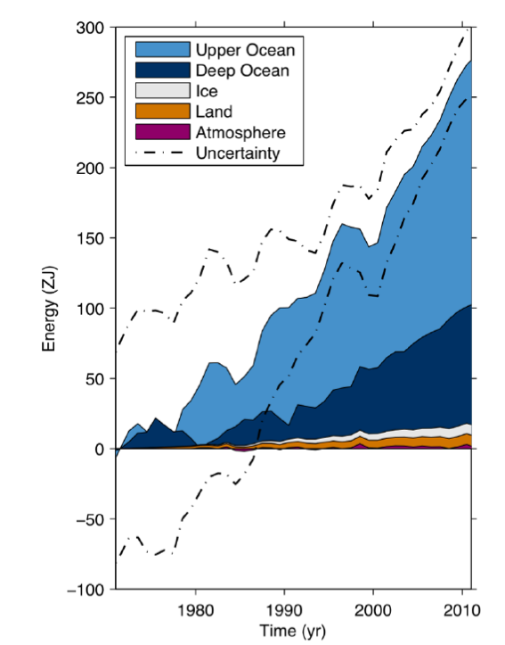
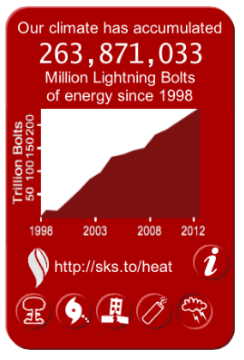
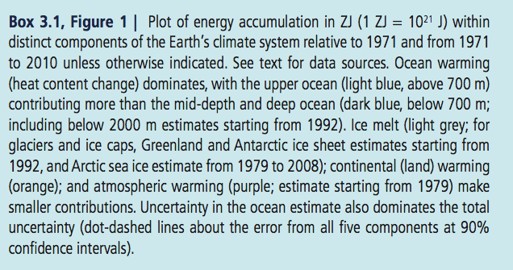
The Ocean Climate Heat Reservoir
Source: sks.to/heat
Source: IPCC, chap 3, pg 264, box3.1, 2013

Slide 6
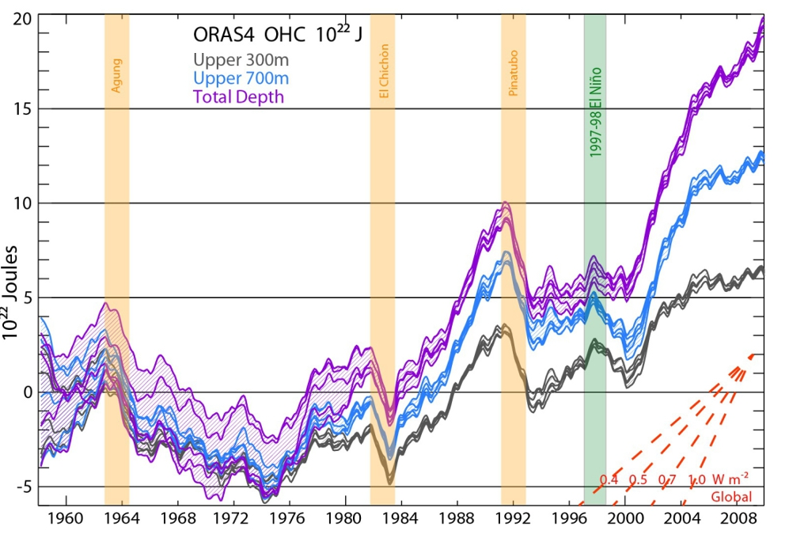
Heat buried in the deep ocean?
Ocean heat content in regions from 0 to 300 m (grey), 700 m (blue), and total depth (violet) from ORAS4, each with five lines as ORAS4 is an ensemble with five parts. Yellow bars are volcanic eruptions, and the green bar is the 1997-1998 El Niño. The graph is shown with respect to an 1958–1965 base period whose average heat value provides the zero baseline for the graph. The red lines in the corner show the rate of warming different slopes of the lines in the graph would mean. Figure © Wiley,
Source: Magdalena A. Balmaseda, Kevin E. Trenberth, Erland Källén (2013). Distinctive climate signals in reanalysis of global ocean heat content Geophysical Research Letters : 10.1002/grl.50382

Slide 7
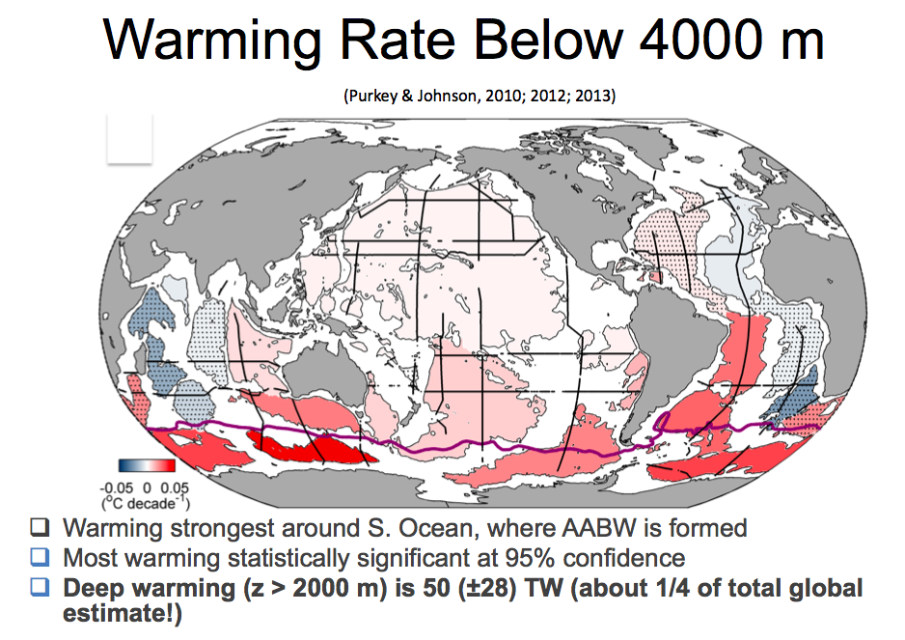
Regional Distribution

Slide 8

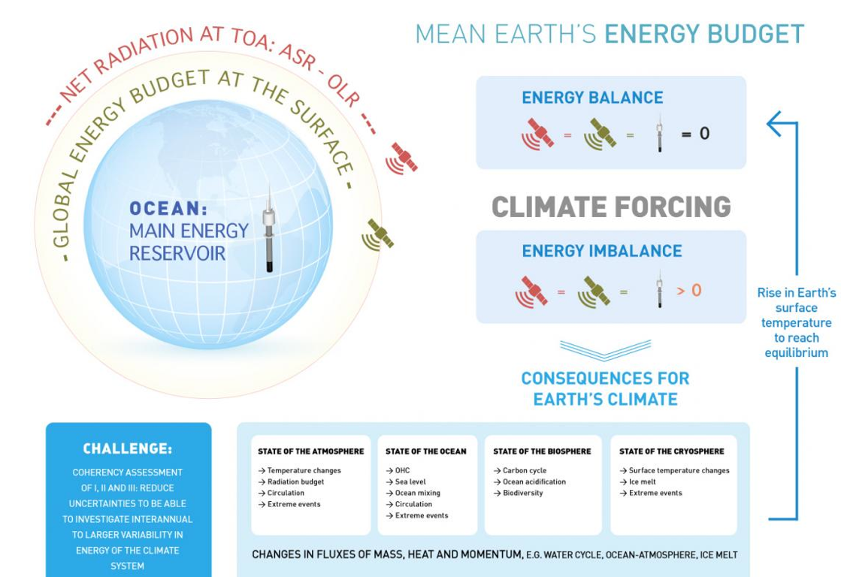
CLIVAR & New Research Focus
CLIVAR OCEANS & CLIMATE variability, predictability and change
    The World Climate Research Programme’s project on ocean-atmosphere interactions To improve understanding and prediction of ocean-atmosphere interactions
    and their influence on climate variability and change,
    to the benefit of society and the environment.

Slide 9
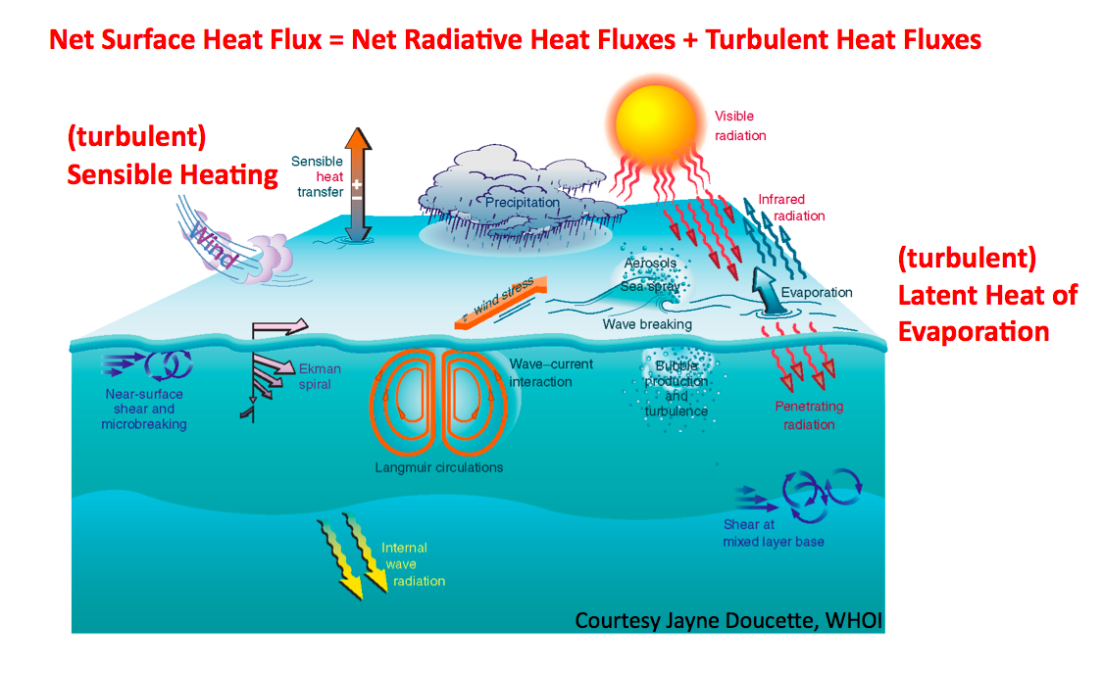
WCRP focus on Air-Sea exchanges
Air-Sea fluxes are a key WCRP cross-cut focus of WCRP, across programmes (GEWEX, CLIVAR, SOLAS, iLEAPS, CLiC), and data (EO, in-situ, models),
WCRP Working Group & GEWEX LandFlux - SeaFlux
Action plan on Surface Fluxes (2012), WOAP meeting (Frascati, 2012)
Source: Janette Doucette
ESA UNCLASSIFIED - For Official Use

Slide 10
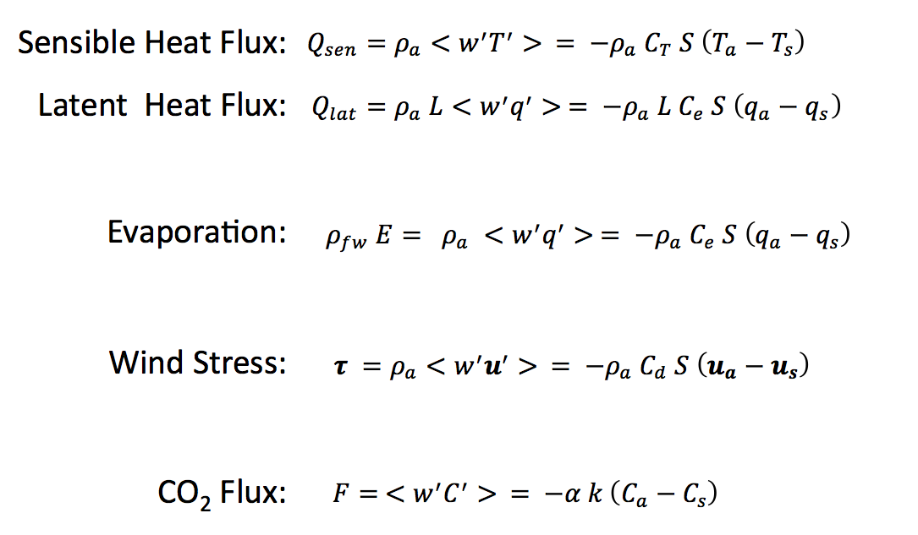
The Challenge of quantifying Air-Sea Fluxes
Direct (covariance) vs. Indirect (bulk formula) estimation
Temperature
Humidity
Wind speed
2-50m height
Source: Cronin

Slide 11
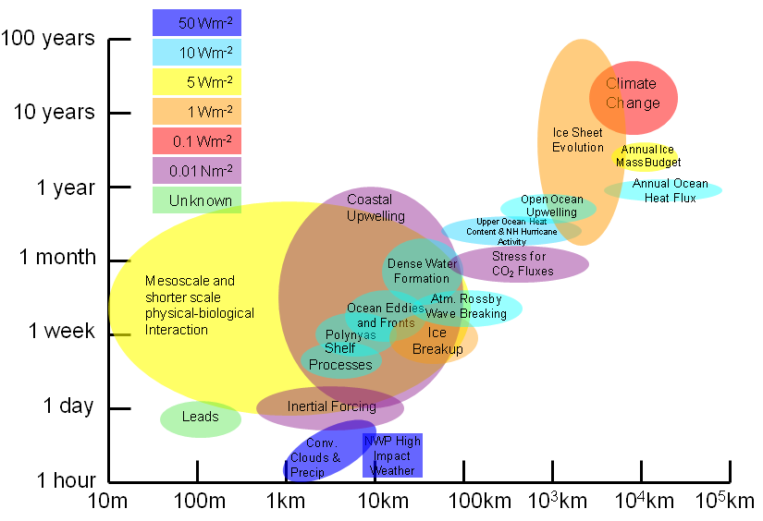
The Challenge of Accuracy
Spatial and temporal scales for high-latitude processes and the recommended accuracy of related surface fluxes. These accuracies are estimates from a wide range of scientists who require flux products for their research.
Source: Mark Bourassa

Slide 12
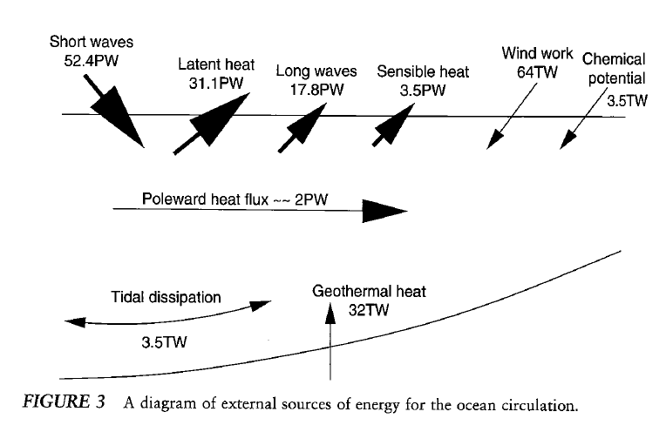
The Challenge of Closing Energy Budget
Source: Huang, R. X., 2004. Ocean, energy flow. In: Encyclopedia of Energy, C.J Cleveland, ed., Elsevier, 4, 497-509
( ftp://ecco2.jpl.nasa.gov/data9/articles/WindWork/huang_2004_energy.pdf,
Source: clivar.org
ESA UNCLASSIFIED - For Official Use

Slide 13
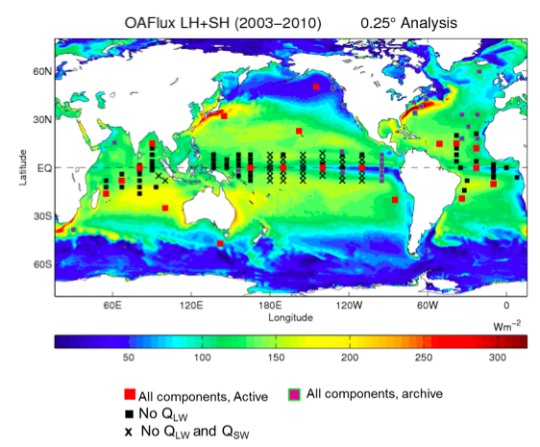
The Challenge of Observation – In-Situ
Point-based – Sparse – Uneven view,
85% buoys in tropical regions, about 20 active full-flux buoys, + OceanSITES
Source: Lisan Yu, GSOP report
ESA UNCLASSIFIED - For Official Use

Slide 14
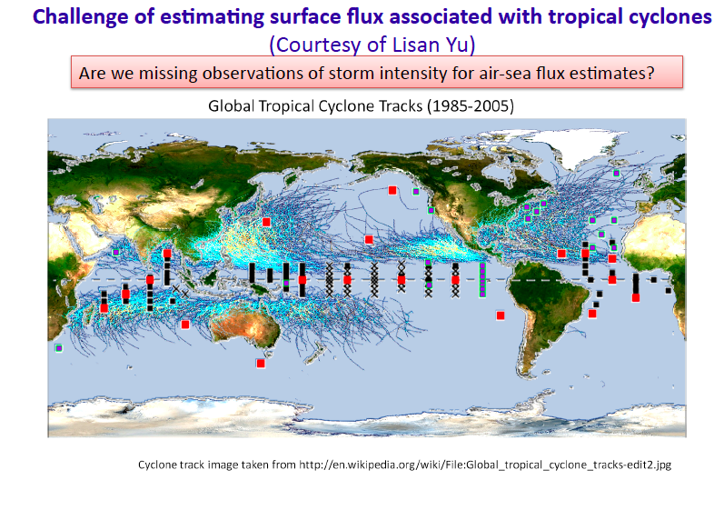
Local View - Poor sampling?
Source: Lisan Yu,

Slide 15
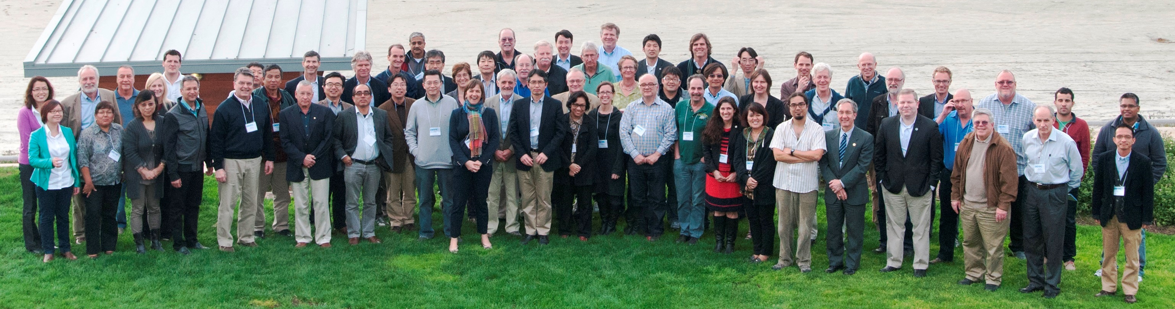
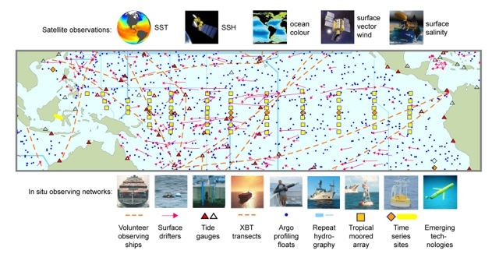
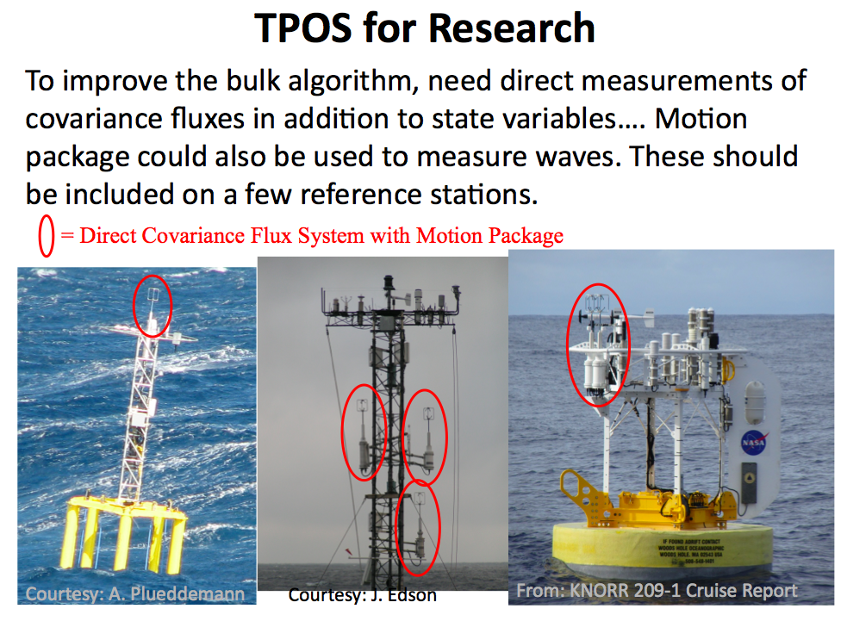
Tropical Pacific Observing System (TOPS)
TPOS 2020 Workshop, 27-30th January, 2014, Scripps Institution of Oceanography.
Source: Kathy Hilll, WMO

Slide 16
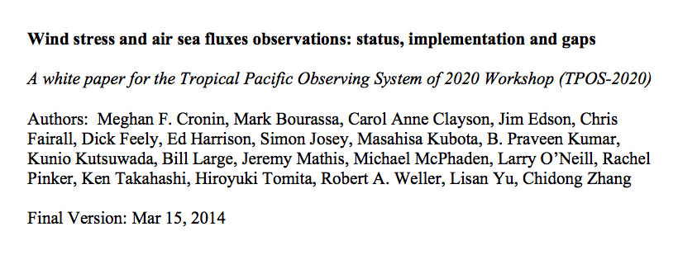
TOPS 2020 recommendations
The Review recommends the creation of a focussed TPOS 2020 Project to achieve the transition from a loosely coordinated set of ocean observing activities in the tropical Pacific to a systematic and sustained TPOS by 2020.
  More Reference Stations in Tropical Pacific,
  Include meridional transect sections, e.g. extending ITCZ zone,
  Multipurposes Multivariables,
  Colocated Contemporaneous measurements e.g. SST, Flux, Mixed Layer,
  Resolve diurnal cycle e.g. SST, wind, Solar Radiation,
  Resolve oceanic boundary layer profiles,
  Report uncertainty with measurements,
  Add radiative sensors to TRITON buoys
  Report depth of measurement e.g. SST,
  Build interdisciplinary process studies built around the infrastructure
Source: Cronin

Slide 17
The Challenge of Observations - Satellites
 | 92 | 93 | 94 | 95 | 96 | 97 | 98 | 99 | 00 | 01 | 02 | 03 | 04 | 05 | 06 | 07 | 08 | 09 | 10 | 11
ERS-1 | Aug 91 – May 96
ERS-2 |  |  |  | Apr 95 – Jan 01
ADEOS-1 |  |  |  |  |  | Sep 97 – Jun 98
QSCAT |  |  |  |  |  |  |  | Jul 99 – Nov 09
ADEOS-2 |  |  |  |  |  |  |  |  |  |  | Dec 02 – Jul 03
METOP |  |  |  |  |  |  |  |  |  |  |  |  |  |  | Dec 06 - Present
OCEANSAT |  |  |  |  |  |  |  |  |  |  |  |  |  |  |  |  |  | Dec 09 - Present
WindSat |  |  |  |  |  |  |  |  |  |  |  | Feb 03 - Present
SSM/I 10 | Dec 90 – Nov 97
SSM/I 11 | Dec 91 – May 00
SSM/I 13 |  |  |  | May 95 – Nov 09
SSM/I 14 |  |  |  |  |  | May 97- Aug 08
SSM/I 15 |  |  |  |  |  |  |  | Dec 99 - Present(?)
AMSU N15 |  |  |  |  |  |  |  |  | Jan2000-Present
AMSU N16 |  |  |  |  |  |  |  |  | Oct 00-Present
AMSU N17 |  |  |  |  |  |  |  |  |  |  | Jul 02-Present
AMSU N18 |  |  |  |  |  |  |  |  |  |  |  |  |  |  | Sep 05-Present
AMSU MTP |  |  |  |  |  |  |  |  |  |  |  |  |  |  |  |  | Mar 07-Present
AMSRE AQ |  |  |  |  |  |  |  |  |  |  |  | Jun 02-Present
Source: Bentamy, IFREMER
Notes:
Fluxes at global and regional scales are estimated from NWP models (ECMWF; NCEP; Era-Interim; CFSR; …), from ships (ICOADS), and mainly from remotely send measurements (IFREMER; HOAPS;WHOI;JFRO;…). This slides shows example of satellites used to estimate momentum and turbulent fluxes at IFREMER.

Slide 18
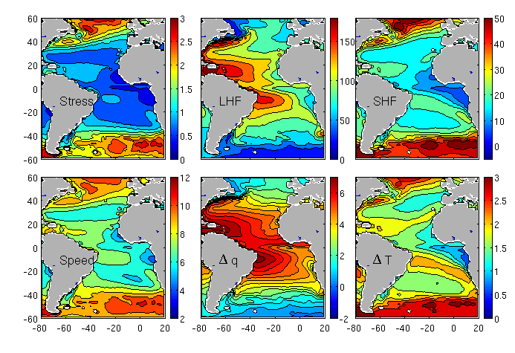
The Challenge of generating Global Products
Satellite Turbulent Fluxes : 1999 - 2009
Notes:
18
18

Slide 19
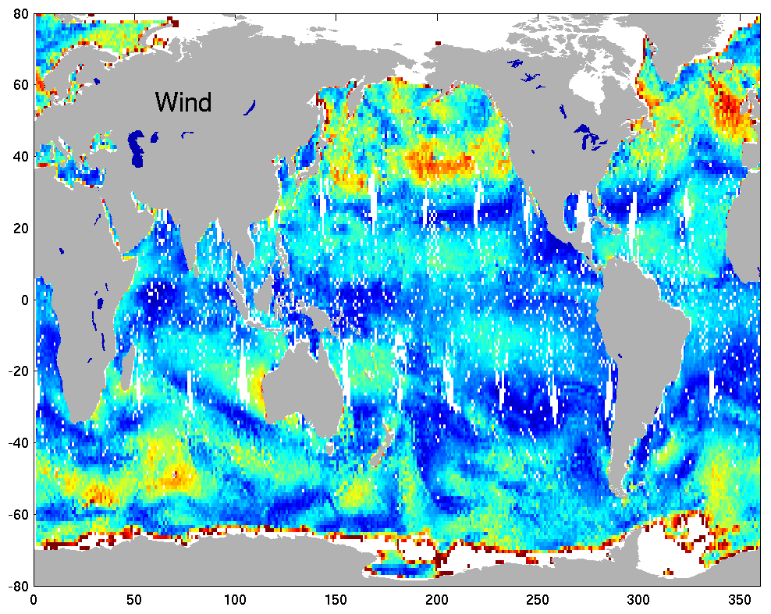
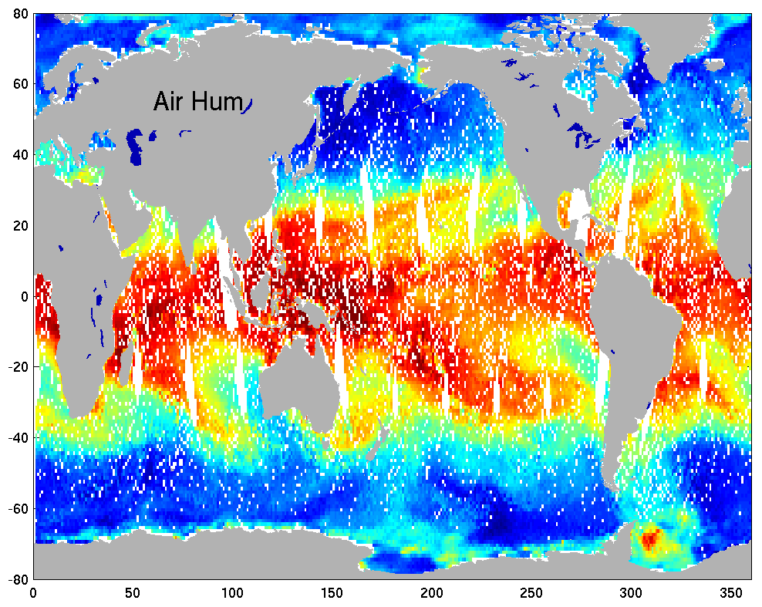
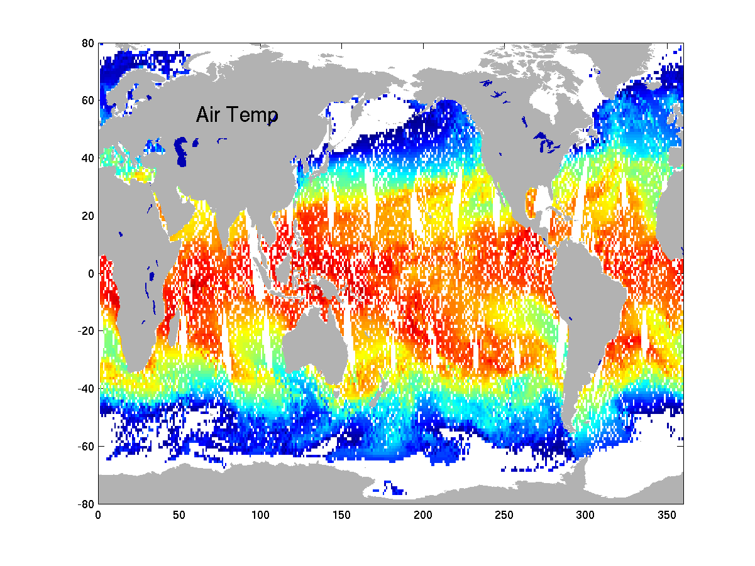
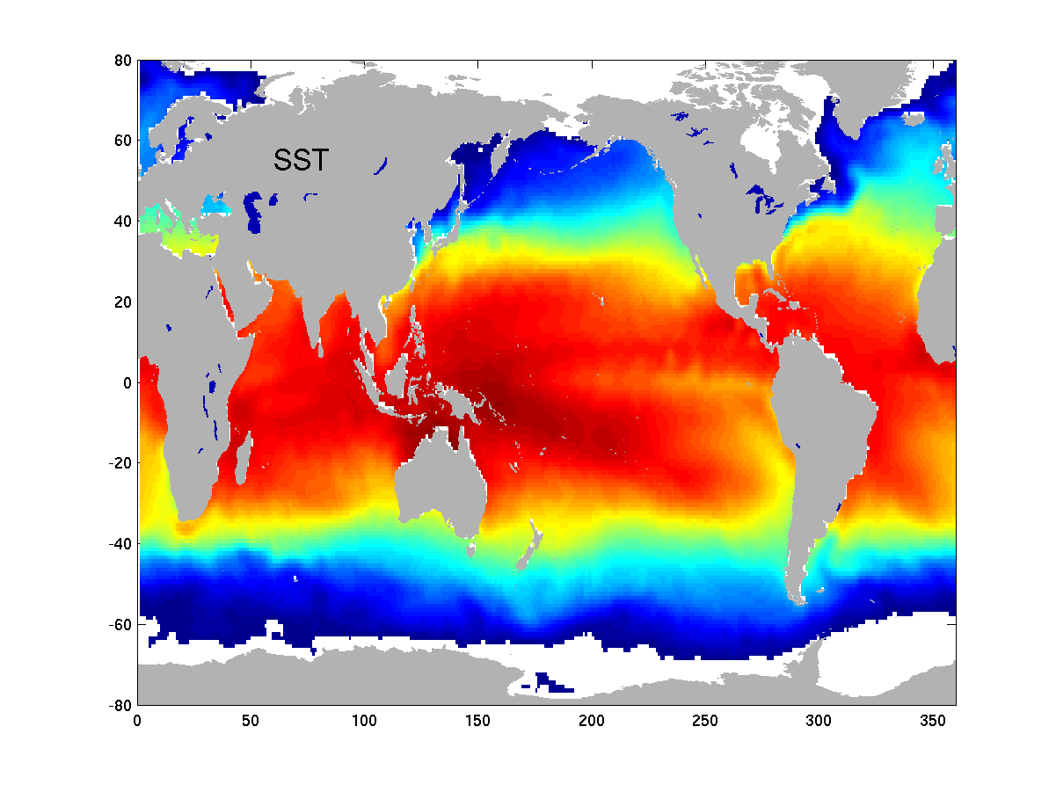
Calculating Average Fluxes
Bulk Parametrisation
Daily Wind Stress, Latent and Sensible Heat Fluxes Estimations
Objective Method
0.25°x0.25° Daily and Monthly Averaged Fluxes (L4 products)
: Spatial and Temporal Structure Function for each
Variable.
1992 – 2012 Daily and Monthly Fluxes (0.25°x0.25°)
Source: Bentamy
Notes:
19

Slide 20
Data Variety

Slide 21
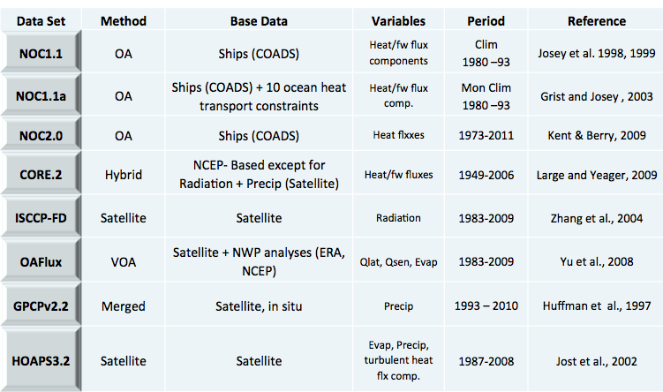
Source: Maria Valdivieso, Reading University
Wealth of Flux Data Sets
And others satellite data sets, IFREMER, J-OFURO, GSSTF …

Slide 22
Atmospheric Re-analysis
WHOI blended (OAFlux, Yu&Weller 2007) – monthly/daily
Source: Sergey Gulev

Slide 23
Ocean Synthesis
Product | Institution | Product | Institution
CFSR | NCEP | ECCO-v4 | NASA/JPL
GODAS | NCEP | GECCO2 | Hamburg University
Glosea5 | UK MetOffice | MOVE-C | MRI/JMA
ORAS4 | ECMWF | MOVE-G2 | MRI/JMA
PEODAS | BMRC | MOVE-CORE | MRI/JMA
GLORYS | Mercator | K7-ODA | JAMSTEC
C-GLORS | CMCC | K7-CDA | JAMSTEC
UR025.4 | Reading University
GEOS5 | NASA/GMAO | ARMOR3D | CLS (T/S/SLA)
ECDA | GFDL | NODC | NOAA (T/S )
SODA | University Meryland | EN3 | MetOffice (T/S )
ECCO-NRT | NASA/JPL | LEGOS | LEGOS (SLA)
Source: Magdalena, ECMWF

Slide 24
Data Quality

Slide 25
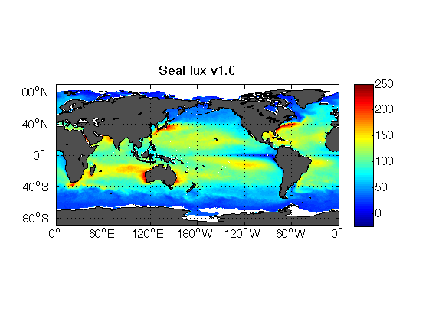
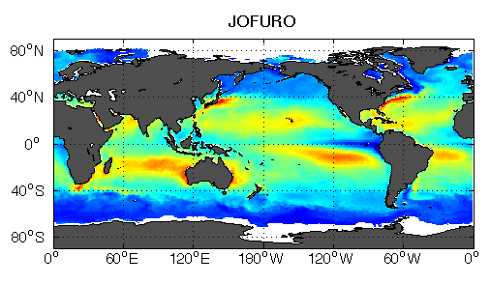
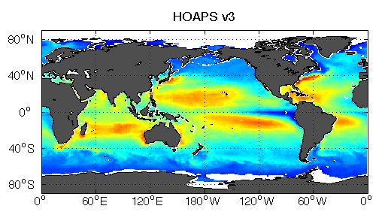
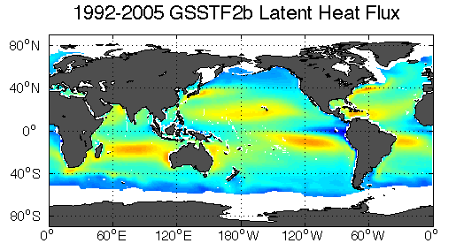
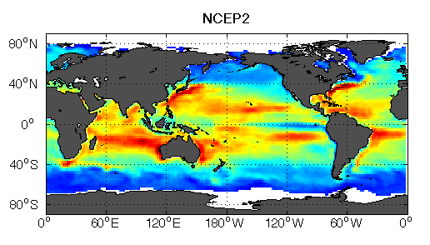
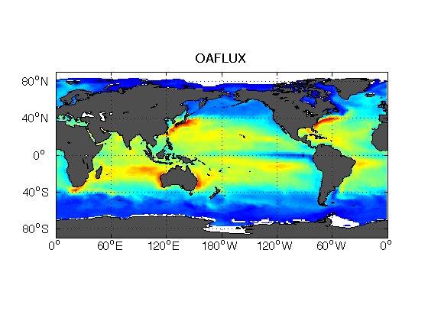
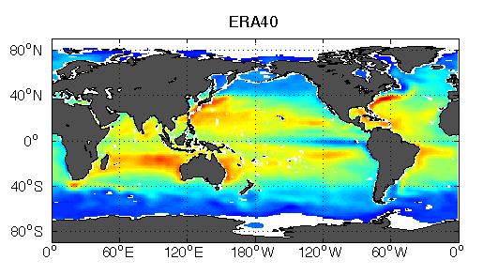
Inter-comparison of Fluxes (Latent)
W m⁻²

Slide 26
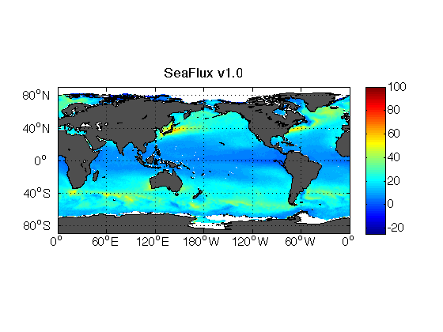
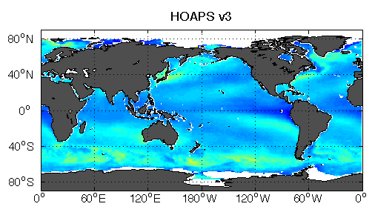
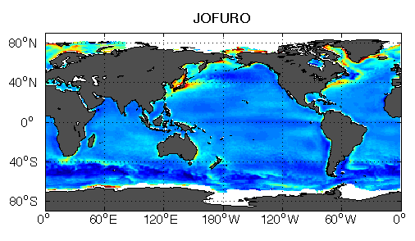
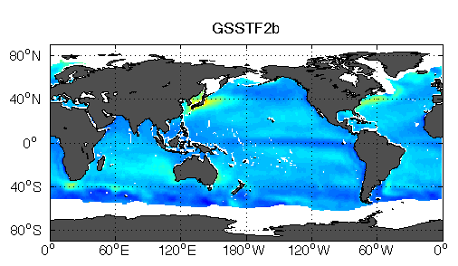
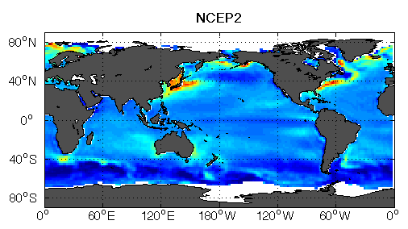
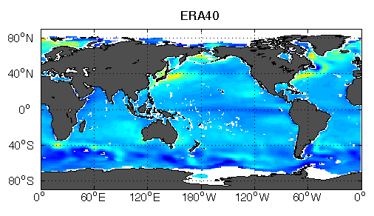
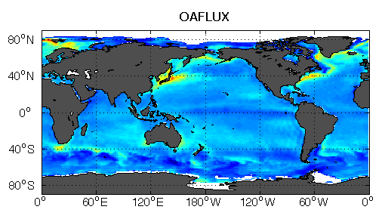
Inter-comparison of Fluxes (Sensible)
W m⁻²

Slide 27
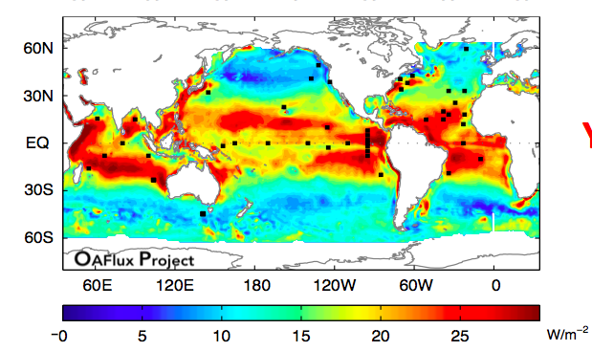
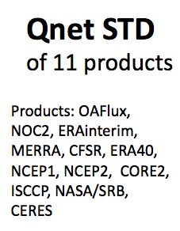
Inter-comparison of Fluxes (Net)
Source: Lisan Yu

Slide 28
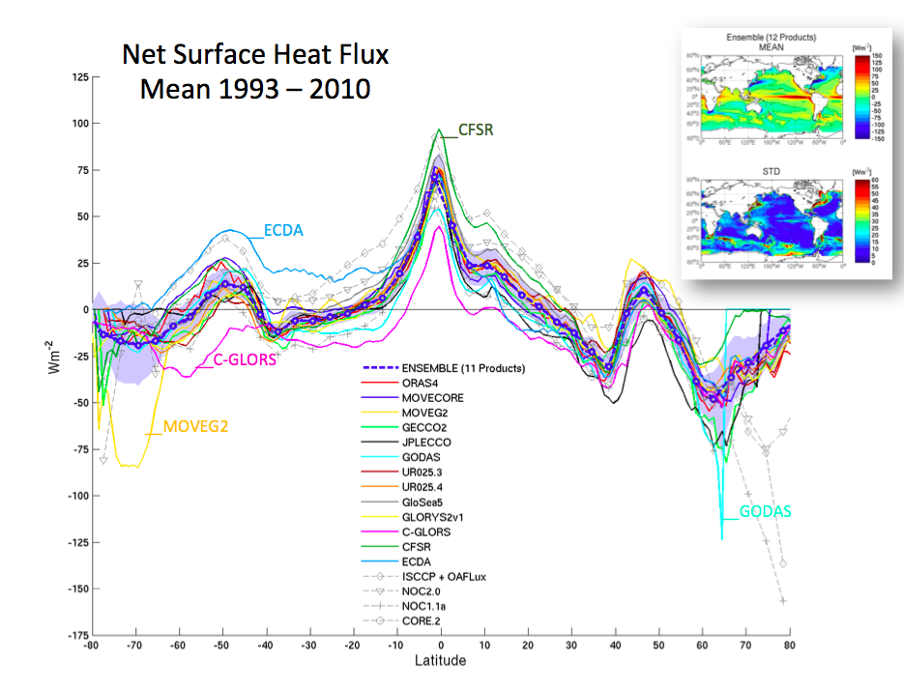
Source: Maria Valdivieso, Reading University
Inter-comparison of Ocean Synthesis (ROAIP)
Variable | Responsible | Institution
Steric Height | Andrea Storto | CMCC
Sea Level | Fabrice Hernandez | Mercator Ocean
Ocean Heat Content | Matthew Palmer | UK MetOffice
Depth of 20 degree Isotherm | Fabrice Hernandez | Mercator Ocean
Mixed Layer Depth | Takahiro Toyoda | MRI-JMA
Salinity | Li Shi | BMRC
Surface fluxes and transports | Maria Valdivieso | University of Reading
Atlantic Meridional Overturning at 26N | Vladimir Stepanov/Keith Haines | University of Reading
Sea Ice | Gregory Smith | Environment Canada

Slide 29
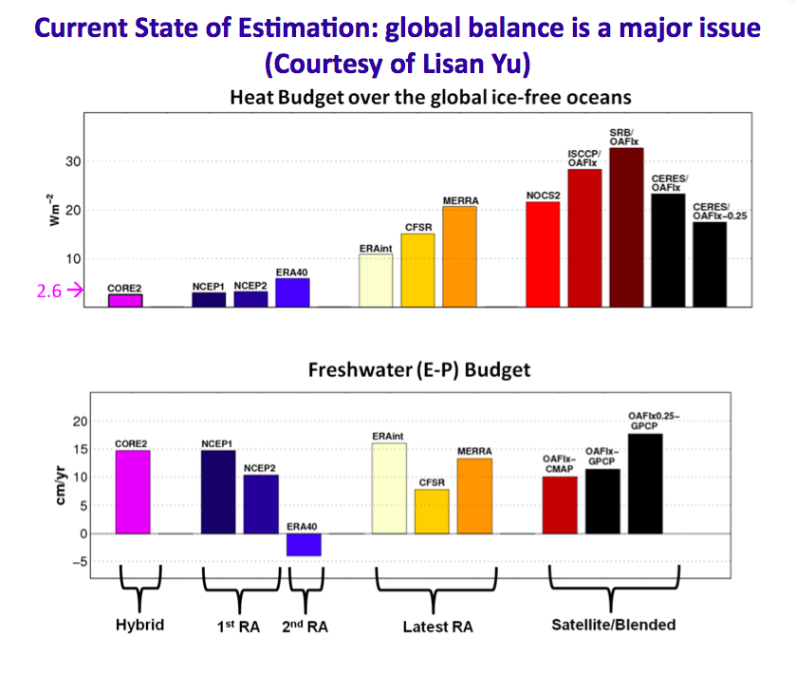
Data sets & budget constraints

Slide 30
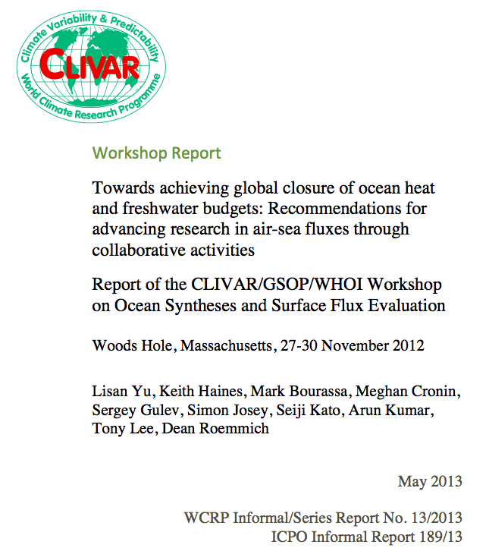
GSOP workshop on Air-Sea Fluxes
Recommendations
Regional Heat/Salt budget analysis
Direct point wise comparison with OceanSITE
Metrics for flux evaluation
Requirements on Products
Requirements on Infrastructure
Perspective of CAGE experiments
(Bretherton, 1986)
Source: clivar.org
ESA UNCLASSIFIED - For Official Use

Slide 31
ESA-CLIVAR Ocean Heat Flux Workshop
Background
ESA-CLIVAR workshop in Reading, within the framework of the ESA Support to Science Element (STSE) e.g. GEWEX (WACMOS Land Flux), SPARC (SPIN), CLiC (North Hydrology), SOLAS (OceanFlux GHG, Seaspray, Upwelling), iLEAPS, ....
Participants
20+ across disciplines, world experts
Objectives
Review existing activities, gaps & opportunities.
Identify the scientific requirements for a CLIVAR/ESA activity this year.
Outcomes
EO requirement document for ESA
Roadmap document input for CLIVAR Community White Paper (ISSI book)
“Great opportunity for collaboration around the world to improve globally important data sets that are iconic for climate sciences”, Martin Visbeck

Slide 32


Opportunity of EO from space
Missions
20yrs archive ERS, Envisat + Explorers (SMOS, Cryosat, GOCE)
20yrs of data to come, e.g. Sentinels, Met missions
Products
ESA Climate Change Initiative CCI (e.g. SST, OC, Aerosol, Cloud)
GLOB products (e.g. current, wave) + STSE products
ESA UNCLASSIFIED - For Official Use

Slide 33

Opportunity from Argo float data
3000+ Argo floats for T/S profiles, Sampling of upper ocean 2000m, 7+yrs complete data,
ESA UNCLASSIFIED - For Official Use

Slide 34
Exploiting Heat Budget Constraints
Qa
EO obs
Barotropic (RA)
SST (AATSR)
W (ERS)
Absorption (MERIS)
Ocean Synthesis
to enable optimal sampling of suitable reference regions
Surface
Heat Transport
In-situ obs
OHC (Argo)
Q Fluxes (Buoys)
div Fh
dt OHC
Advection
Heat Transport
Change in Heat Content
Diffusive
Heat Transport
div Fz
ESA UNCLASSIFIED - For Official Use

Slide 35
ESA Ocean Heat Flux study
The overarching objective of Ocean Heat Flux is to Develop a collaborative “Ocean air-sea Flux Laboratory Platform” to reconcile EO-based air-sea fluxes with heat budget constraints derived from EO and sub-surface data.
In particular, to achieve this objective the project will aim to:
Gather input data sets to derive air-sea fluxes from EO (e.g. W, SST, OC, Altimetry, Globwave, TOA..), ancillary data (Met data, Reanalysis, with associated meta-data), and ground truth (e.g. direct/indirect flux measurements), on one collaborative portal to enable easy inter-comparison of products.
Generate an ensemble of fluxes based on existing data sets (e.g. HOAPS) and latest developments in algorithms and data, maximising the use of ESA data and products such as CCI. e.g. the ensemble would explore space of parameters and hypothesis, (e.g. wave/no wave, averaging SST), ..
Develop a strategy to perform assessment of fluxes, at regional spatio-temporal scale, exploiting heat budget constraints.
Identify “Reference” Regions (e.g. natural/pre-defined CAGES, Bubbles, Medsea) and time windows suitable to perform evaluation of flux (e.g. good signal to noise).
Quantify Quality of fluxes, and parameterisations, through comparison with in-situ and regional constraints.
Provide ESA with recommendations of future work and satellite missions useful to address the CLIVAR research opportunity on planetary energy budget.
New flux retrieval algorithm based on a variational approach
to partition fluxes components on the CAGES regions
ESA UNCLASSIFIED - For Official Use

Slide 36
Enabling Easy Inter-comparison of products
 | Wind |  | Stress |  | LHF |  | SHF
FSU |  |  |  |  |  |  |  |  | www.coaps.fsu.edu
GSSTF |  |  |  |  |  |  |  |  | disc.gsfc.nasa.gov/ precipitation
HOAPS* |  |  |  |  |  |  |  |  | www.hoaps.zmaw.de
IFREMER* |  |  |  |  |  |  |  |  | www.ifremer.fr/cersat
IPSL |  |  |  |  |  |  |  |  | climserv.ipsl.polytechnique.fr
J-OFURO |  |  |  |  |  |  |  |  | dtsv.scc.u-tokai.ac.jp/j-ofuro
WHOI* |  |  |  |  |  |  |  |  | oaflux.whoi.edu
Source: Bentamy
Notes:
36

Slide 37
Re-processing, Merging EO data
 | 92 | 93 | 94 | 95 | 96 | 97 | 98 | 99 | 00 | 01 | 02 | 03 | 04 | 05 | 06 | 07 | 08 | 09 | 10 | 11
ERS-1 | Aug 91 – May 96
ERS-2 |  |  |  | Apr 95 – Jan 01
ADEOS-1 |  |  |  |  |  | Sep 97 – Jun 98
QSCAT |  |  |  |  |  |  |  | Jul 99 – Nov 09
ADEOS-2 |  |  |  |  |  |  |  |  |  |  | Dec 02 – Jul 03
METOP |  |  |  |  |  |  |  |  |  |  |  |  |  |  | Dec 06 - Present
OCEANSAT |  |  |  |  |  |  |  |  |  |  |  |  |  |  |  |  |  | Dec 09 - Present
WindSat |  |  |  |  |  |  |  |  |  |  |  | Feb 03 - Present
SSM/I 10 | Dec 90 – Nov 97
SSM/I 11 | Dec 91 – May 00
SSM/I 13 |  |  |  | May 95 – Nov 09
SSM/I 14 |  |  |  |  |  | May 97- Aug 08
SSM/I 15 |  |  |  |  |  |  |  | Dec 99 - Present(?)
AMSU N15 |  |  |  |  |  |  |  |  | Jan2000-Present
AMSU N16 |  |  |  |  |  |  |  |  | Oct 00-Present
AMSU N17 |  |  |  |  |  |  |  |  |  |  | Jul 02-Present
AMSU N18 |  |  |  |  |  |  |  |  |  |  |  |  |  |  | Sep 05-Present
AMSU MTP |  |  |  |  |  |  |  |  |  |  |  |  |  |  |  |  | Mar 07-Present
AMSRE AQ |  |  |  |  |  |  |  |  |  |  |  | Jun 02-Present
Source: Bentamy, IFREMER
Notes:
Fluxes at global and regional scales are estimated from NWP models (ECMWF; NCEP; Era-Interim; CFSR; …), from ships (ICOADS), and mainly from remotely send measurements (IFREMER; HOAPS;WHOI;JFRO;…). This slides shows example of satellites used to estimate momentum and turbulent fluxes at IFREMER.

Slide 38


New SST data from CCI
Impact of diurnal cycle SST
Source: Clayson & Bogdanoff, J. Climate, 2013

Slide 39


Heat Budget Constraints: Warm Pool Bubble
Source: Song and Yu (2013)

Slide 40

Regional heat Constraints: The Med Sea

Slide 41

A PDF view to uncertainty
Labrador Sea
Gulf Stream
Source: S. Gulev

Slide 42

Better Characterisation of Uncertainty
Need to define what accuracy is for. The net heat flux error which would provide a seasonal SST spread less than one-half the peak to trough seasonal SST variability (Clayson and Bogdanoff 2013).
Source: Clayson & Bogdanoff, 2013

Slide 43
Flux Exploitation Platform
Test Bed Environment for Consistency Assessment
Input Data
SST, q, W
CAGE 1
SST CCI
SST AVHRR
W PMW
W Scat
Flux Data
Heat Budget Data
ESA Ocean Heat FLux
SeaFlux
OHC Argo
Diffusive FLux
HOAPS
TOA
ERA-Interim
ERA-Interim
Test - benchmark flux algorithms & parameterizations
Assess Consistency / Quality .. Heat / Freshwater ?
Quantify sensitivity, perform effective inter-comparisons
Recalibrate parameters regionally
Flexible to integrate other layers e.g. land fluxes
ESA UNCLASSIFIED - For Official Use

Slide 44

Flux Exploitation Platform
Parametrisations
Data Sets
Additional Data
Re-processed
Methodology
New Parametrisations
Ensembles
PDF assessment
Budget heat Constraints
Process-oriented study
ESA UNCLASSIFIED - For Official Use

Slide 45
Conclusions for Flux improvement
Improvements of the retrievals (Bulk Variables)
  Surface Winds
  Specific Air humidity
  Air and Surface Temperatures
Long Time Consistency of Bulk Variables over Global Ocean
Acquirement of OHF from Dedicated Experiments
Homogenization of OHF measurements used as ‘Truth”
OHF parameterizations particularly for high and low wind conditions
Global Long Time Series of OHF
Validations and inter-comparisons at Global and Regional Scales
Make Variable and OHF data accessible
Assess consistency with regional heat constraints
Source: Bentamy

Slide 46



COSPAR-WCRP-IOC-ESA Capacity Building
“Matching Oceanographic Problems of the Indonesian Seas to the Right Data Sets and Models “
January 12-22, 2014, Bandung Institute of Technology, Bandung, Indonesia
Participated by 32 students from seven countries in southeast Asia (Indonesia, Philippines, Vietnam, East Timor, Malaysia, China, and Singapore).
Lectures by 6 international and 6 Indonesian lecturers, covering the subjects of the resources of satellite and in-situ observations and modeling and assimilation and analysis methods and tools.

Slide 47

Pan-CLIVAR meeting
July 16-18 2014, The Hague, Netherlands, joint with GEWEX

Slide 48
Backup Slides
ESA UNCLASSIFIED - For Official Use

Slide 49

SeaFlux Climatological Data Set v1.0
Near-surface air temperature and humidity
  Roberts et al. (2010) neural net technique
  SSM/I only from CSU brightness temperatures (thus only covers 1997 - 2006)
  Gap-filling methodology -- use of MERRA variability – 3 hour
Winds
  Uses CCMP winds (cross-calibrated SSM/I, AMSR-E, TMI, QuikSCAT, SeaWinds)
  Gap-filling methodology -- use of MERRA variability – 3 hour
SST
  Pre-dawn based on Reynolds OISST
  Diurnal curve from new parameterization
  Needs peak solar, precip
Uses neural net version of COARE
Available at http://seaflux.org
1999 Latent Heat Flux
1999 Sensible Heat Flux

Slide 50
Wealth of Flux Data Sets
Model, Re-analysis (e.g. ERA-Clim, NCEP / CFSR, NASA/MERRA, JRA)
In-situ (e.g. ICOADS NOCS)
  Satellite (e.g. HOAPS [de], GSSTF [us], J-OFURO [jp], SeaFlux [us],...)
  Hybrid (e.g. CORE.2, DFS4, OAFlux, ...)
GSSTF - Goddard products
  Daily, 0.25°, input variables and turbulent fluxes; satellite plus Ta from reanalysis
  1988- 2008; global oceans. No current plans to update again – funding issues
IFREMER version 3
  Daily, 0.25°, input variables, turbulent fluxes; satellites plus Ta from reanalysis
  Currently available: 1992 (1999 with QuikSCAT) – November 2009; global oceans
J-OFURO - Japanese Ocean Flux datasets
  Input variables, fluxes, radiation, Daily, 1°, 1988 – 2005; global oceans, Satellites, JMA model analyses
HOAPS 3.2
  6-hourly, 0.5°, global oceans; input variables, precipitation; satellites, July 1987 - December 2008
OAFlux
  Daily, 1°, global oceans; blended using reanalysis, in situ, satellites, July 1985 – current (monthly available back to 1958)
Source: Caroline Clayson

Slide 51


Assessment of the Turbulent Flux Accuracy
Insitu/NOCS
Insitu/Satellite

Slide 52

Assessment of the Turbulent Flux Accuracy
Insitu/Satellite
Insitu/Era-I
Insitu/CFSR

