Slide 1
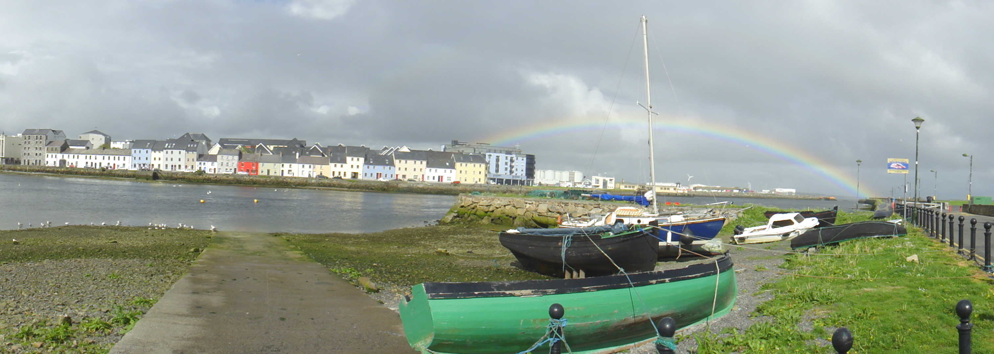
Reanalyses
WDAC3, 6 May 2014
Michael Bosilovich (NASA GSFC) with significant contributions from others

Slide 2
Overview
Atmospheric Reanalysis Updates
  JRA, ERA, NCEP and MERRA
Community efforts
  NOAA CRTF
  Reanalysis.org
  ObsMips workshop feedback
  Meetings

Slide 3

JRA-55 Reanalysis system
 | JRA-25 | JRA-55
Reanalysis years | 1979-2004 (26 years) | 1958-2012 (55 years)
Equivalent operational NWP system | As of Mar. 2004 | As of Dec. 2009
Resolution | T106L40 (~110km) (top layer at 0.4 hPa) | TL319L60 (~55km) (top layer at 0.1 hPa)
Time integration | Eularian | Semi-Lagrangian
Assimilation scheme | 3D-Var | 4D-Var (with T106 inner model)
Bias correction (satellite radiance) | Adaptive method (Sakamoto et al. 2009) | Variational Bias Correction (Dee et al. 2009)
GHG concentrations | Constant at 375 ppmv (CO₂) | Annual mean data are interpolated to daily data (CO2,CH4,N2O)

Slide 4

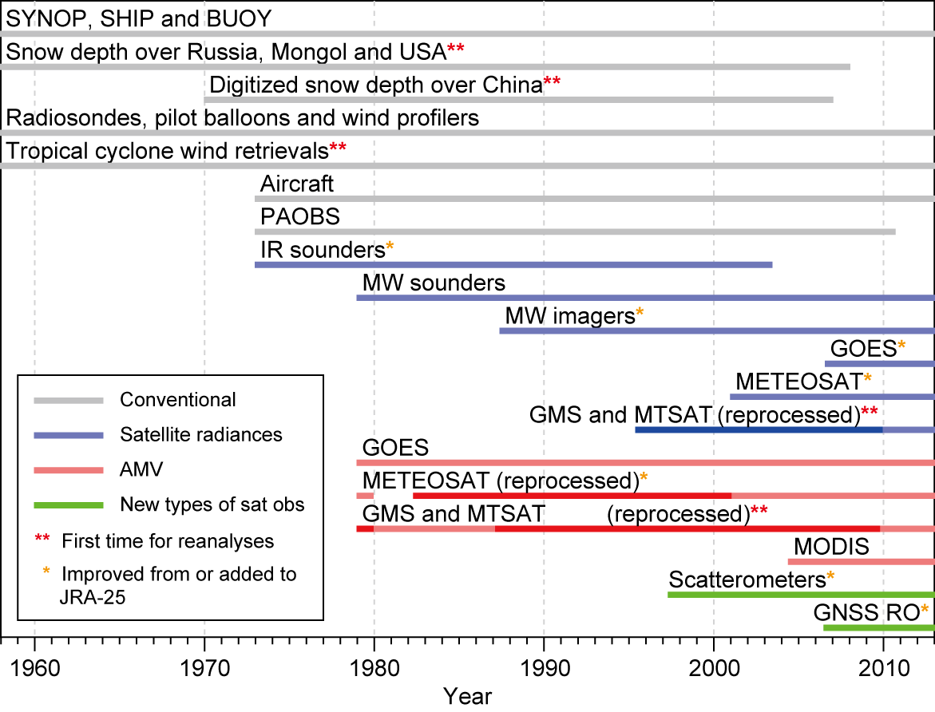
Observational Data available for JRA-55
GNSS: Global Navigation Satellite System

Slide 5
JRA-55 Summary
Observational Data for JRA-55
  Improvement in both quality and quantity from JRA-25
    Many reprocessed Satellite Data
    Newly available data
Validation of JRA-55
  JRA-55 has much better quality than JRA-25.
  Unnatural gaps have been significantly reduced.
References
  Ebita et al. (2011) SOLA, 2011, 7, 149-152
    The Japanese 55-year Reanalysis “JRA-55”: An Interim Report
    Interim report as of 2011
  Comprehensive report was submitted to JMSJ in March.
    Kobayashi et al. (2014) Please refer this when it is accepted.
5

Slide 6

ERA-20C family of reanalyses
Pilot reanalyses, outcome of the EU FP7 ERA-CLIM project
Time period: January 1899- December 2010, 3-hourly output.
Global, 125km horizontal resolution, 91 vertical levels
ERA-20CM: Model-only integration, 10 members
  1st run: IFS version CY37R3, HadISST.2.0.0.0
  2nd run: IFS version CY38R2, HadISST.2.1.0.0
ERA-20C: Assimilates surface observations of pressure (ISPD 3.2.6) and marine winds (ICOADS 2.5.1)
  1st run: 10-member ensemble. Completed in ~200days
  2nd run: deterministic (1 member). Completed in ~50days
ERA-20CL: Land-surface downscaling to high horizontal resolution (25 km)
  1st run: driven by ERA-20C ensemble, hence 10 members
  2nd run: driven ERA-20C deterministic, hence 1 member
All data & obs. feedback to be published at http://apps.ecmwf.int/datasets/
Data access
Documentation:
ERA Report Series 16
Documentation:
ERA Report Series 14

Slide 7
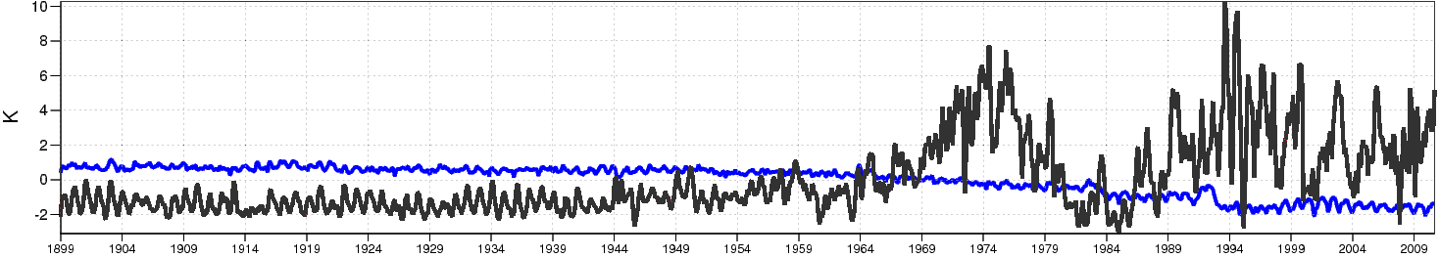
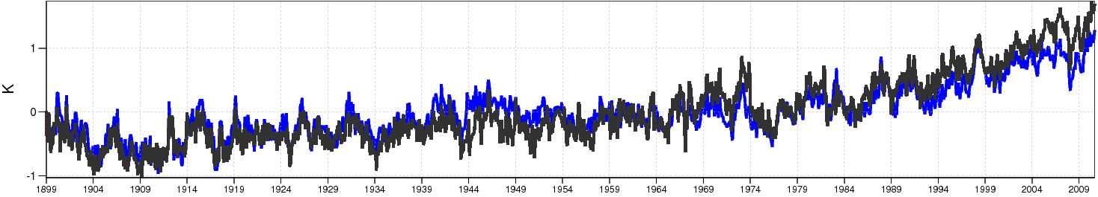
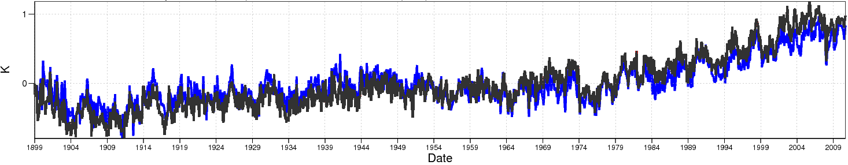
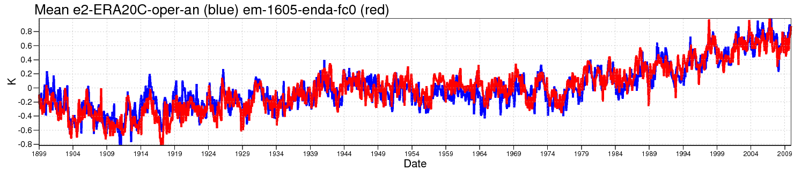
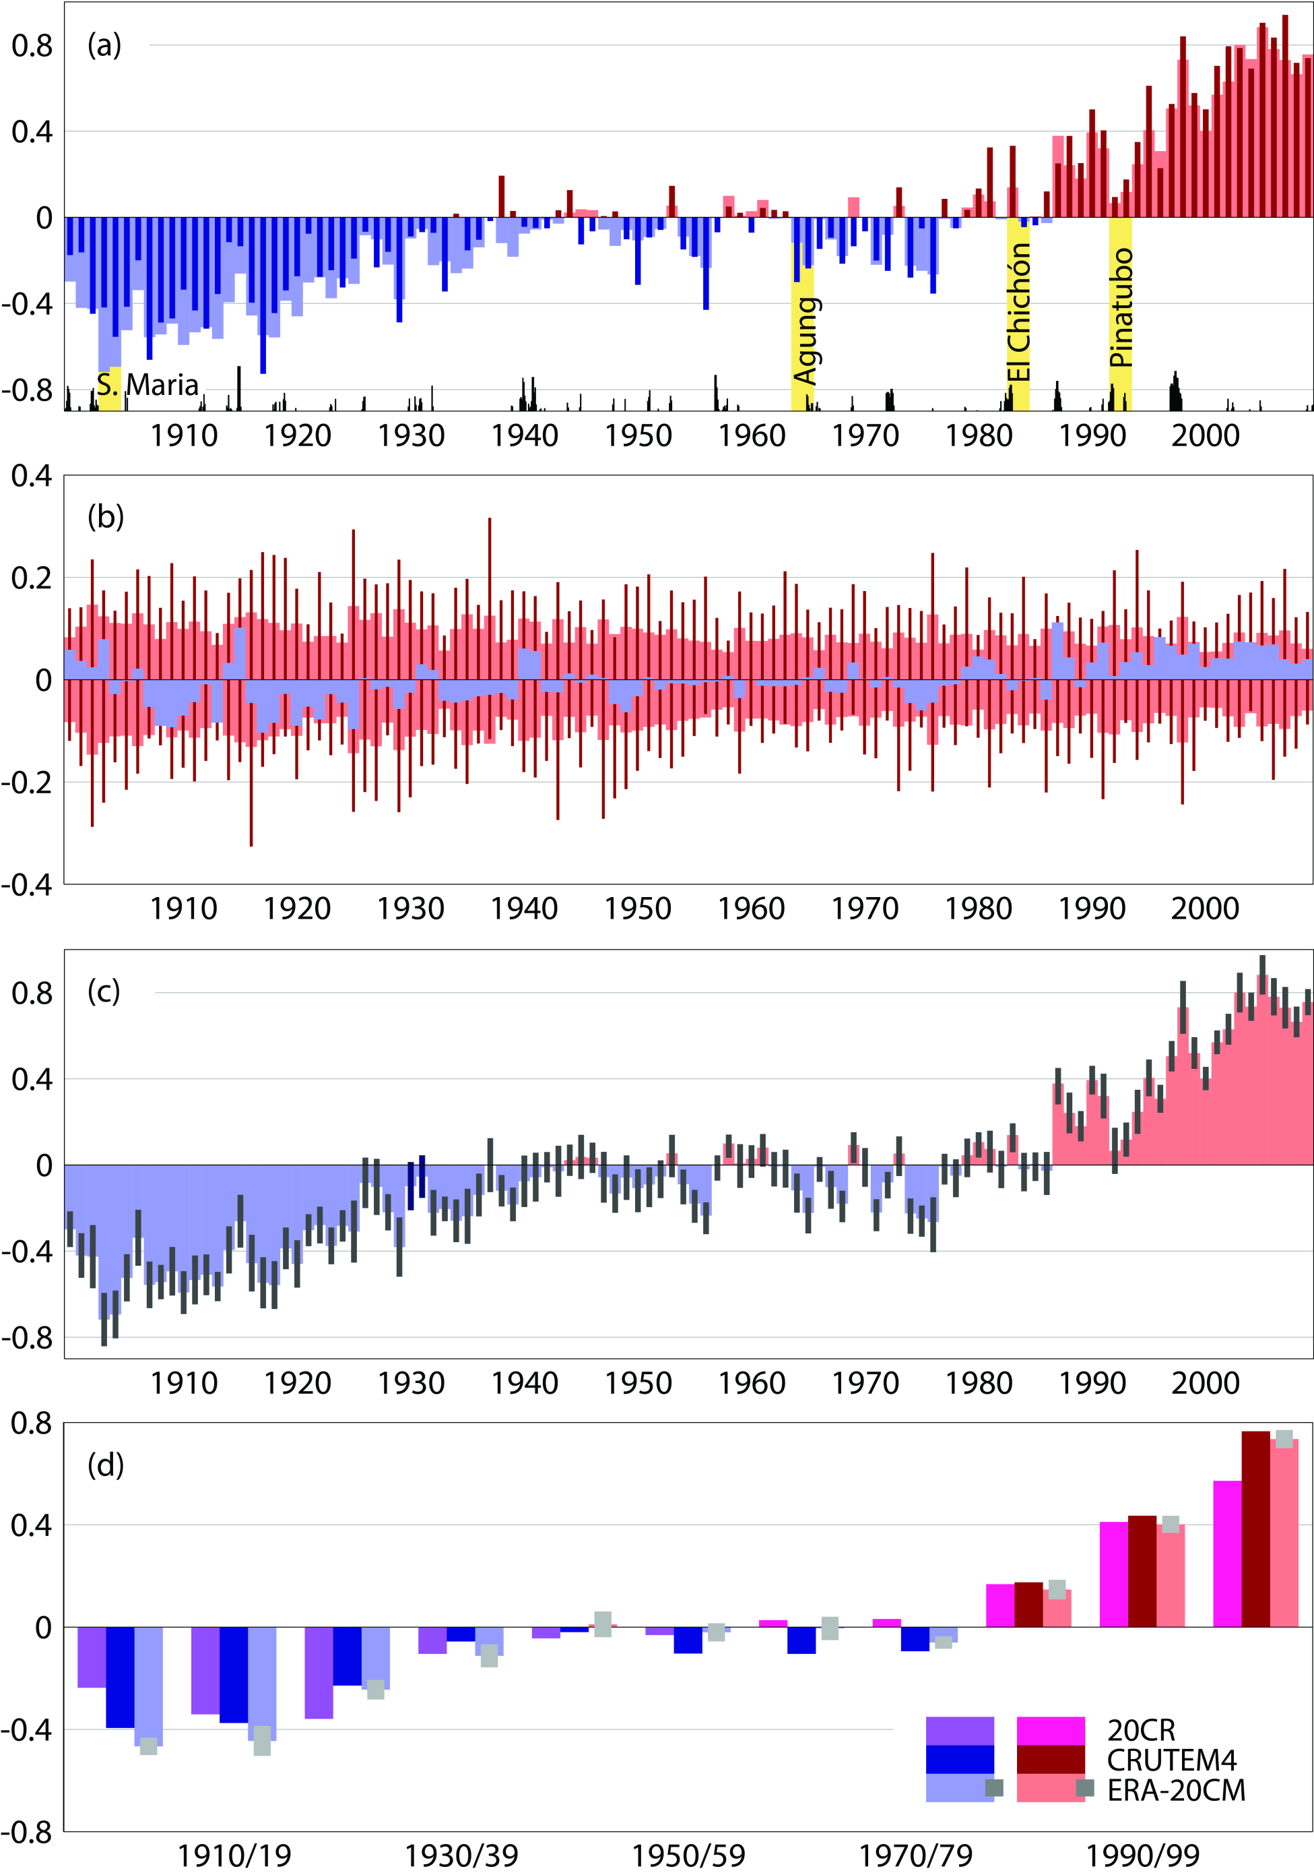
Low frequency variability: temperature anomalies
Model level 30 (about 50 hPa)
1st ERA-20C run: Ensemble
2nd ERA-20C run: Deterministic
Model level 71 (about 700 hPa)
1st ERA-20C run: Ensemble
2nd ERA-20C run: Deterministic
Model level 89 (near-surface)
1st ERA-20C run: Ensemble
2nd ERA-20C run: Deterministic
2-meter
2nd ERA-20C run: Deterministic
1st ERA-20CM run
CRUTEM4 data (Jones et al., 2012)
ERA-20CM

Slide 8
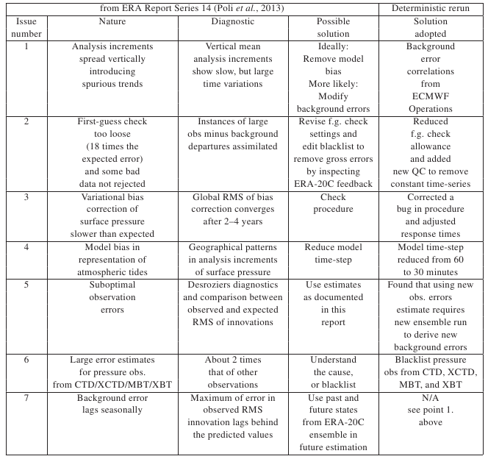
Differences between the two ERA-20C assimilation runs
First run, ensemble, was absolutely necessary to estimate the time-variation of background errors for the 4DVAR
Lessons learnt were applied to 2nd run:
  Essentially much better climate trends throughout the vertical
  Fixed data problems in several locations
  Slightly degraded synoptic analyses (background error correlations too narrow)

Slide 9
NCEP Reanalyses
Arun Kumar is the overall PI of a team effort of NCEP, ESRL & CIRES, and NCDC
Stream 0: Boundary-forced, 1850-present “AMIP” simulation with large ensemble
Stream 1: Historical, 1850-present using only surface data
Stream 2: Modern, 1946-present using only surface and conventional upper air data
Stream 3: Satellite, 1973-present using quality-controlled satellites, Global Positioning System Radio Occultation, and surface and conventional upper air data.
Hybrid EnKF data assimilation system is running; The present configuration is T254/L64
Two Streams going; 1981 and 1998
Testing a coarse resolution 3DVAR for feasibility of replacing legacy NR1 and NR2
Notes:
Place Holder waiting on Annarita

Slide 10
MERRA: Beginning of The End
MERRA will eventually cease production
  Termination is presently not planned, but will be determined as to the assimilated observations
  New observations cannot go into MERRA without updating GSI (and the requisite fte) – Office philosophy is more looking forward to a new system
MERRA2 originally planned to use the latest system, starting in 2010, and pick up where MERRA left off
  Several overlapping years would permit corrections to the time series, if discontinuities would be large
  But.... Upon further review-

Slide 11
MERRA2 Evolution
Precipitation bias correction for land forcing and aerosol deposition
Aerosol data assimilation interactive radiation - Black and Organic Carbon, Dust, Sea Salt
Substantial revisions to the boundary layer in the background model
Updated observational data (e.g. IASI, GPSRO)
Tropical Cyclone Relocation
Water Vapor Mass Increment Correction
  Constrains the water vapor increment to be very small when averaged globally

Slide 12
Sweeper (2°) Experiment
Water Vapor Mass Conservation stabilizes TPW
Global E/P balance – Increments are infinitessimal
Increments would still be locally influential
Notes:
Caveat: M2 Sweeper is not intended for science validation. We have low expectation that the model physics function nearly as well with this coarse resolution, compared to high resolution. This is merely and example of the what we hope will be the positive results of the half degree resolution MERRA2

Slide 13
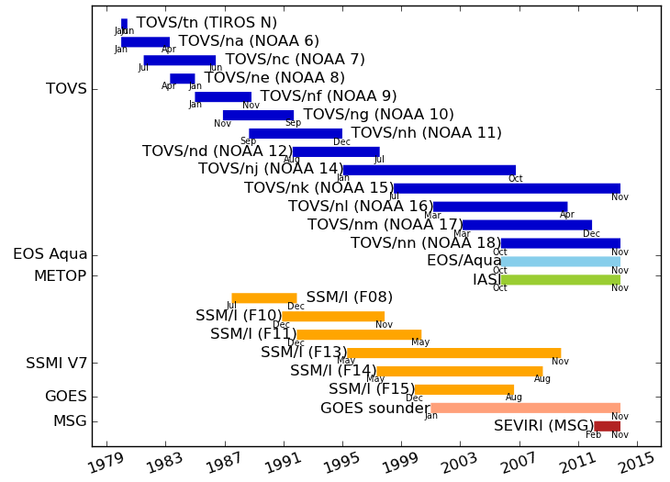
MERRA2 – New Data in the Modern Climate Record From 1979 – Present
Satellite Radiances to be Assimilated
MERRA2 includes the latest satellite observing systems
  NPP: ATMS, CrIS, OMPS
  MetOp-A/B: IASI, ASCAT, GOME2, AMSU, MHS
  OSCAT, GPS-RO, SSMI (v7)
  Reprocessed AMV
  SBUV-v8
MERRA2 will begin from 1979 and carry on for several years to come, adding some of the latest observations and significant updates to the data assimilation and global model.

Slide 14
NOAA Climate Reanalysis Task Force
Accepted proposals to a climate reanalysis funding call; regular telecons
Improving communications among NOAA’s reanalysis team and research groups
  focusing on research to address outstanding issues in atmospheric, ocean, and land reanalysis
  develop a greater degree of integration among Earth system reanalysis components
Leads: Gil Compo, Arun Kumar, Mike Ek and Jim Carton
http://cpo.noaa.gov/ClimatePrograms/ModelingAnalysisPredictionsandProjections/MAPPTaskForces/ClimateReanalysisTaskForce.aspx

Slide 15
Climate Reanalysis Task Force
A coordinated research effort in preparation for the next generation of NOAA’s climate reanalysis
NOAA-led, involving scientists from academia and other agencies
Builds on 7 MAPP funded research projects, about 30 investigators (2013-2016)
  Overcoming issues with past generation of NOAA atmospheric reanalyses (CFSR, 20CR): Inhomogeneities, data and model biases, stratospheric and Arctic issues
  Exploring more integrated Earth system reanalysis (ocean-atmosphere coupling and land-atmosphere coupling
Emphasizes coordination and collaboration with other major reanalysis efforts
Uses reanalysis.org as communication tool and to connect with the broader community

Slide 16
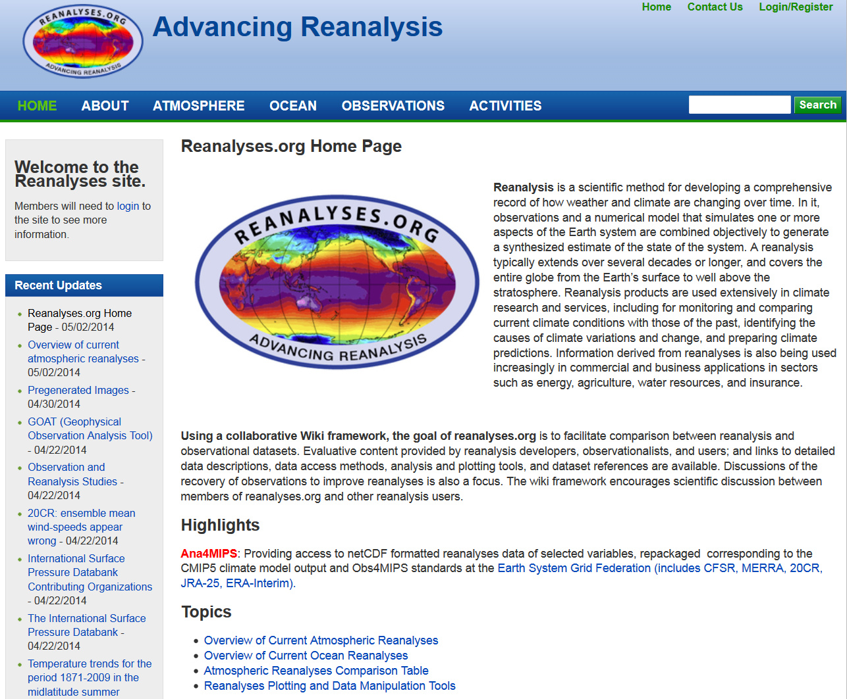
Now: Advancing Reanalysis - reanalyses.org
Updates and contributions are coming regularly
NOAA will no longer support a .org domain, reanalysis.org is looking for a benefactor to cover the $500/yr domain charge

Slide 17
Intercomparison of Reanalyses
With so many reanalysis “flavors”, there is a need for standard comparisons and metrics
Reanalysis.org provides a “wiki” venue for discussions and links to news and tools
Community developed projects
  ana4mips/ESGF: provides standards for model-data comparison, and
  S-RIP: focus on representation of the stratosphere
  CORE-Climax: Info from P. Poli
  Time on agenda tomorrow for intercomparison discussion

Slide 18
Community Needs: From Obs4MIPS Workshop
Some comments from the Obs4MIPS workshop
  Quantitative uncertainty estimates on reanalysis variables
  Qualitative quality flags as in Kalnay et al. (1996)
  Access to the assimilated observations, O-F and O-A
Quantitative Uncertainty has long been discussed, and not easily produced
Quality flags could be assigned, but best would be a systematic method of determination applied across all the centers
Who has responsibility to coordinate?

Slide 19
Meetings
Observations for Reanalyses workshop – June 2015 hosted by the ERA program, invitation
  Goal of discussing best practice in using observations in reanalyses
5th WCRP International Conference on Reanalysis
  Europe In the 2016-2017

Slide 20
Reporting on Reanalyses
Is there a need for delineation of reanalysis activity reporting?
Example: Ocean reanalyses may be broadly covered by GSOP, while land reanalyses (or LDAS) may be covered by GLASS
Are these considered under reanalyses, or with their parent panels (CLIVAR and GEWEX)?

