Slide 1

Global Climate Observing System
GCOS Status and Plans
Mark Bourassa, OOPC Co-Chair
Katy Hill, GCOS Secretariat

Slide 2
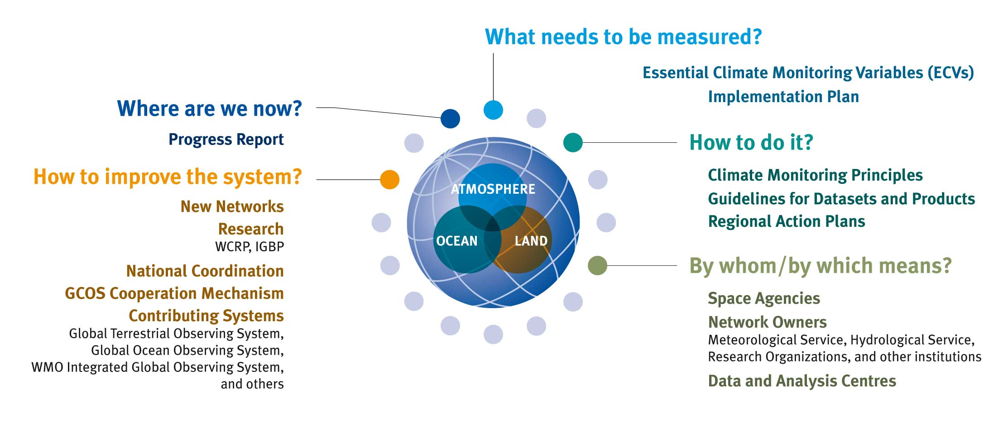
Continuous improvement and assessment cycle

Slide 3



GCOS Expert Panels
Terrestrial Observation Panel for Climate (TOPC)
Chairman Konrad Steffen (Switzerland)
  Meeting of TOPC-16: 10-11 March 2014, JRC, Ispra, Italy
  Next meeting TOPC-17: back-to-back with AOPC 9-13 March or 16-20 March 2015, Zürich
  Atmospheric Observation Panel for Climate (AOPC)
  Kenneth Holmlund (Finland) and Albert Klein-Tank (The Netherlands),
  Chair and Deputy-Chair since April, 2014
  Next meeting of AOPC-20: back-to-back with TOPC 9-13 March or 16-20 March 2015, Zürich
  Ocean Observations Panel for Climate (OOPC)
  Mark Bourassa (US) and Toshio Suga (Japan) co-Chairs since 2013
  Next meeting of OOPC-17: 22-24 July 2014, Barcelona, Spain
  Back-to back with GOOS Steering Committee: 25 July 2014, Barcelona

Slide 4
GCOS Continuous Improvement & Assessment Cycle
The GCOS programme has started the process for:
  a 2015 report on the progress and status of climate observation
  a new “Implementation Plan” in 2016, which should identify:
    continuing and new requirements, including a restatement of the rationale for the list of ECVs and possible amendment of the list
    the adequacy of present arrangements for meeting the requirements
    the additional actions needed, with indicative costs, performance indicators and potential agents for implementation
  statements of specific requirements for products
    from both in situ networks and the space-based component
    and from integration of the data provided by both
  either embedded in the main Plan or as separate supplement(s)

Slide 5
Road Map for 2014 to 2016
Input to the Assessment
WCRP Conference 2011
WIGOS Planning
IOC GOOS Planning
SPARC Data Workshop 2013
ESA CCI
CORE-CLIMAX
QA4ECV
UNFCCC National Reports
EUMETSAT-WCRP Climate Symposium (Oct 2014)
GCOS Adaptation Workshop 2013
WCRP WDAC (May 2014)
GEO Work Plan Symposium (April 2014)
CEOS-CGMS Response
GCOS GOFC-GOLD Mitigation Workshop (5-7 May 2014)
GCOS-IPCC WG II and DRR Workshop (Nov 2014)
IPCC AR5 2013/2014
WCRP-IPCC WG I Workshop (Sep 2014)
GCOS AOPC TOPC OOPC
Space Architecture–ECV Inv.
2014
2015
2016
COP20
October
COP21
COP22
Assembling information
12-16 January
Workshops
2 days-status progress report;
3 days-draft impl. plan
Aug/Sep
Workshop
finalising progress report
Summer
Workshop
Draft plan
Workshop
Finalising plan
Progress report
end April/
begin May
Workshop
(final draft progress
report)
Finalisation
Report to SBSTA43
Submission of Progress Report
Report to SBSTA41
on status
1-15 Dec 2014, Lima
Final progress Report
Draft of
New Plan
Report to SBSTA45
Submission of new Plan
for Public Review

Slide 6
Continuous improvement and assessment cycle
meeting all criteria
Variable
Pool
emerging
not feasible
New Plan 2016
2015
Data set generation & exploitation
Heritage
record

Slide 7
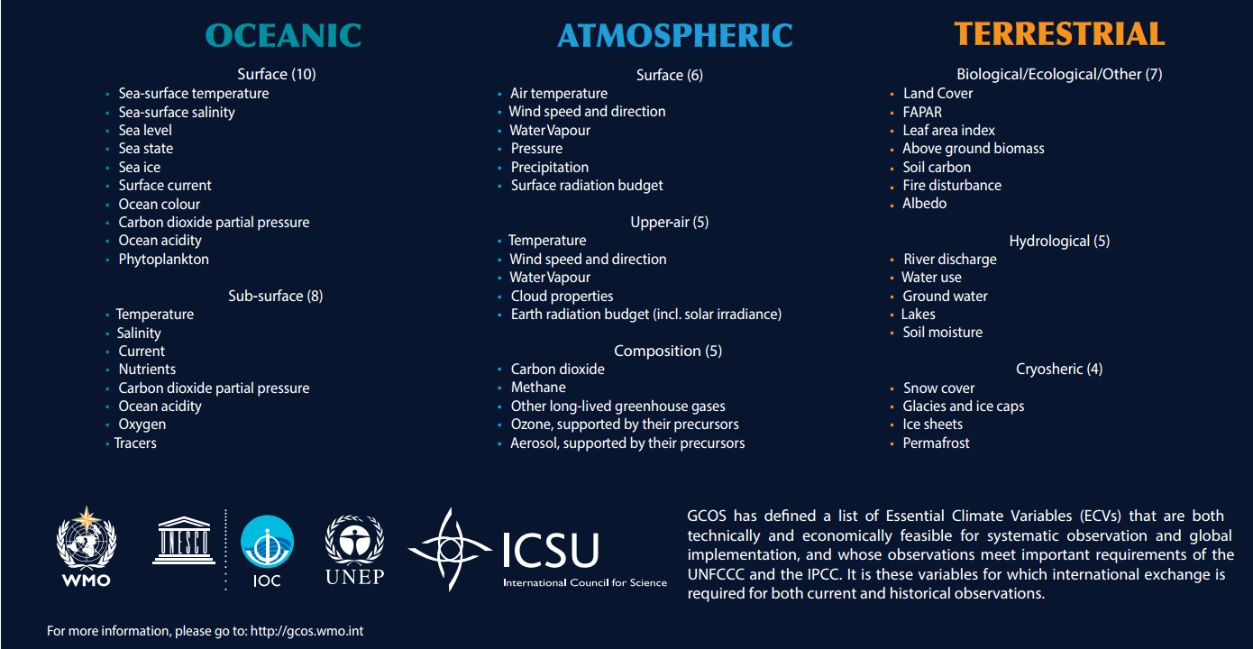
Essential Climate Variables

Slide 8
GCOS and Fluxes (General)
GCOS Organised around domains (atmosphere, ocean, land):
Most ECVs are state (rather than rate/process) variables. Do these deliver WCRP requirements for Fluxes?
  Exceptions: Rainfall, river discharge.
Addressing integration (requirements, and data) through discussions on major climate budgets and cycles (Water, Carbon, Energy)
Connection to WCRP projects (focus on interfaces) ìs a powerful combination (potentially)

Slide 9
Connections between GCOS and WCRP *
AOPC: Connection to SPARC
  SPARC represented at AOPC meetings
OOPC: Strong connection to CLIVAR:
  CLIVAR Basin Panels and GSOP at OOPC meetings: very fruitful relationship.
  OOPC focus on systems based observing system design and evaluations. E.g. Tropical Pacific Observing System 2020 Workshop.
  CLIVAR connection: requirements, process studies and feedbacks into the sustained observing system. See: CLIVAR-OOPC session on sustained obs at Pan-CLIVAR Meeting.
TOPC: Potential for strengthened connection to GEWEX?
Notes:
Highly ocean biased!

Slide 10
GCOS Actions Related to Surface Fluxes
As of yet there are no GCOS guidelines for fluxes other than precipitation
OOPC (2013 meeting) prioritized surface fluxes as an important topic to be addressed within the next five years
  Preliminary input will be gathered as part of other activities
  The Tropical Pacific Observing System (TPOS) review provided key details on constraints
  OOPC is co-sponsoring an workshop on Southern Ocean Surface Fluxes in Spring 2015
AOPC (2014 Meeting) recognized that fluxes between domains (Atmosphere, Ocean, and Land) were very important for climate
Drafts of flux requirements were considered emerging ECVs in the last GCOS satellite supplement (2011)
We must work with other groups (WCRP, SOLAS and others) to understand regional and global requirements for various applications

Slide 11
Specifics on Fluxes: the road forward
OOPC in particular and GCOS in general has an interest in surface fluxes
We would like to draw on input from CLIVAR, WDAC, SOLAS, and others to characterize the observational needs
  Accuracy of the network
  Sampling requirements in space and time
  Distribution of the data
  For a wide range of applications
    Different spatial spatial/temporal scales (e.g., regional and global)
    Different time scales: e.g., seasonal, interannual, decadal
We will work with GSOP and GOV to assess through models as well as pursue statistical evaluations of how the observing system is meeting these requirements

Slide 12
High-Latitude Example of
Flux Accuracies and Applications
50 Wm⁻²
100 years
10 Wm⁻²
5 Wm⁻²
1 Wm⁻²
Climate Change
10 years
0.1 Wm⁻²
Ice Sheet Evolution
0.01 Nm⁻²
Annual Ice Mass Budget
1 year
Unknown
Annual Ocean Heat Flux
Open Ocean Upwelling
Upper Ocean Heat Content & NH Hurricane Activity
1 month
Dense Water Formation
Stress for CO₂ Fluxes
Mesoscale and
shorter scale
physical-biological
Interaction
Ocean Eddies and Fronts
Atm. Rossby Wave Breaking
1 week
Polynyas
Ice Breakup
From US.CLIVAR Working Group on High Latitude Fluxes
Bourassa et al. (BAMS, 2013)
Shelf Processes
1 day
Leads
Conv. Clouds &
Precip
NWP High Impact
Weather
1 hour
10m 100m 1km 10km 100km 10³km10⁴km 10⁵km
Notes:
Very difficult to get these number for scientists
Most gave us the TOGA-COARE accuracy requirement of 10 Wm^-2 per year
Sid Levitus was an exception with the published value for climate change
the 10 Wm^-2 in each month is close to Sid’s requirements if almost all the error is random
That would give us an OK estimate of the mean change, but not the trend: the choice of application matters
Given these requirements we are working to determine if the observing system as a whole, rather than the individual components can meet these requirements

Slide 13
Example: Requirements for fluxes from TAO buoys
Variable | Flux | Target Required Accuracy | Single Observatn. Std Dev | Target er(TAU) (N/m²) | Target er(Q0) W/m² | Target er(E-P) mm/day
wind speed (m/s) | all | 0.1 | 1.75 | 0.0027 | 2.1 | 0.053
SST (C) | all | 0.1 | 1.45 | 0.0002 | 4.4 | 0.081
air temp. (C) | all | 0.1 | 1.30 | 0.0002 | 3.6 | 0.075
rel. hum. (percent) | all | 2.7 | 4.83 | 0.0002 | 11.9 | 0.32
SWR (W/m²) | Q0 | 6 | 42.00 | 0 | 5.6 | 0
LWR (W/m²) | Q0 | 4 | 13.75 | 0 | 3 | 0
sfc currents (m/s) | all | 0.05 | 0.25 | 0.0008 | 0.65 | 0.017
Rain (mm/day) | E-P | 0.72 | 5.34 | 0 | 0 | 0.7
Notes:
-Q0 is the energy budget
-These flux errors assume mean values averaged across the full equatorial Pacific.
-It should be noted that because of non-linearities (e.g. Clasius-Clapeyron), sensitivities to errors may be larger in the western Pacific than in the eastern Pacific.
-The total measurement errors assume that these errors are independent and do not include errors associated with the bulk algorithm.
-Variables listed in bold font are flux variables; others are flux parameters.
-Uncertainty estimates assume hourly observations averaged over a year
- Currently, the uncertainty in RH is too large to achieve the desired accuracy in the energy budget

Slide 14
Outstanding Flux Issues in the Observing System
Error in fluxes is increased if the observations of the bulk variables are not coincident in space and time
  Current requirements do not cover coincidence
Flux reference sites, which are used to remove biases in other networks, do not measure wave characteristics
  Wind stress has a substantial dependency on sea state
  Errors propagate from stress to other fluxes
  Dependency on swell could be a big issue
Temporal sampling is non sufficient away from moored buoys
  The diurnal cycle could cause month average difference of 10Wm⁻²
Small scale changes in winds associated with SST gradients and changes in stability can alter fluxes on spatial scale smaller than captured in NWP
  Regional monthly averaged differences >30Wm⁻² by western boundary currents
  Non-linearities cause larger spatial scale small biases: a few Wm⁻²)

Slide 15
Wave Influences on Flux Parameterizations
τ = ρ u∗ |u∗| ≈ ρ C_{D} (U₁₀ – U_{s}) |(U₁₀ – U_{s})| Stress
H = - ρ C_{p} θ* |u∗| ≈ ρ C_{p} C_{H} (T_{s} – T₁₀) |(U₁₀ – U_{s})| Sensible Heat Flux
E= - ρ q∗ |u∗| ≈ ρ C_{E} (q_{s} – q₁₀) |(U₁₀ – U_{s})| Evaporation
Q = - ρ L_{v} q∗ |u∗| ≈ L_{v} E Latent Heat Flux
ρ air density
C_{D} drag coefficient
C_{H} heat transfer coefficient
C_{E} moisture transfer coefficient
U_{s} mean surface motion
U₁₀ Wind speed at height of 10m
L_{v} latent heat of vaporization
u∗ friction velocity
θ∗ temperature scale factor
(analogous to friction velocity)
q∗ moisture scale factor
T mean air temperature
q mean specific humidity
C_{p} heat capacity
Waves modify stress through C_{D} (alternatively U_{s}) or u∗
Traditionally, remotely sensed winds are tuned to equivalent neutral winds (Ross et al. 1985), which are directly translatable to friction velocity – not stress (Bourassa et al. 2010)
Notes:
An equivalent neutral wind speed can be measured from satellite, with about half the uncertainty indicated for a TAO buoy
Accounts for stability dependence and air density
Might account for variability due to sea state – investigations are on going
If so, it will remove sea state related biases in sensible and latent heat fluxes

Slide 16
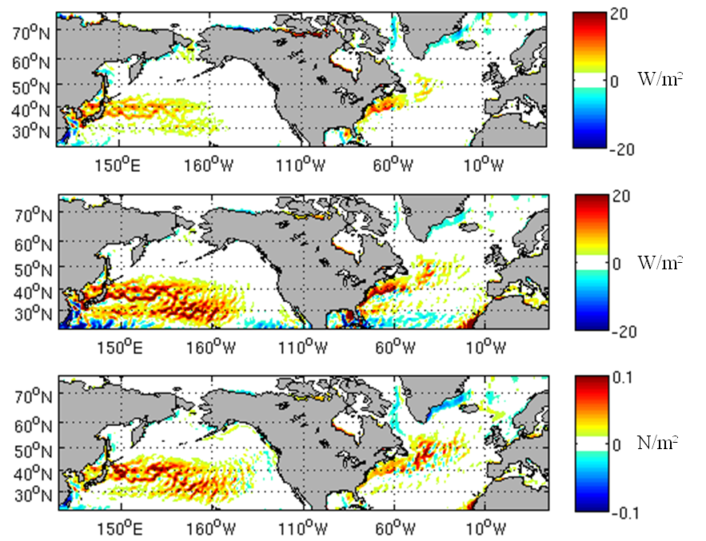
Small Scale (<600km) Variability in Fluxes
Sensible Heat Flux
Modeled changes in fluxes due to changes in wind speed caused by SST gradients
Monthly average for December
Small scale changes are large compared to accuracy requirements
This spatial variability is currently not in reanalyses
This spatial variability should be considered in evaluating the observing system
Latent Heat Flux
Stress
Graphic courtesy of John Steffen

Slide 17
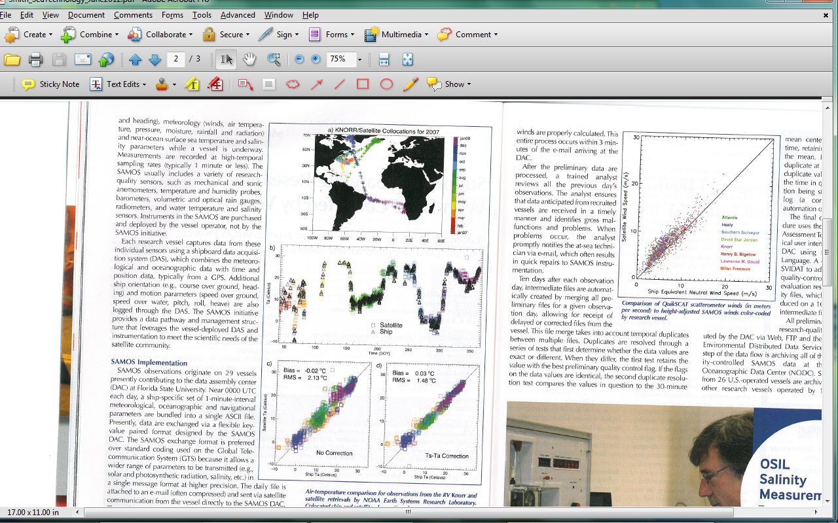
Evaluation of Satellite Retrievals of 10m Ta and Qa
We need coincident observations of air/sea differences in temperature and humidity
Figures show comparison to research vessel observations from SAMOS R/Vs
Jackson et al., 2012
Notes:
Bulk variables measured from space need to include TA and QA for non-stress fluxes
Ta and Qa from Jackson and Wick are tuned to ICOADS and validated against research vessel observations

Slide 18
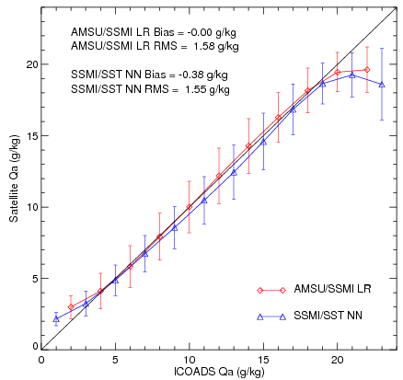
Comparison of Two Retrieval Techniques
Blue – Roberts et al. (SeaFlux; JGR 2010)
Red – Jackson and Wick (JAOT, 2010)
Compared to independent ICOADS observations
Need more data to improve extremes
Graphic courtesy of Darren Jackon in
Bourassa et al. (TOS, 2010)

Slide 19
Summary
Multiple networks must be combined to produce climate quality flux products
  Coincident observations are critical by not yet required
  Needed to meet spatial and temporal sampling requirements
Current practice does not adequately measure sea state (waves) which have a substantial impact on fluxes
Small spatial scale variability is substantial compared to flux accuracy requirements
OOPC would like to draw on input from CLIVAR, WDAC, SOLAS, and others to characterize the observational needs
  Accuracy of the network
  Sampling requirements in space and time
OOPC will work on statistical assessments of system accuracy
  Work with GOV and GSOP on model assessments

