Slide 1
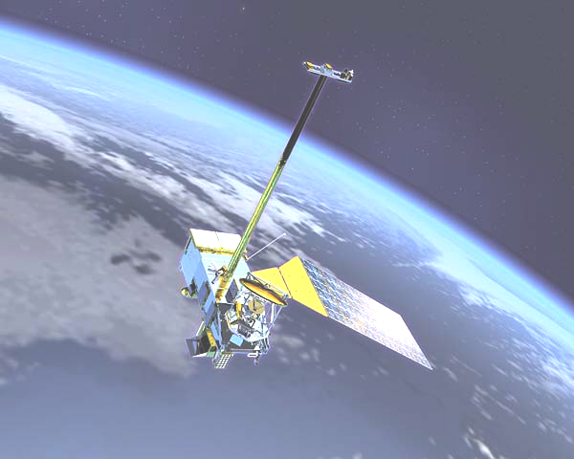

Air-sea fluxes: Introduction
Carol Anne Clayson
Woods Hole Oceanographic Institution
WCRP Data Advisory Council 3rd Session
Galway, Ireland
6 May 2014

Slide 2
SEAFLUX overview
International project under the auspices of the GEWEX Data and Assessments Panel: to improve our understanding and determination of ocean surface turbulent fluxes
Our main questions:
  What is feasible in terms of resolution and length-of-time series for satellite data?
  Can we produce a high resolution dataset using satellites that is better than conventional climatology and NWP products?
  What are the best methods for creating this dataset?
  How do the different datasets perform under varying applications?
Elements of the project include:
  Evaluation of bulk turbulent flux models
  Evaluation of global flux products
  Providing library of flux datasets and in situ data sets for easy comparisons by researchers
  Production of a high-resolution (1º, 3 hourly) turbulent flux dataset

Slide 3
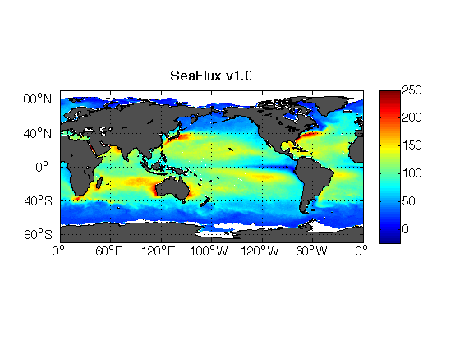
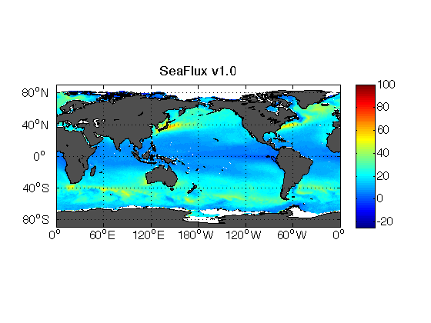

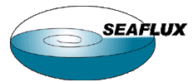
SeaFlux Climatological Data Set
Version 1.0
1999 Latent Heat Flux
Near-surface air temperature and humidity
  Roberts et al. (2010) neural net technique
  SSM/I only from CSU brightness temperatures (thus only covers 1997 - 2006)
  Gap-filling methodology -- use of MERRA variability – 3 hour
Winds
  Uses CCMP winds (cross-calibrated SSM/I, AMSR-E, TMI, QuikSCAT, SeaWinds)
  Gap-filling methodology -- use of MERRA variability – 3 hour
SST
  Pre-dawn based on Reynolds OISST
  Diurnal curve from new parameterization
  Needs peak solar, precip
Uses neural net version of COARE
Available at http://seaflux.org
1999 Sensible Heat Flux

Slide 4
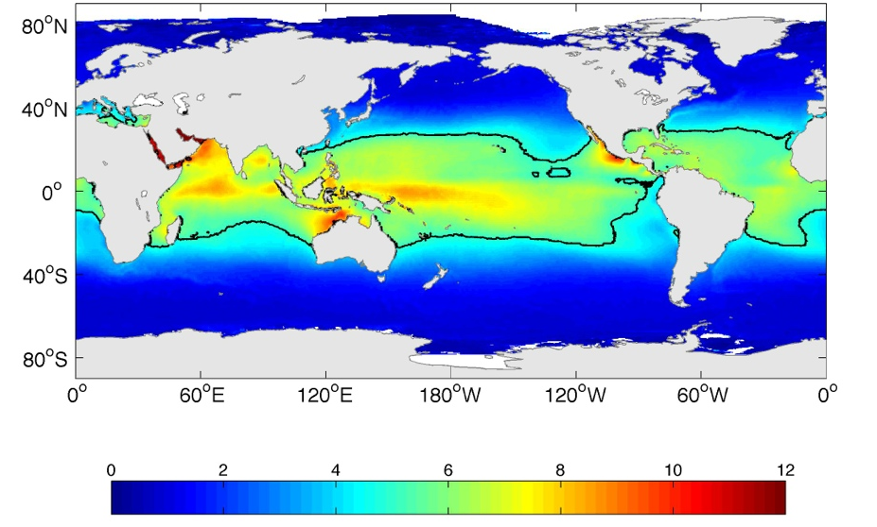
Average effect of diurnal SST on fluxes
Clayson and Bogdanoff (2012)

Slide 5
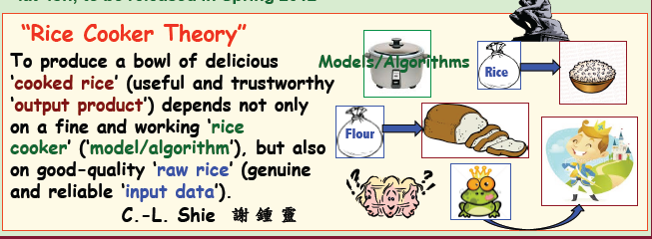
Current Satellite/Blended Datasets
Goddard product: GSSTF3
  Daily, 0.25°, input variables and turbulent fluxes;
    satellite plus Ta from reanalysis
  1988- 2008; global oceans
  No current plans to update again – funding issues
IFREMER version 3
  Daily, 0.25°, input variables, turbulent fluxes; satellites plus Ta from reanalysis
  Currently available: 1992 (1999 with QuikSCAT) – November 2009; global oceans
Japanese Ocean Flux datasets: J-OFURO2v2
  Input variables, fluxes, radiation, satellites plus Ta from reanalysis
    Daily, 1°, 1988 – 2005; global oceans
    Satellites, JMA model analyses
HOAPS3.2
  6-hourly, 0.5°, global oceans; input variables, precipitation; satellites
  July 1987 - December 2008
OAFlux
  Daily, 1°, global oceans; blended using reanalysis, in situ, satellites
  July 1985 – current (monthly available back to 1958)

Slide 6
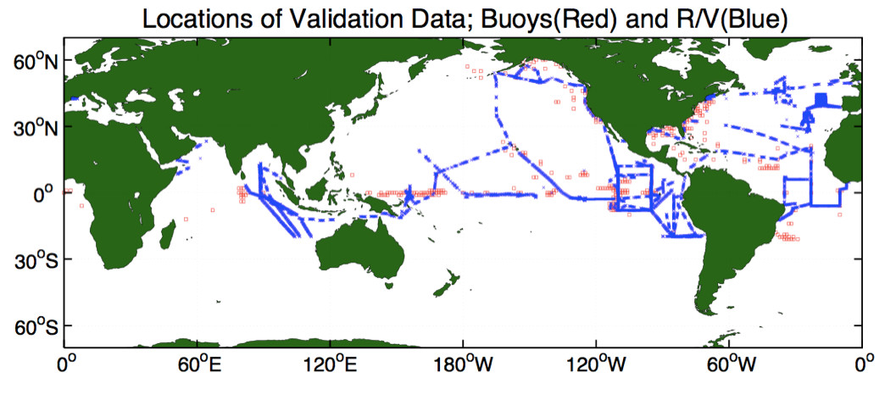
In-situ measured fluxes used in comparisons: true eddy-correlation fluxes in blue

Slide 7
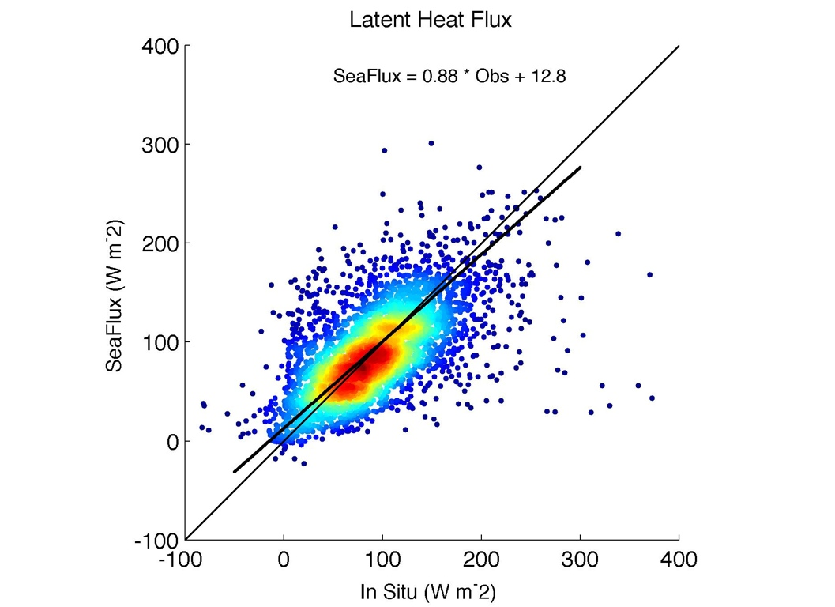
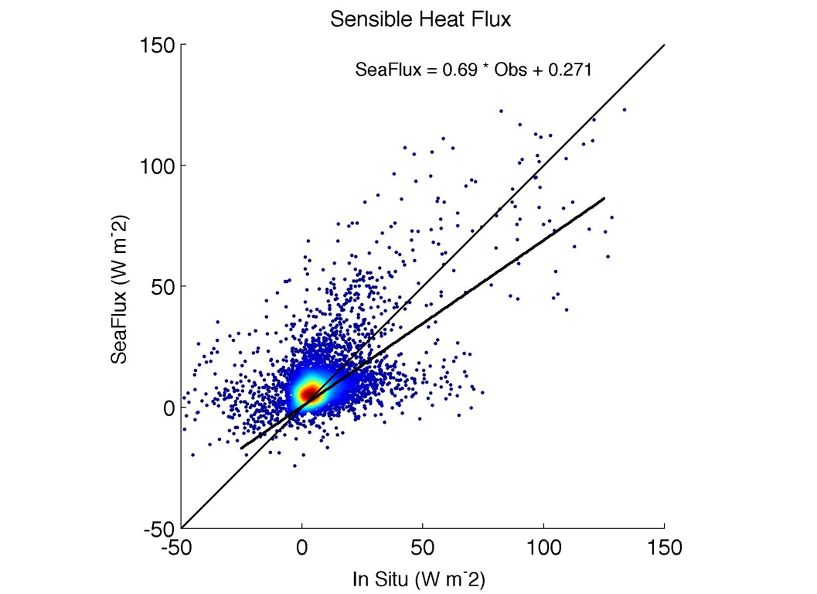
Some comparisons
Bias: 2.1 W m⁻²
Std Error: 38 W m⁻²
Bias: -3.1 W m⁻²
Std Error: 13.2 W m⁻²
Here we do comparison with eddy covariance fluxes from research vessels -- they are our “ground truth”

Slide 8
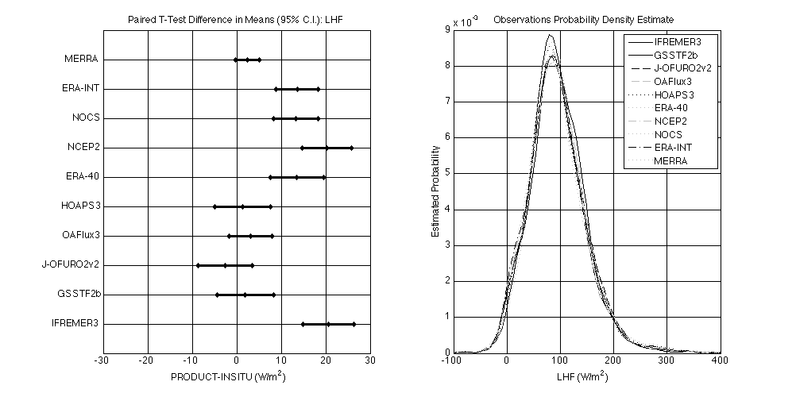
Some sample comparisons
8

Slide 9
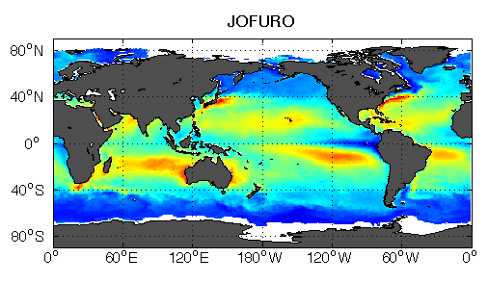
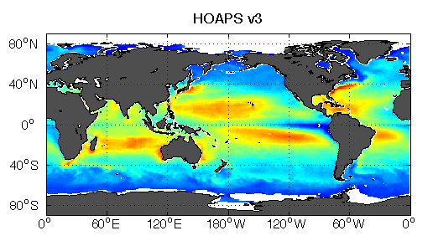
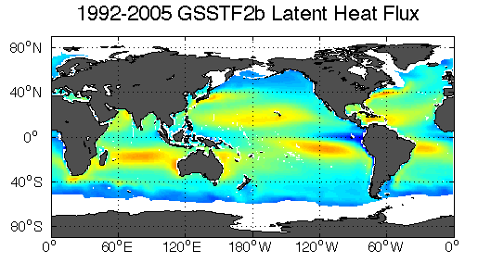
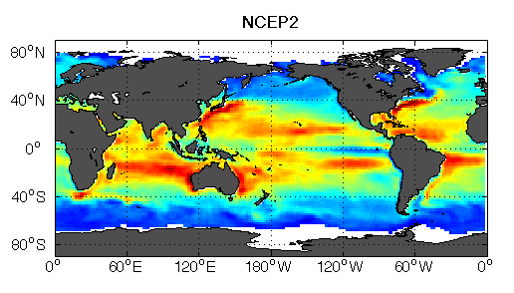
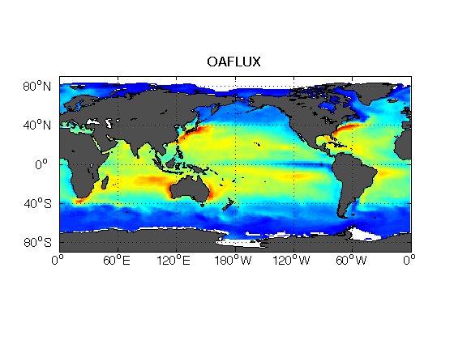
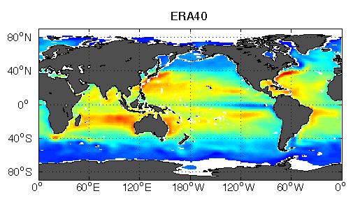
Latent Heat Flux: 1999-2005
W m⁻²

Slide 10
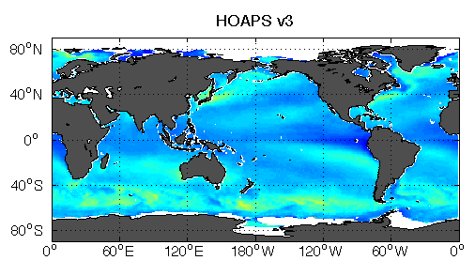
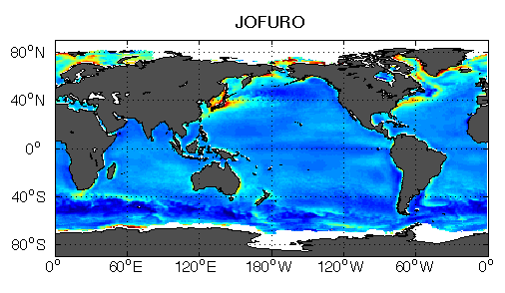
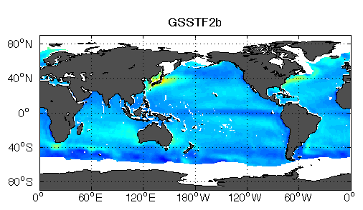
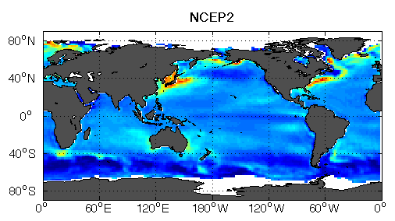
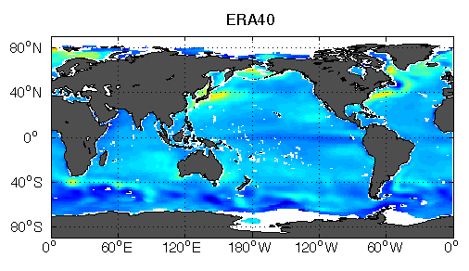
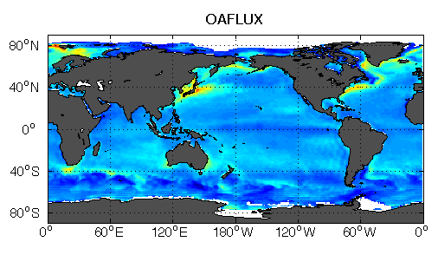
Sensible Heat Flux: 1999 - 2005
W m⁻²

Slide 11
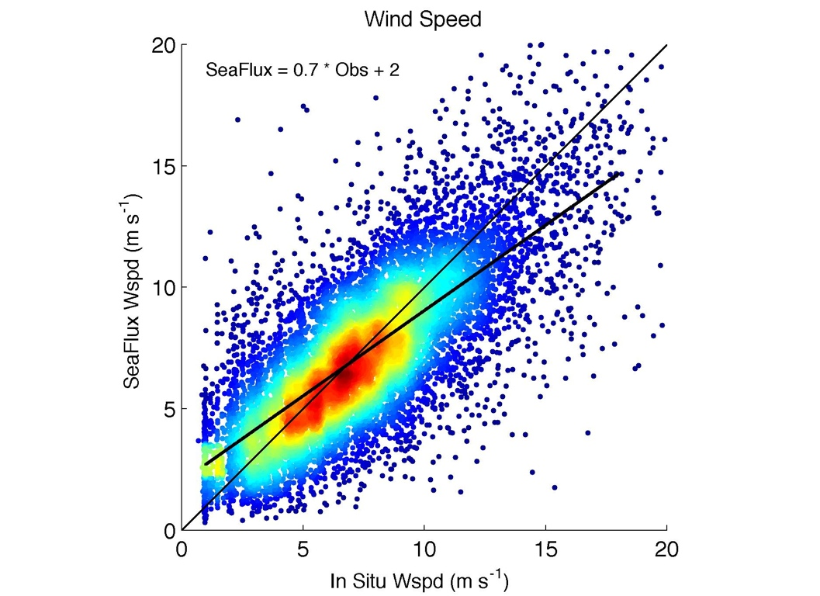
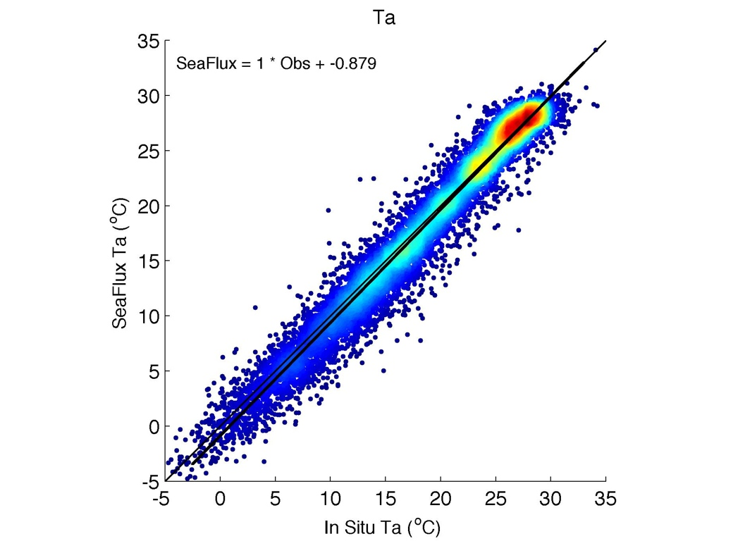
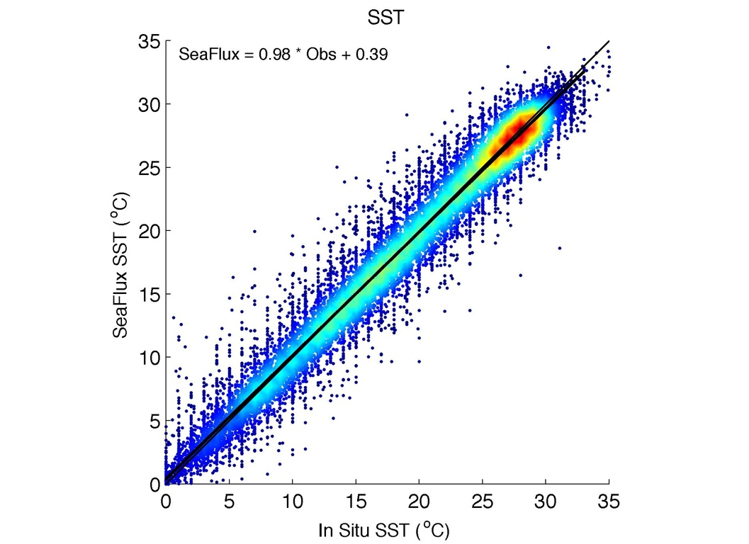
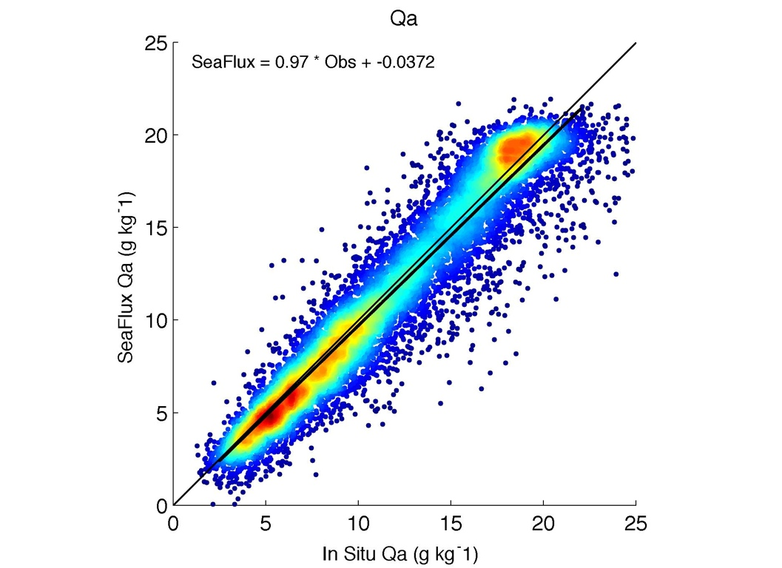
Comparison of SeaFlux derived parameters with ICOADS Value-Added Database (ships of opportunity)
Bias: 0.37 º C
Std Error: 1.67 º C
Bias: -0.21 m s⁻¹
Std Error: 2.17 m s⁻¹
Bias: 0.09 º C
Std Error: 1.43 º C
Bias: 0.33 g kg⁻¹
Std Error: 1.69 g kg⁻¹

Slide 12
Evaluating uncertainty using IVAD data
Wind Speed
Qs - Qa
Ts-Ta
Clayson et al. 2014

Slide 13


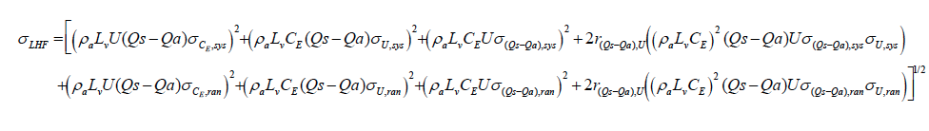
Calculation of Uncertainties
We need to use propagation of errors
If F is a function of two variables, x and y, the uncertainty of F (σ_{F}) due to uncertainties in x (σ_{x}) and y (σ_{y}) can be written as:
For multiple measurements, the terms can be written as (using simple sampling theory):

Slide 14
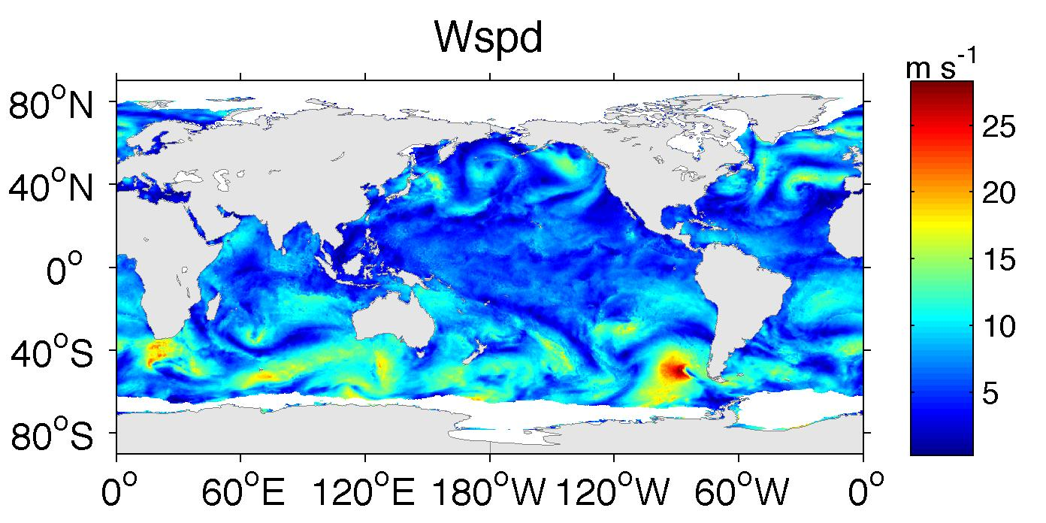
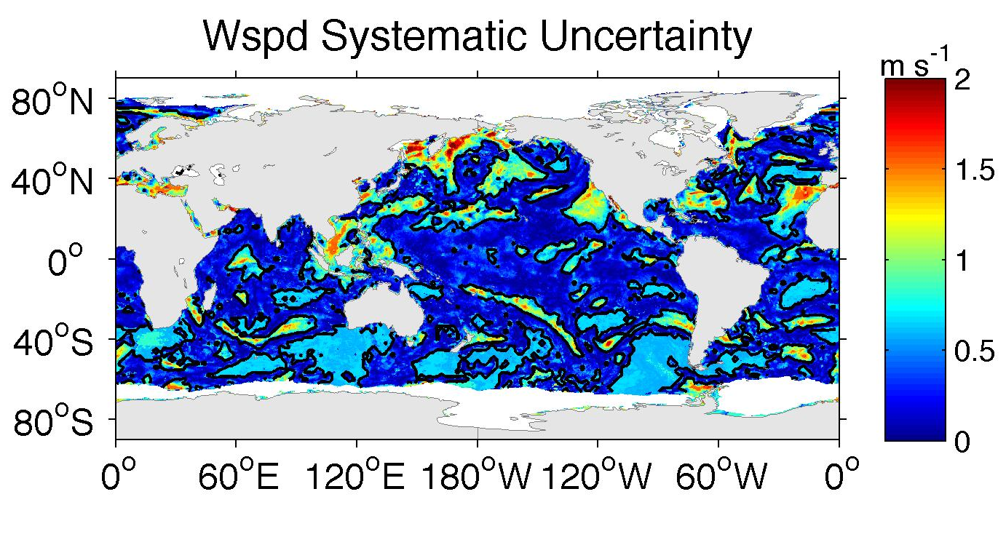
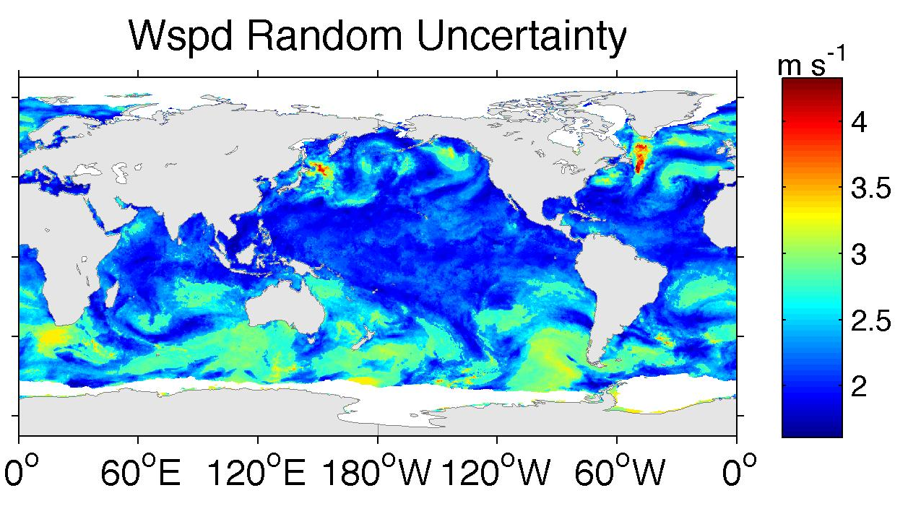
Instantaneous fields

Slide 15
SeaFlux Uncertainty Estimates

Slide 16
SeaFlux Uncertainty Estimates

Slide 17
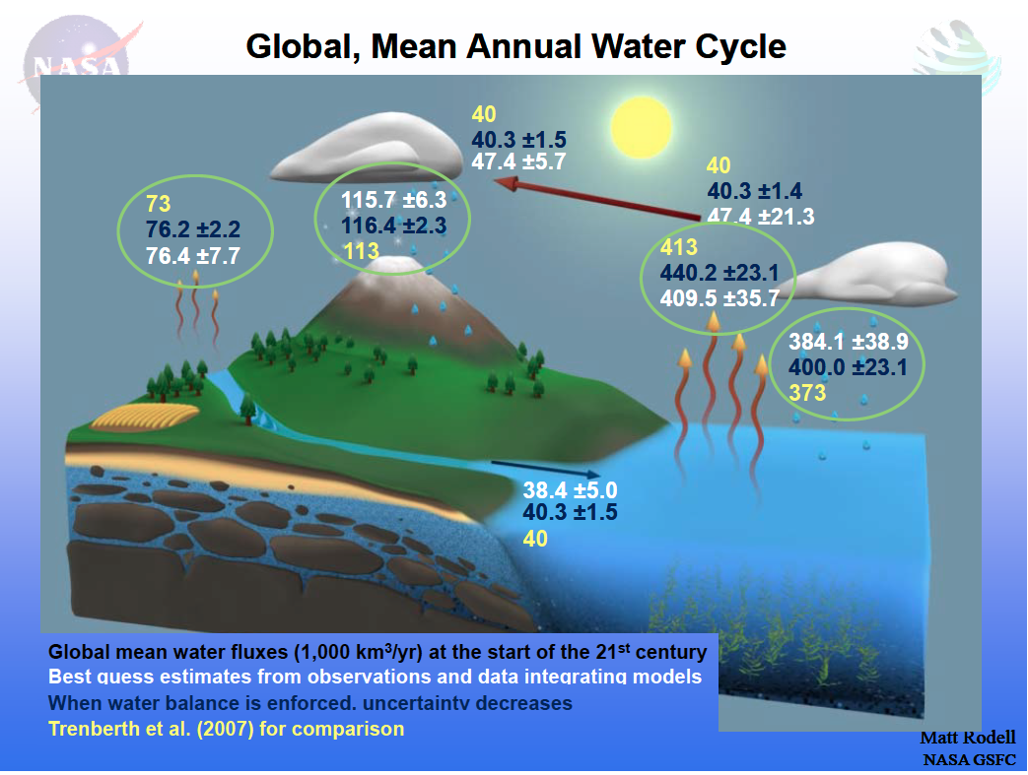
Reconciling the global budget
SeaFlux LHF: 90.3 W m ⁻² SHF: 17.8 W m ⁻² combined: 107.6 W m ⁻²
Large and Yeager LHF: 96 W m⁻² SHF: 14 W m⁻² combined: 110.0 W m ⁻²

Slide 18
Regional Water Budgets
Brown and
Kummerow 2013

Slide 19
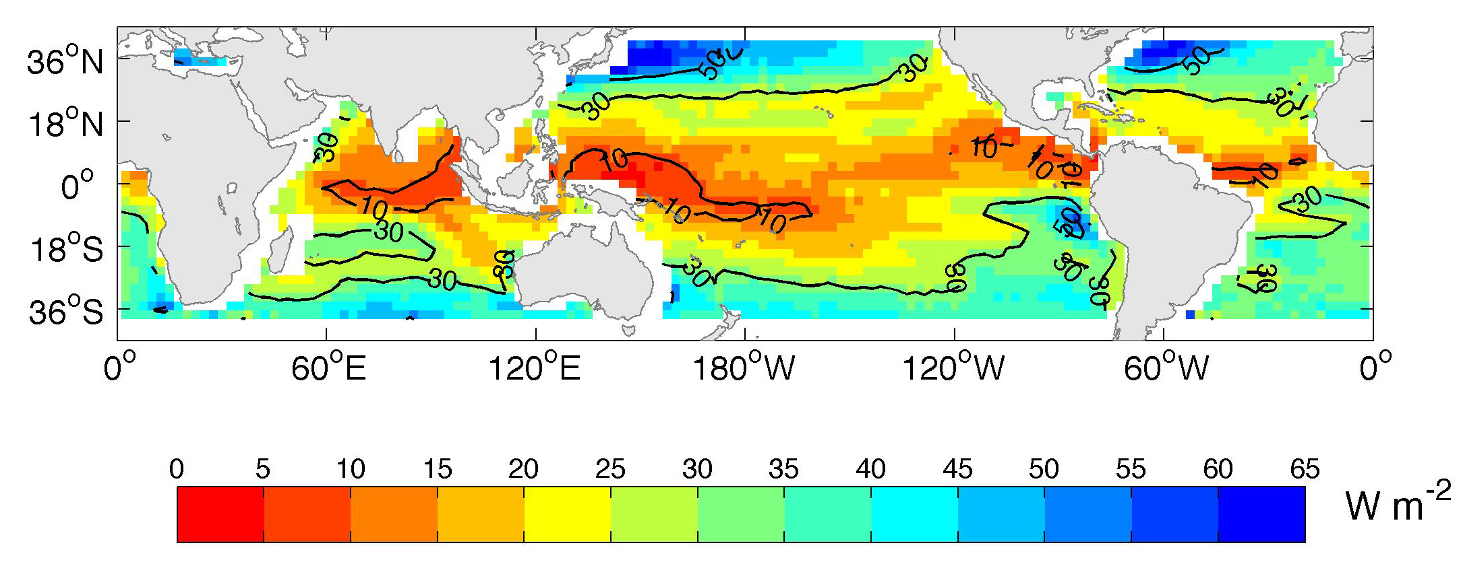
Need to define what accuracy is for
The net heat flux error which would provide a seasonal SST spread less than one-half the peak to trough seasonal SST variability (Clayson and Bogdanoff 2013).

Slide 20
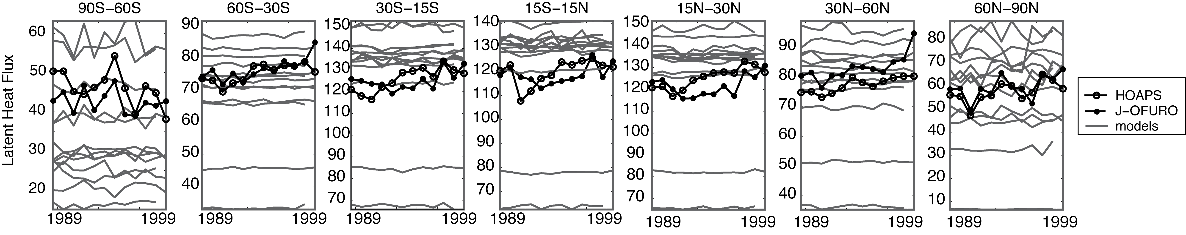
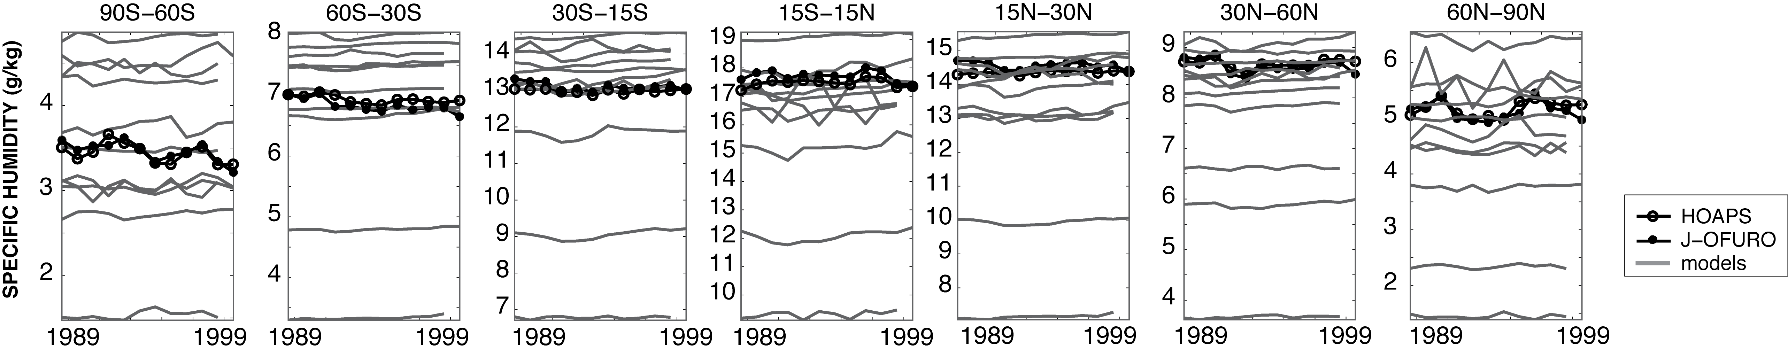
Comparisons with CMIP4 models
Latent Heat Flux
Specific Humidity

Slide 21
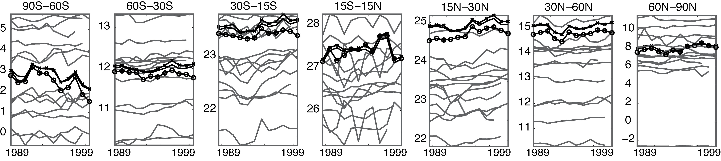
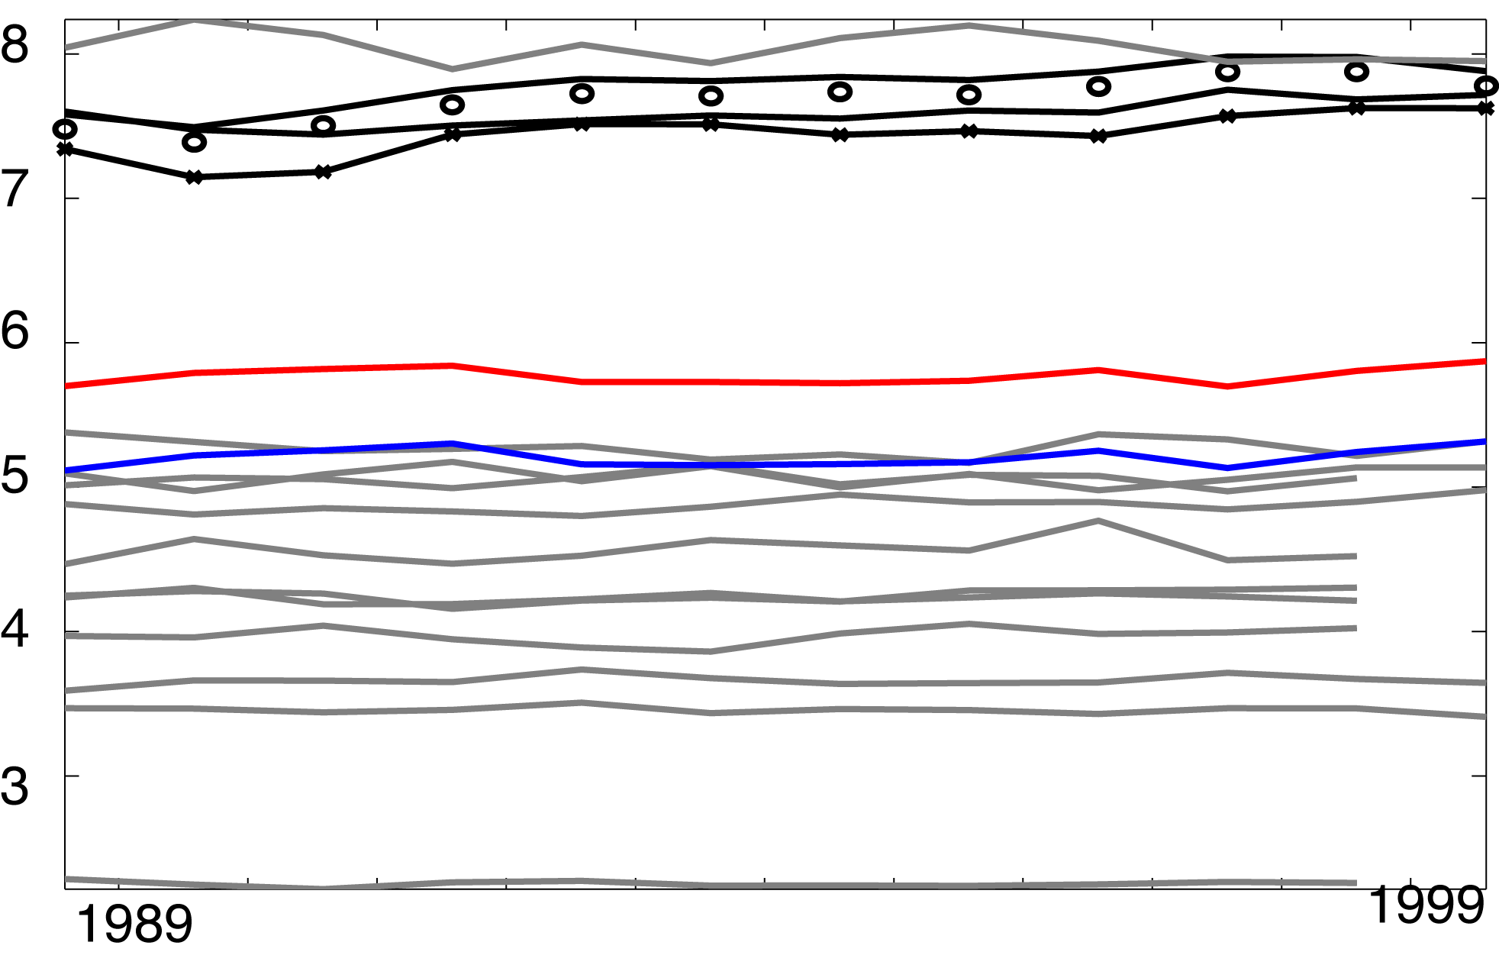
Sea Surface Temperature
Winds
Winds

Slide 22
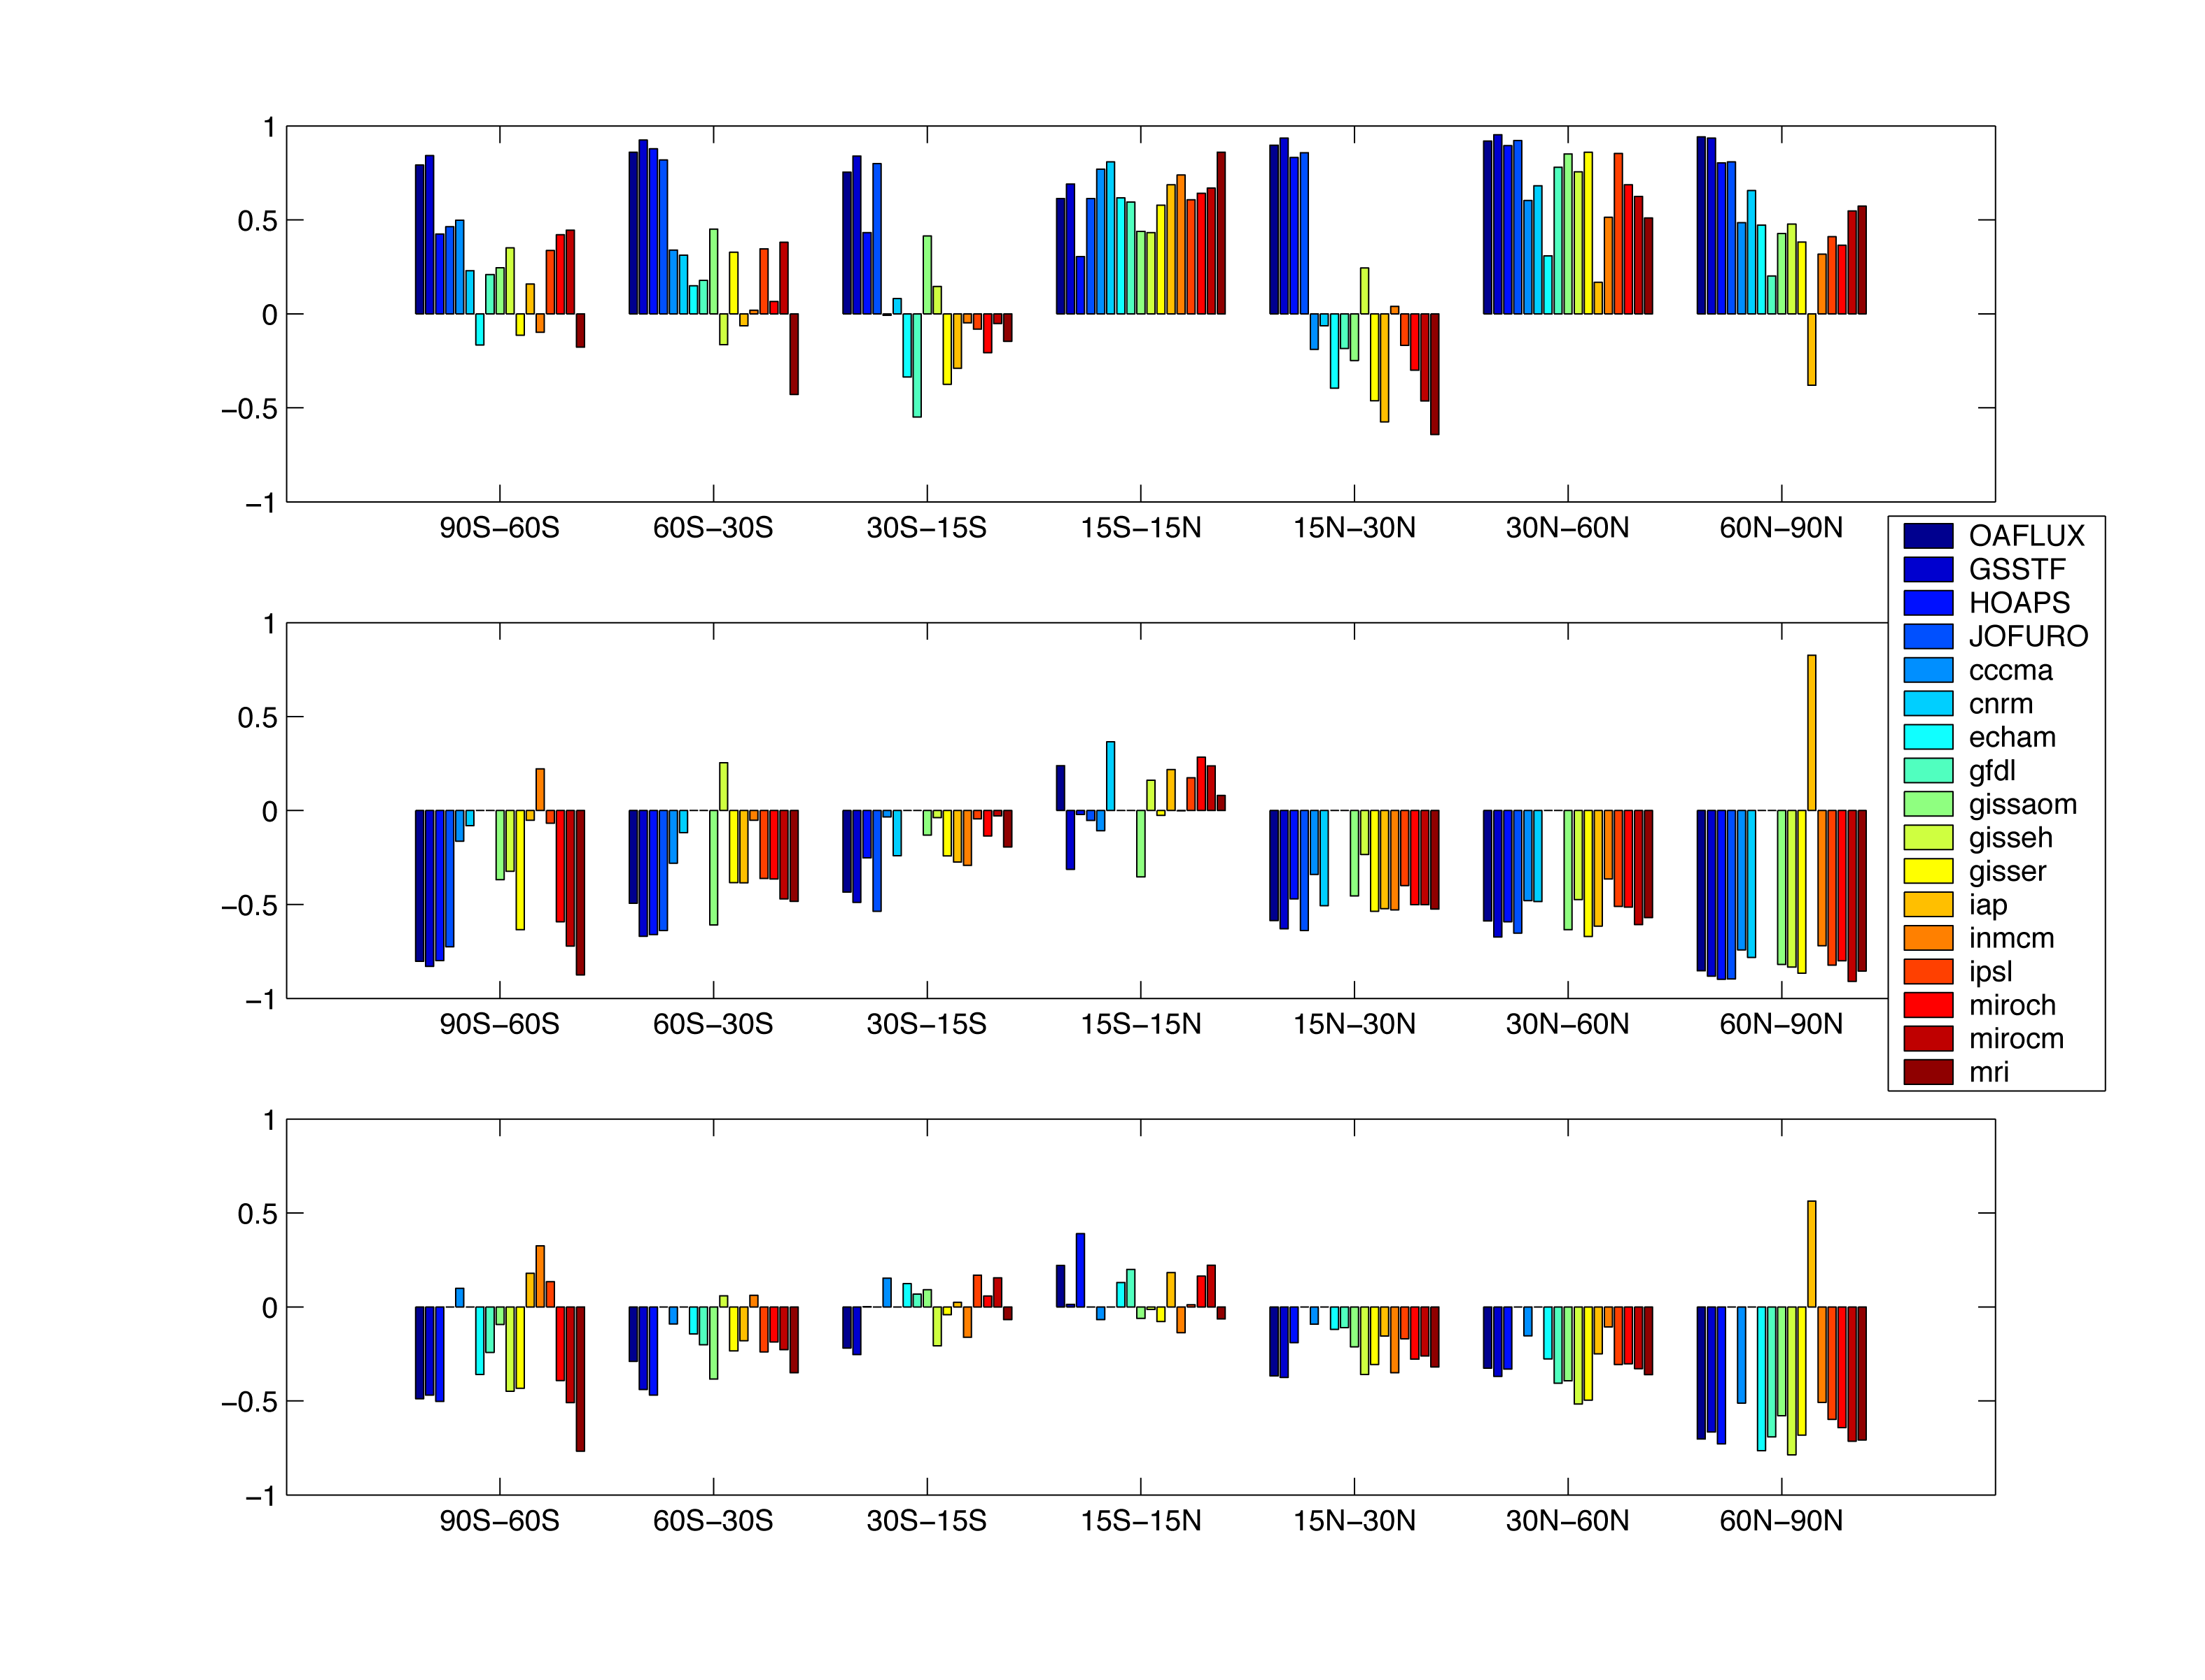
Correlation of trends: satellites, CMIP4
LHF and wind
LHF and humidity
LHF and SST

Slide 23
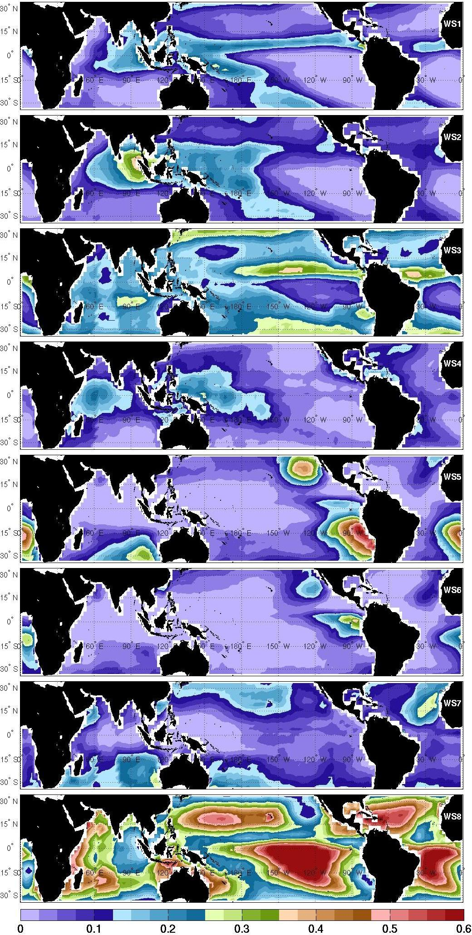
Motivation and background
Use of ISCCP cluster weather states (Jakob and Tselioudis 2003)
Datasets:
  ISCCP Extratropical Cloud Clusters (35N/S, 2.5°x2.5° 1985-2007, 3-hr)
  SEAFLUX (1998-2007,0.25°x0.25° 3-hr), LHF/SHF/Surface Variables
Product Homogenization:
  Fluxes regridded and resampled to ISCCP 2.5x2.5
  ISCCP 3-hr used to assign a daily class based on the most frequent cluster
Compositing Methodology:
  Conditionally sample data using weather state classification
  Further sampled based on compositing index to evaluate low-frequency coupled variability
  Use NOAA Climate Prediction Center (CPC) indices for ENSO and MJO
More convection
Less convection

Slide 24
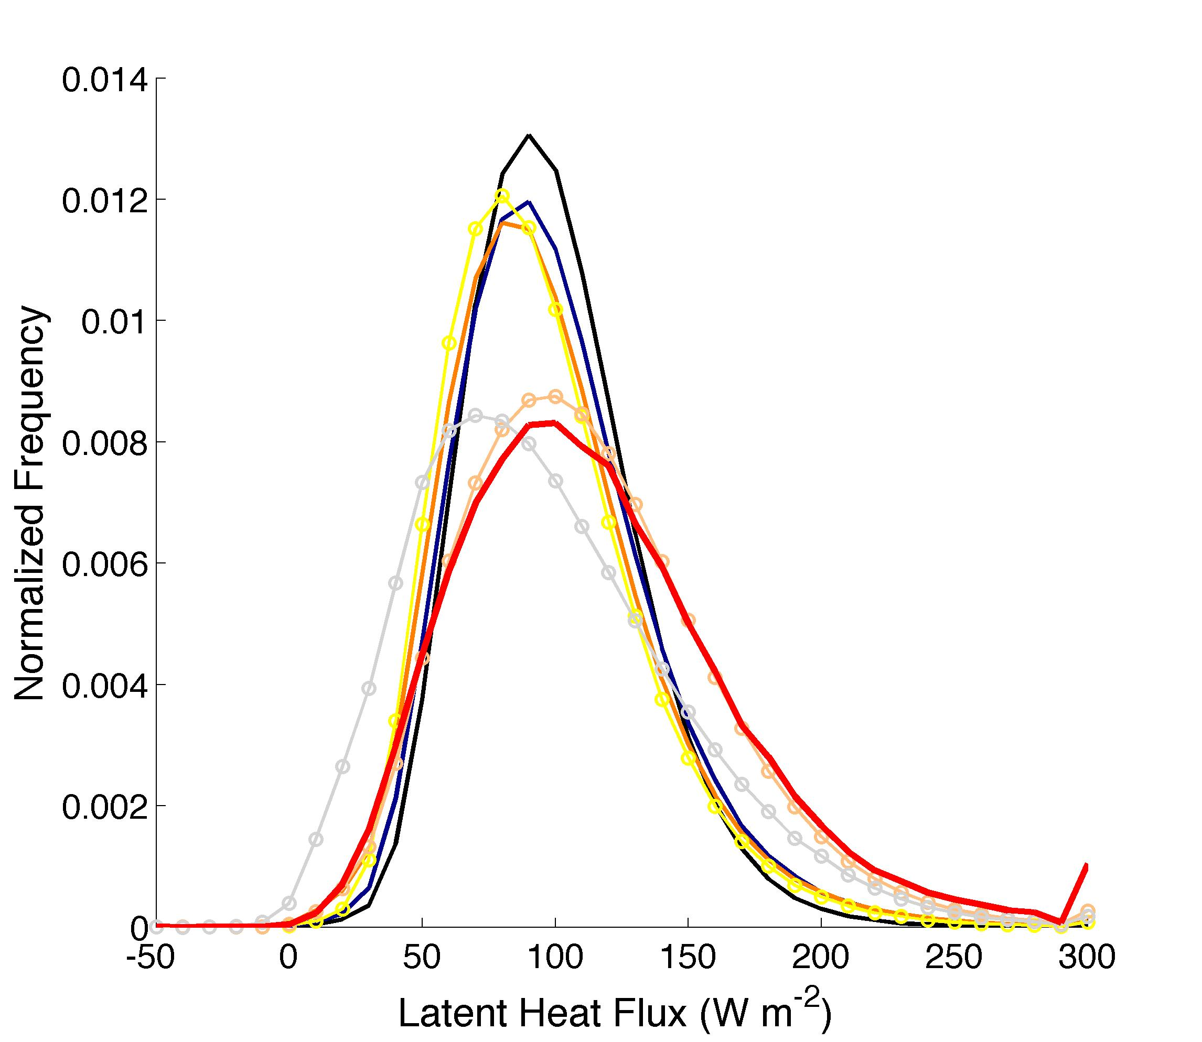
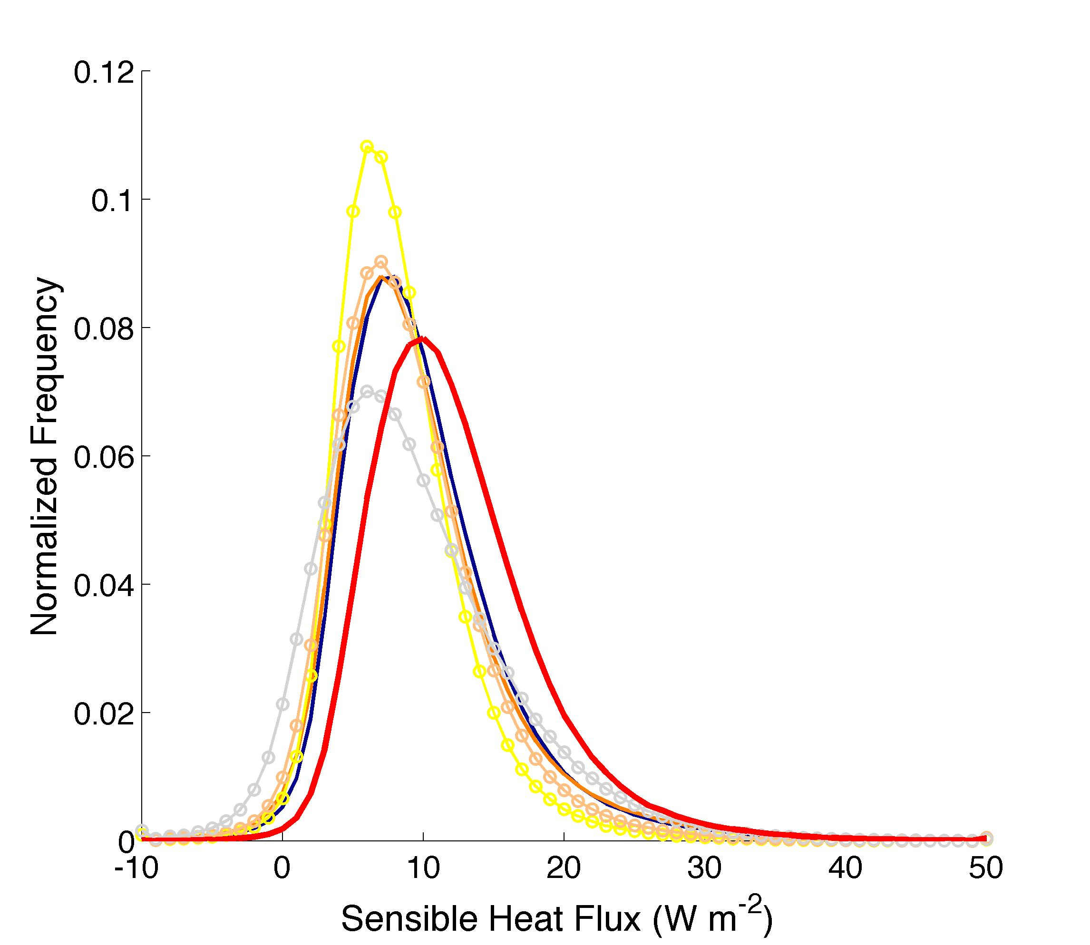
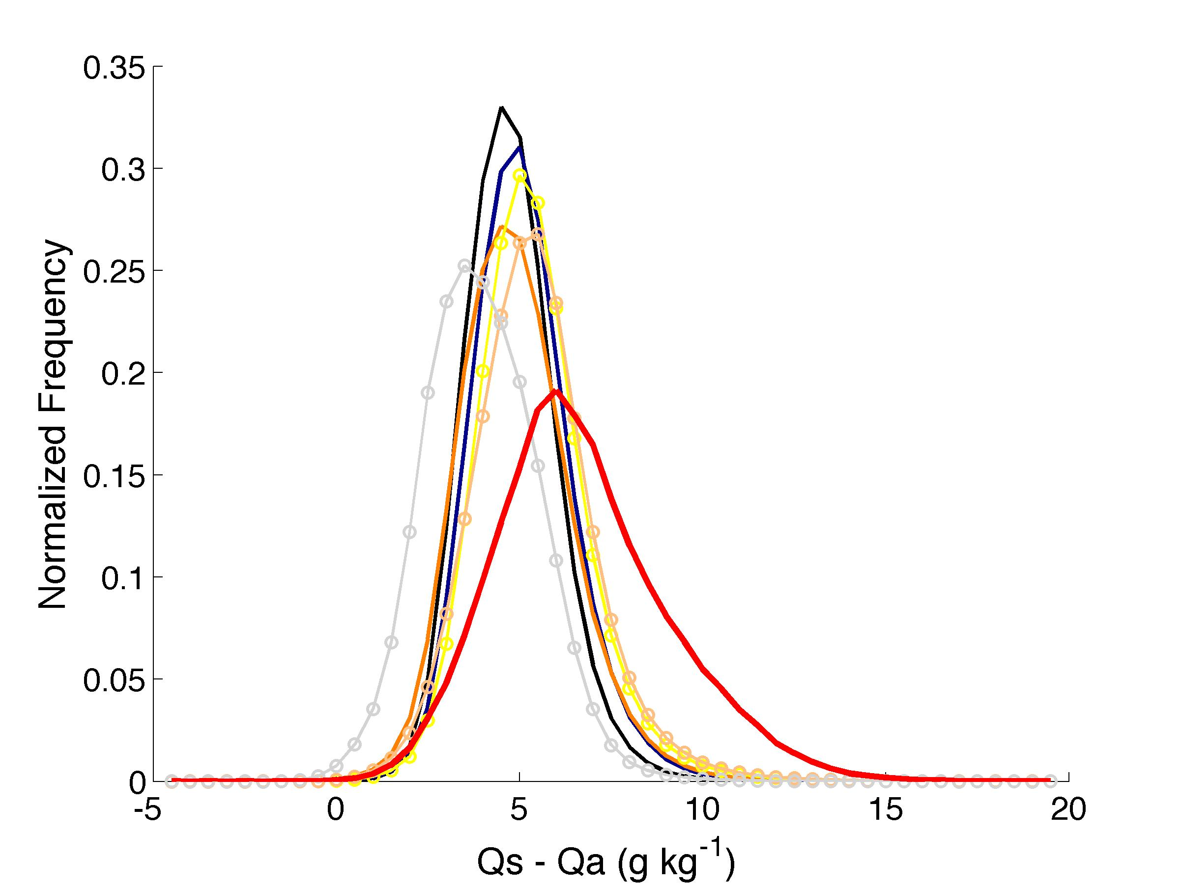
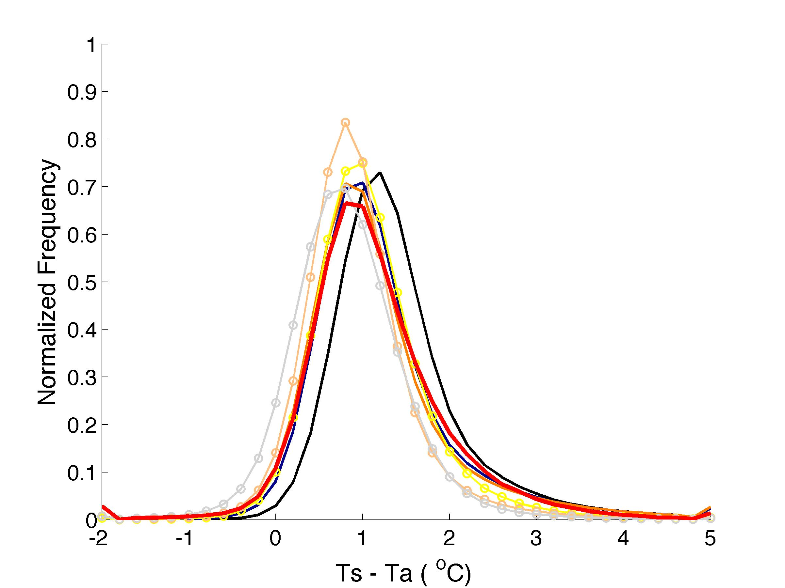
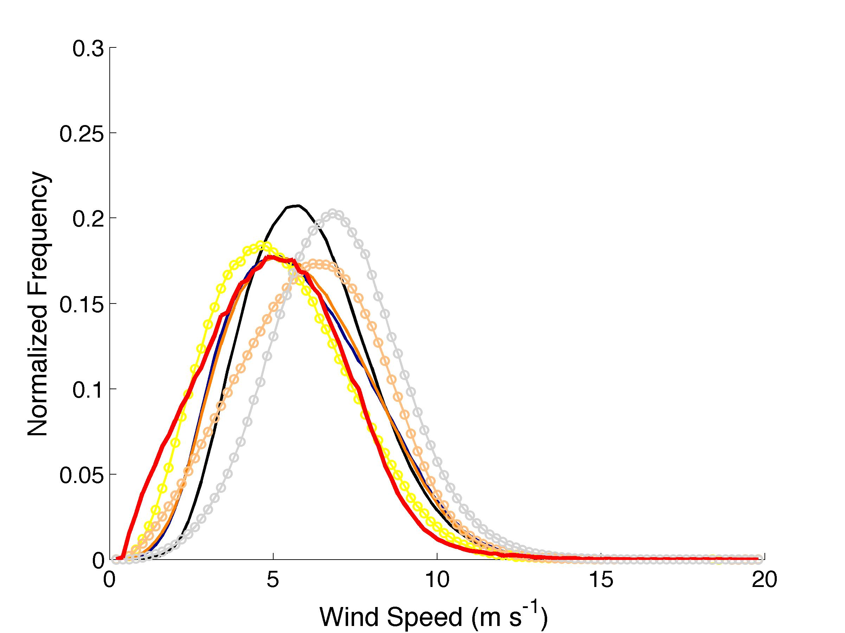
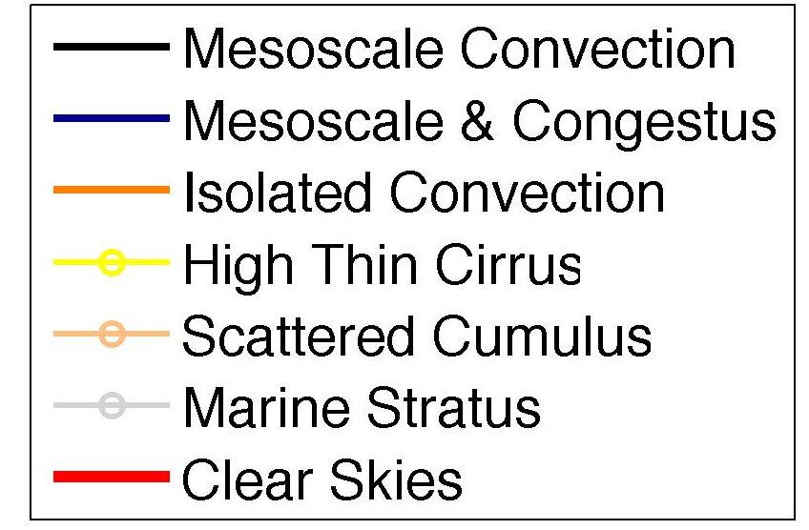
Decomposition of surface fluxes by weather state
LHF
SHF
Weather regimes result in distributions of fluxes with different mean and extreme characteristics
These are associated with changes in the bulk variables, as should be expected
Both wind speed and near-surface humidity gradients are particularly well stratified, though the latent heat flux means are less so
  Indicates potential compensations
Qs-Qa
Ts-Ta
Wind Speed

Slide 25
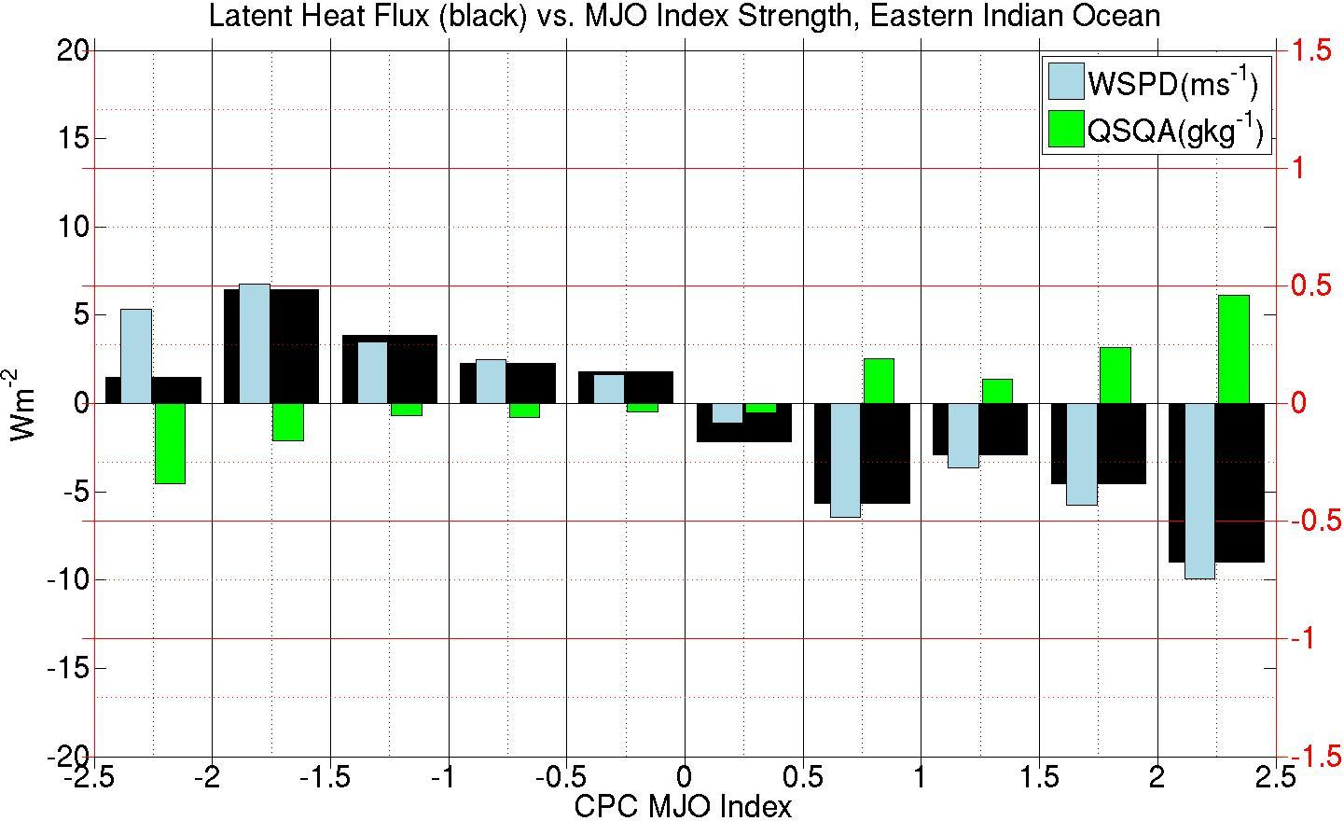
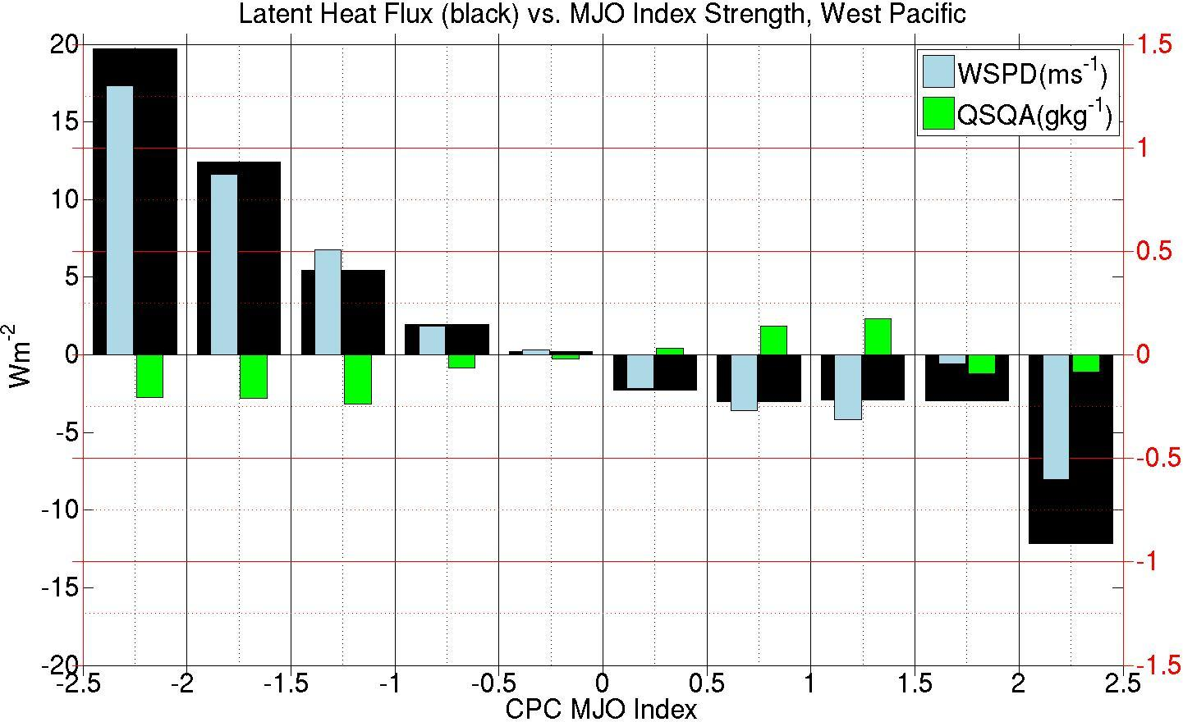
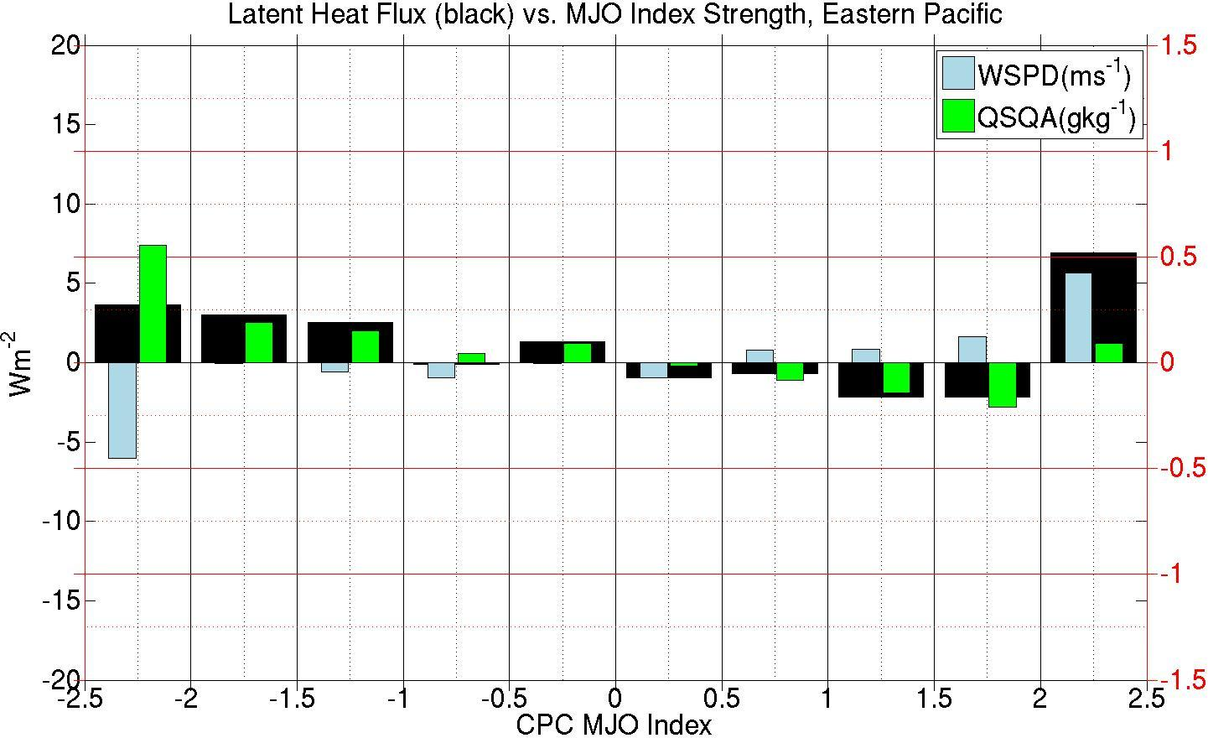
MJO Composites by strength
EIO
70E-90E
Composite MJO based on index strength not time-lagging
All three regions typically show increased evaporation during convective phase and decreased evaporation during suppressed phase
The Indo-Pacific region changes → more wind-driven Eastern Pacific changes → more near-surface moisture gradient changes
  But: EIO more coherent near-surface moisture changes than WP
Convective
Neutral
Suppressed
WP
130E-150E
EP
130W-110W

Slide 26
EIO
70E-90E
EIO and WP: deeper ML in convective; EP: slightly deeper ML in suppressed
WP: LHF variability has roughly same effect on SST tendency throughout MJO. EP: LHF much higher effect on variability during convective phase
EIO: Even shallower ML in suppressed phase, but still large LHF due to Qs-Qa difference: LHF variability strongest effect during suppressed phase
Convective
Neutral
Suppressed
WP
130E-150E
Deeper ML
Shallower ML
LHF variability roughly same effect
EP
130W-110W
Shallower ML
Deeper ML
LHF variability very different effect

Slide 27
Strategies for Improving Ocean Turbulent Fluxes
More routine observations:
  Extremes: cold air outbreaks, hurricanes
  High-latitudes
  Both limited duration focused on physical processes and long time series at given locations
  Should be noted: we also need the actual turbulent flux measurements as well for continued understanding of bulk flux paramaterizations
Clearly defined, common measures of accuracy:
  Tropical array of surface flux moorings (some sub-tropical) – use to benchmark
  Process studies – why are some biased?
  More flux intercomparisons with standardized methods
More process studies: put together evap, precip, latent heating profiles into some case studies
Better calibration: we need to resolve what are appropriate calibrations for multiple uses
More global coverage: “missing” events significant problem
More funding: compare surface turbulent flux with precipitation groups
Increase accessibility of available datasets

Slide 28
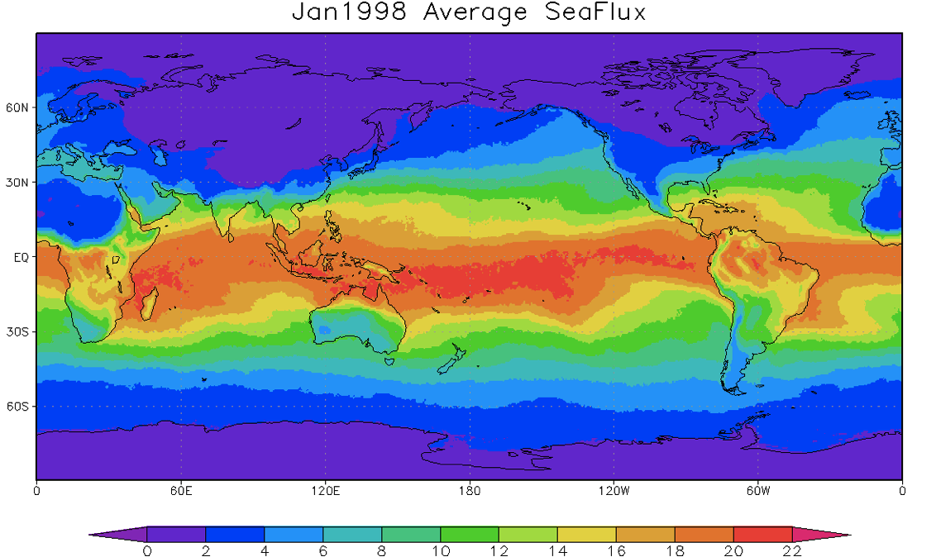
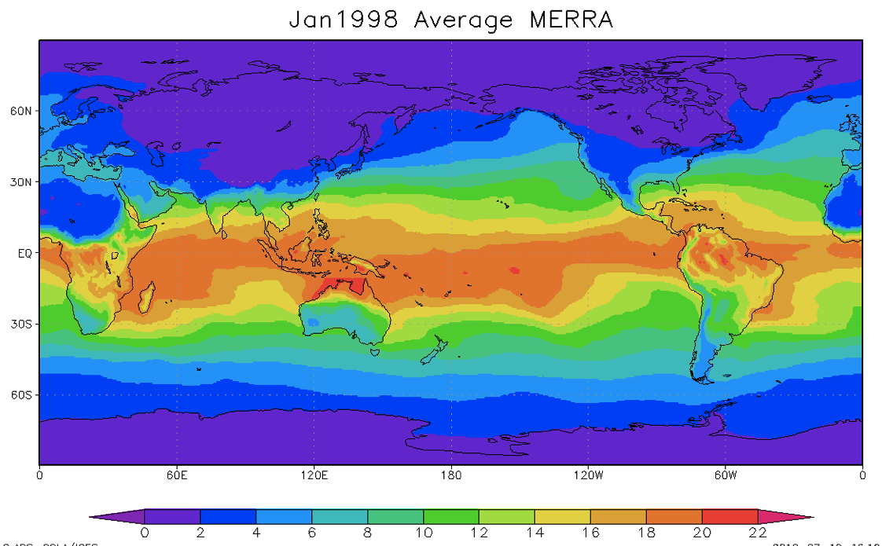
Some sample comparisons with MERRA
Near-surface specific humidity

Slide 29
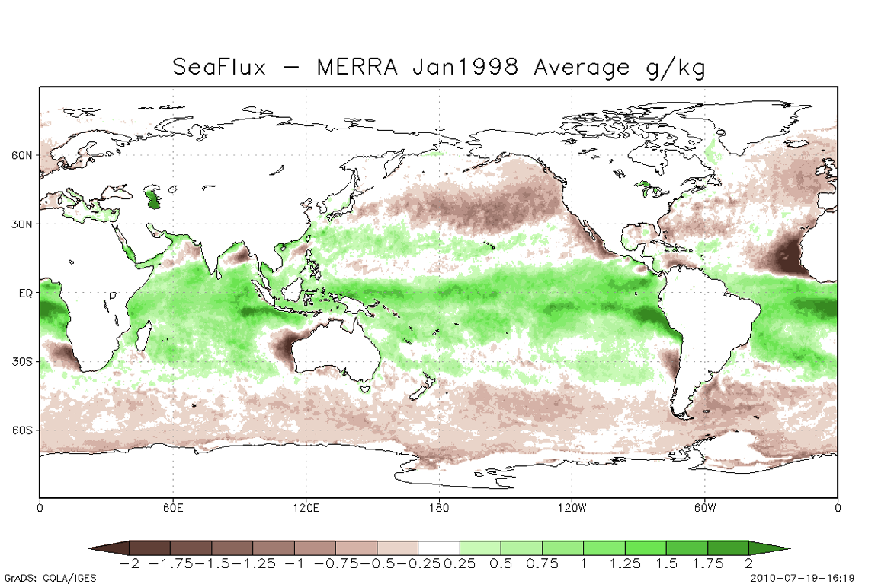
Some sample comparisons with MERRA
Near-surface specific humidity

Slide 30



“Transfer coefficient”

Slide 31

Trends in evaporation

Slide 32


Trenberth et al. 2011

Slide 33

“Transfer coefficient”
  Depends on:
    Wave breaking
    Roughness of sea surface
    Air-sea temperature difference
    Sea spray
    ?

Slide 34

Estimating the fluxes
How well we estimate is now both a function of how well we MEASURE and how good our MODEL is

Slide 35


Hurricanes from models, data
SeaFlux

Slide 36

Hurricane Fluxes
Wave effects
5%
Sea spray
effects
15%
Liu, Curry, Clayson, Bourassa 2011

Slide 37



Example distributions
Latent heat
flux 1999

Slide 38



95th Percentile

