Slide 1
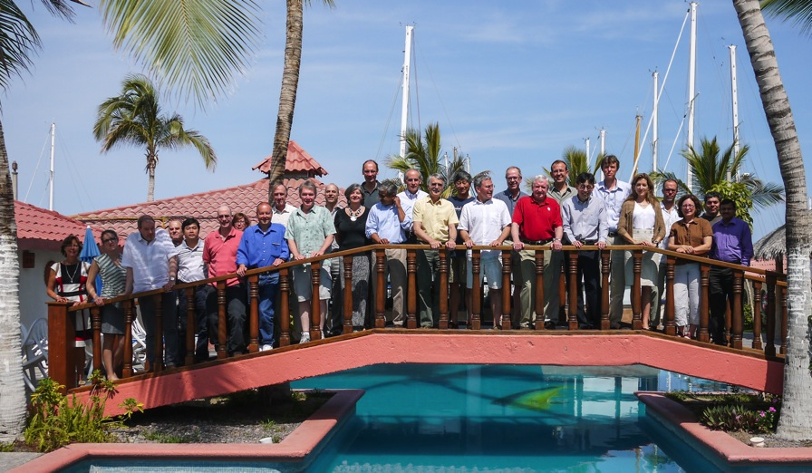
Evolution of CLIVAR
The World Climate Research Programme’s project on ocean-atmosphere interactions
Notes:
Thanks SSC

Slide 2








International Science Organization
Global Environmental Change Programs
Information @ townhall
room B6 Tuesday 19:00
World Climate Research Program’s Projects
Notes:
See p. 2 of Draft IP
2

Slide 3
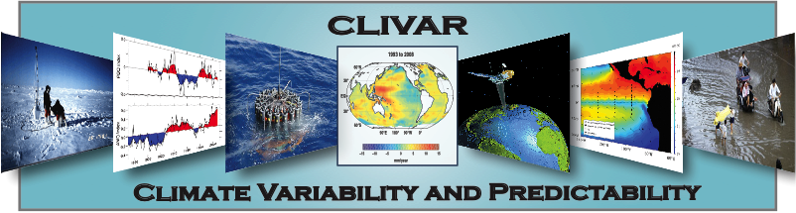
CLIVAR Mission
The World Climate Research Programme’s project on ocean-atmosphere interactions
    To improve understanding and prediction
    of ocean-atmosphere interactions
    and their influence on climate variability and change,
    to the benefit of society and the environment.

Slide 4
CLIVAR Objectives
Understand the causes of climate variability on
intra-seasonal to centennial time-scales through
observations, analysis, and modeling.
Improve predictions of climate variability and
change associated with both internal and
external processes.
Extend observational climate record through
assembly of quality-controlled data sets.
Improve the atmosphere and ocean components
of Earth-System Models.

Slide 5
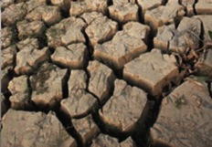
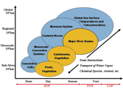
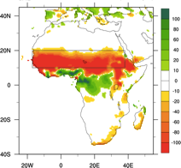
current CLIVAR Research
Anthropogenic Climate Change
Natural variability versus forced change
Climate sensitivity and feedbacks
Regional phenomena (e.g., ENSO, AMOC, …)
Extremes
CMIP#
Climate Engineering (Geo-engineering)
Intra-to-Seasonal Variability, Predictability and Prediction
Monsoons (and ENSO, TAV, …)
ISV/MJO
Quantifying prediction uncertainty
Building pan-WCRP and WWRP links
CHFP
Decadal Variability, Predictability and Prediction
Determine predictability
Mechanisms of variability (AMO, PDV, …)
Role of oceans
Adequacy of observing system
Coupled Initialization
Quantifying prediction uncertainty
Building pan-WCRP links
Notes:
COPES THEMES
MODELING (Exploring concepts related to seamless prediction paradigm, improving (ocean) models, climate change experiments in support of AR5, and regionally focused experiments)
OBSERVATIONS (Sustained ocean observations and monitoring, process studies, and improved historical data)
SYNTHESIS (ocean data assimilation, reanalysis)
WCRP Cross Cuts
CLIVAR leads in Seasonal and Decadal Prediction and, with GEWEX, Monsoons and Extremes
INFRASTRUCTURE
Computation, Human Resource, Commitments to maintaining the ocean observing system

Slide 6
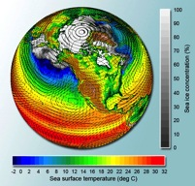
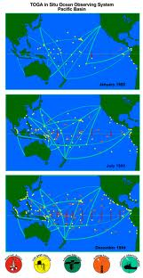

current CLIVAR Imperatives
Improved Atmosphere and Ocean Components of ESMs
Analysis and Evaluation
“Climate Process Teams” (process studies)
Building links pan-WCRP and IGBP
Model-Data comparisons
Data Synthesis and Analysis
Ocean
Coupled Data Assimilation Systems
Links – carbon, biogeochemistry, marine-ecosystems
Ocean Observing System
Development, implementation and system design
Advocacy for sustained observations
IGBP links for Carbon, Biogeochemistry, Ecosystems
Capacity Building
Summer schools and topical workshops
Expert training
Call for panel membership
Notes:
COPES THEMES
MODELING (Exploring concepts related to seamless prediction paradigm, improving (ocean) models, climate change experiments in support of AR5, and regionally focused experiments)
OBSERVATIONS (Sustained ocean observations and monitoring, process studies, and improved historical data)
SYNTHESIS (ocean data assimilation, reanalysis)
WCRP Cross Cuts
CLIVAR leads in Seasonal and Decadal Prediction and, with GEWEX, Monsoons and Extremes
INFRASTRUCTURE
Computation, Human Resource, Commitments to maintaining the ocean observing system

Slide 7
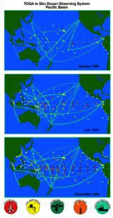
Current CLIVAR Research&Imperatives
Anthropogenic Climate Change
Intra-to-Seasonal Variability, Predictability and Prediction
Decadal Variability, Predictability and Prediction
Improved Atmosphere and Ocean Components of ESMs
Data Synthesis and Analysis
Ocean Observing System
Capacity Building
All Must Remain WCRP Priorities
Capacity Building
Summer schools and topical workshops
Expert training
Call for panel membership
Notes:
COPES THEMES
MODELING (Exploring concepts related to seamless prediction paradigm, improving (ocean) models, climate change experiments in support of AR5, and regionally focused experiments)
OBSERVATIONS (Sustained ocean observations and monitoring, process studies, and improved historical data)
SYNTHESIS (ocean data assimilation, reanalysis)
WCRP Cross Cuts
CLIVAR leads in Seasonal and Decadal Prediction and, with GEWEX, Monsoons and Extremes
INFRASTRUCTURE
Computation, Human Resource, Commitments to maintaining the ocean observing system

Slide 8
SPARC
Ocean Tropo- Strato-
sphere sphere
CLIVAR
GEWEX
CliC
Cryosphere
Land

Slide 9
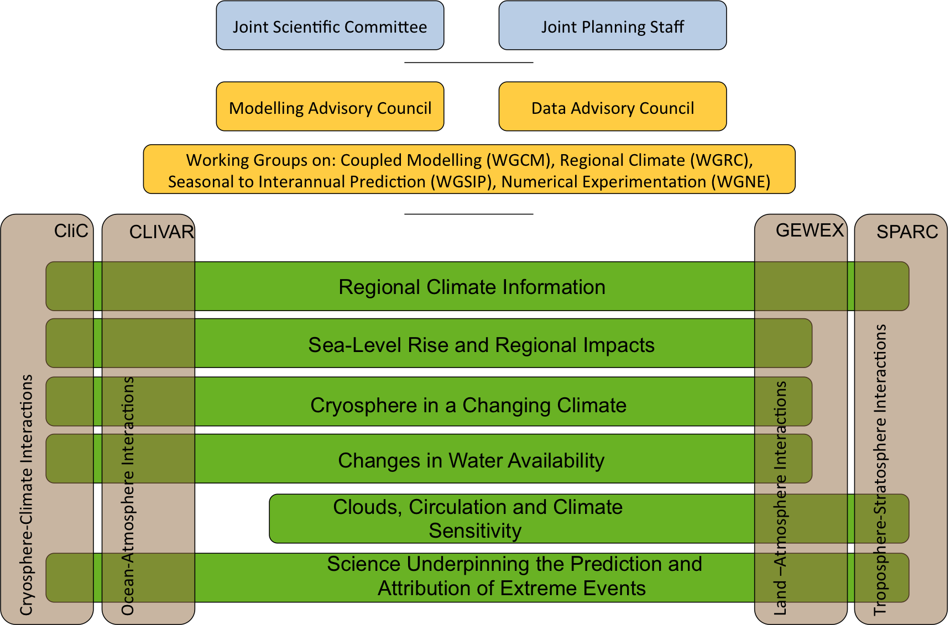
WCRP Grand Challenges

Slide 10
new CLIVAR Research Opportunities
Intraseasonal, seasonal and interannual variability and predictability of monsoon systems
Decadal variability and predictability of ocean and climate variability
Trends, nonlinearities and extreme events
Marine biophysical interactions and dynamics of upwelling systems
Dynamics of regional sea level variability
…

Slide 11
new CLIVAR Capabilities
Improving the atmosphere and ocean component of Earth System Models.
Implementing innovative process and sustained ocean observations.
Facilitate free and open access to climate and ocean data, synthesis and information.
Support Regional and global networks of climate and ocean scientist.
Facilitate knowledge transfer and user feedback.
Support education, capacity building and outreach.

Slide 12
new CLIVAR Research Opportunities
Intraseasonal, seasonal and interannual variability and predictability of monsoon systems
Decadal variability and predictability of ocean and climate variability
Trends, nonlinearities and extreme events
Marine biophysical interactions and dynamics of upwelling systems
Dynamics of regional sea level variability
…

Slide 13
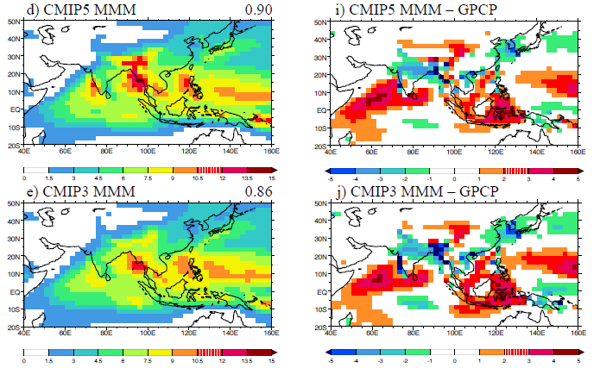
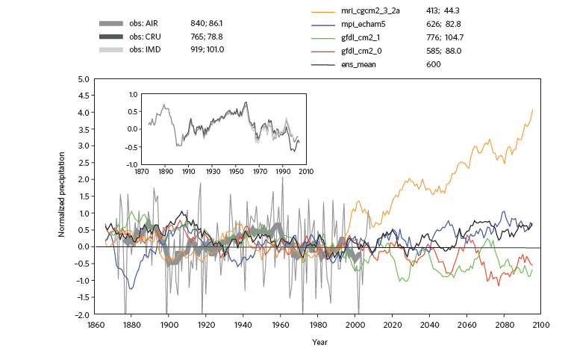
Intraseasonal, seasonal and interannual variability and predictability of monsoons
Key areas for progress in the next 5-10 years:
Improved model constraint on monsoon variability and change.
Better model representation of the key processes involved in monsoon variability.
Improved prediction of monsoon variability and change using land surface modelling and incorporation of land surface initialisation.
Enhanced understanding of natural climate variability and anthropogenic change on monsoon systems.
Figure shows large multi-model mean precipitation biases are present for the Asian summer monsoon in CMIP5 (from Sperber et al., 2012, Clim. Dyn.).
Figure demonstrates (for South Asian monsoon):
Discrepancies between observed datasets.
Apparent recent downward trend in monsoon rainfall
Large decadal variability
Uncertainty in future projections in SRES-A1B
(from Turner & Annamalai, 2012, Nature Climate Change).
CLIVAR tiger teams currently
develop ideas and plans …
Your input is desired!

Slide 14
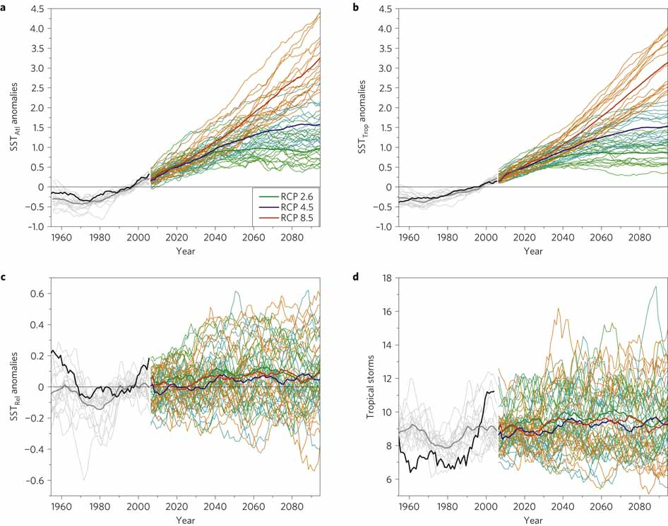
Decadal variability and predictability of ocean and climate variability
Improving understanding of decadal variability and predictability.
Application of past data sets including instrumental and proxy data.
Improving models to better represent key processes associated with decadal variability.
Analysis and development of current prediction potential of CMIP5 hindcasts.
Developing critical evaluations of proposed climate/geo engineering methods.
Twenty-first-century projections of SST (top) and North Atlantic Tropical Storm frequency (bottom) using CMIP5 (Villarini and Vecchi 2012)
CLIVAR tiger teams currently
develop ideas and plans …
Your input is desired!

Slide 15
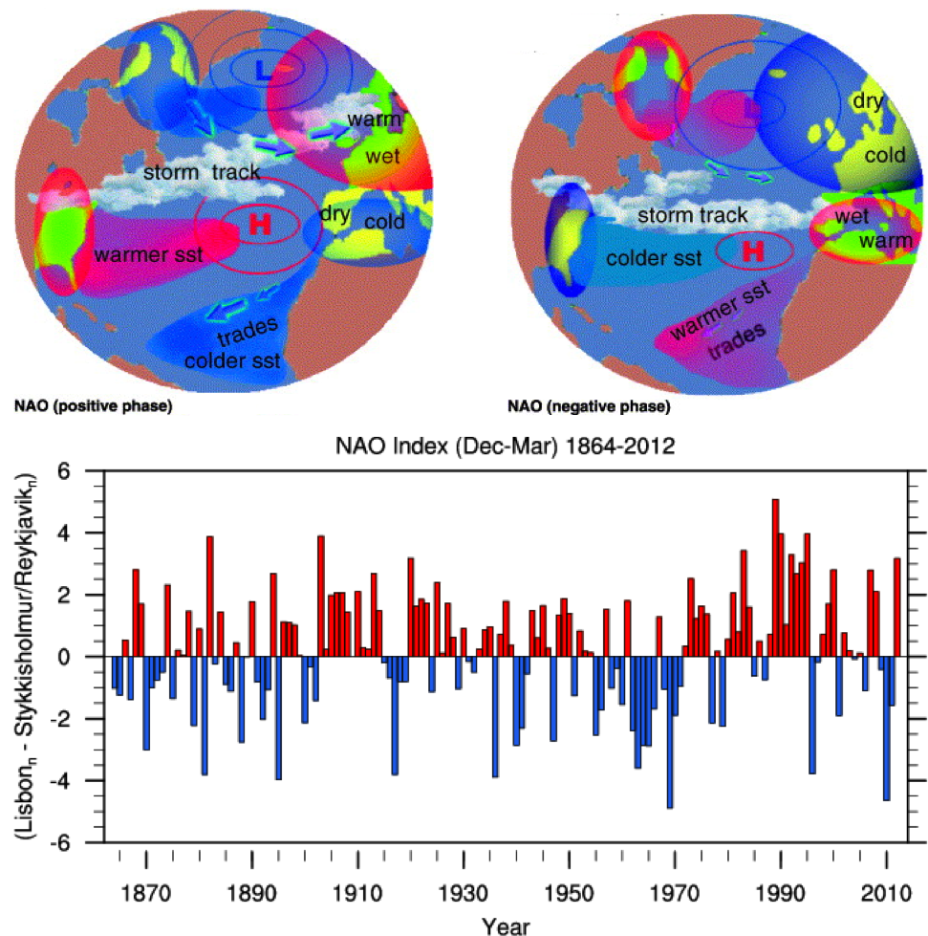
Trends, nonlinearities and extreme events
Ocean-atmosphere variations influencing the magnitude and frequency extreme events, both now and in the future.
Increasing observational data sets, providing higher temporal and spatial resolution for ocean-atmosphere processes.
Developing ocean-atmosphere models, which simulate extreme events, focusing on observational approaches.
Investigating the physical mechanisms leading to changes in high impact extreme events.
Top: The positive and the negative phases of the North Atlantic Oscillation (Bojariu and Gimeno 2003); Bottom, Hurrell North Atlantic Oscillation (NAO) Index (Hurrell 2012).
CLIVAR tiger teams currently
develop ideas and plans …
Your input is desired!

Slide 16
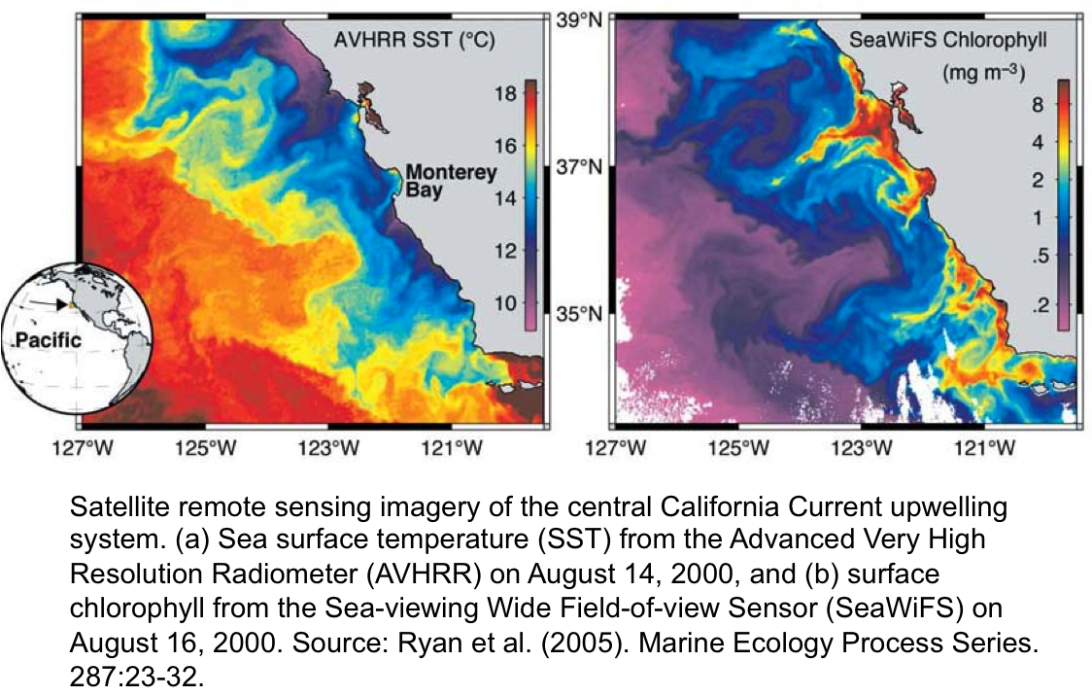
Marine biophysical interactions and dynamics of upwelling systems
Identifying the key physical processes that are responsible for upwelling.
Improving model representation of upwelling processes.
Examining interactions between the physical, biogeochemical and marine ecological systems.
Examining the cause of tropical bias in climate models.
Understanding future variability of upwelling systems, including changes in the biology and biogeochemistry associated with upwelling.
CLIVAR tiger teams currently
develop ideas and plans …
Your input is desired!

Slide 17
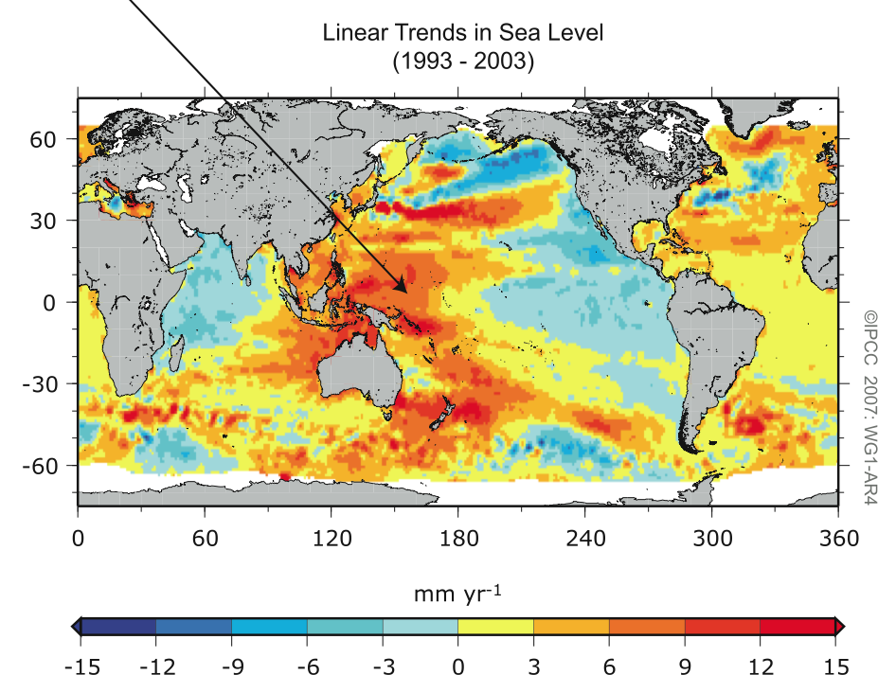
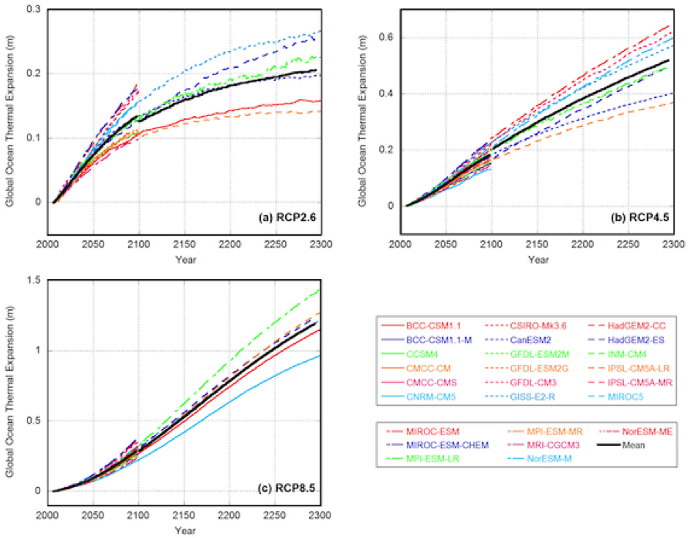
Dynamics of regional sea level variability
Examining wind-driven circulation changes to sea level variability.
Regional distribution of ocean heat content changes by ocean circulation and regional warming.
Understanding ocean-ice sheet interactions in Southern Ocean and Greenland.
Representation of gravitational attraction in climate models (with geodetic community).
CLIVAR tiger teams currently
develop ideas and plans …
Your input is desired!
Projections of ocean global thermal expansion under low, medium and high representative concentration pathways, relative to 2006 (Yin 2012).

Slide 18
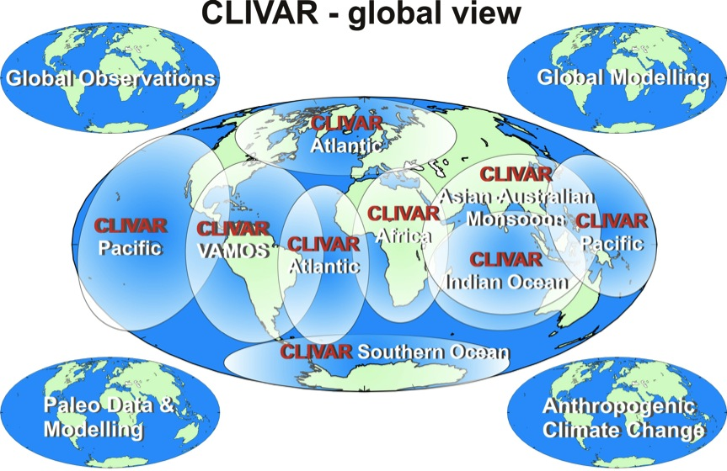
CLIVAR – A Global View
Regional implementation

Slide 19
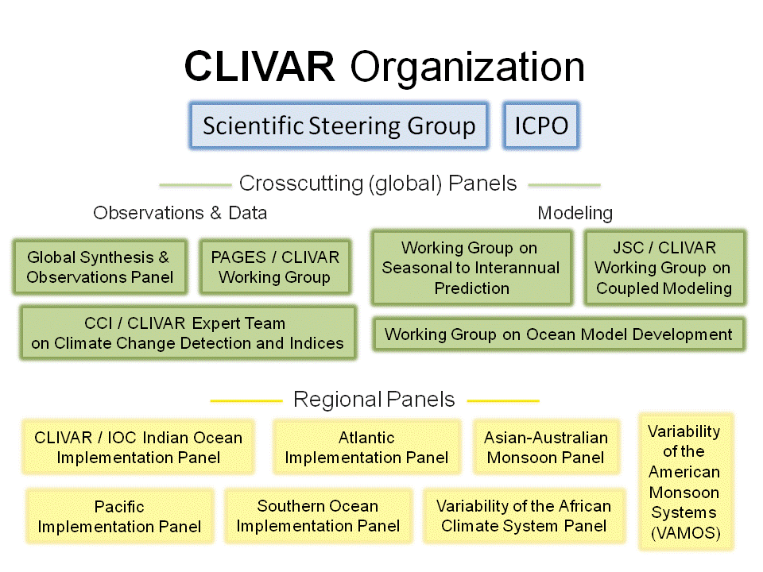

current
✔
✔
joint with
joint with

Slide 20

Proposed
(2014 - )
Core capabilities Research challenges
Working Group on
Ocean Model Development
I-S-I variability and predictability
of monsoon systems
CLIVAR Synthesis and Observations Panel
Decadal climate variability
and predictability
Atlantic Implementation Panel
Marine biophysical interactions and dynamics of upwelling systems
Pacific Implementation Panel
Dynamics of regional
sea level variability
Indian O. Implementation Panel
Southern O. Implementation Panel
Trends, nonlinearities and
extreme events
Knowledge Exchange and
Capacity Building

Slide 21





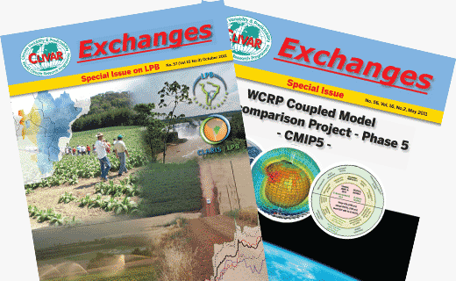





International CLIVAR Project Office (ICPO)
Roger Barry
Director
Jennifer Riley
Staff Scientist
Valery Detemmerman
WCRP JPS
Nico Caltabiano
Staff Scientist
Carlos Ereño
Staff Scientist
Anna Pirani
Staff Scientist
Xiaohui Tang
Staff Scientist
www.clivar.org
Notes:
Thanks SSC

Slide 22
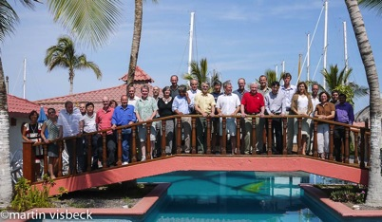
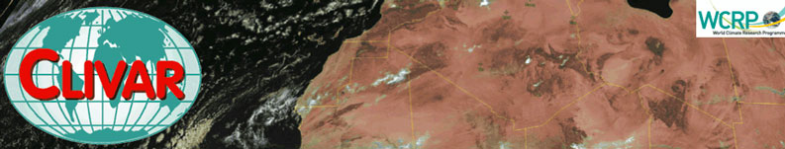
What should the letters
CLIVAR stand for?
What’s in a name?
Climate variability and change in the atmosphere - ocean system
(current proposal – can you do better?)

Slide 23
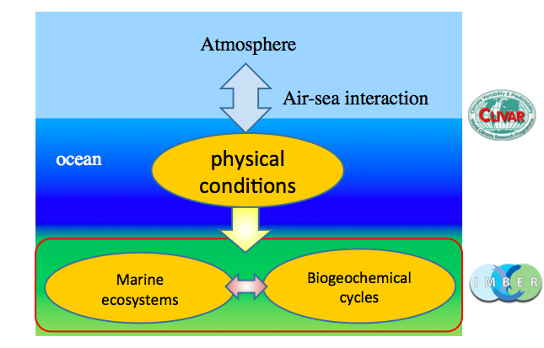
Evolution of CLIVAR – Main Directions
CLIVAR remains the ocean-atmosphere program of the World Climate Research Program
CLIVAR is in the process of formulating a new set of research opportunities that will contribute to the Grand Challenges of WCRP and the wider context of the oceans role in climate variability and change.
CLIVAR will retain its global and balanced approach based on observations, models and theory and their joint exploitation for climate assessment and climate prediction.
CLIVAR supports the development of sustained climate and ocean observations as well as targeted improvements to the climate and ocean components of earth system models.
CLIVAR will intensify its partnerships with the
marine biogeochemistry and eco-system community
as well as with a selected spectrum of its information
user community.
CLIVAR support education, capacity building and outreach.
Next Steps
- SGS-20 (May 2013, Kiel Germany)
- AGU (December 2013) townhall discussion
- OCEAN SCIENCE MEETING (March 2014) rollout of NEW CLIVAR strategy and plans

Slide 24

Feedback on CLIVAR –Strategy
What’s in a Name?
Climate variability and change in the atmosphere - ocean system
(a proposal – ongoing naming)
CLIVAR Research Opportunities
Intraseasonal, Seasonal & Interannual variability and predictability of monsoon systems
Decadal variability & predictability of ocean & climate variability
Extreme events in the atmosphere-ocean system
Marine biophysical interactions and dynamics of upwelling systems
Dynamics of regional sea level variability
…
CLIVAR Capabilities
Improving the climate and ocean component of Earth System Models.
Implementing innovative and sustained ocean observations.
Facilitate open access to climate and ocean data, synthesis and information.
Support Regional and global networks of climate and ocean scientist.
Knowledge transfer and user feedback.
Education, capacity building and outreach.
FOR CLIVAR

Slide 25

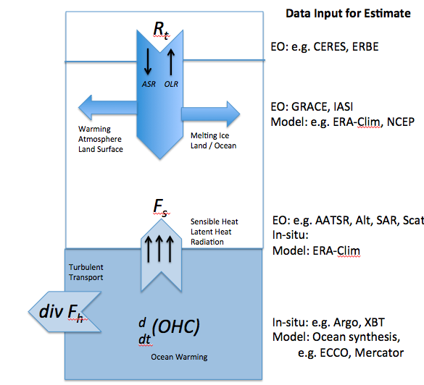
EO-MCOHB
“Earth Observation Measurement Constraints
on Ocean Heat Budget”
A potential CLIVAR-ESA activity within the framework of the ESA “Support To Science Element” (STSE) programme.
Workshop options:
a) ESA ESRIN 21-23 May 2013
b) U. Reading 4-5 July 2013
Pierre.Philippe.Mathieu@esa.int

Slide 26
Feedback on CLIVAR –Strategy
What’s in a Name?
Climate variability and change in the atmosphere - ocean system
(a proposal – ongoing naming)
CLIVAR Research Opportunities
Intraseasonal, Seasonal & Interannual variability and predictability of monsoon systems
Decadal variability & predictability of ocean & climate variability
Extreme events in the atmosphere-ocean system
Marine biophysical interactions and dynamics of upwelling systems
Dynamics of regional sea level variability
…
CLIVAR Capabilities
Improving the climate and ocean component of Earth System Models.
Implementing innovative and sustained ocean observations.
Facilitate open access to climate and ocean data, synthesis and information.
Support Regional and global networks of climate and ocean scientist.
Knowledge transfer and user feedback.
Education, capacity building and outreach.
FOR CLIVAR

Slide 27
WCRP Grand Challenges

Slide 28
WCRP/CLIVAR Research Challenges
Intraseasonal, seasonal and interannual variability and predictability of monsoon systems
Lead the WCRP Grand Challenge ‘regional predictability’
Contribute to GEWEX lead Grand Challenge ‘water’
Decadal variability and predictability of ocean and climate variability
Lead the WCRP Grand Challenge ‘regional predictability’
Trends, nonlinearities and extreme events
Contribute to GEWEX lead Grand Challenge ‘extreme events’
Marine biophysical interactions and dynamics of upwelling systems
Dynamics of regional sea level variability
Lead the WCRP Grand Challenge ‘regional sea level’

Slide 29
Feedback on CLIVAR –Strategy
What’s in a Name?
Climate variability and change in the atmosphere - ocean system
(a proposal – ongoing naming)
CLIVAR Research Opportunities
Intraseasonal, Seasonal & Interannual variability and predictability of monsoon systems
Decadal variability & predictability of ocean & climate variability
Extreme events in the atmosphere-ocean system
Marine biophysical interactions and dynamics of upwelling systems
Dynamics of regional sea level variability
…
CLIVAR Capabilities
Improving the atmosphere and ocean component of Earth System Models.
Implementing innovative process and sustained ocean observations.
Facilitate free and open access to climate and ocean data, synthesis and information.
Support Regional and global networks of climate and ocean scientist.
Facilitate knowledge transfer and user feedback.
Support education, capacity building and outreach.
FOR CLIVAR

